Slide 1
Travel agency booking system
TEAM - 344​​
G Komal Suryanarayana (21BRS1280)
KS NAGAVISHNESH (21BRS1312)
Manohar Reddy(21BRS1177)
K Siva Naga Raju(​​21BRS1389)
Kaushal Francis (21BPS1438​ )
Date: 23/11/2023
Notes:
Title Slide
Project Name: The title of the AWS-based project.
Team Members: Names and roles of all team members.
Date: Presentation date.

Slide 2
Introduction
Brief outline of the project and its objectives. Objective: Develop a comprehensive platform for streamlined travel bookings, enhancing user experience for customers and administrators while showcasing the system's value and potential impact.
Key Features:
User-friendly Interface:
Intuitive and responsive design for easy navigation.
Customizable user profiles for customers with preferences and history tracking.
Booking Capabilities:
Seamless booking process for flights, accommodations, tours, and transportation.
Real-time availability checks and instant confirmation for bookings.
Admin Dashboard:
Comprehensive control panel for administrators to manage bookings, listings, and user data.
Analytics and reporting tools for performance tracking and business insights.
Integrated Payment System:
Secure payment gateway integration for seamless and safe transactions.
Support for various payment methods to accommodate diverse customer preferences.
Communication and Notifications:
Automated notifications for booking confirmations, updates, and reminders.
In-platform communication channels for users and administrators.
Notes:
Introduction
Brief Outline: A summary of what the project is about.
Objectives: High-level goals to be covered in the presentation.

Slide 3
Project Objectives
Specific goals and outcomes expected.
Customer-Centric Experience:
Enhance the travel booking experience with a user-friendly interface and efficient booking process.
Personalization options to cater to individual preferences, ensuring a tailored experience for users.
Efficient Administrative Tools:
Provide administrators with robust management tools to streamline operations and improve productivity.
Access to comprehensive analytics for informed decision-making and optimization of services.
Demonstrate Value and Impact:
Showcase the system's capabilities to stakeholders, emphasizing its potential to revolutionize travel bookings.
Inspire confidence by highlighting how the system contributes to a seamless and enjoyable travel experience for customers while improving operational efficiency for the agency.
The MERN-based Travel Agency Booking System aims to revolutionize the travel industry by offering a user-centric platform that optimizes the booking process, empowers administrators, and demonstrates significant potential for positive impact and growth within the market.
Notes:
Project Objectives
Goals: Specific milestones or deliverables.
Expected Outcomes: What the project aims to achieve.

Slide 4
Project Scope
Specific goals and outcomes expected.
Goals:
One-stop Platform for Travel Booking (Long-Term Objective): Establish the website as a comprehensive, all-inclusive platform for travel planning and bookings, covering various services like flights, accommodations, tours, and transportation.
Responsive and Feature-rich Website: Deliver a responsive and interactive website that provides users with a seamless experience across devices. Implement essential features and functionalities to streamline the booking process.
Expected Outcomes:
Comprehensive Booking Services: Offer a broad spectrum of travel services on a unified platform, simplifying the planning and booking process for travelers, thereby increasing user satisfaction and retention.
Positive User Feedback and Engagement: Elicit positive feedback from users regarding the website's usability, features, and overall experience. Foster user engagement by providing a platform that caters to their diverse travel needs.
Laying the Foundation for Future Expansion: Establish a strong foundation using the MERN stack, enabling seamless integration of future updates, features, and expansions, ensuring the website's scalability and adaptability.
Demonstrate Business Value: Showcase the website's capability to stakeholders, highlighting its impact on enhancing user experience, improving operational efficiency, and contributing to the company's growth and success in the travel industry.
Notes:
Project Scope
Statement: The project statement as provided by the instructor.
Scope Boundaries: What is and isn't covered by the project.

Slide 5
Individual Contributions
Member 1: G Komal Suryanarayana (21BRS1280) Specific role and tasks performed: Testing & Deployment Member 2: KS NAGAVISHNESH (21BRS1312)
Specific role and tasks performed: Frontend Development
Member 3: Manohar Reddy(21BRS1177) Specific role and tasks performed: User Authentication
Member 4:K Siva Naga Raju(​​21BRS1389)
Specific role and tasks performed: Integrate APIs
Member 5:Kaushal Francis (21BPS1438​ )
Specific role and tasks performed: Backend development
Notes:
Individual Contributions
Member 1: Specific role and tasks performed.
Member 2: Specific role and tasks performed.
Member 3: Specific role and tasks performed.
Member 4: Specific role and tasks performed.
…

Slide 6
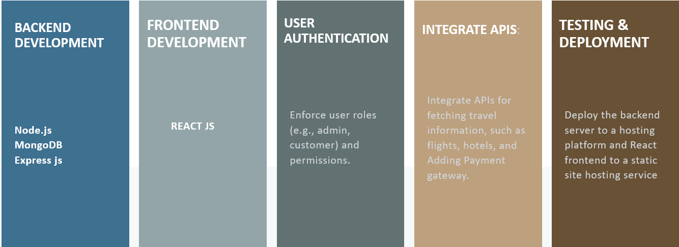
Key Concepts
Features: Important MERN features utilized.
Notes:
Key Concepts
Features: Important AWS features utilized.
Services: Key AWS services employed and their significance.

Slide 7
Challenges and Solutions
Challenge 1: Scalability and Performance
Description: Managing increased traffic and data load as the user base grows, causing potential performance issues.
Resolution:
Load Balancing: Distribute traffic across servers using tools like AWS Elastic Load Balancer.
Caching Strategies: Implement Redis or Memcached to store frequently accessed data.
Database Optimization: Optimize queries, use indexing, and consider sharding databases.
Horizontal Scaling: Add server instances based on demand using cloud services.
Challenge 2: Data Security and Privacy
Description: Protecting sensitive user data (e.g., payment details) against breaches or unauthorized access.
Resolution:
Encryption: Encrypt data in transit and at rest using standard encryption methods.
Authentication: Employ JWT or OAuth for secure user authentication.
Authorization: Implement role-based access control (RBAC) to limit user access.
Regular Audits: Conduct security audits and penetration testing regularly.
Compliance: Adhere to industry standards (e.g., GDPR, PCI DSS) for data privacy and regulatory compliance.
Notes:
Challenges and Solutions
Problem 1: Description and resolution.
Problem 2: Description and resolution.

Slide 8
Lessons Learned
Technical Insights:
MERN Stack Mastery: Proficiency in MongoDB, Express.js, React, and Node.js.
Database Optimization: Effective schema design and query optimization in MongoDB.
RESTful API Development: Seamless communication between front-end and back-end using Node.js and Express.js.
Front-end Expertise: Building dynamic interfaces with React and efficient data management.
Security Implementation: Secure authentication (JWT/OAuth) and data encryption for privacy.
Process Insights:
Effective Communication: Clear and regular team communication for smoother workflow.
Agile Methodologies: Improved adaptability and productivity during development.
Collaborative Problem-Solving: Leveraging diverse skills for efficient issue resolution.
Task Management Tools: Organized project tracking via Jira, Trello, etc.
Continuous Learning: Cultivated a learning culture for skill growth and project success.
Notes:
Lessons Learned
Technical Insights: What was learned technically.
Process Insights: What was learned about team collaboration.

Slide 9
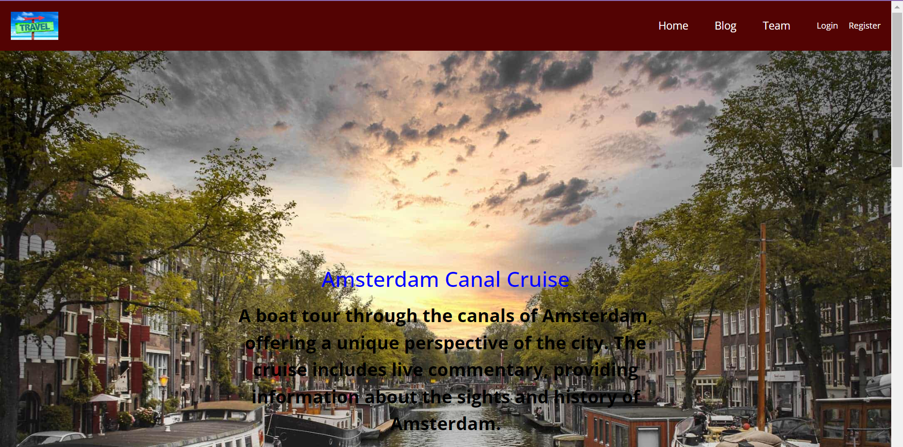
Screenshots
Notes:
Screenshots
Screen Captures: Visual snapshots to showcase key elements.
Context: Description explaining what the screenshot represents.

Slide 10
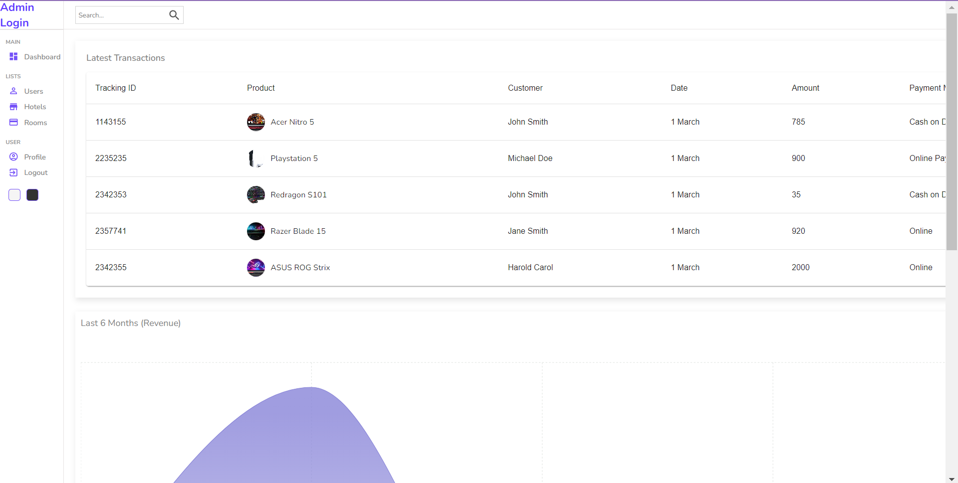
Screenshots
.
Notes:
Screenshots
Screen Captures: Visual snapshots to showcase key elements.
Context: Description explaining what the screenshot represents.

Slide 11
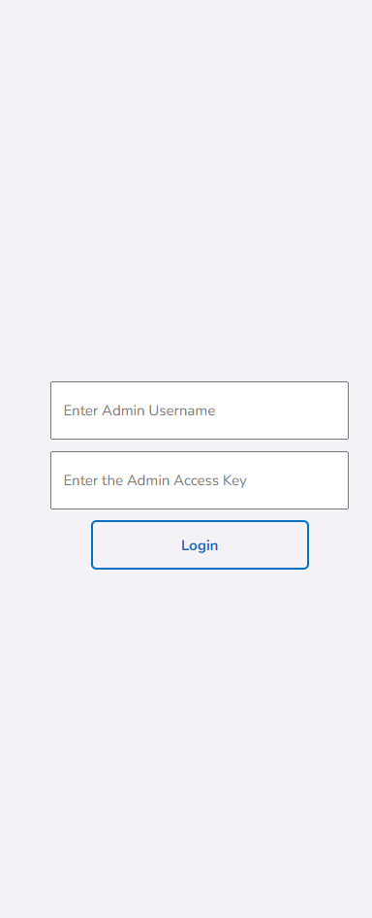
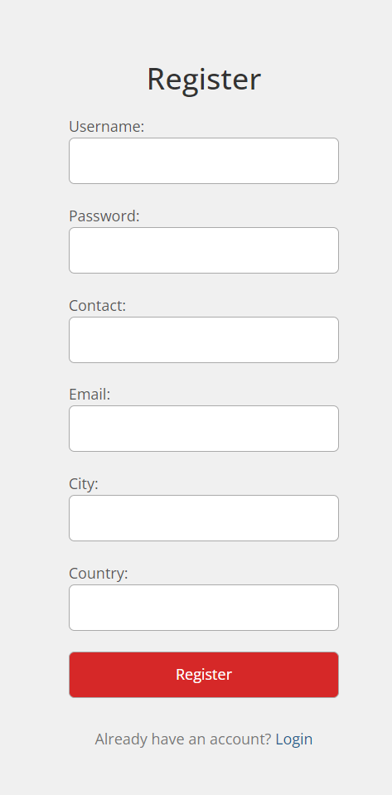
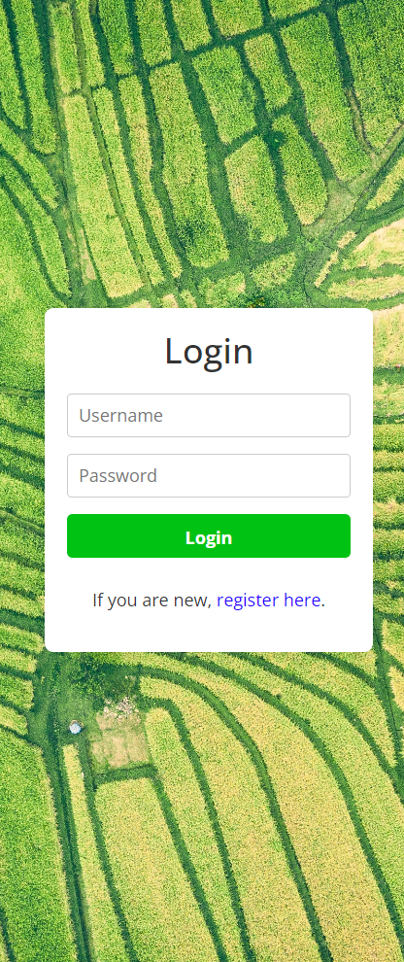
Screenshots
Notes:
Screenshots
Screen Captures: Visual snapshots to showcase key elements.
Context: Description explaining what the screenshot represents.

Slide 12
Future Scope
Future Scope Improvements: Potential Updates or Add-ons
As we progress beyond the front-end development phase scheduled for completion by this upcoming Friday, our focus shifts towards augmenting and refining the functionality of our travel agency website built on the MERN stack. We are dedicated to advancing our backend infrastructure while continuously enhancing database management, server performance, and fortifying data security measures.
Next Steps: Future Phases or Expansions
Enhanced Booking Features: Expand our booking capabilities to include a wider array of travel services such as car rentals, activities, and comprehensive vacation packages. Implement advanced search filters and personalized recommendations for a tailored booking experience.
Mobile Application Development: Initiate the development of a companion mobile application compatible with both iOS and Android platforms. Offer users the convenience of planning and booking their trips on-the-go, ensuring a seamless cross-platform experience.
Integration of AI and Machine Learning: Explore the integration of AI and machine learning algorithms to analyze user preferences and behavior. Utilize this data to provide personalized recommendations and optimize the user journey throughout the booking process.
Geolocation and Mapping Services: Implement geolocation features and mapping services to assist users in visualizing destinations, nearby attractions, and navigation assistance during their travel planning.
Community and User Engagement: Introduce community-driven features such as user reviews, ratings, and forums to foster interaction among travelers. Encourage user-generated content to enrich the platform and build a vibrant travel community.
Multi-language Support and Global Expansion: Incorporate multi-language support to cater to a diverse global audience, facilitating access for users worldwide. Plan for expansion into new markets and regions to broaden our reach and services.
Notes:
Future Scope
Improvements: Potential updates or add-ons.
Next Steps: Future phases or expansions.

Slide 13
Thank You!
Our Team : 344
G Komal Suryanarayana (21BRS1280)
KS NAGAVISHNESH (21BRS1312)
Manohar Reddy(21BRS1177)
K Siva Naga Raju(​​21BRS1389)
Kaushal Francis (21BPS1438​ )
Notes:
Thank You
Acknowledgments: Thanks to those who contributed.
Contact Info: How to reach the team for further queries.

