Slide 1

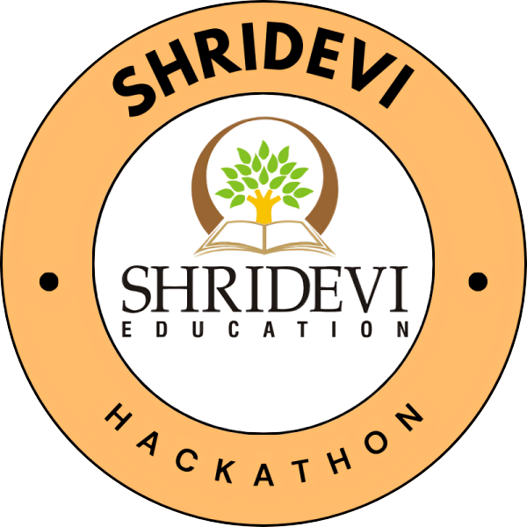
SHRIDEVI HACKATHON 2024
LIFESYNC
Theme: Medical
Team Members:
Dakshith S
Dhishanth G Patel
Vishnu R
Yashas D R
College:Shridevi Institute of Engineering and Technology
SHRIDEVI NATIONAL LEVEL HACKATHON - 2024

Slide 2
PROBLEM STATEMENT
M-68
During medical emergencies, healthcare providers face delays in critical care due to insufficient access to real-time patient data and poorly integrated health record systems. Additionally, individuals with symptoms like cough and tiredness often lack personalized health recommendations. A prescription model analyzing symptoms is essential for informed health decisions.
SHRIDEVI NATIONAL LEVEL HACKATHON - 2024

Slide 3
PROPOSED SOLUTION
M-68
QR Code : Users have a tattooed QR code for secure, easy access to critical medical information.
Emergency Access: Healthcare providers can quickly scan the QR code or use a wristband to retrieve essential patient data during emergencies.
API-Driven Prescriptions: The prescription model utilizes APIs for quick actions and offers personalized health recommendations based on user symptoms.
SHRIDEVI NATIONAL LEVEL HACKATHON - 2024

Slide 4
FEATURES
M-68
QR Code Generation: Ability to generate unique QR codes containing encrypted medical data for patients, which can be printed or shared digitally.
Data Encryption and Decryption: Medical data will be securely encrypted before being embedded in the QR code. The application will decrypt the data upon scanning to ensure confidentiality.
Personalized Health Recommendations: The system will generate personalized health recommendations based on user inputs, including symptoms and physical parameters.
SHRIDEVI NATIONAL LEVEL HACKATHON - 2024

Slide 5
TECHNICAL APPROACH
M-68
Programming Languages: Python
Frameworks: Django Web Framework
Databases: SQLite ,MongoDB
APIs: External API’s for Data Processing
SHRIDEVI NATIONAL LEVEL HACKATHON - 2024

Slide 6
CHALLENGES FACED
M-68
Encryption and Decryption Challenges: Key management and safeguarding encryption keys can be difficult.
AI Chatbot Challenges: Ensuring accurate natural language understanding (NLU) can be difficult.

