Slide 1
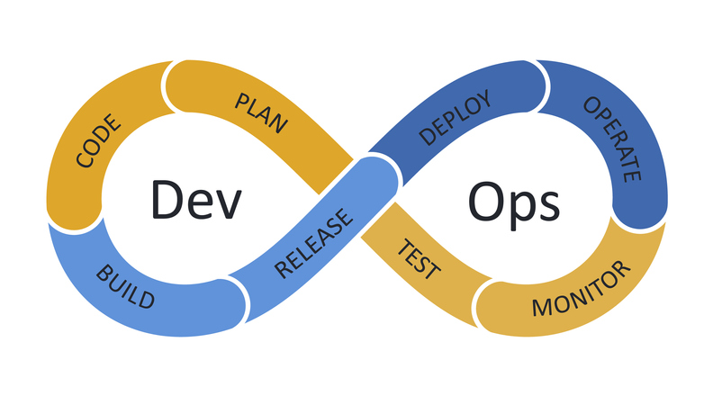
DevOps Roadmap
Vishnu Kusumba

Slide 2
What is DevOps
DevOps is a methodology or a culture in the software development and IT industry.
Used as a set of practices and tools, DevOps integrates and automates the work of software development and IT operations as a means for improving and shortening the systems development life cycle.
DevOps is a collaboration between Development and IT Operations to make software production and Deployment in an automated & repeatable way.

Slide 3
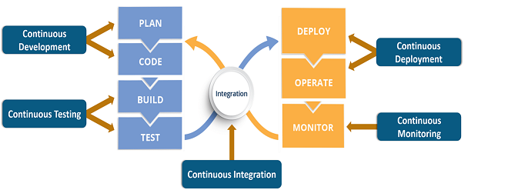
DevOps Life Cycle

Slide 4
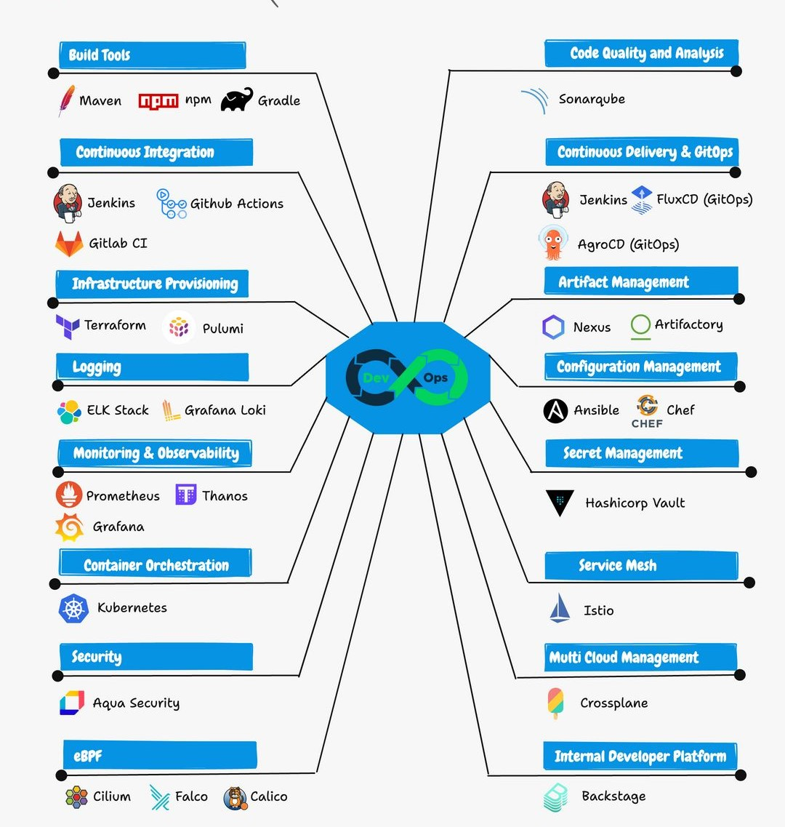
DevOps Tools

Slide 5
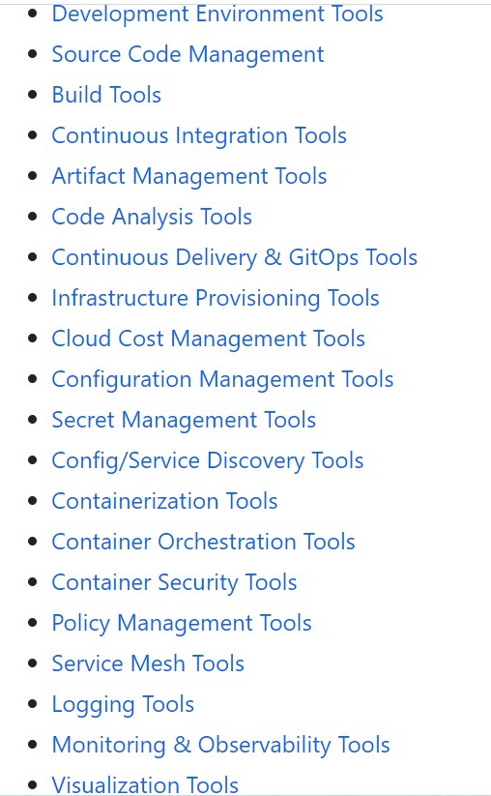
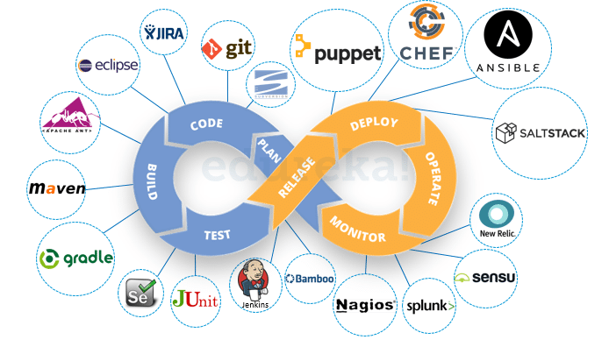
List of DevOps Tools

Slide 6
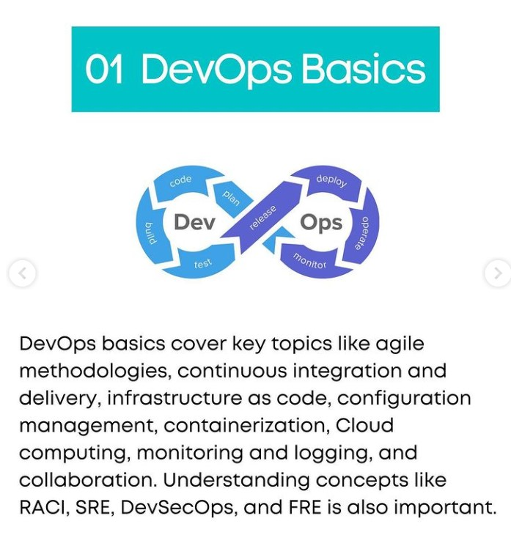

Slide 7
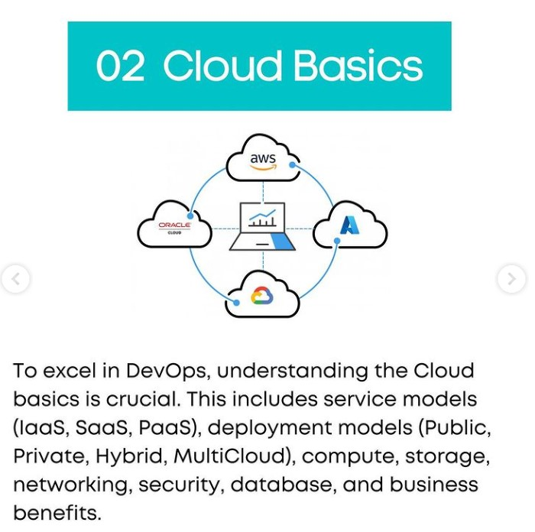

Slide 8
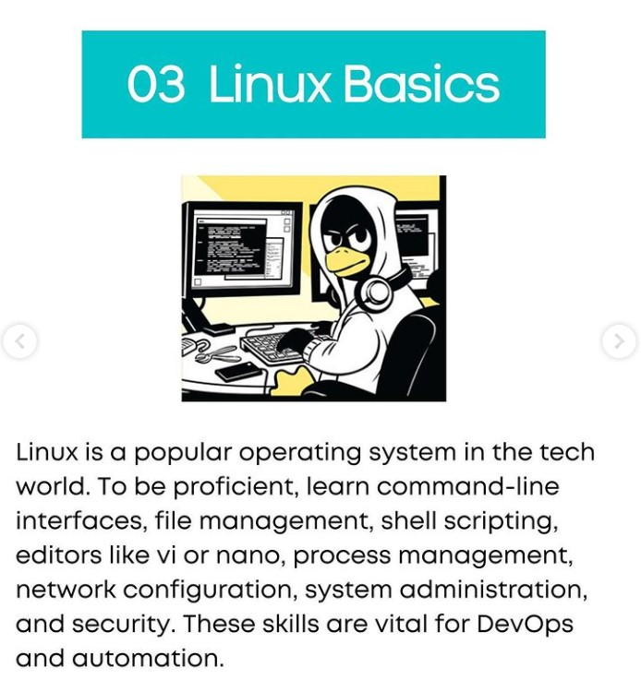

Slide 9
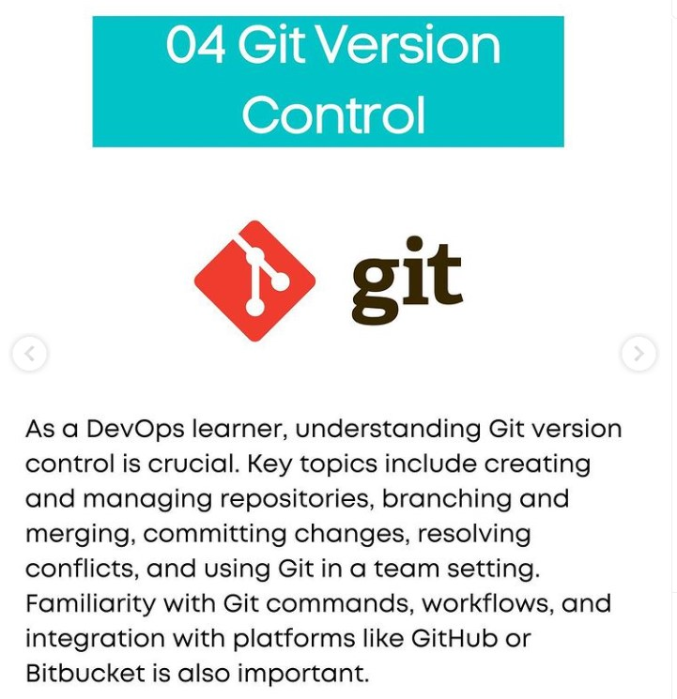

Slide 10
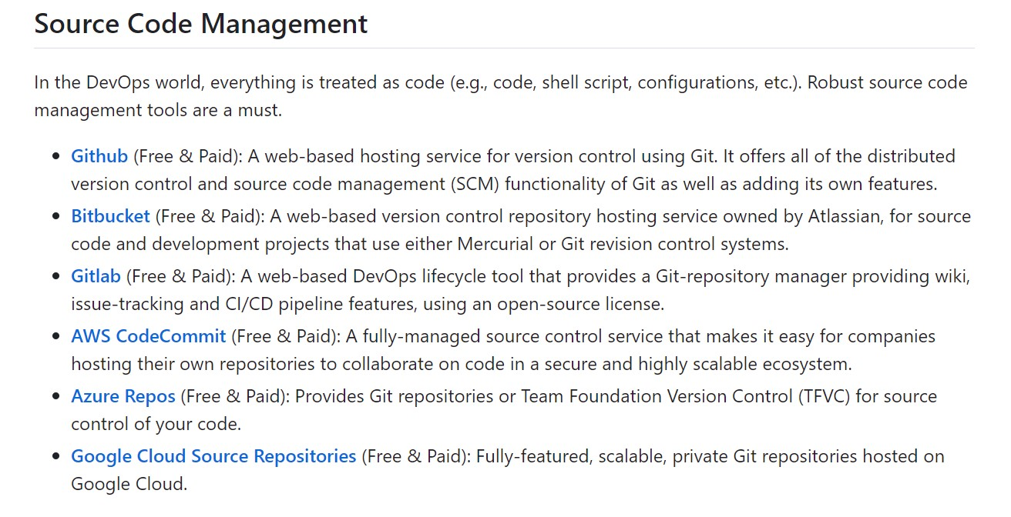

Slide 11
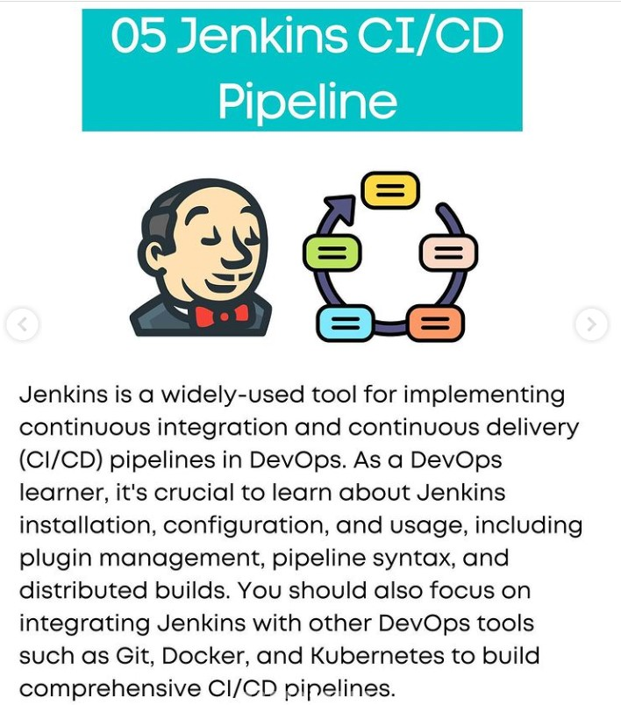

Slide 12
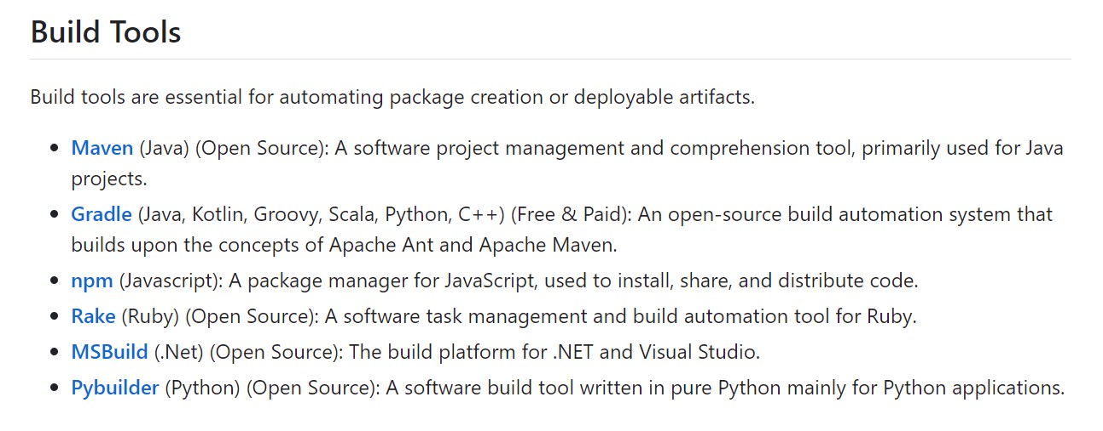

Slide 13
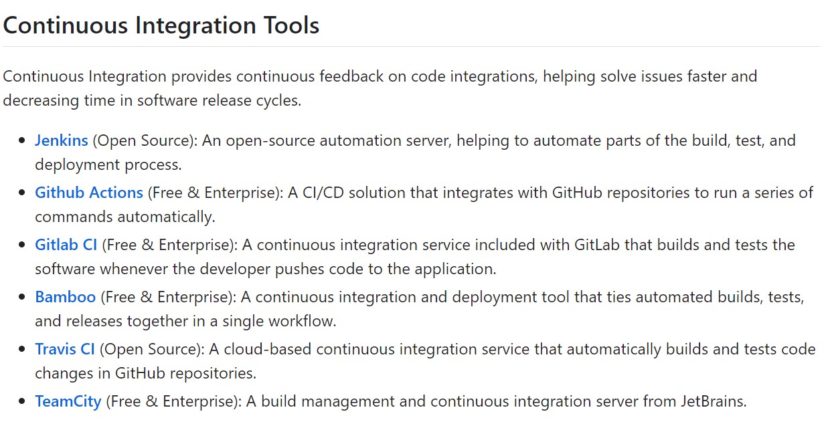

Slide 14
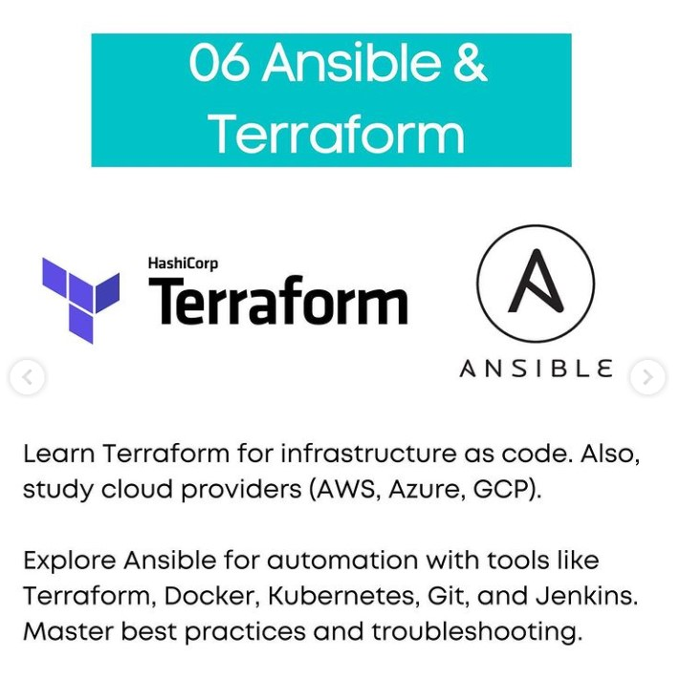

Slide 15
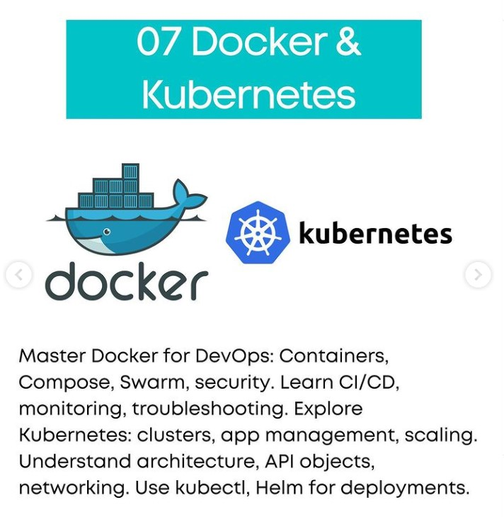

Slide 16
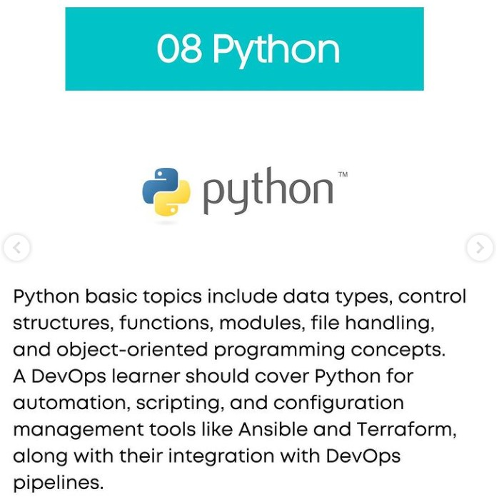

Slide 17
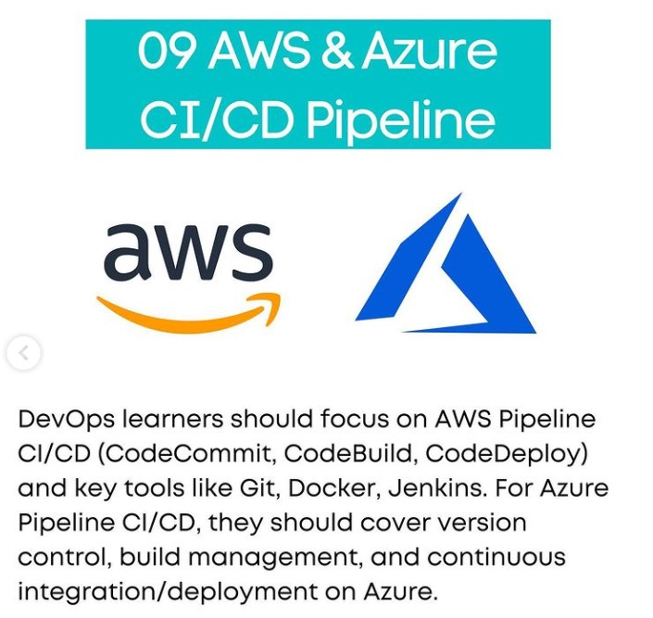

Slide 18
CI/CD
What is continuous integration (CI)?
Continuous integration is the practice of integrating all your code changes into the main branch of a shared source code repository early and often, automatically testing each change when you commit or merge them, and automatically kicking off a build, enabling easier identification and resolution of errors and security issues in the development process.
Regular merging of changes and automatic testing reduces code conflict and allows for bug and security fixes.
Common code validation processes involve static code analysis that verifies the quality of the code, automated CI routines, and a version control system to track changes so you know the version of the code used and ensure code quality.

Slide 19
What is continuous delivery (CD)?
Continuous delivery (CD) is a software development practice that automates infrastructure provisioning and application release.
Once code has been tested and built as part of the CI process, CD takes over during the final stages to ensure it's packaged with everything it needs to deploy to any environment at any time.
It covers everything from infrastructure provisioning to deployment to testing or production environments.
CD allows software to be deployed to production at any time and can be triggered manually or automated in continuous deployment.

Slide 20
What is continuous deployment?
Continuous deployment automates application deployment, eliminating human intervention.
DevOps teams set code release criteria and validate them, enabling faster deployment of new features.
While you can do continuous integration without continuous delivery or deployment, you can't really do CD without already having CI in place as deploying to production requires integrating code, automating testing, and working in small batches daily.

Slide 21
What is continuous testing?
Continuous testing is a software practice that runs tests to identify bugs in the codebase. It is performed automatically in a CI/CD pipeline, ensuring the application works as expected.
This helps identify problems early in the development process and provides valuable feedback to developers on code quality, preventing costly and time-consuming fixes.
Unit testing, which checks that individual units of code work as expected
Integration testing, which verifies how different modules or services within an application work together
Regression testing, which is performed after a bug is fixed to ensure that specific bug won't occur again

Slide 22
Thank You

