Slide 1

Exploratory Data Analysis (EDA) on Diabetes Dataset
Introduction to Data Science
Project -1
-By Vishnu Vardhan Reddy Bijjam

Slide 2
Contents
Dataset Acquisition and Preliminary Overview
Descriptive Statistics
Data Types And Transformation
Correlation Matrix
Feature Importance in Diabetes Progression
Limitations in the Dataset
Introduction

Slide 3
Introduction
Objective: The goal is to prepare the diabetes dataset for predictive modeling and to uncover initial insights through EDA, focusing on identifying outliers, analyzing feature importance, and understanding the dataset's structure.
Data Source: Data from the Stanford U’s Machine Learning Repository, inspired by the seminal paper by Bradley Efron et al. (2004).
Data Loading: Data was directly loaded from Stanford U’s Machine Learning Repository using np.genfromtxt through the provided URL, ensuring immediate access to the dataset for analysis.

Slide 4
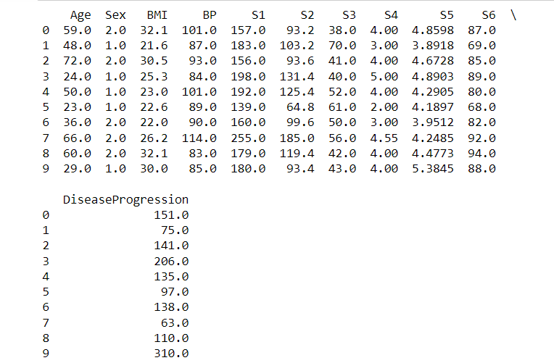
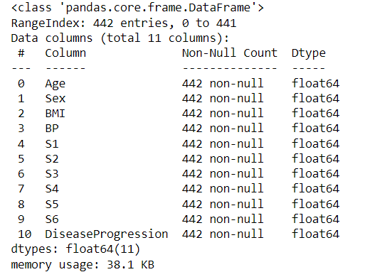
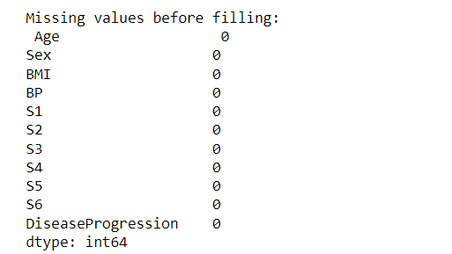
Dataset Acquisition and Preliminary Overview
Our dataset, comprising 442 entries across 10 feature variables, was meticulously curated to include critical indicators such as age, sex, body mass index (BMI), average blood pressure (BP), and six blood serum measurements (S1 to S6).
The dataset was thoroughly checked for missing, null, or NaN records, with none found, indicating readiness for further analysis without the need for imputation.

Slide 5
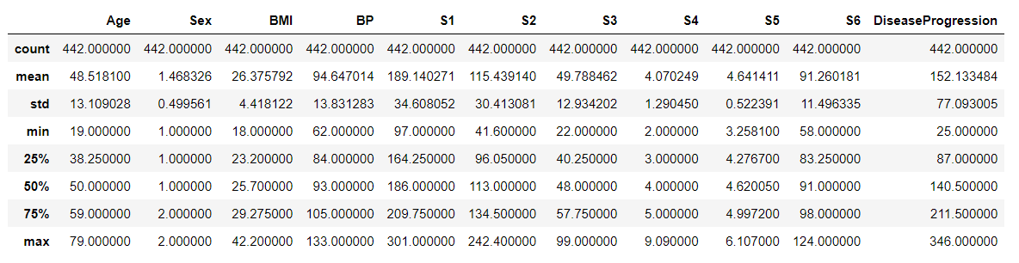
Descriptive statistics serve as our first window into the dataset, revealing the average age to be mid-forties, indicating a middle-aged demographic focus.
The average BMI falls within the overweight classification, which is a significant concern in diabetes.
Serum measurements show variability, hinting at potential biomarkers for diabetes progression.
Descriptive Statistics

Slide 6
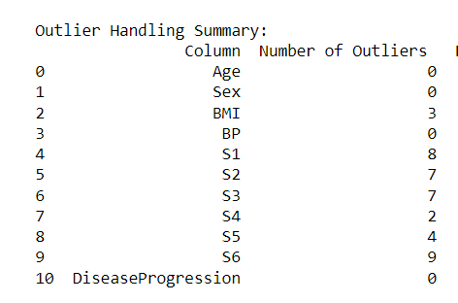
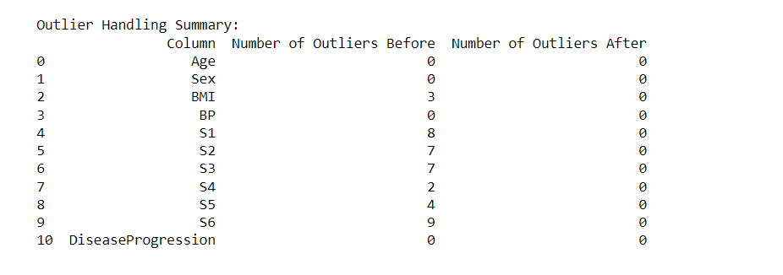
Data Types and Transformation
Data Types: The dataset is entirely numeric, simplifying the analysis process. No categorical data types were present, negating the need for encoding techniques.
Transformation: The focus was on ensuring all data remained numeric and handling outliers to prepare the dataset for modeling
Used the IQR method for outlier detection
The summary table displayed reveals the count of outliers detected in each variable of the diabetes dataset.
Notably, there are no outliers in the Age, Sex, BP, and DiseaseProgression variables, which suggests consistency in these measurements across the population studied.
BMI and other serum measurements S1,S2,S3,S4,S5,S6 have outliers. And I removed the outliers using IQR.
Next Slide will follow the Boxplots of each column

Slide 7
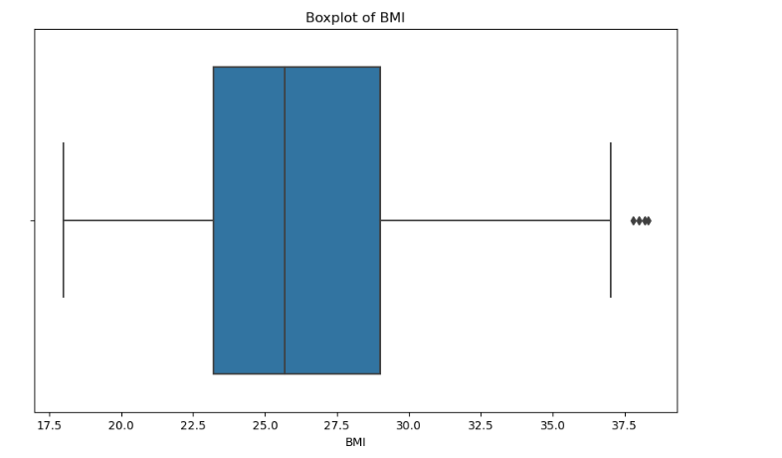
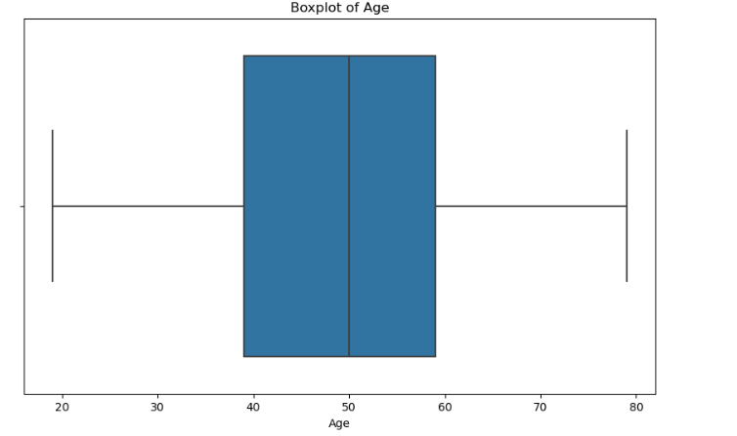
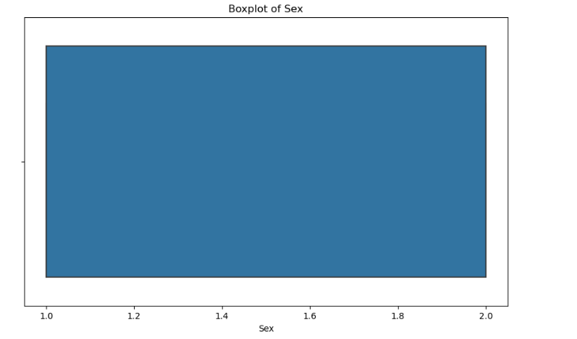
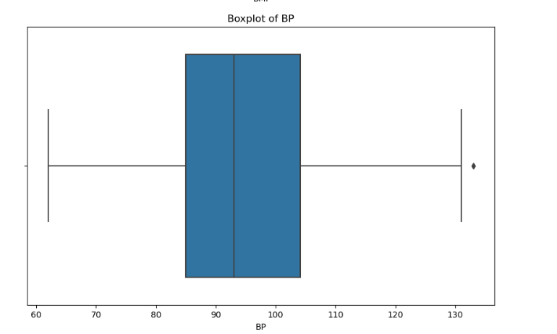
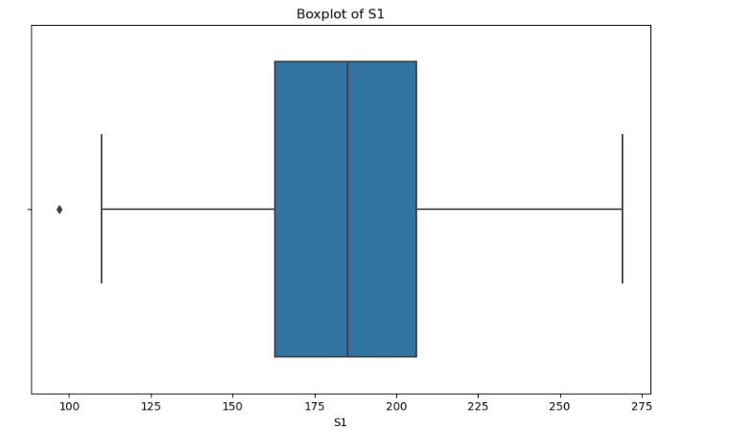
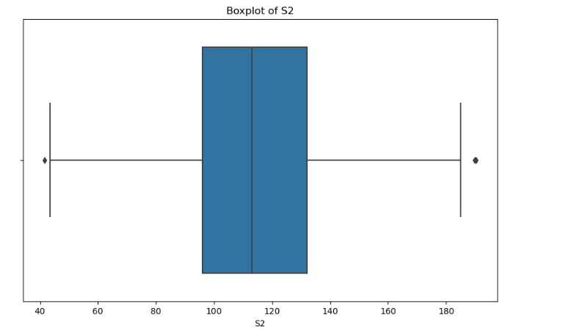
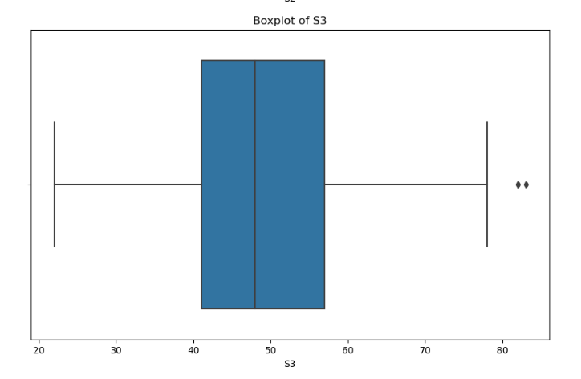
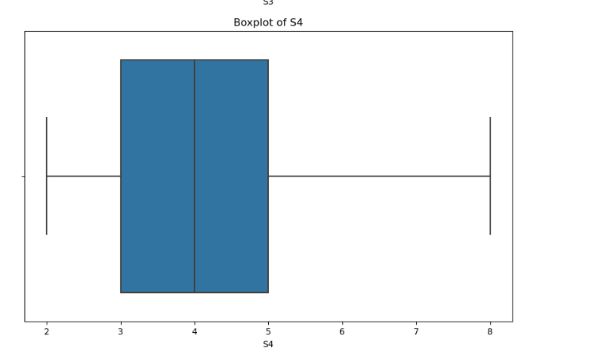
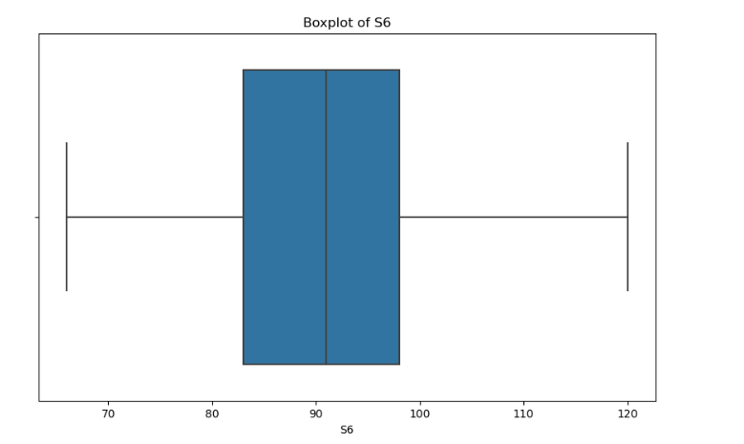
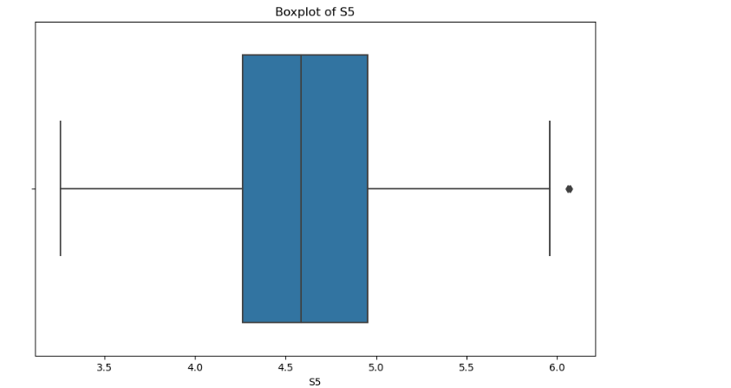

Slide 8
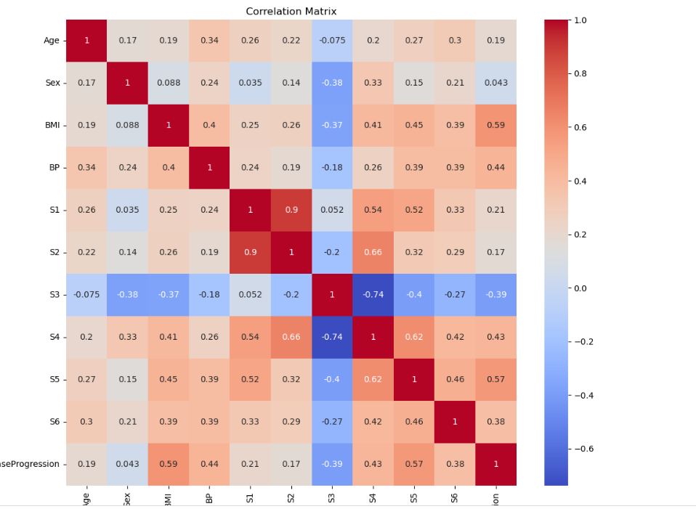
Correlation Matrix
The variable BMI (Body Mass Index) shows a relatively strong positive correlation (0.59) with DiseaseProgression, suggesting that higher BMI levels are associated with the progression of diabetes.
Blood Pressure (BP) also displays a notable positive correlation (0.44) with DiseaseProgression, aligning with medical understanding that hypertension is a risk factor for diabetes.
Serum measurements S3 and S4 reveal an interesting contrast; S3 has a moderately strong negative correlation (-0.39) with DiseaseProgression, while S4 shows a positive correlation (0.43), indicating their opposite relationships with the target variable.
S1 and S2, which likely represent related blood serum measurements, have a very high positive correlation (0.9), indicating potential redundancy or a strong relationship between these features.
S4 shows negative correlations with S3 (-0.74) suggesting an inverse relationship between these two serum measurements.

Slide 9
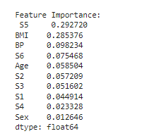
Feature Importance in Diabetes Progression
Using a RandomForestRegressor, each feature's importance is calculated, highlighting its contribution to our understanding of diabetes progression.
The blood serum measurement S5 emerges as the most influential factor, suggesting a strong association with the progression of diabetes.
BMI follows closely, underscoring the well-documented link between body weight and diabetes risk.
Other variables like blood pressure (BP), another serum measurement (S6), and Age also play a notable role, albeit to a lesser extent.

Slide 10
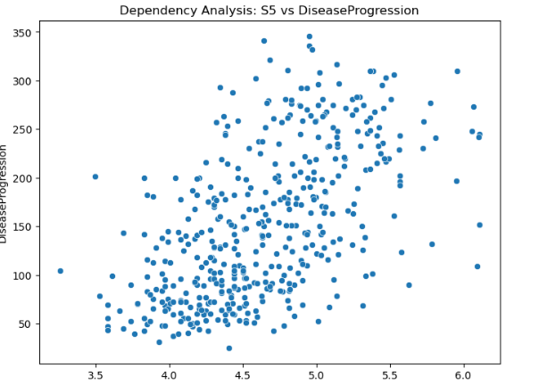
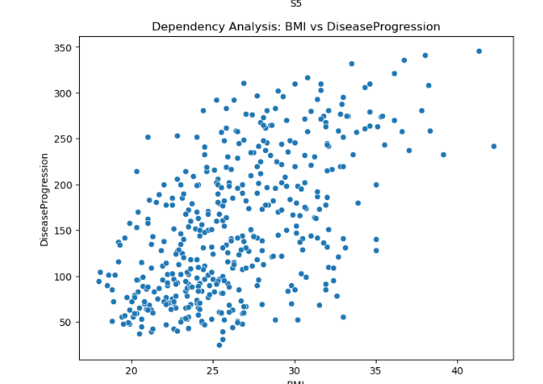
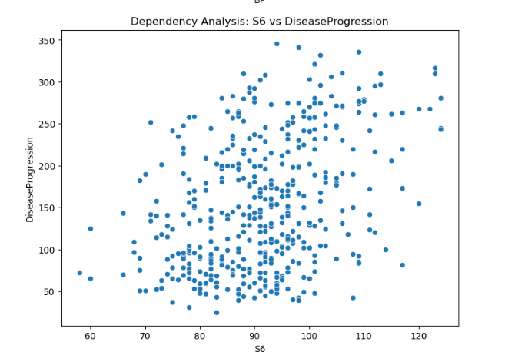
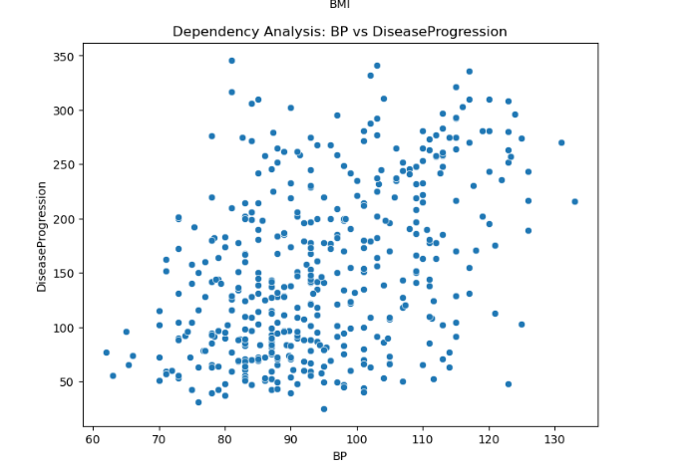

Slide 11
Limitations in the Dataset
the dataset appears to be limited to demographic and basic blood test results. Critical variables that could influence diabetes progression, such as lifestyle factors, detailed dietary information, genetic factors, or long-term medical histories, are not included.
Replacing outliers with the median value and removing outliers altogether yield different sets of variables as significant in the correlation heatmap.
Replacing outliers with the median may dilute extreme effects but preserves the overall structure of the data, possibly maintaining existing relationships. In contrast, removing outliers can alter the data distribution and relationships, leading to different variables becoming more or less correlated with the target.
Despite changes in the correlation heatmap, the feature importance rankings from the RandomForestRegressor remain consistent.
Certain features (e.g., BMI, S5, BP) consistently appear as important both in correlation analysis and feature importance rankings, regardless of outlier handling method.
These features likely have a strong and stable relationship with the target variable, making them key predictors. Their consistent appearance underscores their potential significance in understanding or predicting the target variable.

