Slide 1

Prediction of Disease Progression
Introduction to Data Science
Project 2 (continue)
Vishnu Vardhan Reddy Bijjam

Slide 2
Contents
Linear Regression
Best feature in X to predict Y using Linear Regression
Find out best Pair feature for prediction of Y using Linear Regression
Prediction of Y using All Features in X using Linear Regression
Computing training MSE and validation MSE for different train size dataset
XGBoost
Best feature for Y using XGBoost
Best pair of features for prediction of Y using XGBoost
Using All Features
Training set sizes and their Training and Validation MSE's

Slide 3
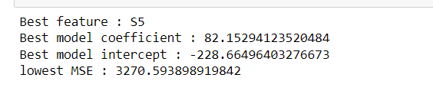
Find the best feature for predicting disease progression using linear regression
For each feature in our dataset, we create a separate Linear Regression model. This involves isolating each feature as the sole predictor variable and training the model to predict the outcome based on this feature alone.
We split our dataset into training and testing sets, with 80% of the data used for training and 20% for testing. This split ensures that our model can be trained on a significant portion of the data while retaining an untouched subset for evaluation.
After training, we use the Mean Squared Error (MSE) as the metric to evaluate the model's performance.
The feature that results in the lowest MSE is selected as the best predictor, and its corresponding model is considered the best performing model.
Feature S5 as the most predictive of disease progression.

Slide 4
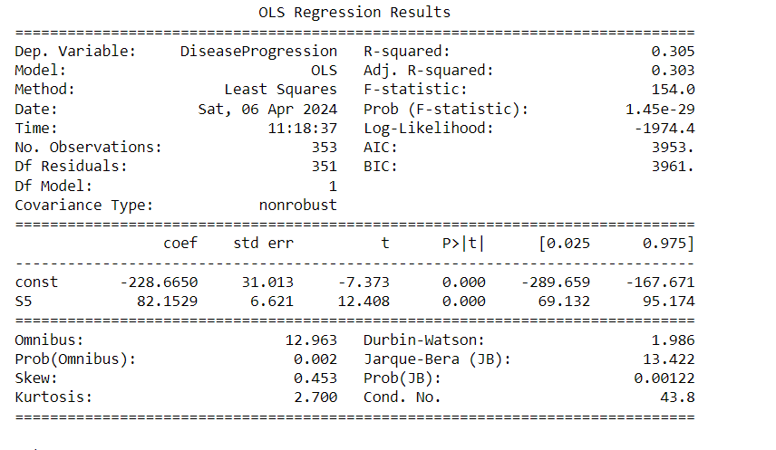
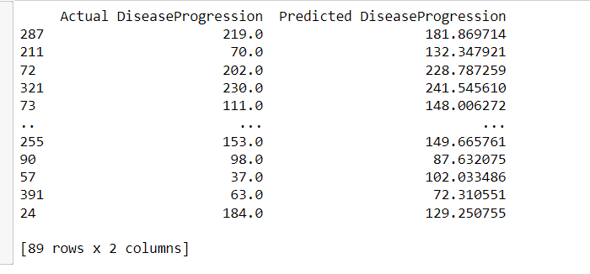
we delve into a comprehensive analysis of the Ordinary Least Squares (OLS) regression results for the best-performing model, which utilizes Feature S5 as the predictor for disease progression.
The R-squared value of 0.305 signifies that Feature S5 alone accounts for about 30.5% of the variation in disease progression outcomes.

Slide 5
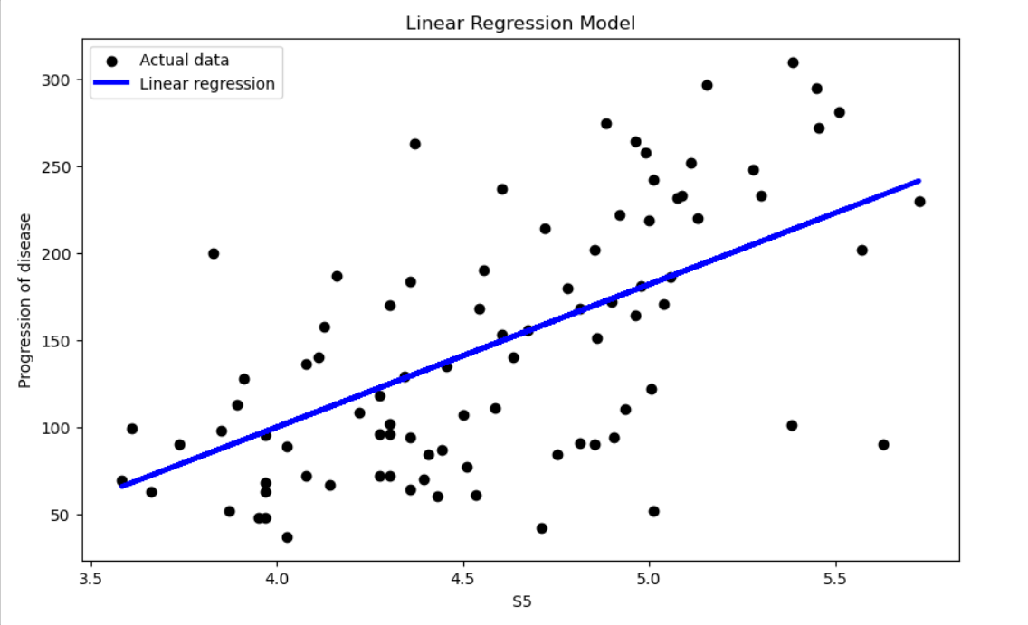

Slide 6
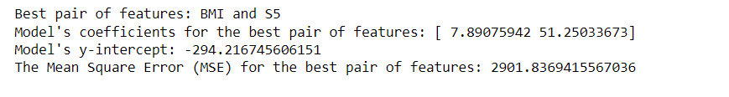
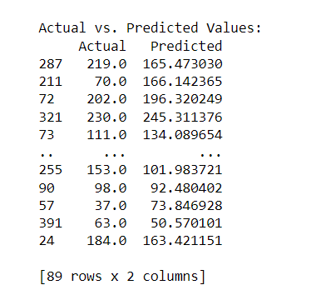
Find out best Pair feature for prediction of Y using Linear Regression
Utilizing the combinations function, we iterate over each unique pair of features within our dataset.
for every feature pair, a Linear Regression model is instantiated and trained.
Our analysis reveals a standout pair BMI and S5, as the best predictors of 'Y'.
This precision of prediction by each model is measured through the metric called Mean Squared Error (MSE).
R-squared (0.458) is very encouraging compared to single-feature models and further suggests the increased explanatory power and fit our model has over the single-feature models, hence confirming its predictive relevance for the chosen feature pair.
The close alignment between actual and predicted values in many cases highlights the model's accuracy.

Slide 7
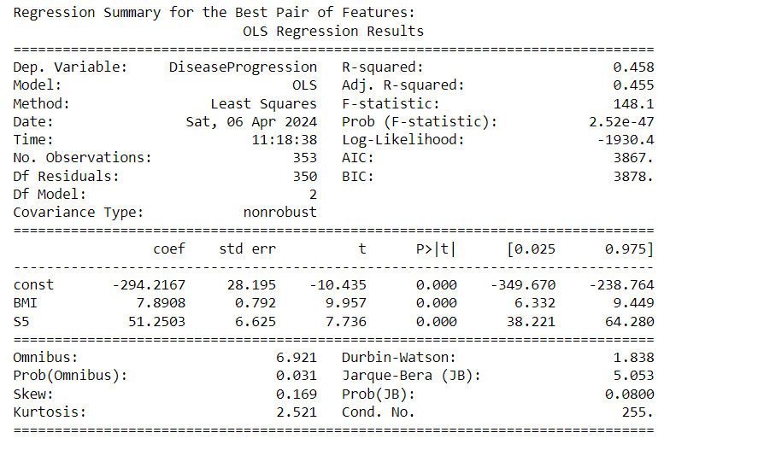
The regression model with BMI and S5 as features has an improved R-squared of 0.458, explaining about 45.8% of the variation in Disease Progression.
Both BMI (coefficient = 7.8908, p-value < 0.001) and S5 (coefficient = 51.2503, p-value < 0.001) have positive and statistically significant coefficients, indicating that an increase in either feature is associated with an increase in Disease Progression.

Slide 8
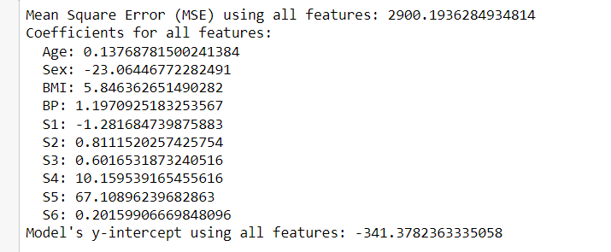
Prediction of Y using All Features in X using Linear Regression
we explore the outcomes of deploying a Linear Regression model using all available features within the dataset to predict ‘Y’.
R-squared (0.528): This value entails that about 52.8% of the variance in disease progression is represented by the model, hence a moderate-to-good fit.
The coefficient for each feature gives its individual contribution to the model. For instance, if the coefficient for BMI were positive, then larger values of BMI would relate to increased progression of the disease, holding other factors at a constant.
The large condition number (7.07e+03) indicates potential multicollinearity problems.

Slide 9
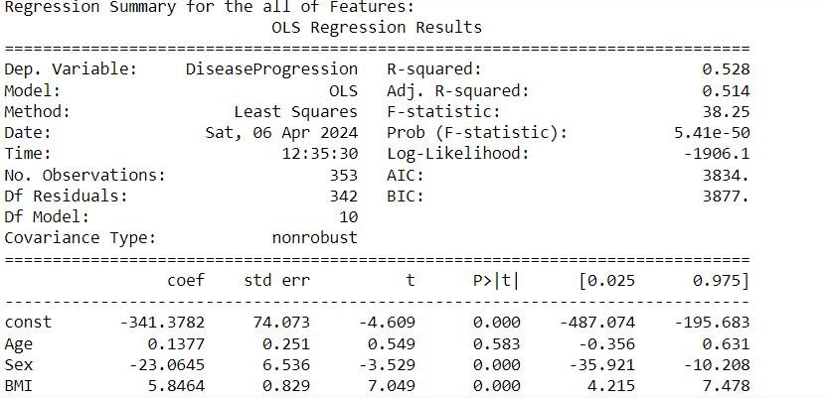
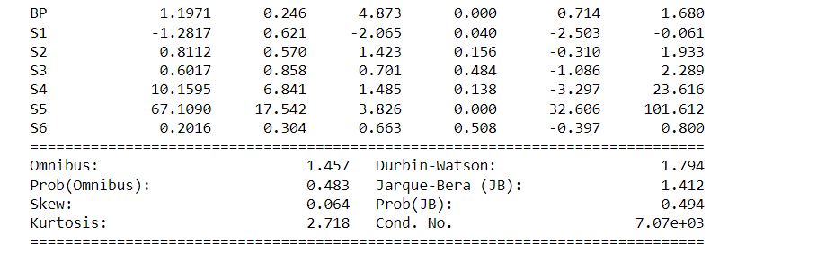
The regression model including all features has an R-squared of 0.528, explaining about 52.8% of the variation in Disease Progression.
The following features have statistically significant coefficients (p-value < 0.05):Sex (coefficient = -23.0645, negative impact on DiseaseProgression)
BMI (coefficient = 5.8464, positive impact)
BP (coefficient = 1.1971, positive impact)
S1 (coefficient = -1.2817, negative impact)
S5 (coefficient = 67.1090, positive impact)
Adding more variables to the model did increase the R-squared from 0.458 to 0.528, indicating an improvement in the model’s accuracy. However, the increment, though statistically significant, suggests that the new variables offer limited additional insight into the dependent variable. This could be due to overlapping information among predictors (multicollinearity) or because some of the added variables are not strong predictors of the outcome.

Slide 10
Computing training MSE and validation MSE for different train size dataset
We investigated four distinct sizes for the training dataset: 20, 50, 100, and 200 observations.
For each training set size, we trained a Linear Regression model exclusively on that subset. We then evaluated the model's performance by computing the Mean Squared Error (MSE) on both the training set (to assess fitting) and a fixed validation set (to assess generalization).

Slide 11
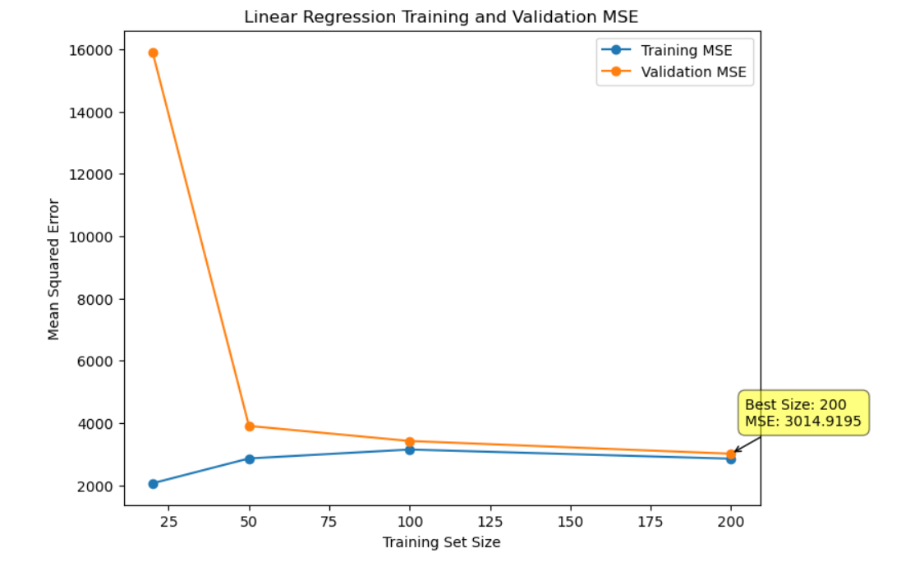
A visual plot illustrating the MSE for both training and validation sets across different training sizes provided clear insights.
Our analysis revealed a discernible pattern where the training MSE generally increased with the size of the training set. Conversely, the validation MSE exhibited a decreasing trend, highlighting an improvement in the model's ability to generalize as it was trained on more data.
The optimal training set size, determined by the smallest difference between training and validation MSEs, was identified to be 200 observations. At this size, the model achieved a validation MSE of 3036.69, suggesting a balance between fitting the training data and generalizing well to unseen data

Slide 12
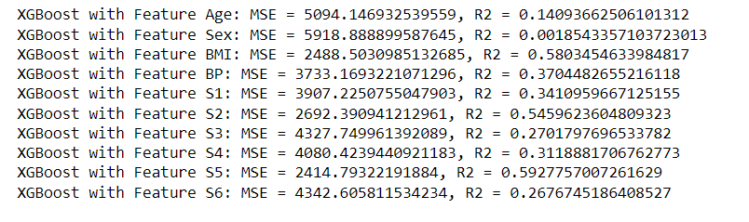
Best feature for Y using XGBoost
This concerns evaluating the performance of models trained using individual features, researching the potential that features pairs have to improve prediction accuracy.
We built separate XGBoost Regressor models with each of these features in our dataset.
In each model, there were two main metrics; Mean Squared Error (MSE) and R-squared (R2). MSE was directly related to the measurement of model prediction error, and R2 gave a clue as to how much variance of 'Y' was being explained from the model.
The variable S5 had a lower value (2414.79) of MSE, and its R2 value of 0.5928 was maximum, reflecting the best predictive power.

Slide 13
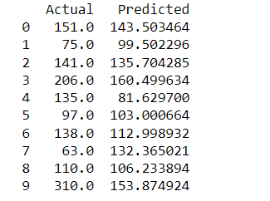
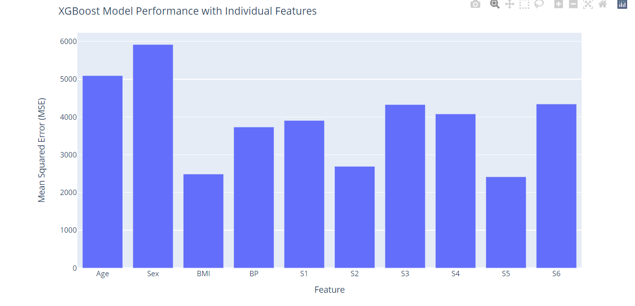

Slide 14
Best pair features for prediction of Y using XGBoost
Our method involved iterating over each unique pair of features, training an XGBoost model for each combination, and assessing its performance based on MSE.
We focused on MSE to gauge the accuracy of each model's predictions, with a lower MSE indicating a model that more closely approximates the actual values of 'Y'.
Through comprehensive evaluation, the feature pair ('BMI', 'S2') emerged as the most effective, demonstrating the lowest MSE (73.83), thus indicating a potent combination for predicting 'Y' with considerable accuracy.
visual representation of MSE for each feature pair was provided through a bar chart, illustrating the variability in model performance across different combinations.

Slide 15
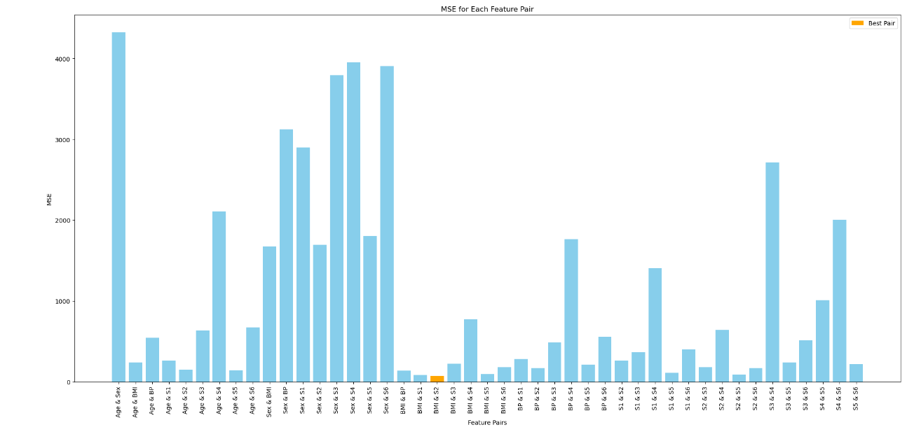
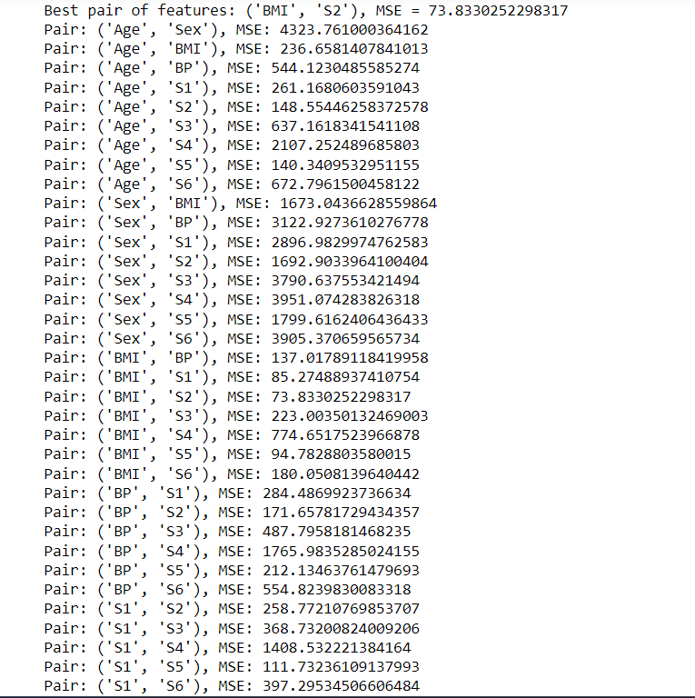

Slide 16
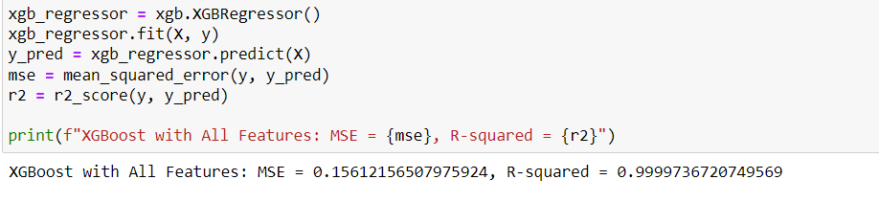
Using All Features

Slide 17
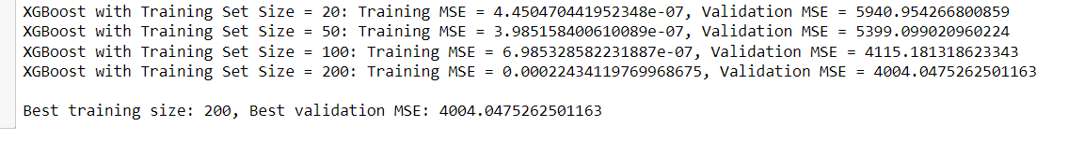
Computing Training and Validation MSE
We systematically assessed the performance of the XGBoost model across four distinct training set sizes: 20, 50, 100, and 200 observations.
The analysis pinpointed a training set size of 200 as optimal within the evaluated range, achieving the best balance between model training and its capacity to generalize, as evidenced by the lowest validation MSE of 4004.0475262501163.

Slide 18
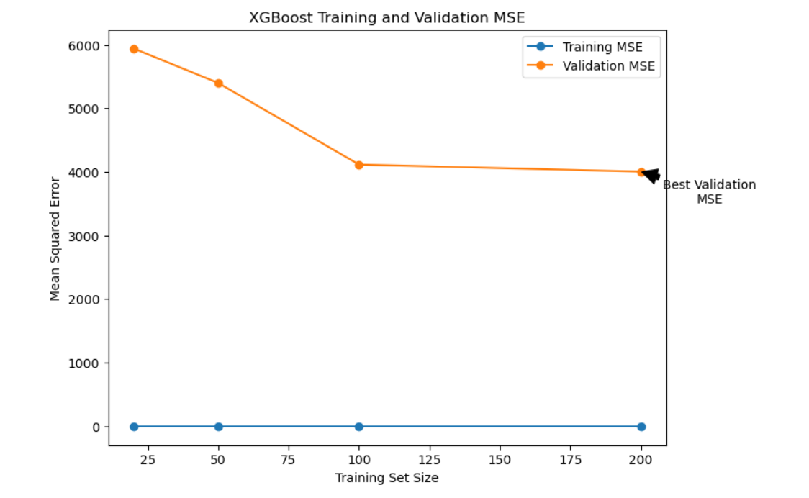

Slide 19

Conclusion
Feature Importance: Both models underscored the significance of specific features (e.g., S5, BMI) in predicting disease progression. This aligns with clinical understandings that certain physiological markers are closely related to health outcomes.
Model Selection and Complexity: The comparison illustrates that while XGBoost can capture complex data patterns, linear regression models may be preferred for their simplicity and interpretability, especially when relationships are nearly linear or when model transparency is crucial.
Data Size and Model Performance: Exploring different training set sizes revealed that larger datasets generally enhance model performance. However, the diminishing returns observed highlight the balance between having sufficient data for training and the marginal gains in predictive accuracy.
Generalization vs. Overfitting: XGBoost's near-perfect accuracy raises questions about overfitting, reminding us of the importance of model evaluation based on not just training performance but also its ability to generalize to unseen data.
As the independent variables are non-linear with target variable. i consider this as a nonlinear data.XGBoost inherently handles non-linear relationships between features and the target variable more effectively than linear regression.

