Slide 1

Time Series Forecasting of NYC's Electricity Consumption
-By Vishnu Vardhan Reddy Bijjam

Slide 2
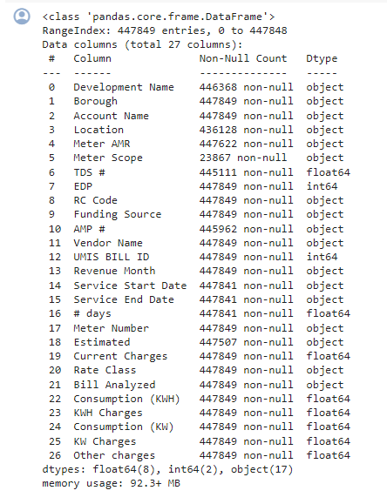
Descriptive statistics
The dataset contains 447,849 entries and it includes 27 columns with diverse data types (categorical and numerical).

Slide 3
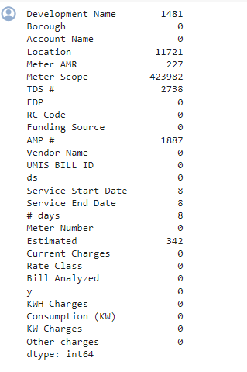
Missing Values
The dataset contains various columns with missing data, most notably in the 'Meter Scope' column, which has 423,982 missing entries, representing a significant portion of the dataset. Other columns with notable amounts of missing data include 'Location' with 11,721 missing entries, and 'TDS #' missing 2,738 entries. There are also smaller gaps in data such as 'Development Name' with 1,481 missing entries, and 'AMP #' which lacks 1,887 entries. Minor discrepancies are present in 'Meter AMR' with 227 missing entries, 'Estimated' readings short by 342 entries, and very few missing entries in 'Service Start Date', 'Service End Date', and '# days', each missing just 8 entries. The rest of the columns, including 'Borough', 'Account Name', 'EDP', 'RC Code', 'Funding Source', 'Vendor Name', 'UMIS BILL ID', and several others related to charges and consumption, are completely filled with no missing data.
Missing values in numeric columns of the dataset were filled using the mean of each respective column, ensuring data integrity without skewing distributions. However, this approach does not address missing data in categorical columns.

Slide 4
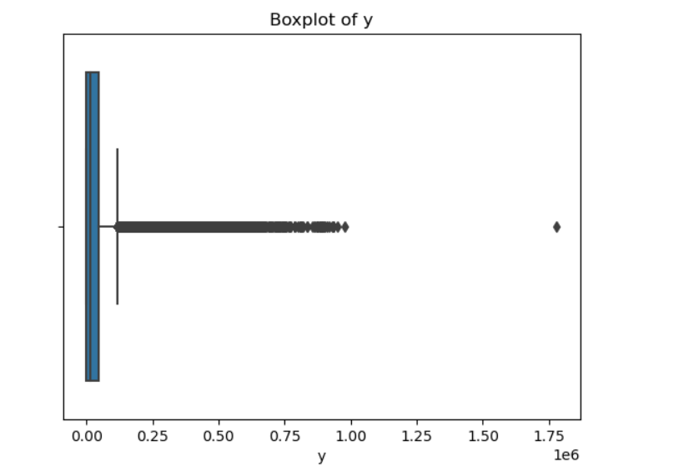
Outliers Detection
Using the Interquartile Range (IQR) method, I identified outliers in Y. The total number of outliers detected was 20,462.
After identifying these outliers, I removed them from the dataset to ensure the data’s integrity and improve the accuracy of further analysis.
Following the removal of these outliers, the dataset now contains 427,387 entries.

Slide 5
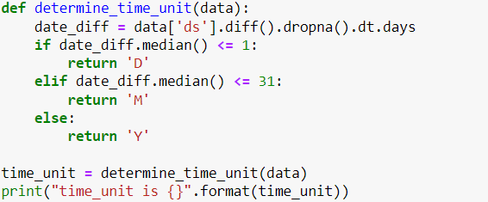

Time Unit
For time unit determination, defined a function which analyze whether the time unit is in days or months or yearly.
The function uses this median value to decide the predominant interval of the dataset:
If the median day difference is 1 day or less, it categorizes the data as having daily ('D') intervals.
If the median day difference is up to 31 days, it suggests that the data points are likely recorded monthly ('M').
If the median exceeds 31 days, it classifies the intervals as yearly ('Y').
Found time unit is D

Slide 6

Model Training and Prediction Using Prophet
For each specified period in days, the model predicts future consumption. These predictions are plotted against historical data to visualize the expected trends.
(100D)-The graph shows a stable forecast with minor fluctuations around a downward trend, indicating a decreasing trend in consumption forecast
(200D)-There is a slightly more pronounced decrease compared to the 100-day forecast.
(365D)-There is a marked decline suggesting a significant drop in expected consumption over the next year.
All forecasts suggest a general decline in consumption over the coming days and year.
This trend could inform strategies around energy conservation, resource allocation, or policy adjustments if the trend reflects broader energy usage behaviors.

Slide 7
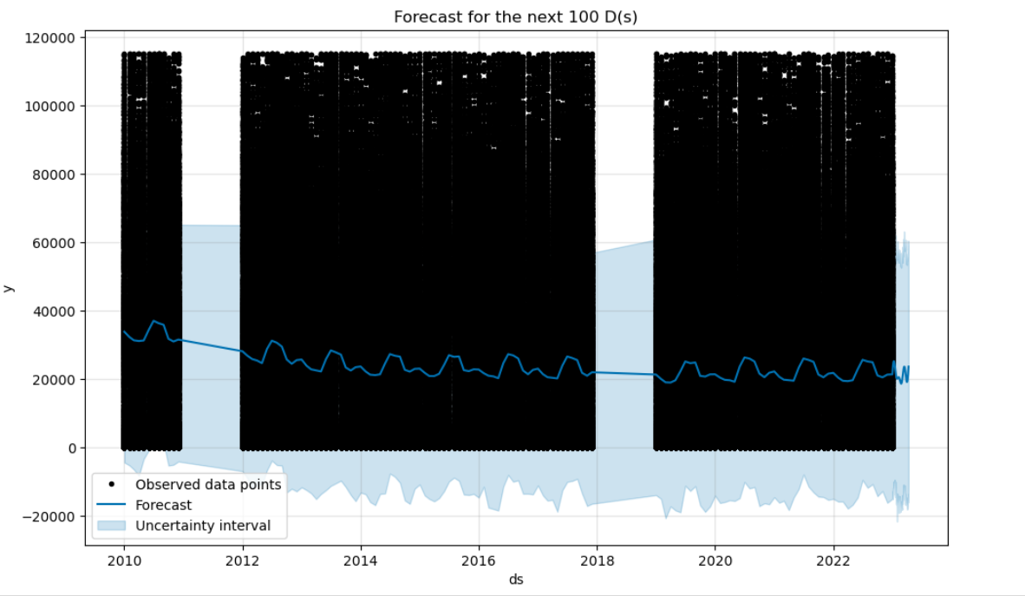
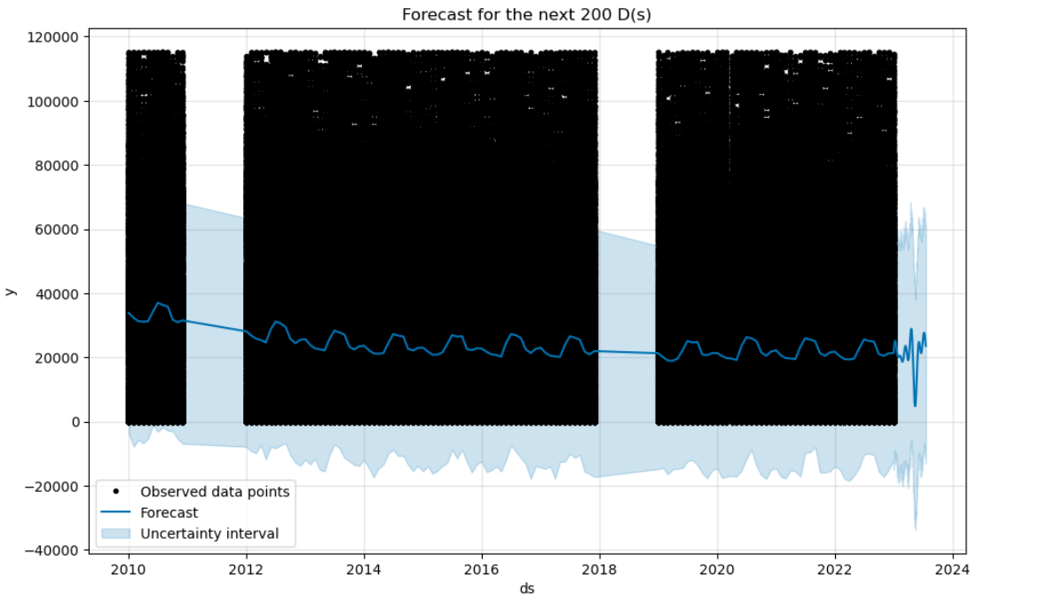

Slide 8
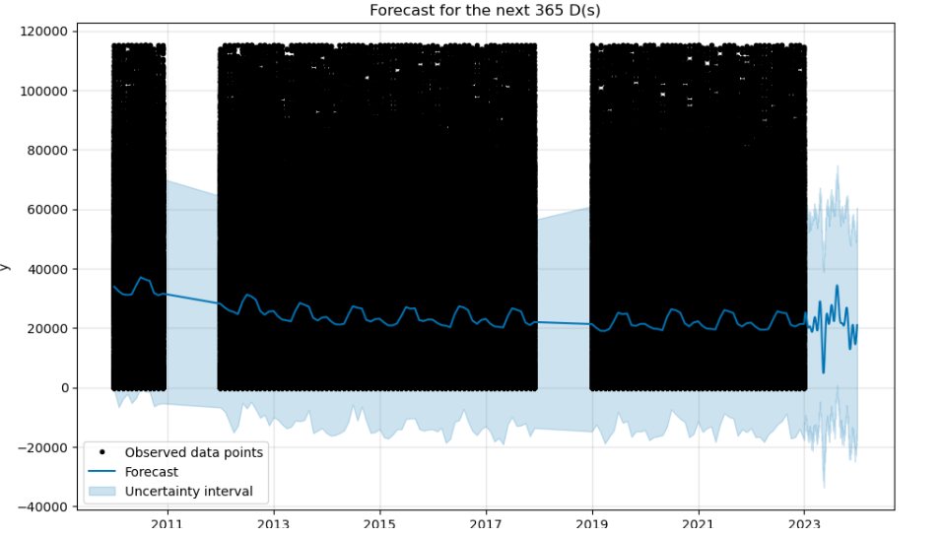

Slide 9
Model Tuning and Forecasting
The model is configured with logistic growth, incorporating a maximum capacity (cap) of 6 and a minimum floor of 1.5 to reflect physical or operational constraints in the dataset. Seasonalities added include monthly, daily, weekly, yearly, and quarterly, each with specific Fourier orders designed to capture periodic fluctuations accurately.
Intervals widen as the forecast extends into the future, indicating increasing uncertainty in longer-term predictions. This is typical in forecasting models as the predictive confidence generally decreases with time.
Trend graph shows a decreasing pattern over the years, suggesting a long-term decline in the values being forecasted.
Contrary to the logistic model, the trend component in this flat growth model is relatively flat, indicating the absence of a significant long-term increase or decrease, consistent with the flat growth assumption.

Slide 10
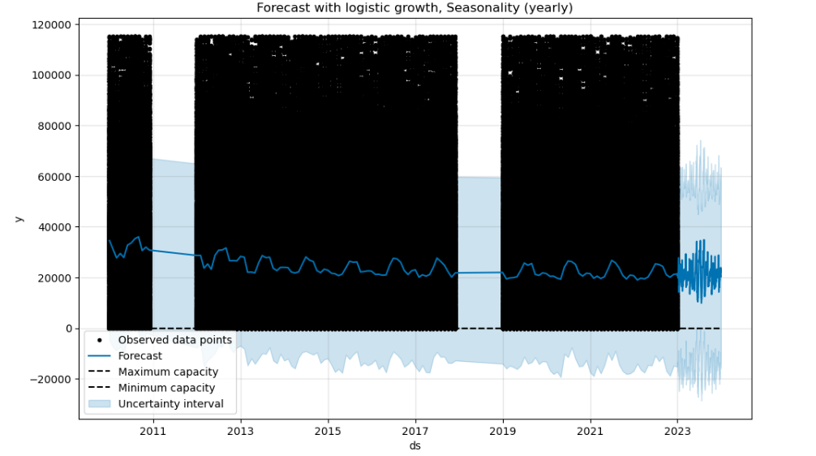
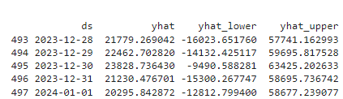

Slide 11
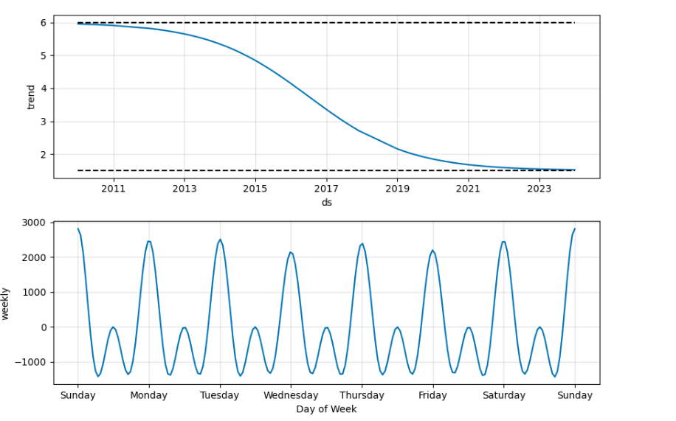
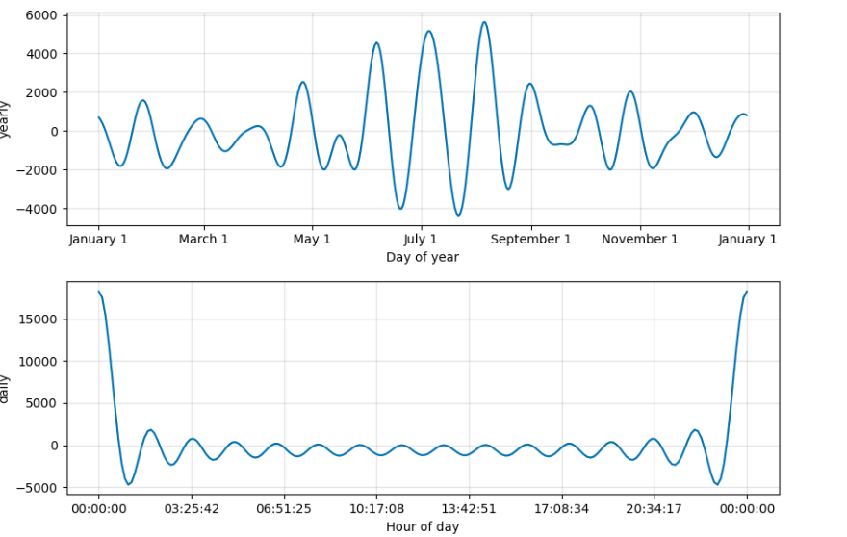

Slide 12
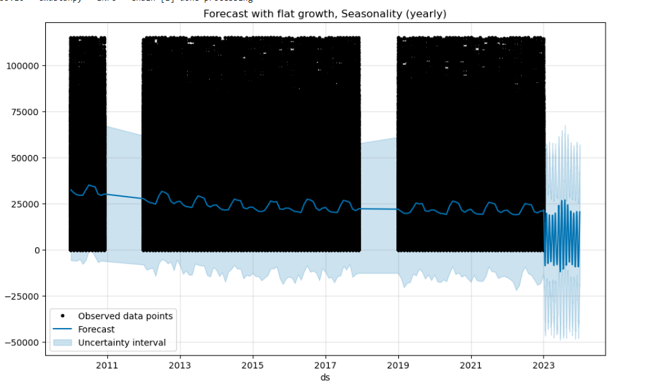

Slide 13
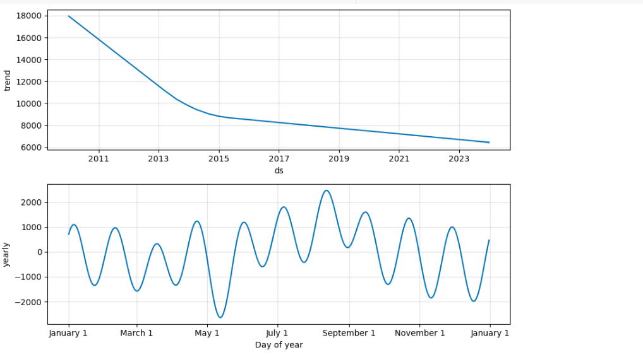

Slide 14
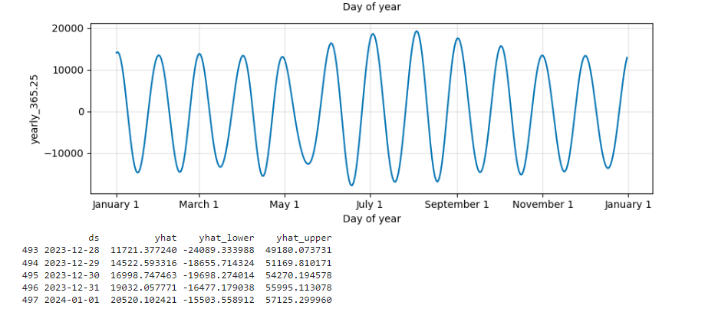

Slide 15

Model Evaluation
The flat growth model with yearly seasonality performs marginally better than the logistic model in terms of R^2, although the MAE and MAPE are still substantially high.
Similar to the yearly seasonality under flat growth, the biweekly model shows only a slight improvement in R^2.
The R^2 values close to zero across all configurations indicate that the models, regardless of the growth type or seasonality, explain very little of the variance in the observed data. This suggests that the models may not be appropriate for this particular dataset or that the dataset's characteristics and noise might be challenging for these models to capture effectively.

Slide 16
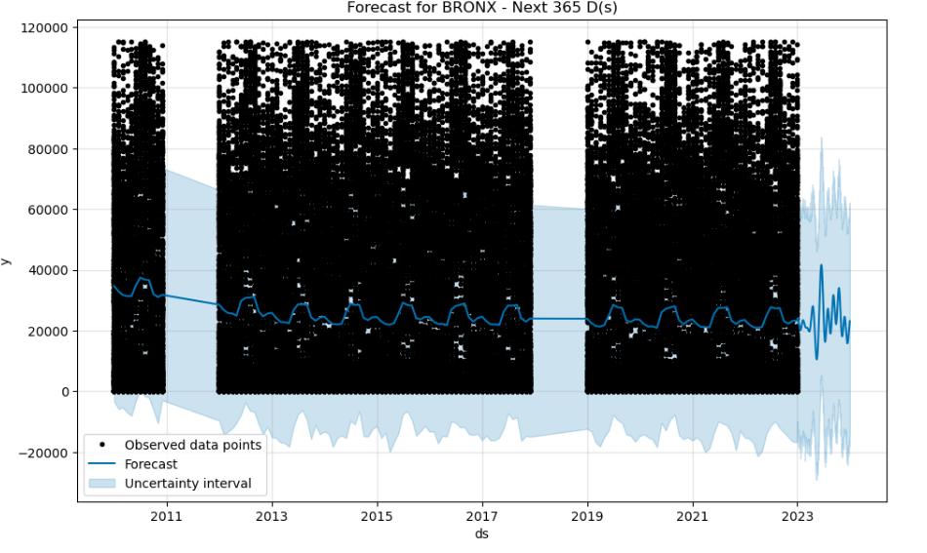
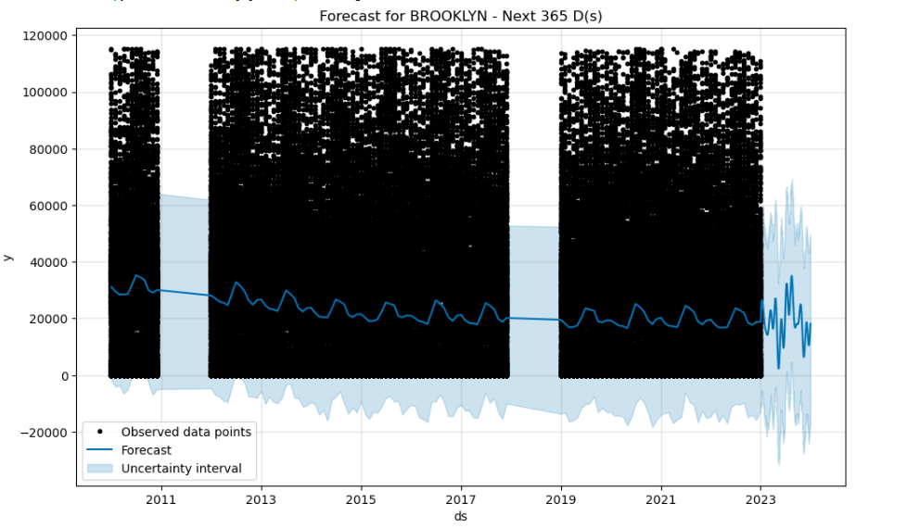
Electric Consumption for each of the 5 Boroughs

Slide 17
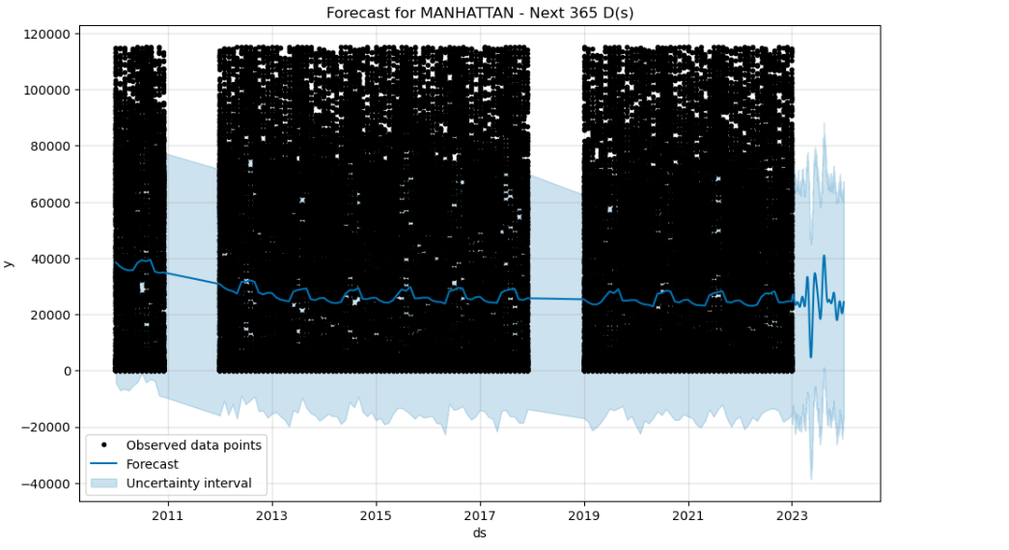
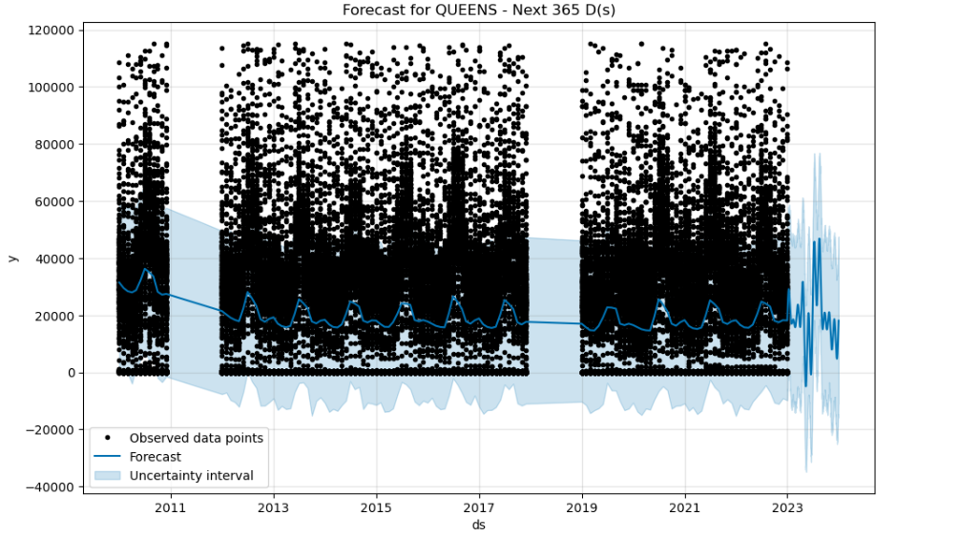

Slide 18
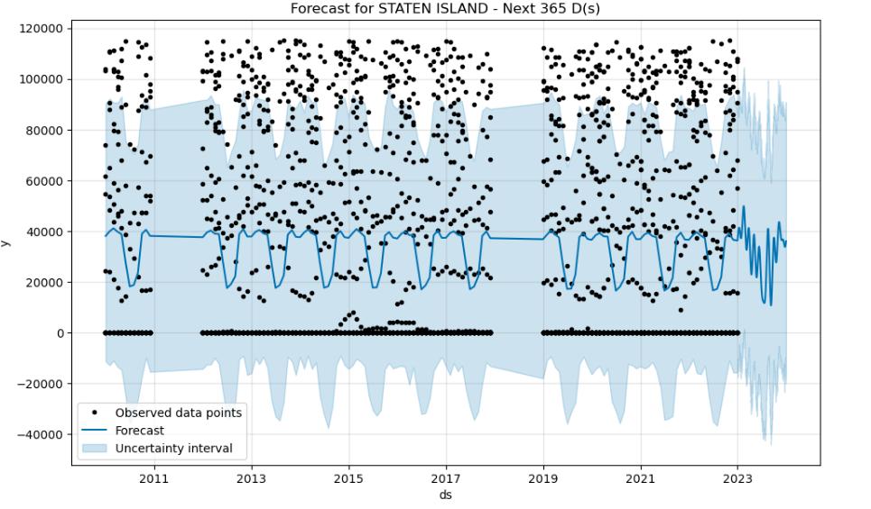
Across all boroughs, the forecasts tend to stabilize the inherent noise and variability of the observed data, producing a smoother prediction line that captures the central trends but often underestimates the peaks and overestimates the troughs. The uncertainty intervals generally widen as the forecast extends into the future, which is typical in forecasting models but varies notably between the boroughs, reflecting different levels of data stability and model fit.

Slide 19

Conclusion
Tried to remove all missing values in categorical values it results decrease more than9 0% of dataset (23k). But accuracies would be still less when compared to dataset contains 447k.
Given the complex nature of electricity consumption patterns, incorporating additional predictors such as weather conditions, economic indicators, or event-based anomalies might improve the model's performance.
Continuous monitoring and updating of the model with new data are recommended to maintain its relevance and accuracy over time.

