Slide 1

DESIGN OF CROWN SHAPED PATCH ANTENNA FOR UWB APPLICATIONS
UNDER THE GUIDANCE OF
Mr. G.MAHESH, M.Tech
ASSISTANT PROFESSOR
DEPT OF E.C.E
PRESENTED BY
G. VISHNU SRIVARDHAN (Y17AEC455)
D.AKHIL KUMAR (Y17AEC443)
CH.MOHITH SRI MITHRA (Y17AEC434)
G.RAMA KRISHNA (Y17AEC453)
CH.RAJESH VARMA (Y17AEC426)
Notes:
5/30/2021
1
1

Slide 2
CONTENTS
Abstract
Microstrip Antennas
Dielectric Substrate
Feeding techniques
Design equations
HFSS
Antenna structure
Antenna design
Graphs
Radiation patterns
Proposed Antenna performance parameters
Applications
Conclusion and Future Scope
References
Notes:
5/30/2021
2
2

Slide 3
ABSTRACT
In this a Compact crown shaped patch antenna, using hfss is designed at a rage of ultra wide band. The substrate FR4_epoxy is used for designing the proposed antenna with dielectric constant of 4.4 and height of the substrate is 1.6mm. The UWB antenna is simulated by using high frequency structured simulator. The designed antenna resonates at 3.6, 7.6 and 10.6 GHz with a bandwidth of 3.1 to 11.5 GHz, the return loss is -31.8dB, -34dB and -18.1dB respectively and the VSWR is 1.05, 1.0 and 1.2 for the three resonant frequencies. The proposed antenna is operated for UWB applications.
Notes:
5/30/2021
3
3

Slide 4
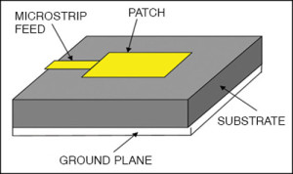
MICRO STRIP ANTENNAS
It is a kind of internal antenna. There are mostly used at microwave frequencies. An individual microstrip antenna consists of a patch of metal foil of various shapes on the surface of a PCB, with a metal foil ground plane on the other side of the board.
Advantages
Light weight and low volume.
Capable of double and triple frequency operations.
Micro-strip antennas are moderately cheap to produce and design as a result of the basic 2-dimensional physical geometry.
Notes:
5/30/2021
4
4

Slide 5
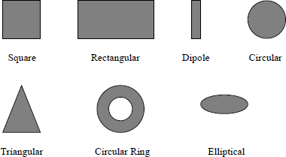
DIFFERENT SHAPES OF MICROSTRIP PATCH ELEMENTS
5
Notes:
5/30/2021
5
5

Slide 6
DIELECTRIC SUBSTRATE
The FR4 is used as a dielectric substrate having relative permittivity of 4.4 and loss tangent 0.009.
The advantage of FR4 is cheap and largely abundant element.
Based on the substrate the antenna parameters changes.
6
Notes:
5/30/2021
6
6

Slide 7
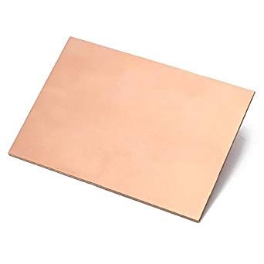

FR4 SUBSTRATE
7
Notes:
5/30/2021
7
7

Slide 8
FEEDING TECHNIQUES
1.Microstrip Line Feeding
2.Coaxial Feeding
3.Aperture Coupling
4.Proximity coupling
Notes:
5/30/2021
8
8

Slide 9
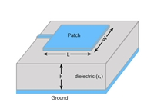
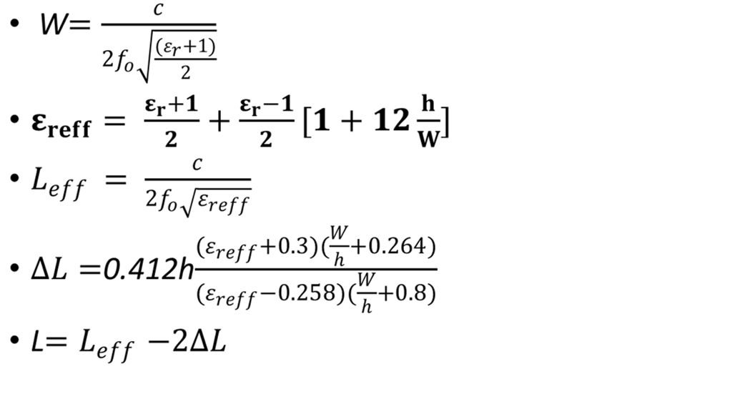
DESIGN EQUATIONS OF RECTANGULAR PATCH ANTENNA
W=30mm
L=35mm
Notes:
5/30/2021
9
9

Slide 10
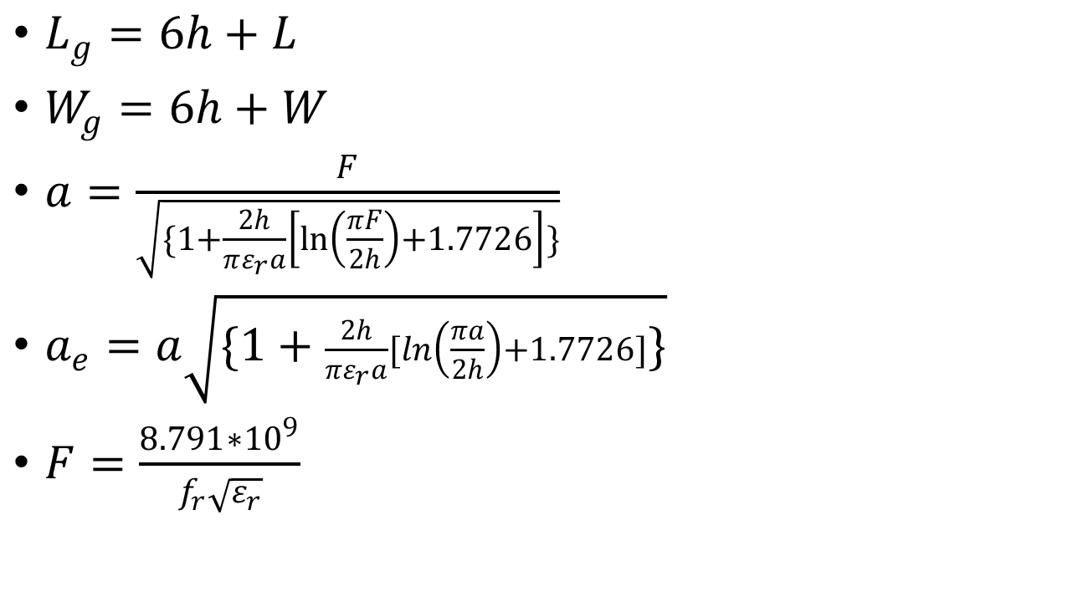
DESIGN EQUATIONS OF RECTANGULAR PATCH ANTENNA
10
Notes:
5/30/2021
10
10

Slide 11
HFSS software
HFSS – High Frequency Structure Simulator.
Simulation software for designing and simulating high frequency electronic products.
Applications:
PCBs
Antennas and microwave components
High frequency IC packages
Biomedical devices
Notes:
5/30/2021
11
11

Slide 12

ANTENNA STRUCTURE
The antenna was fabricated on FR-4 substrate.
Permittivity ϵr = 4.4, height 1.6 mm.
The radiator and the ground plane are on the top and bottom of the dielectric substrate.
A crown shape patch is designed on the top surface of antenna.
A microstrip transmission line is used to excite the suitable set.
The most important and interesting part in this design is the introduction of crown cut shape of proposed antenna.
Defected Ground structure and slotting techniques are useful to enhancing the bandwidth of proposed antenna.
Notes:
5/30/2021
12
12

Slide 13
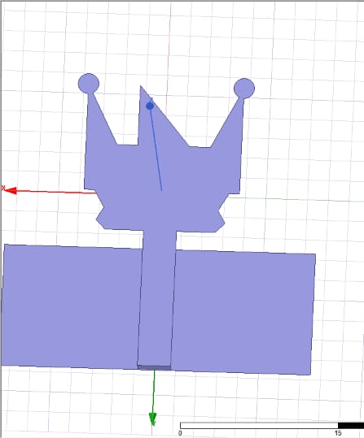
ANTENNA DESIGN
Fig:crown shaped patch antenna
Notes:
5/30/2021
13
13

Slide 14
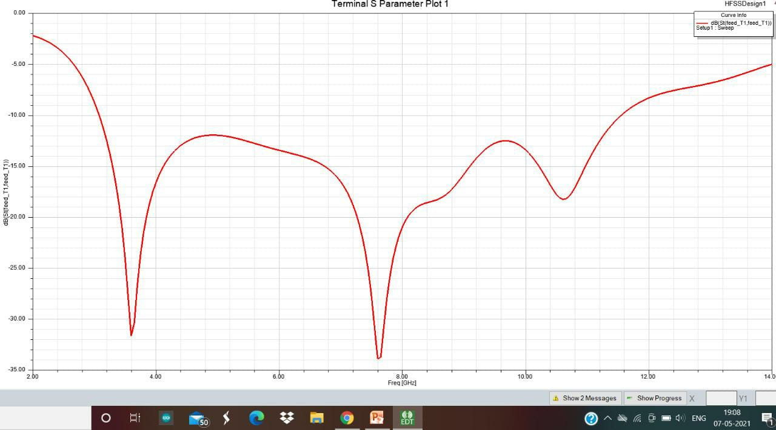
S-PARAMETER GRAPH
Notes:
5/30/2021
14
14

Slide 15
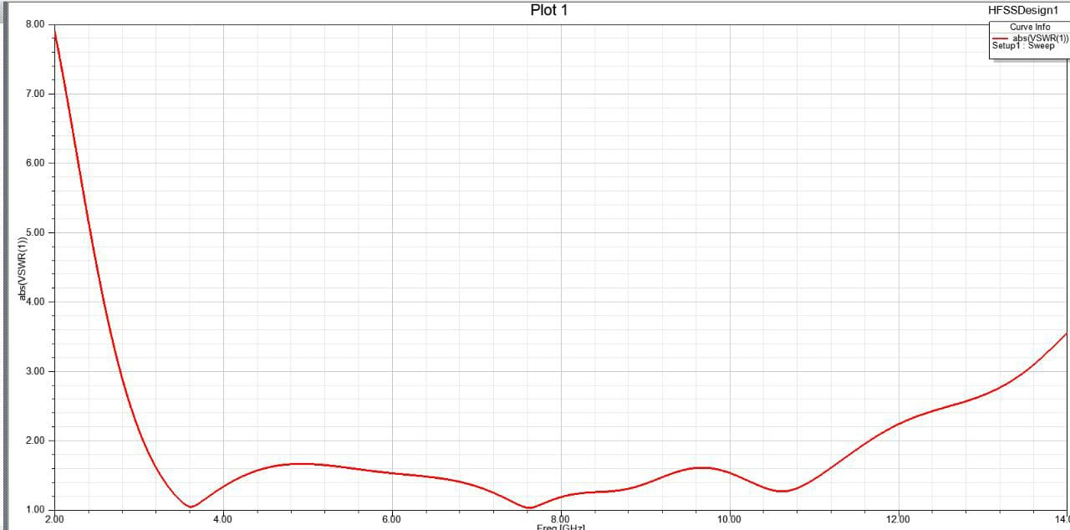
VSWR GRAPH
Notes:
5/30/2021
15
15

Slide 16
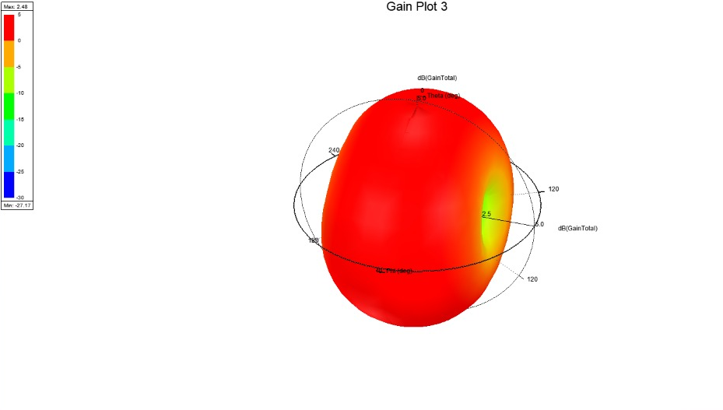
RADIATION PATTERN AT 3.6 GHz
Notes:
5/30/2021
16
16

Slide 17
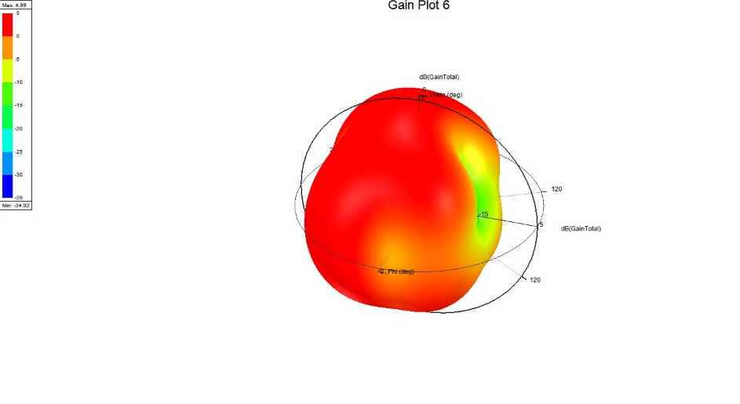
RADIATION PATTERN AT 7.6GHz
Notes:
5/30/2021
17
17

Slide 18
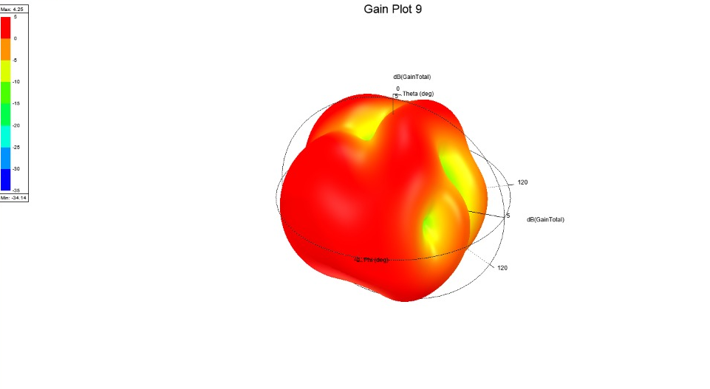
RADIATION PATTERN AT 10.6GHz
Notes:
5/30/2021
18
18

Slide 19
PROPOSED ANTENNA PERFORMANCE PARAMETERS
Resonant frequency(fr) | 3.6 GHz | 7.6 GHz | 10.6 GHz
S11(dB) | -31.8 | -34 | -18.1
VSWR | 1.05 | 1.0 | 1.2
Gain(dB) | 5 | 5 | 5
Notes:
5/30/2021
19
19

Slide 20
APPLICATIONS
Radars
WiMax
Satellite communications
Cordless telephones
WLAN applications
5G Technology
20
Notes:
5/30/2021
20
20

Slide 21
The proposed crown shaped patch antenna is designed for Ultra wide band applications. It resonates at 3.6 GHz, 7.6GHz and 10.6GHz with a return loss of -31.8dB, -34 and -18.1dB, VSWR is less than 2 , bandwidth of 3.1 to 11.5GHz and gain of 5dB.
CONCLUSION AND FUTURE SCOPE
The antenna is designed by using HFSS software. The future scope of this project is by changing the structural modifications using different slots and meta surfaces to achieve more gain and resonate at various applications.
Notes:
5/30/2021
21
21

Slide 22
REFERENCES
N. Niranjan Kumar, B. S. Srikanth, Sameena Pathan “A Slotted UWB Monopole antenna with Truncated Ground plane for Cancer detection”, Alexandria engineering journal 2020.
Sani saminu, Adanu Halilu, Jabir, Adnan Gaffar “Design of a compact UWB antenna with high isolation and gain” IEEE workshop on Microwave theory and techniques 2020.
K.D Prasad “Antenna And Wave Propagation” Revised Edition
C. A. Balanis, “Antenna Theory - Analysis and Design,” 3nd edition, John Wiley.
Notes:
5/30/2021
22
22

Slide 23
Thank you
23
Notes:
5/30/2021
23
23

