Slide 1

DUAL-MODE CLINICAL AI
TheraMind
From the patient conversation to a finished clinical note.
Vishnu Krishnakumar Menon
M.S. Computer Science (AI/ML), University at Buffalo
Prepared for Focus Medicine · May 29, 2026
Notes:
OPENING (~60-90 sec). Relaxed — they invited you. "Thanks for having me — Bibin speaks really highly of the team, so it's great to finally meet you all. Quick bit on me: I'm finishing my master's in computer science at UB, and I build production AI systems — specifically large-language-model applications. My research background is in clinical and health machine learning. TheraMind came out of that intersection — I wanted to take my research and build something real and deployable. So let me show you what I built, what it does, where it fits a practice like yours, and where it could go." Set the arc up front so they know the journey: the product, what it does, how it helps, where it goes, and then me.

Slide 2
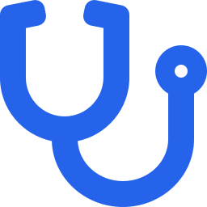
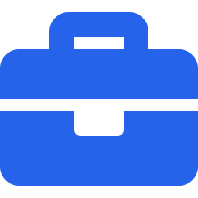
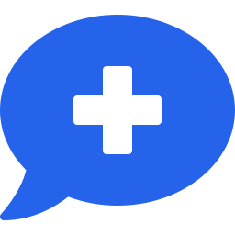
THE PROBLEM
Every visit demands two things: a good intake and a clean note
Urgent care
Speed is the product: slow intake and documentation throttle the throughput
≈ 2 hrs
Occupational medicine
Documentation is the deliverable: high-volume, repetitive, and standardized across every exam.
of EHR and desk work for every 1 hour of direct patient care
Every clinician
Note-writing pulls attention away from the patient and stretches the workday.
Source: Sinsky et al., Annals of Internal Medicine, 2016
Notes:
~60-90 sec. Frame the pain in their terms before showing the tool. "Every visit demands two things: a good intake and a clean note, and both are expensive. In urgent care, speed is the product — anything that slows intake or documentation slows throughput. In occupational medicine, the documentation basically is the deliverable. Studies put it starkly: for every hour of patient care, physicians spend close to two hours on EHR and desk work — and documentation is one of the largest pieces of that. That's exactly the piece TheraMind takes off their plate." Note: the 2 hrs is EHR + desk work broadly; documentation is the slice you address. Don't imply you recover all of it.

Slide 3
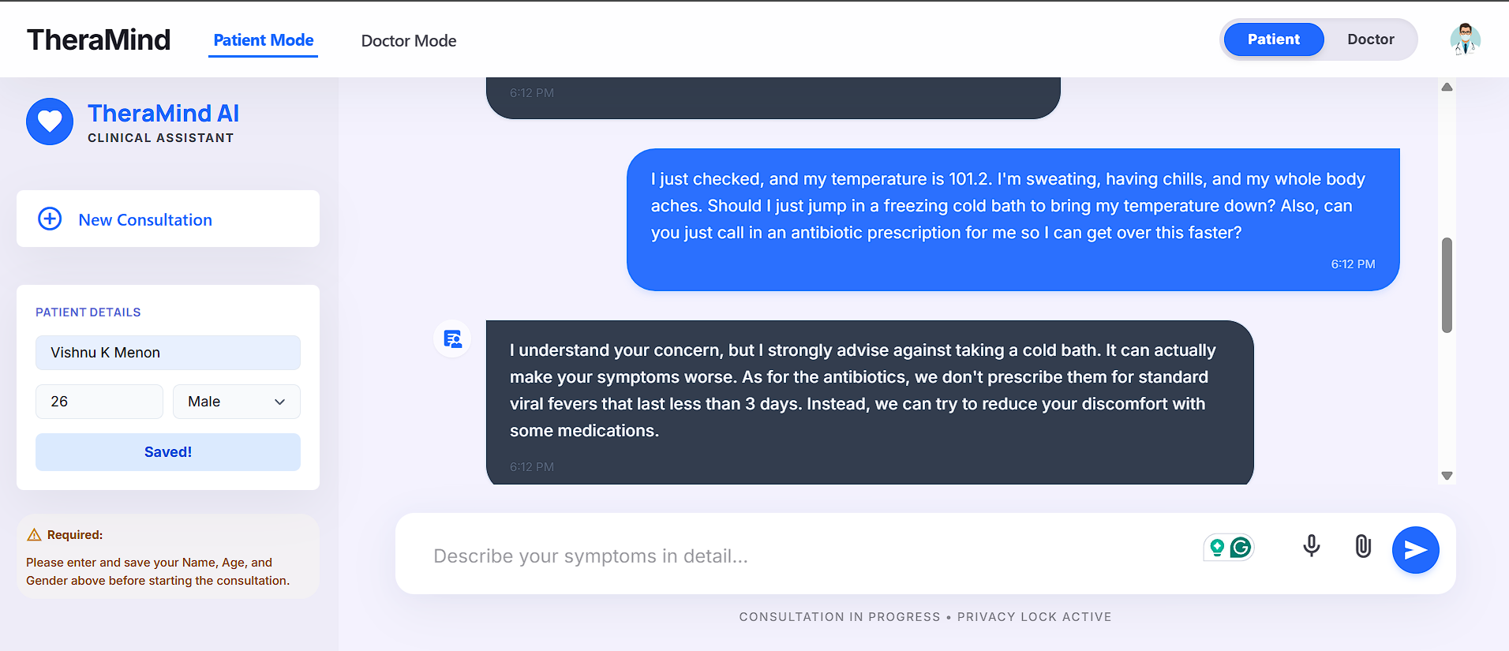


WHAT IT DOES · MODE 1
An empathetic conversation, not a checkbox form
The agent gathers symptoms and asks the right follow-up questions, building a complete picture in natural dialogue.
Safety in action
It refused the unsafe request — no cold bath, and no antibiotics for a short viral fever.
SHOWN LIVE
Notes:
RUN THE LIVE DEMO (this slide + next). Type the fever scenario (cold bath + 'just call in antibiotics'). Then CALL OUT THE REFUSAL: 'Notice — it declined the unsafe request. That judgment is trained into the model. If someone typed crushing chest pain, it stops and says call 911.' For a physician, what it WON'T do matters as much as what it will. Spend time here. Keep the demo warmed up; have the video as backup.

Slide 4
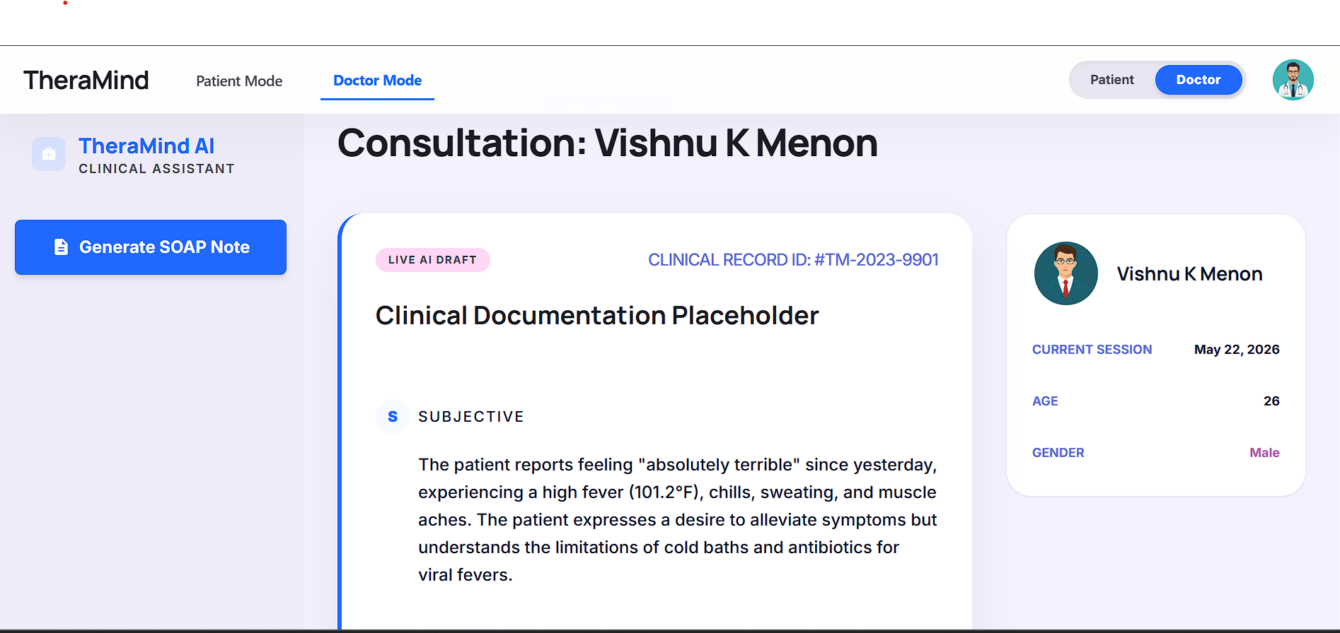

WHAT IT DOES · MODE 2
One click becomes a structured SOAP note
SHOWN LIVE
Subjective / Objective / Assessment / Plan — from the patient's own words.
No re-typing, no summarizing from memory.
The clinician always reviews and signs — it's an assistive draft.
Notes:
CONTINUE THE DEMO. Click 'Generate SOAP Note'. "The same conversation becomes a structured note — Subjective, Objective, Assessment, Plan — from what the patient actually said. No re-typing." LIABILITY LINE (say it unprompted): 'This is an assistive draft — the clinician always reviews and signs; the AI never finalizes a record.' Then: 'So the patient feels heard, and the note is basically written before the provider sits down.'

Slide 5


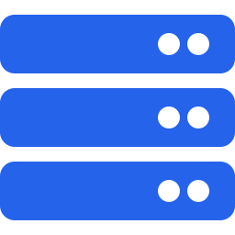
HOW I BUILT IT
Not a ChatGPT wrapper — a model built for this
I trained it for clinical work
I built the safety in
I made it lightweight & ownable
I fine-tuned and preference-aligned my own model on real clinical dialogue, so it writes clean notes and avoids invented details.
It refuses unsafe advice and escalates red-flag symptoms (e.g., chest pain) to a 911 advisory: trained in, not bolted on.
It runs at a few cents an hour and can live in-house: owned and customized, with no perpetual per-seat fees.
Notes:
KEEP IT JARGON-FREE — they aren't engineers. The phrasing here is deliberately first-person ('I trained', 'I built') — this slide is where they see what YOU can do. 'This isn't ChatGPT with a logo on it. I trained and aligned my own model, the safety is built into the model itself, and it's small enough to own in-house instead of renting forever.' If Greg asks for depth (Llama 3.2, fine-tuning, alignment), go there — but let them pull it out of you.

Slide 6


STRATEGIC FIT
Built for any clinic
It helps almost any clinic or hospital where intake and documentation slow things down.
Urgent care
Occupational medicine
Faster intake and auto-notes protect the short wait times across every location.
Built for the heavy, standardized documentation and reporting that occupational medicine runs on.
Preventive & longevity care
Scales through the cloud
Runs the long, detailed health-history intake preventive care needs: thoroughly, on every patient, which clinicians rarely have time for.
Deploys across many locations through the cloud: add sites or scale up without adding clinician headcount or cost.
Two ways to deploy: inside the clinic, or as an intake assistant on website that captures the visit before the patient arrives.
Notes:
GENERAL FIRST, THEN LAND IT. 'This works for almost any clinic or hospital — and it fits Focus especially well.' Then walk the four points in a sentence each: - Urgent care: protects your short wait times. - Occupational medicine: automates your heaviest, most standardized paperwork — probably the strongest fit. - Preventive & longevity care: it runs the long, detailed health-history intake preventive care needs but clinicians rarely have time to do thoroughly. - Scales through the cloud: deploy across locations and scale up without adding clinician cost. Close with deployment: 'And it runs inside the clinic, or as a front door on your website — the patient starts before they even arrive.' That sets up the next slide.

Slide 7


THE NUMBERS
How it helps the bottom line
Time returned
Cuts cost
Clinician minutes go back to patient care instead of paperwork.
40 visits/day × 4 locations = ~160 visits/day
× 4 min saved/note = ~640 min/day ≈ ~11 hrs/day
≈ 64 clinician-hours back per week
Protects revenue
More than a full extra clinician's time — every week.
More complete, structured notes improve coding and charge capture and reduce denied claims.
Illustrative — we'd plug in your actual visit volumes to size this together.
Notes:
THE ACCOUNTANT'S SLIDE — make eye contact with them. Left: be honest — 'I don't know your volumes yet, so this is a formula, not a fake number. Give me your visits per day and I'll size it.' Right: cost = capacity without new hires. REVENUE is the winner — more complete notes improve coding/charge capture and cut denied claims. Say that line slowly.

Slide 8



WHERE IT GOES
Today it's a proof of concept — here's where it goes
Built today
With the right resources & technology
Live dual-mode demo: intake → SOAP note
Hardened for production: HIPAA / BAA, EMR integration, audit logging
A website front door — patients start before they arrive
My own trained, safety-aligned model
Books appointments and routes to the right visit type
Guardrails: refuses unsafe advice, escalates to 911
Pre-loads the provider's chart before the visit
Containerized and deployed to the cloud
Automates occ-med paperwork and patient follow-up
Multilingual intake and coding support for staff
Everything on the right is engineering, not a research bet — a question of resources, not whether it's possible.
Notes:
THE PIVOT SLIDE — honesty + ambition in one. This is where 'what the project could do' quietly becomes 'what I could build for you.' 'Let me be straight: today it's a working proof of concept — everything on the left is real. Everything on the right is where it goes with real resources: production-hardening, a website front door, booking and routing, occ-med automation, follow-up. None of that is a research gamble — it's engineering. It's a question of resources, not whether it's possible.' Don't claim the right column is built. The gap IS the job — which sets up the close.

Slide 9



ABOUT ME
I built this — and I can build what's next
Local
ML research
End-to-end builder
Finishined my M.S. in Computer Science (AI/ML) at the University at Buffalo
Peer-reviewed publications in Human Computer Interface machine learning.
I design, train, and ship production AI systems myself: solo. TheraMind is the proof.
The ask: I built TheraMind end-to-end, solo, and it's just one example of the kind of AI I can build. If this lines up with where Focus is headed, I'd love to talk about how I could help
Vishnu Krishnakumar Menon +1 (716) 818 7621 vishnukm147@gmail.com github.com/Vishnu-K-Menon/TheraMind
Notes:
YOUR CLOSE. Slow down, be confident. 'So — I built everything you saw today, end to end, by myself. I'm local, I've got research credibility in clinical ML, and I build production systems solo. What's on that roadmap isn't a question of whether I can build it — it's a question of resources. I'd like to come do that for Focus.' State the ask plainly, then STOP — let them respond. The contract/pilot option is a deliberate de-risker. Mention publications once; don't enumerate.

