Slide 1
FutureMe Simulator
A Streamlit based career adviser that turns your current situation into branching, data-backed futures.
Notes:
Introduce FutureMe as a conversational career adviser.

Slide 2

Career planning is hard to do alone
WHO IT IS FOR
WHO IT IS FOR
New planners
Catch-up planners
People starting out who need to compare real options.
People keeping pace with fast-moving markets.
Ask, then see salary and savings
FutureMe is a conversational adviser that projects both.

Slide 3


A chat-bot adviser on a Streamlit front end
Streamlit front end
Google login
Gemini
Chat, sliders, uploads, Plotly charts, pandas tables
OAuth sign-in
Generates the predictions
MySQL
Stores users, projections and scenarios
Stack: Streamlit, pandas, Plotly, MySQL, Gemini, PyPDF2, python-docx

Slide 4
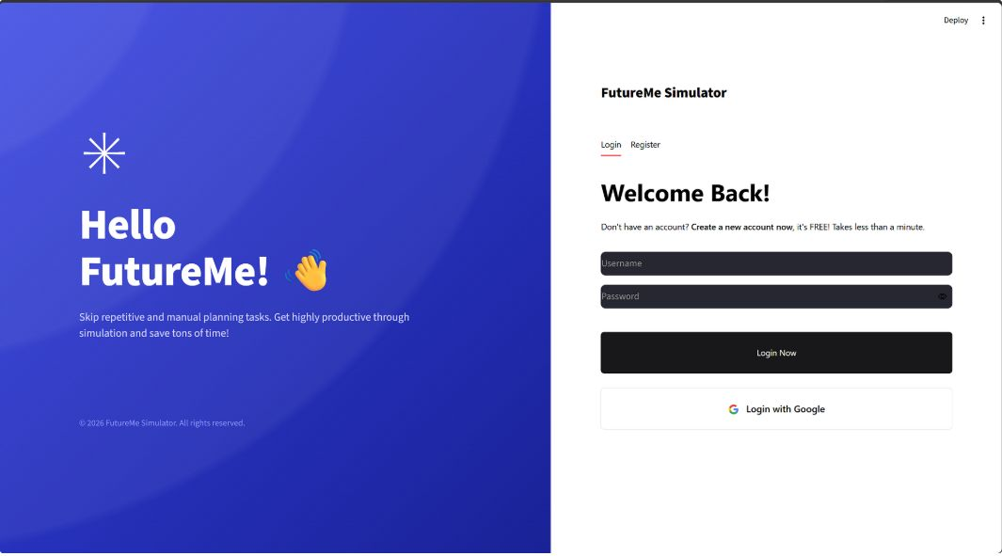
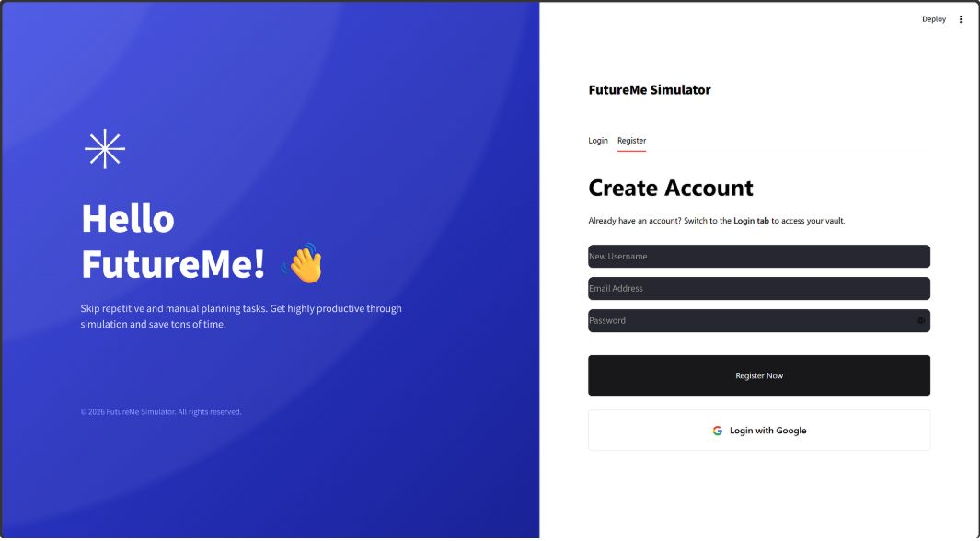
Sign in natively or with Google
Username and password login with a Register tab
Google OAuth as a second option
Passwords are stored as hashes
Google accounts cannot sign in through the password form

Slide 5
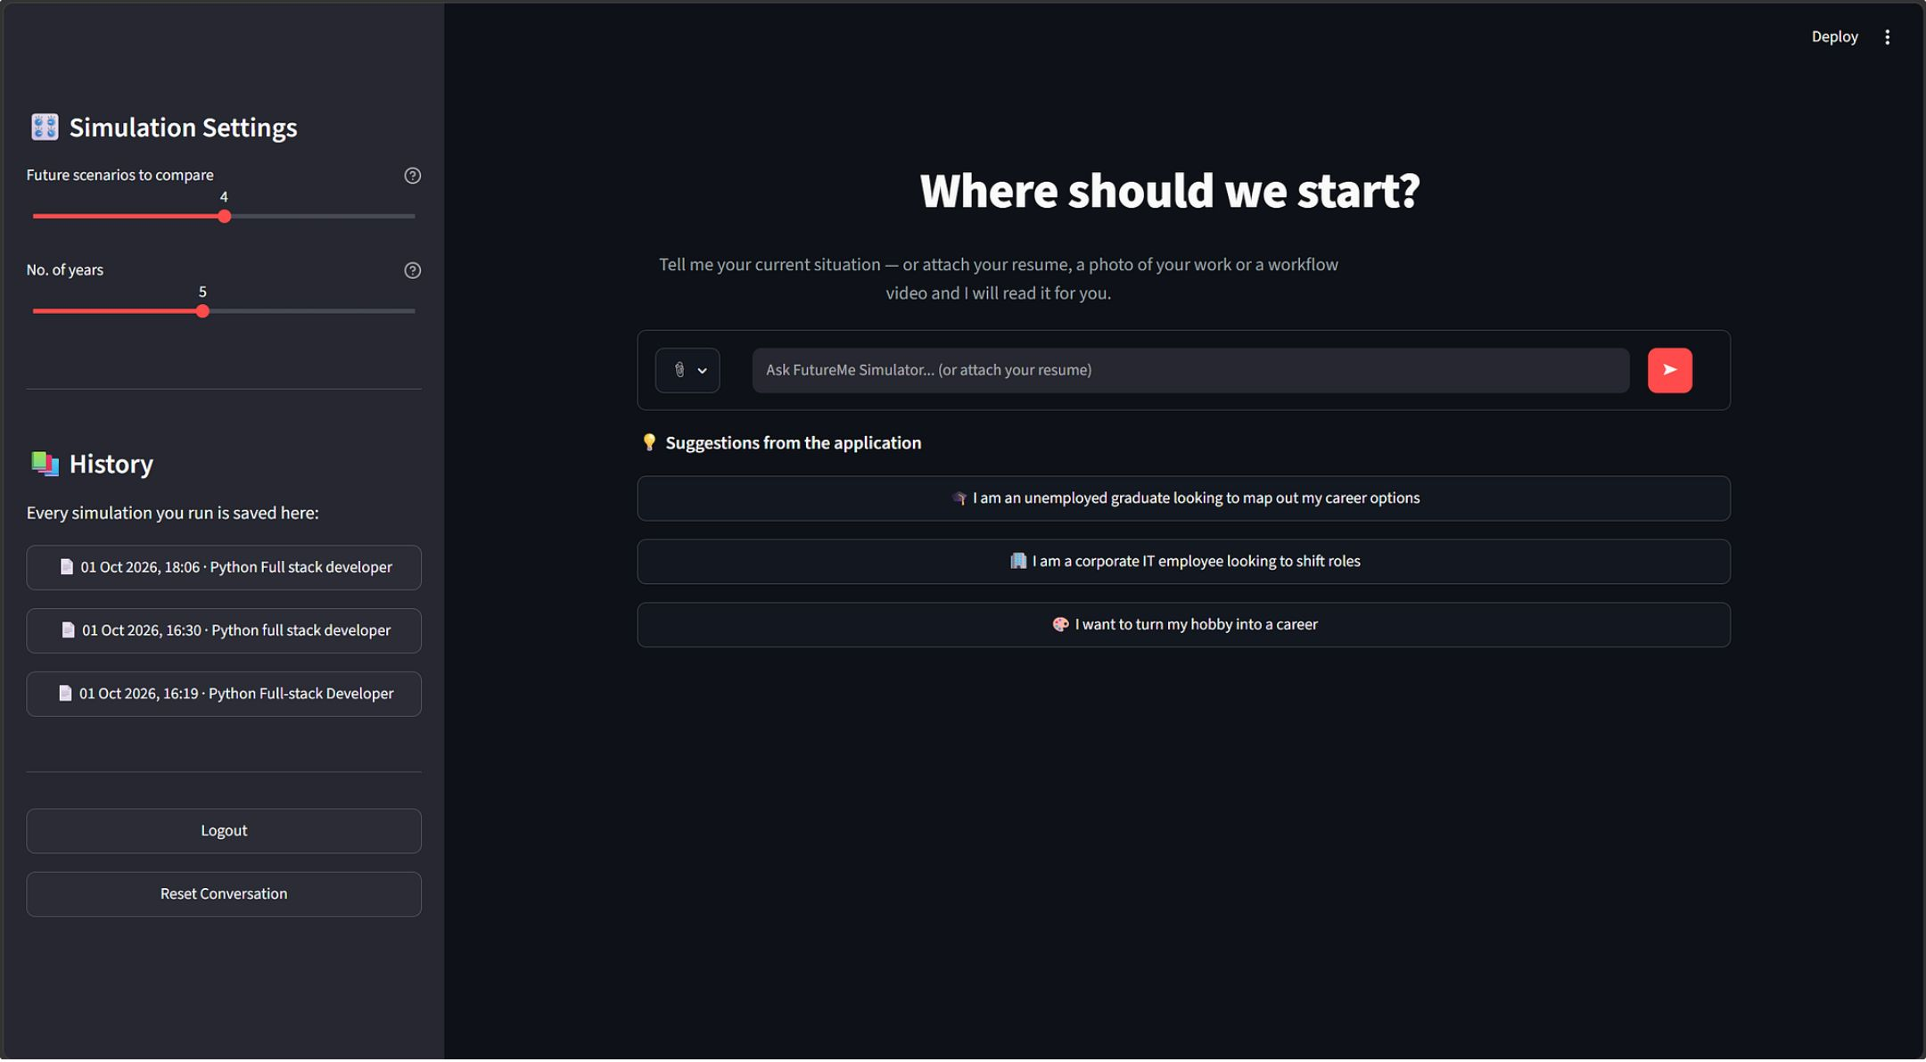

One chat starts the whole simulation
Describe your situation, or pick a suggestion
Unemployed graduate, corporate role shift, or hobby to career
Sidebar sliders set 2-6 scenarios and 1-10 years

Slide 6
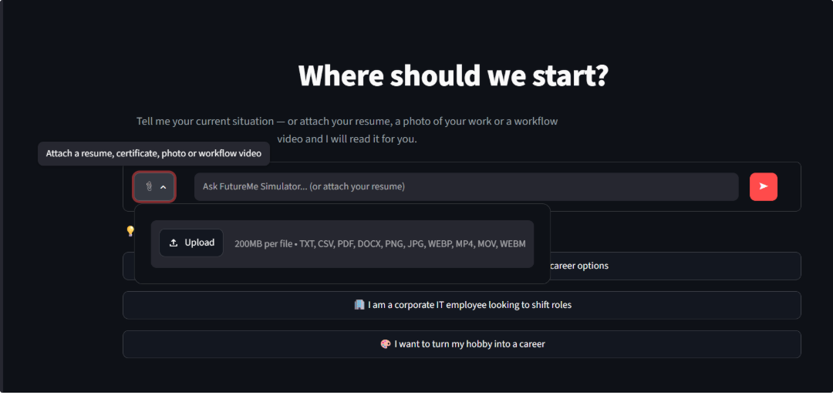
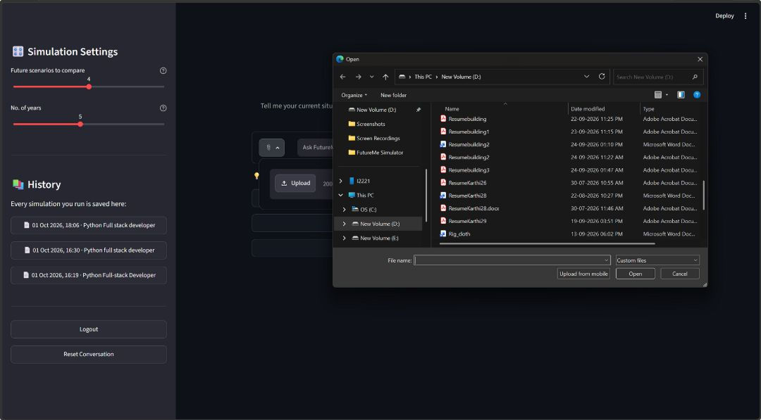
Attach a resume, photo or video and Gemini reads it
Uploads accept TXT, CSV, PDF, DOCX, PNG, JPG, WEBP, MP4, MOV and WEBM.
Gemini extracts the profile and the chat asks only for what is still missing.

Slide 7
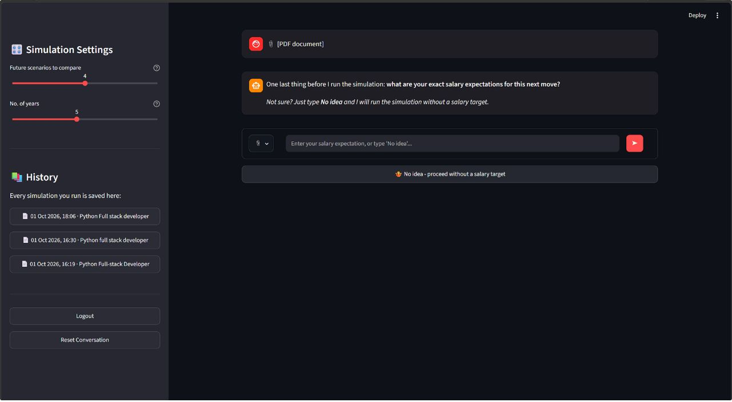
The chat is a guided state machine
01
02
03
04
05
Intake
Details
Hobby check
Salary
Report
Optional
Typing "No idea" for salary is fine. The model falls back to market ranges in INR.

Slide 8
Gemini generates branching scenarios
A lighter model parses intake and a larger one writes the report.
Your profile
Scenario 1 to 6
Chosen horizon: 1-10 years
Role
Risk level
Salary and savings
Benefits and trade-offs
Every scenario is forced onto the chosen horizon.

Slide 9
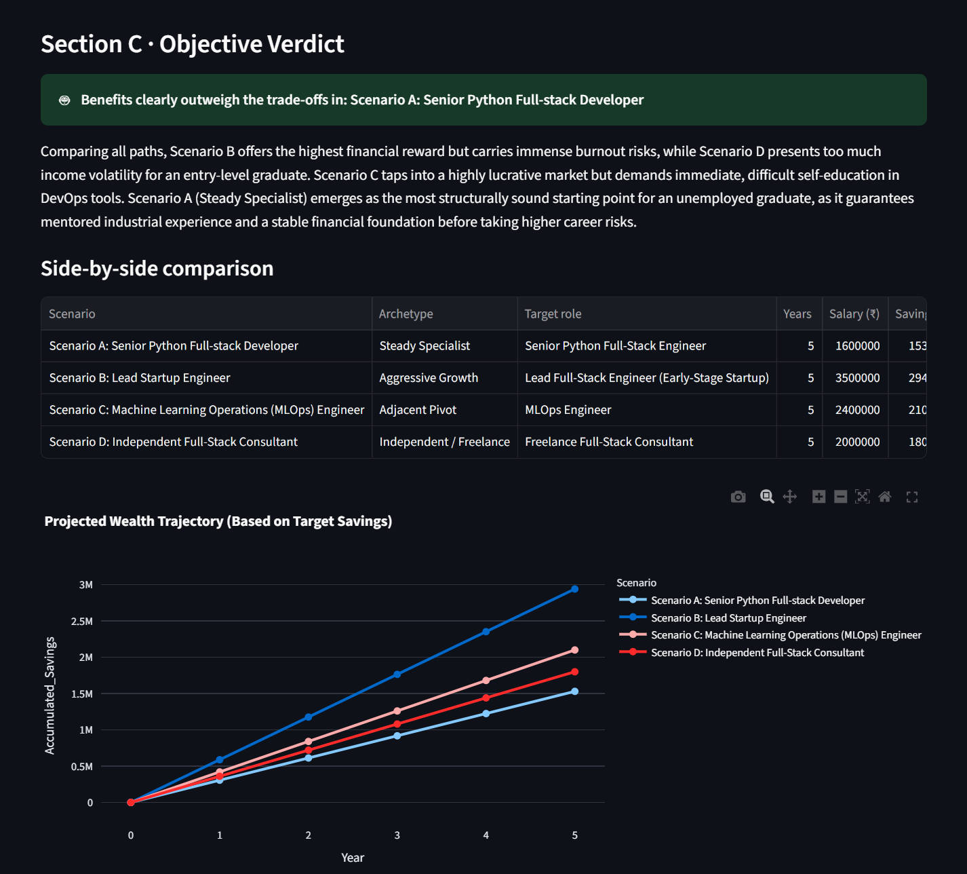
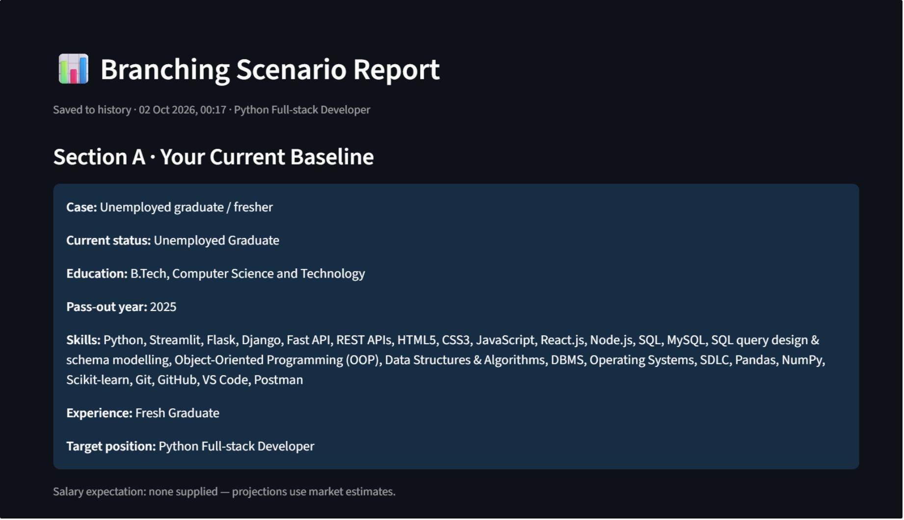
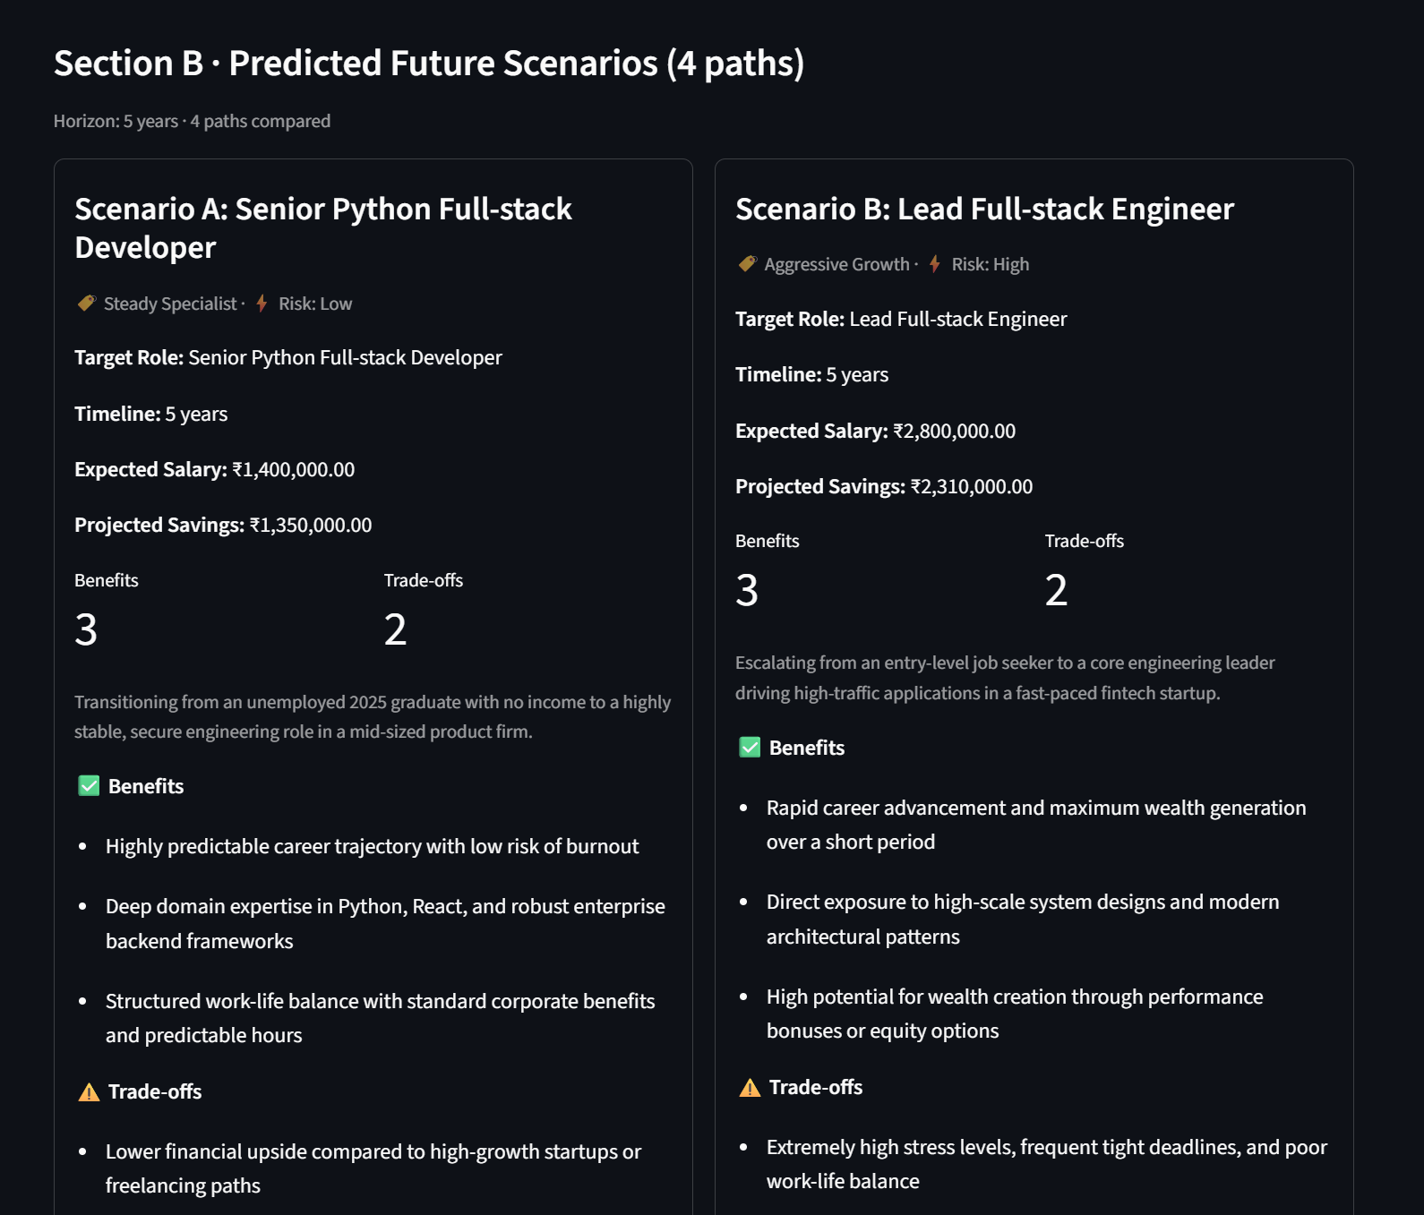
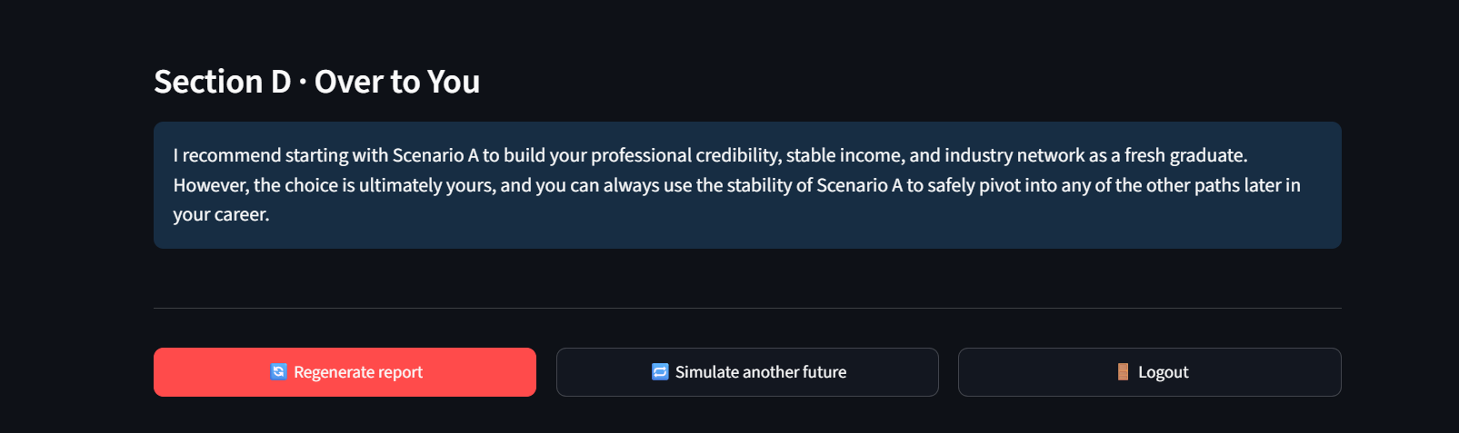
A report you can decide from
Baseline profile
Scenario cards
Comparison table
Wealth-growth line chart
Verdict: a recommended path and a decision note

Slide 10






MySQL remembers every simulation
users
profiles
reports
scenarios
Accounts
Belong to a user
One per run
Belong to a report
Each run saves in one transaction
History reloads at login and reopens from the sidebar

