Slide 1
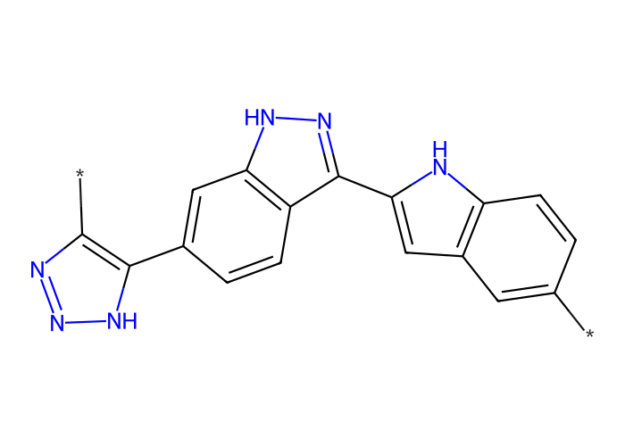




Scaffold
MW Min 509.58, MW Max 713.87, MW Avg 601.80

Slide 2
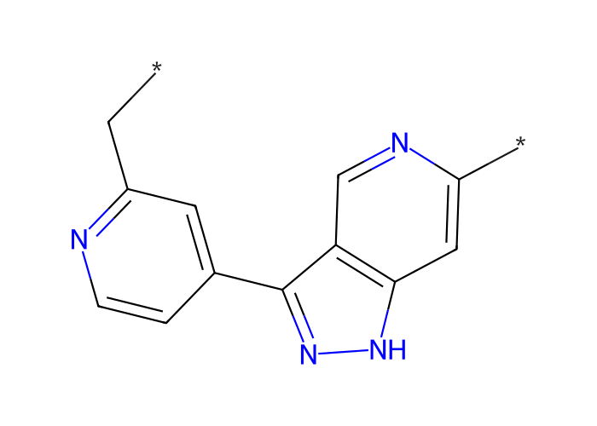




Scaffold
MW Min 505.59, MW Max 742.89, MW Avg 606.01

Slide 3
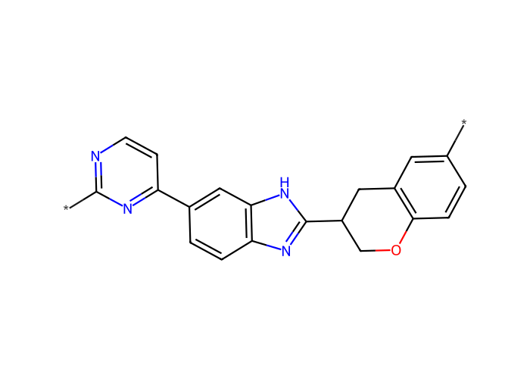




Scaffold
MW Min 499.58, MW Max 703.80, MW Avg 577.82

Slide 4
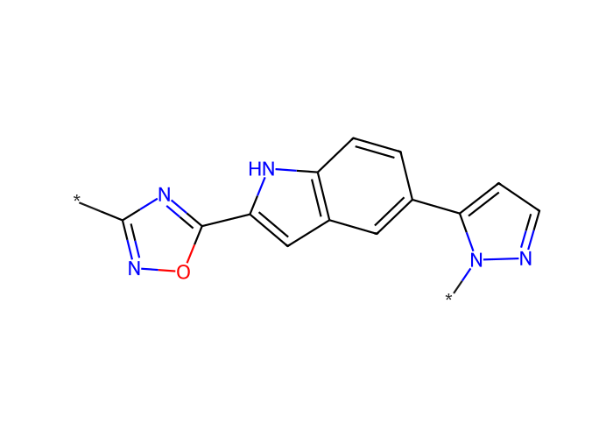




Scaffold
MW Min 560.06, MW Max 797.35, MW Avg 625.64

