Slide 1

VELALAR COLLEGE OF ENGINEERING AND TECHNOLOGY (Autonomous) (Approved by AICTE, New Delhi & Affiliated to Anna University, Chennai) Accredited by NAAC with 'A+' Grade Department of Electronics and Communication Engineering
SEMESTER VIVA-VOCE
SMART HELMET USING ESP-NOW
TEAM MEMBERS
KAVIPRIYA B (21ECR072)
MICHAEL RICHARD D (21ECR095)
MUKESH P (21ECR108)
NANDHAKISHORE K (21ECR110)
SUPERVISOR
Ms. C.SANTHINI M.E.,
ASSISTANT PROFESSOR/ECE
2021-25 / 2024-25 / 21EC6B//VIVA-VOCE/20.05.2024 / Page 1 of 20

Slide 2
AREA / DOMAIN
EMBEDDED INTERNET OF THINGS.

Slide 3
OBJECTIVE
To reduce the risk of accidents by using a smart helmet with ESP-NOW protocol which ensures driving safer than before.

Slide 4
LITERATURE SURVEY
Author (Year) | Title | Name of the journal | Key Features
S.Johnpaul, C.Thirumalaiselvan, P.J.Raguraman (2022) | IOT based Smart Helmet System for Accident Prevention | Institute of Electrical and Electronics Engineers(IEEE) | The project's main goal is to build a practical helmet that can prevent accidents without the use of a helmet and detect alcohol. The bike can only be started if there are no signs of intoxication and a helmet is worn. Sensor operations are used to construct the system.
7

Slide 5
Author (Year) | Title | Name of the journal | Key Features
Mr. Vivek A, Mr. Akash Mishra, Mr. Rana Hiten, Mr. Kautik Prajapati (2017) | Smart Helmet | International Research Journal of Engineering and Technology (IRJET) | The helmet is designed to improve rider safety by ensuring that the helmet is worn correctly and the bike only starts if the helmet is worn.The helmet integrates GPS and GSM modules for location tracking and emergency communication.
4

Slide 6
Author (Year) | Title | Name of the journal | Key Features
Deekshitha K, Pushpalatha S, (2017) | Implementation of smart helmet. | International Research Journal of Engineering and Technology (IRJET) | It incorporates a crash detection system that sends emergency alerts, an alcohol sensor to prevent intoxicated riding, and a GPS module for real-time tracking and location sharing. Helmet ensures the bike starts only when the helmet is worn properly or not. These features aim to reduce accidents and improve safety for motorcyclists.
5

Slide 7
Author (Year) | Title | Name of the journal | Key Features
Pranav Pathak (2020) | IoT based Smart helmet with motorbike unit for enhanced safety | International Conference on Advances in Computing, Communication Control and Networking(ICACCCN) | Sensors detect accidents and send alerts to emergency contacts. Prevents the bike from starting if alcohol is detected in the rider's breath.Ensures the bike starts only if the helmet is properly worn.It also Enables communication between the helmet and the motorbike unit for enhanced functionality
6

Slide 8
Author (Year) | Title | Name of the journal | Key Features
J Joy Mathavan, V K D Wijesekara , N Satheeskanth. (2022) | Smart helmet to start the motorbike and to prevent accidents. | International Conference on Materials Science and Manufacturing Technology ICMSMT-2022 | Ensures the motorbike starts only if the helmet is properly worn.Sensors detect accidents and automatically notify emergency contacts. Prevents the bike from starting if alcohol is detected on the rider's breath.Facilitates communication for emergency alerts and tracking.
8

Slide 9
PROPOSED SYSTEM
As per Motor Vehicles Act, 1988, every single person riding a two-wheeler is required to wear protective headgear following standards of BIS but riders disobey those laws, to avoid this our smart helmet project is used.
The first step is to identify whether the helmet is worn or not. If the helmet is worn then ignition will start otherwise it remains off.
ESP-NOW is a wireless communication protocol which act as transceiver that plays an interface between bike and helmet and it consumes low power

Slide 10
BLOCK DIAGRAM-TRANSMITER(HELMET) & RECEIVER(BIKE)
POWER SUPPLY
POWER SUPPLY
MOMENTARY SWITCH
ESP--8266
ESP-8266
RELAY MODULE
IGNITION SET
2021-25 / 2024-25 / 21EC6B / VIVA-VOCE/ 20.05.2024 / Page 10 of 20

Slide 11
WORKING:
ESP-NOW:
ESP-NOW is a connectionless communication protocol for ESP8266 and ESP32 devices, enabling low-power, low-latency wireless data exchange.
Device Pairing:
When the transmitter module wants to communicate with a specific receiver module, it includes the MAC address of that receiver module in the data packet it sends out. This ensures that the data packet is only received by the intended recipient
2021-25 / 2024-25 / 21EC6B / VIVA-VOCE/ 20.05.2024 / Page 11of 20

Slide 12
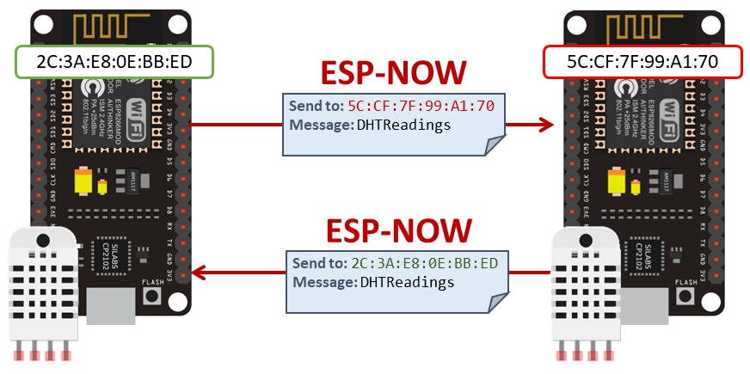
ESP-COMMUNICATION:
2021-25 / 2024-25 / 21EC6B / VIVA-VOCE/ 20.05.2024 / Page 12 of 20

Slide 13
Data Transmission
It supports sending small packets (up to 250 bytes) directly between peers, with encryption options available for secure communication.
Low Power
Optimized for low power consumption, making it suitable for battery-powered applications and IOT devices.
Mesh Networking
Supports simple mesh networking, allowing multiple devices to relay messages across a network.
2021-25 / 2024-25 / 21EC6B / VIVA-VOCE/ 20.05.2024 / Page 13 of 20

Slide 14
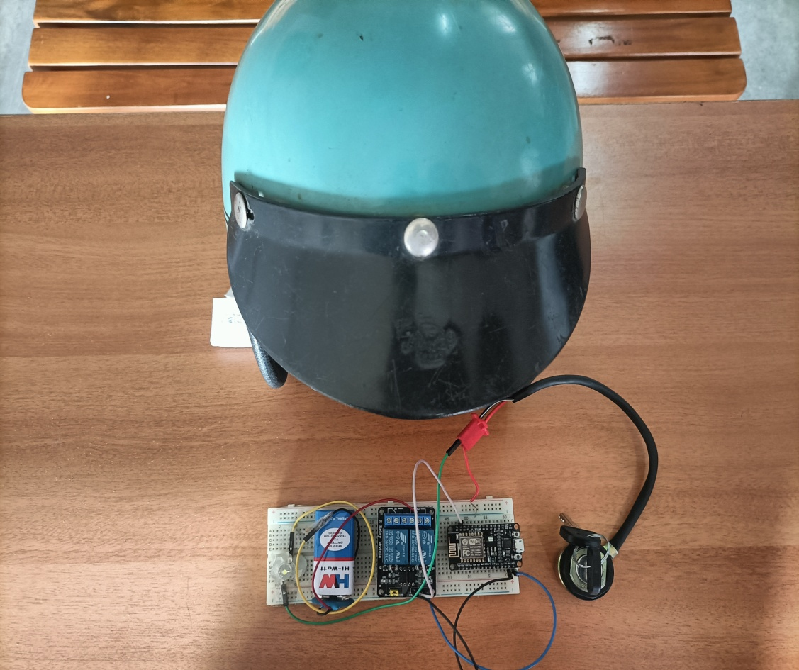
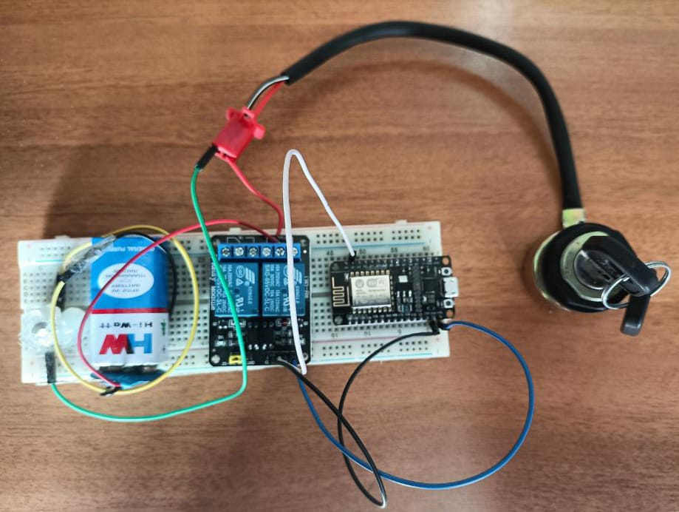
HARDWARE MODULE:
2021-25 / 2024-25 / 21EC6B / VIVA-VOCE/ 20.05.2024 / Page 14 of 20

Slide 15
ADVANTAGES
Low power consumption
Fast and reliable communication
Peer-to-peer connectivity
Reduced latency
Simplicity and cost-effectiveness
APPLICATIONS
It can implement whole circuit into small VLSI chip that can be embedded into the helmet and bike unit
It will reduce the probability of accidents

Slide 16
CONCLUSION
The development of a smart helmet utilizing the ESP-NOW protocol represents a significant advancement in motorcycle safety and security.
By integrating an ESP8266 board into the helmet, we have successfully implemented a system where the motorcycle only starts when the rider is wearing the helmet.It enhances the overall safety of the rider.
This innovative approach ensures that riders prioritize their safety by wearing a helmet before operating the motorcycle, thereby reducing the risk of accidents and potential injuries.Overall, the implementation of the smart helmet using the ESP-NOW protocol underscores the significance of innovation in the realm of motorcycle safety.
2021-25 / 2024-25 / 21EC6B / VIVA-VOCE / 20.05.2024 / Page 16 of 20

Slide 17
FUTURE SCOPE
Future scope for the smart helmet project includes exploring advanced communication protocols like Bluetooth Low Energy and LoRa, integrating additional sensors for enhanced safety features, developing a companion mobile application for added functionality, implementing cloud connectivity for remote monitoring and management, collaborating with motorcycle manufacturers for widespread adoption, optimizing power efficiency for prolonged usage, incorporating machine learning algorithms for intelligent analysis of rider behavior, exploring augmented reality (AR) integration for heads-up display (HUD) features, conducting rigorous testing for reliability and durability, integrating voice control for hands-free operation, exploring the potential for blockchain technology in ensuring data security and authenticity, and continuously updating the system to adapt to evolving safety standards and technological advancements.
2021-25 / 2024-25 / 21EC6B / VIVA-VOCE / 20.05.2024 / Page 17 of 20

Slide 18
REFERENCES
1. Abhinav Anand, "Alcoholic detection", Department of Electronics and Telecommunications, International Journal of Electrical and Electronic Engineering & Telecommunication (IJEETC),2020.
2. Deekshitha K J, Pushpalatha S2, Implementation of "Smart Helmet", International Research Journal of Engineering and Technology (IRJET),2017.
3. Dhaka, “IoT Based Smart Helmet and Accident Identification System", IEEE Region 10 Symposium (TENSYMP), Bangladesh,2020.
4. Jeneetha Jebanazer,"Smart helmet for accident prevention and detection", International Research Journal of Engineering and Technology (IRJET),2021.
5. J Joy mathavan,V K dijesekara, N Satheeskanth,"Smart helmet to start the motorbike and to prevent accidents", International Conference on Materials Science and Manufacturing Technology(ICMSMT),2022.
6. M. Jeong, H. Lee, M. Bae, D. Shin, S. Lim and K. B. Lee, "Development and Application of the Smart Helmet for Disaster and Safety," International Conference on Information and Communication Technology Convergence (ICTC),2018.

Slide 19
REFERENCES
7. N. Nataraja, K. S. Mamatha, Keshavamurthy and Shivashankar, "SMART HELMET," 3rd IEEE International Conference on Recent Trends in Electronics, Information & Communication Technology (RTEICT), Bangalore,2018.
8. N. Manjesh., Sudarshan Raj, "Smart Helmet using GSM & GPS Technology for Accident detection and Reporting System", International Journal of Electrical and Electronics Research (IJEER),2014.
9. N. V. Joshi, S. P. Joshi, M. S. Jojare, N. S. Joshi and A. R. Askhedkar, "Design and Finite Element Analysis of IoT based Smart Helmet," IEEE International IOT, Electronics and Mechatronics Conference (IEMTRONICS),2020. 40
10. Pranav pathak,"Iot based smart helmet with motorbike unit for enhanced safety"2nd International Conference on Advances in Computing, Communication Control and Networking (ICACCCCN),2020.
11. R. Budiman, D. W. Sudiharto and T. Brotoharsono, "The Prototype of Smart Helmet with Safety Riding Sends Notification for Motorcycle Rider," 3rd International Conference on Information Technology, Information System and Electrical Engineering, Computer Engineering(ICITISEE), Yogyakarta, Indonesia,2018.
12. S. A. Shabbeer and M. Meleet, "Smart Helmet for Accident Detection and Notification", 2nd International Conference on Computational Systems and Information Technology for Sustainable Solution (CSITSS), Bangalore,2017.
13. Mr. Vivek A. Patel, Mr. Akash Mishra, Mr. RanaHiten, Mr. Kautik Prajapati, "Smart Helmet", International Journal of Research in Engineering and Technology (IRJET),2017
2021-25 / 2024-25 / 21EC6B / VIVA-VOCE / 20.05.2024 / Page 19 of 20

Slide 20
THANK YOU
2021-25 / 2024-25 / 21EC6B / VIVA-VOCE / 20.05.2024 / / Page 20of 20

