Slide 1
2021 Kaggle Machine Learning &
Data Science Survey
-Vishnu Vardhan Darimidi
-Bharath Kumar Gompa
-Tharun Abhinav Suraneni
-Koosha Sharifani

Slide 2
Data Description
The dataset contains a complete industry-wide survey that represents information about job seekers, including the age, level of their education, skill sets, carrier, and origin. It has around 10,000 rows and 369 Columns.
There are 369 columns in this dataset and these are few important columns in the dataset: Age, Gender, Country, Education level, Job role, Years of coding Experience, Programming language used most often, Computing platform used most often, Type of most data used often , Annual Compensation
The data is the responses to multiple choice questions (only a single choice can be selected) were recorded in individual columns. Responses to multiple selection questions (multiple choices can be selected) were split into multiple columns (with one column per answer choice).

Slide 3


1. Problem Statement
With the growing number of people making their way into data field it has become difficult for the companies to select the best for the job role.
To Find any patterns in the background of job applicants?
To quote a salary based on the job role and their potential?
To create a model that would give predictive analysis for the companies to select the best match for the job role.

Slide 4
Research Objectives
Analyzing the efficiency of a machine learning algorithm in forecasting job roles and selecting the algorithm that produces the most optimal results for the model.
Examine patterns and trends within the data science industry, and explore how various factors such as job roles, education, and compensation may be influencing these trends over time.
Explore the potential effects of emerging technologies and advancements in the data science industry on job roles, skills, and employment opportunities. Understand how the landscape of data science may shift in response to these changes over time.

Slide 5
Data Understanding
Exploratory Data Analysis
Several functions were created to comprehend the data during the exploratory data analysis on the Porter dataset using AWS SageMaker Notebook instances. Here is a list of the roles:
Check for duplicates: Locate any duplicate or entirely identical rows in the dataset. If identical rows are present in the dataset, it outputs a boolean value indicating that. In case there are duplicate rows, the function also shows how many of them there are.
Check For Missing Values: Determine whether the dataset has any missing values (also known as "null values") or not. It generates a binary output indicating the presence of null values. Tries to shows the percentage of missing values in each column if there are any missing values.
We have removed the rows entirely which had more than “50” Null values.
We have used some visualizations to understand the trends in the data and to have a much clear view on the data itself. below

Slide 6
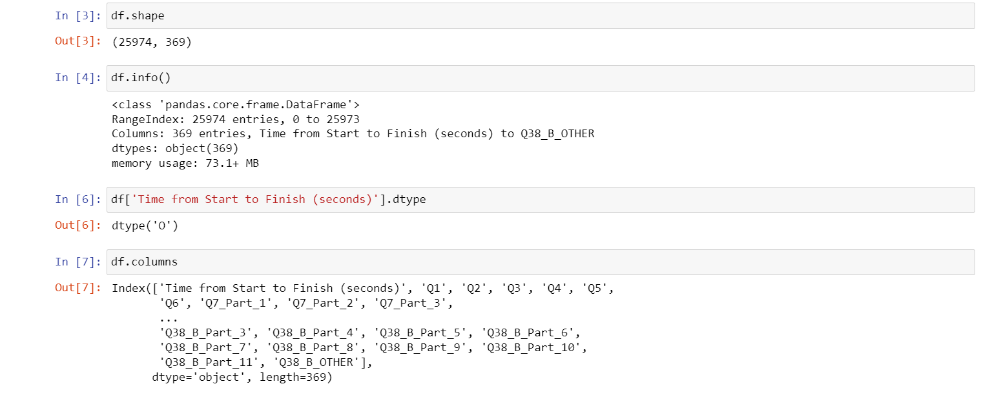
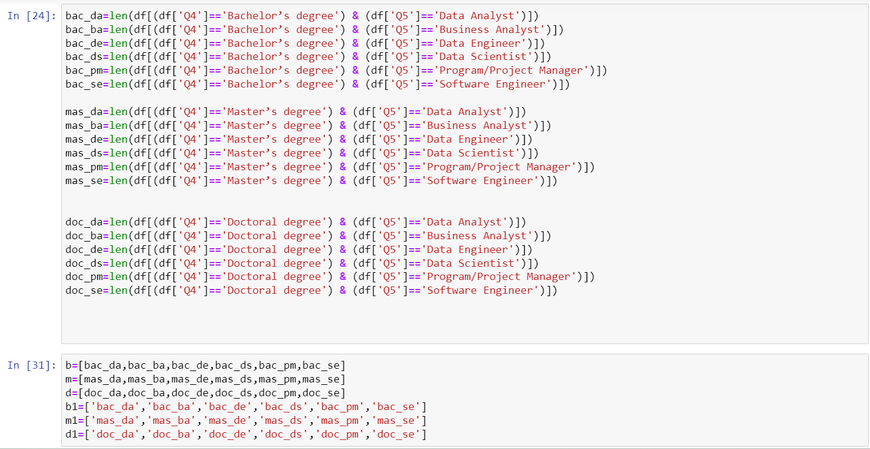

Slide 7
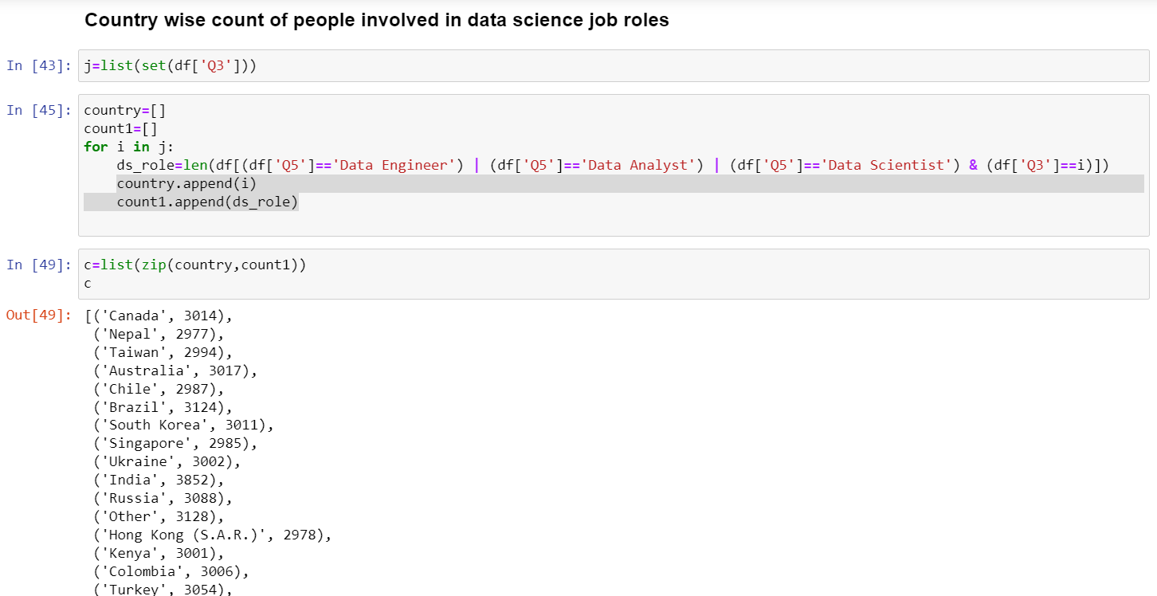
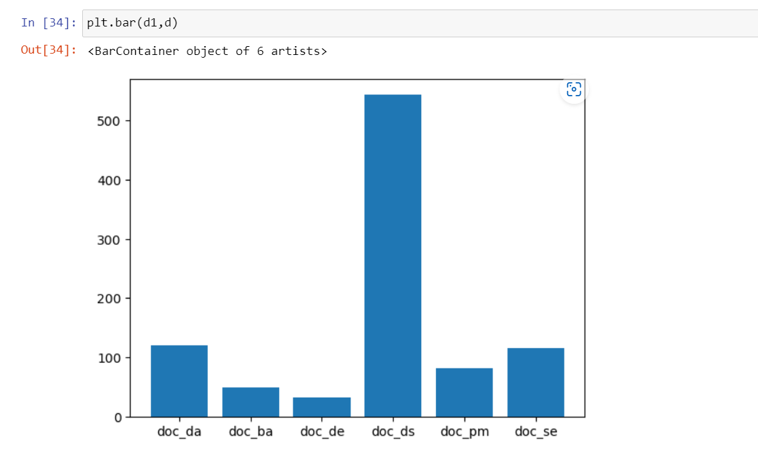
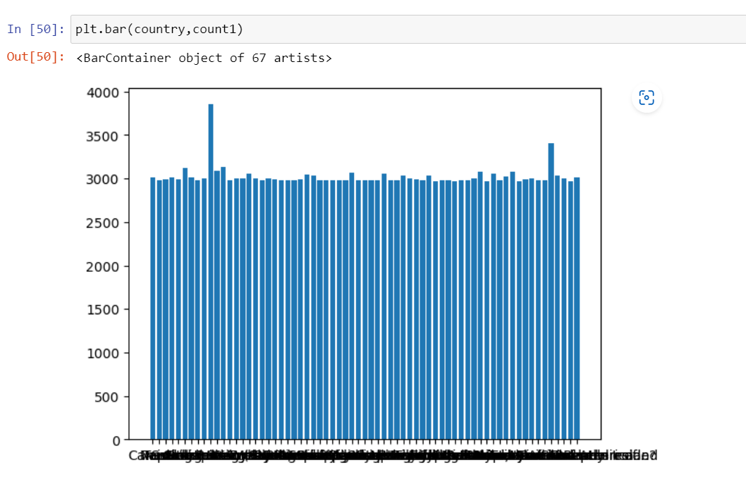

Slide 8
Data Preparation
The code provided reads a CSV file and uses libraries called Pandas and NumPy to analyze the data.
It shows the number of rows and columns in the data and displays details like the type of data and the unique categories in the dataset.
This helps us find patterns, trends, and unusual data in the dataset, which can help us make better decisions based on the data.

Slide 9
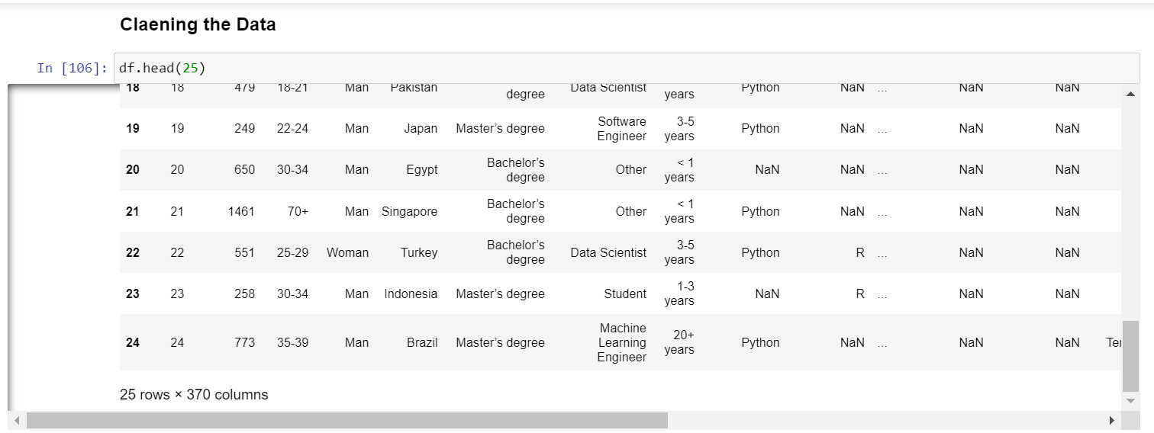
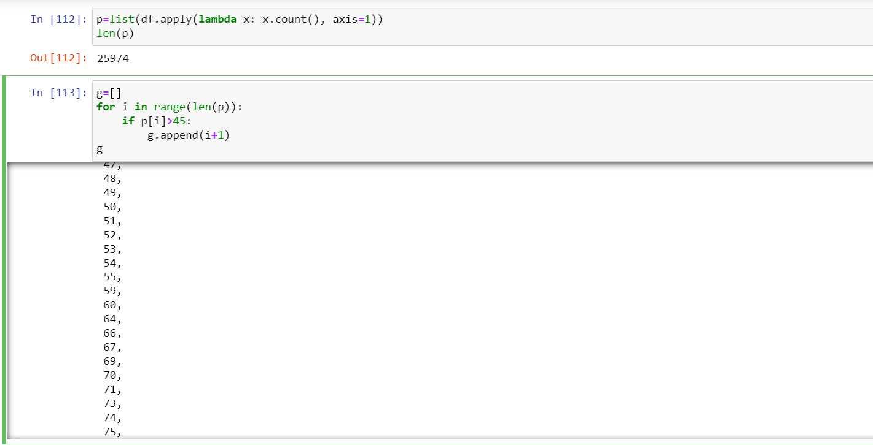
2. Data Preparation
Cleaning the data

Slide 10
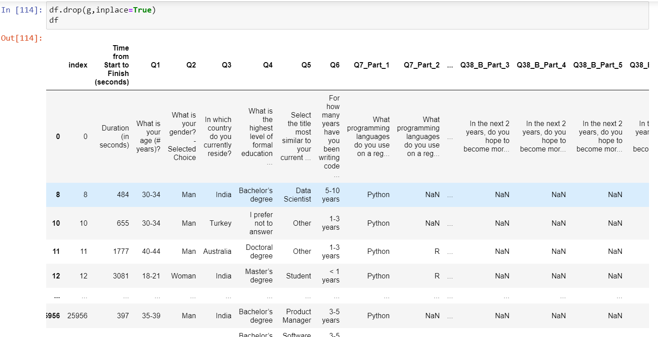
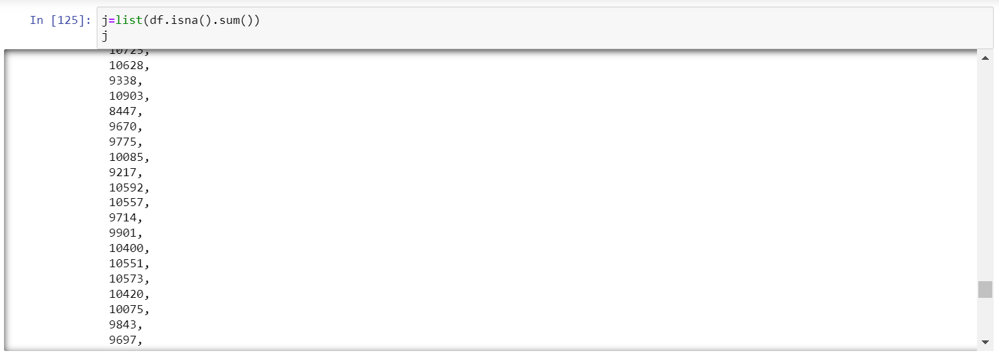
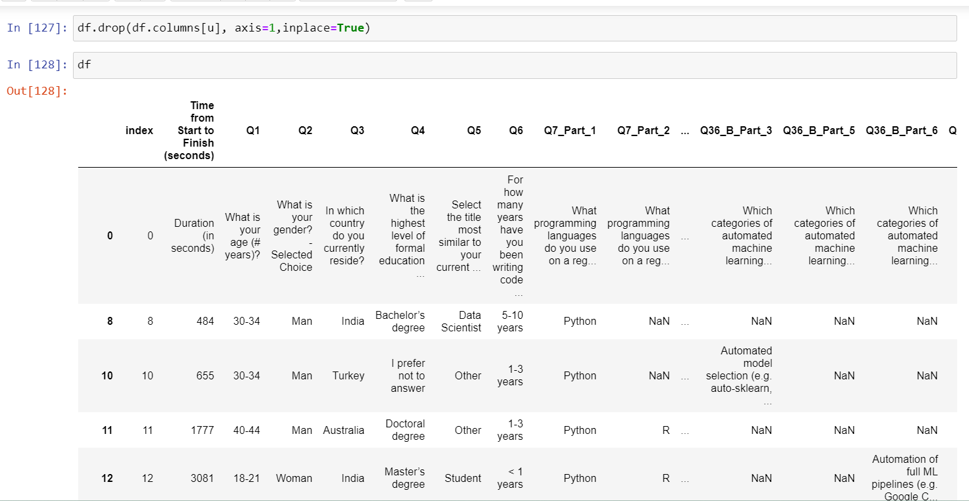
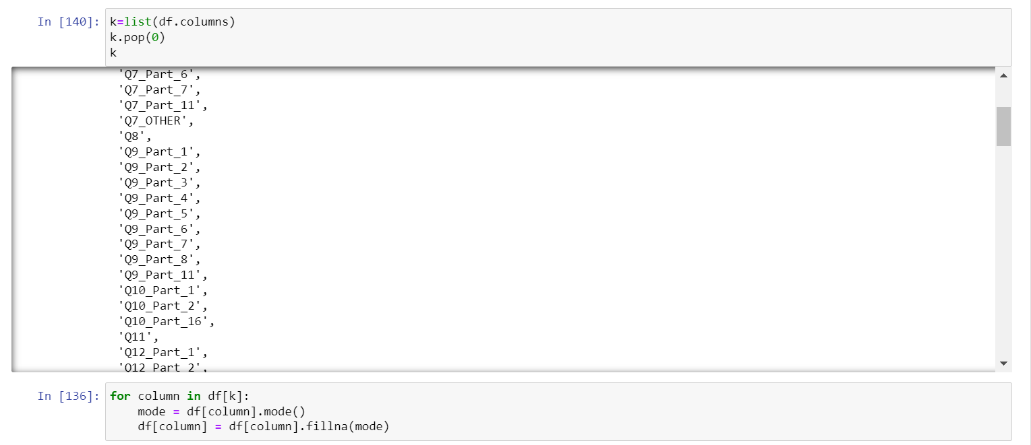

Slide 11
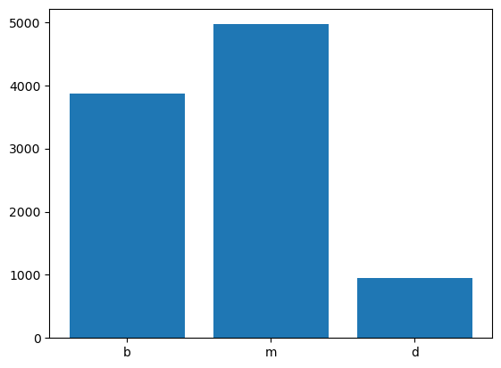
Data Visualizations
This chart displays the overall count of individuals working in the field of data science categorized by their educational degree.

Slide 12
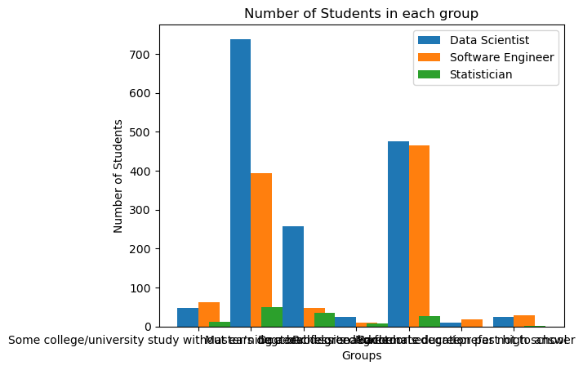
Data Visualizations
This represents the number of individuals in various job positions based on their educational degree.

Slide 13
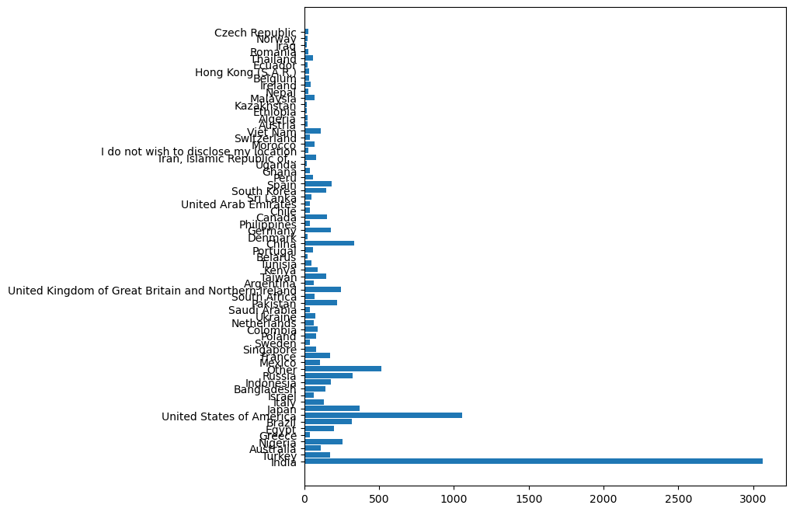
Data Visualizations
The graph displays the mean level of experience for individuals belonging to a specific country.

Slide 14
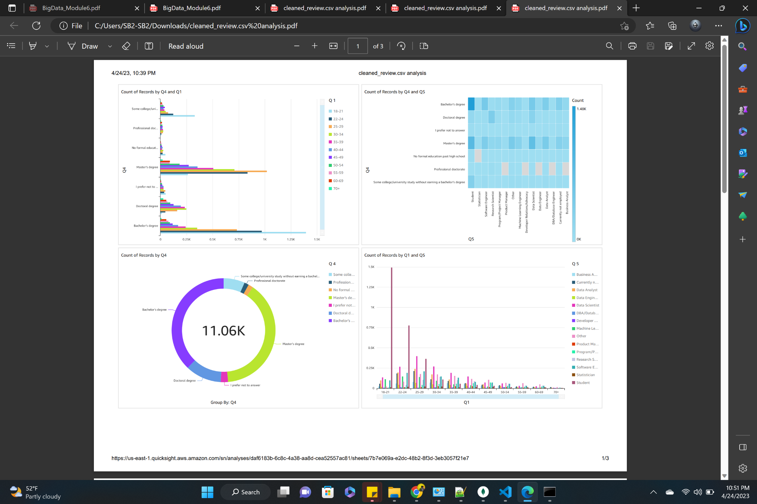
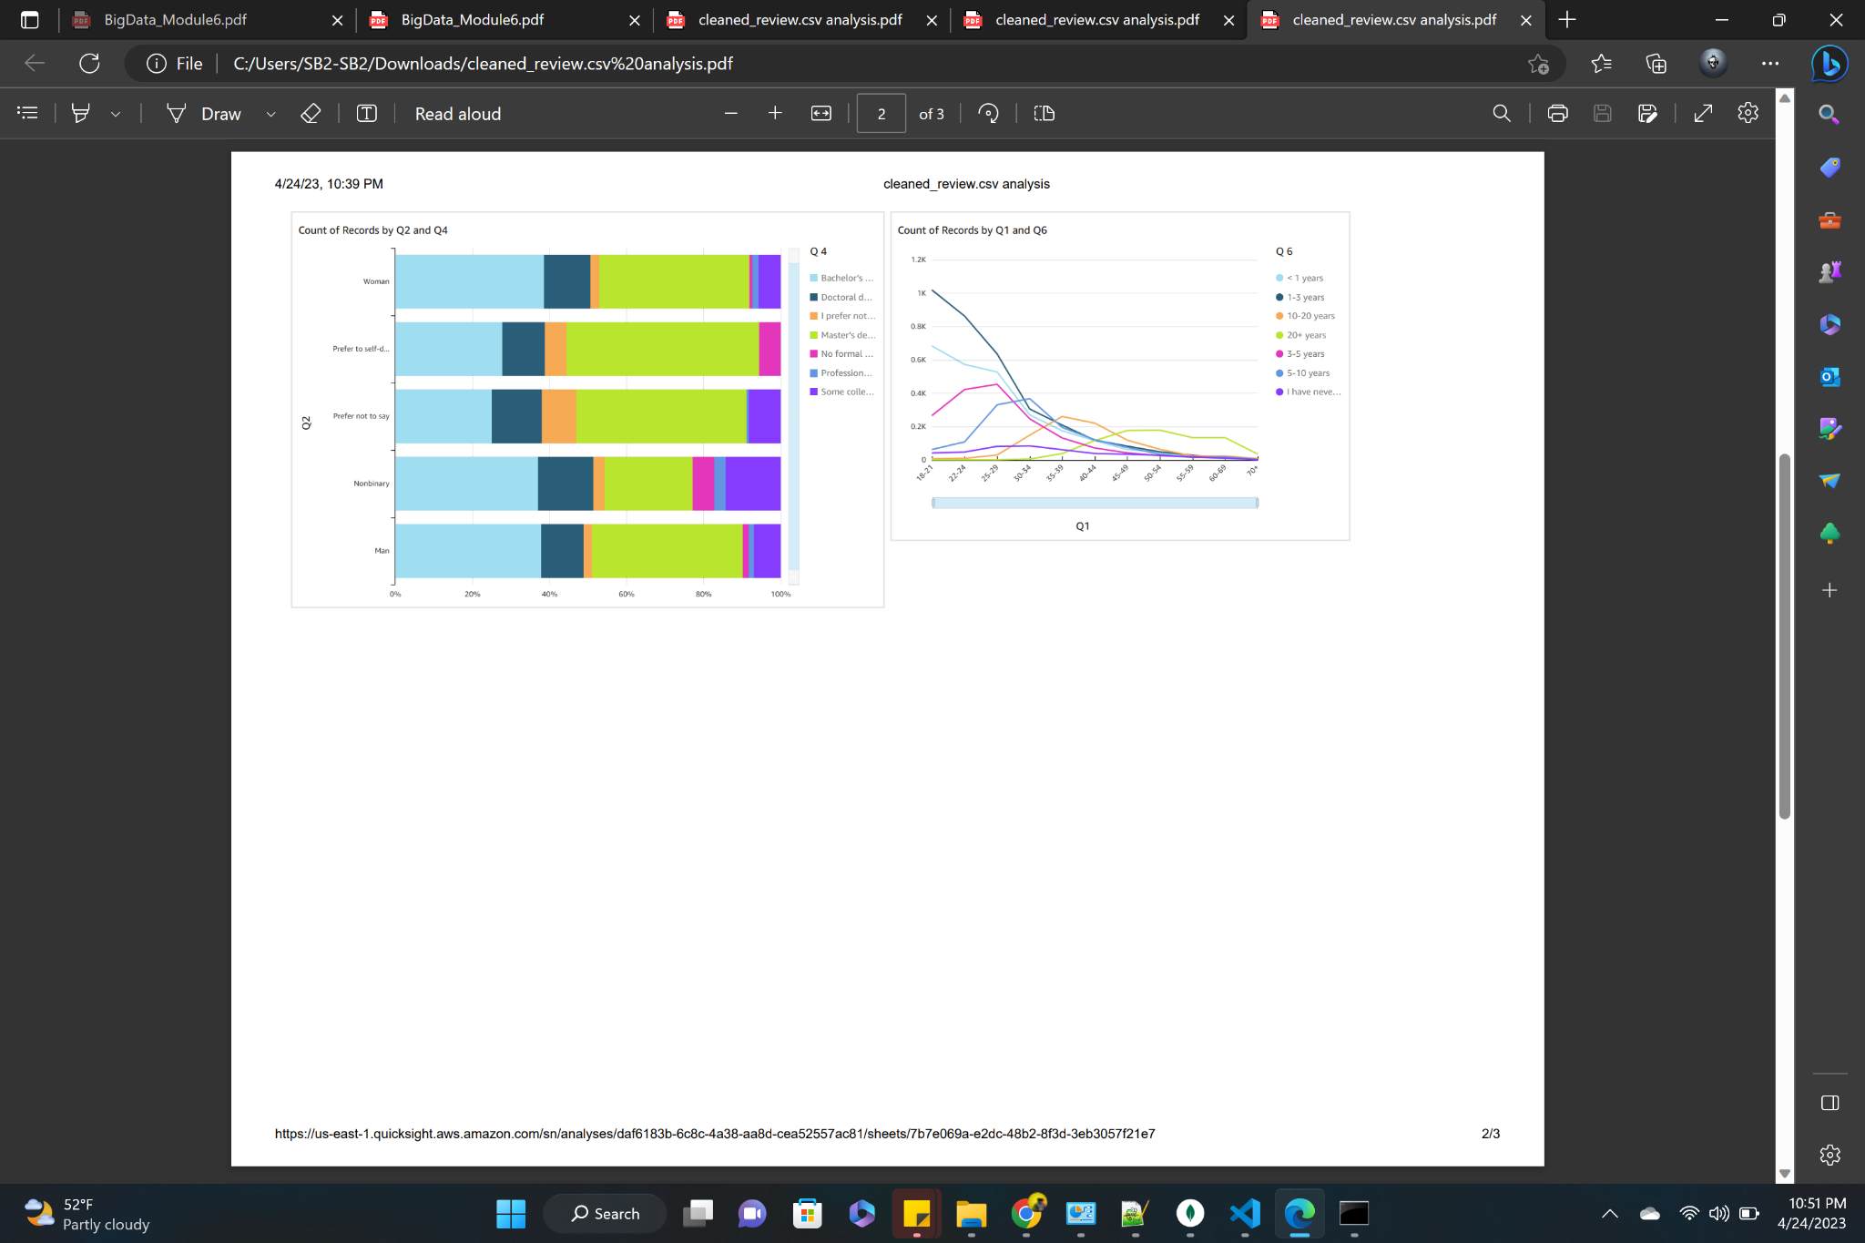
Quick Sight Dashboard

Slide 15
Analytics and Machine Learning
We employed a classification technique to categorize the output column and, therefore, did not take outliers into account as they were deemed irrelevant.
The dataset was split into training and testing sets with 60% and 40% of the data, respectively, to create two models for predicting job roles using random forest classification algorithm.
Standard metrics such as accuracy and confusion matrix were used to evaluate the performance of these models.
The random forest classification algorithm. had an accuracy score of 0.5495.
The statistical approaches utilized by these machine learning algorithms enable them to generate predictions based on the patterns and correlations they uncover within the data.

Slide 16
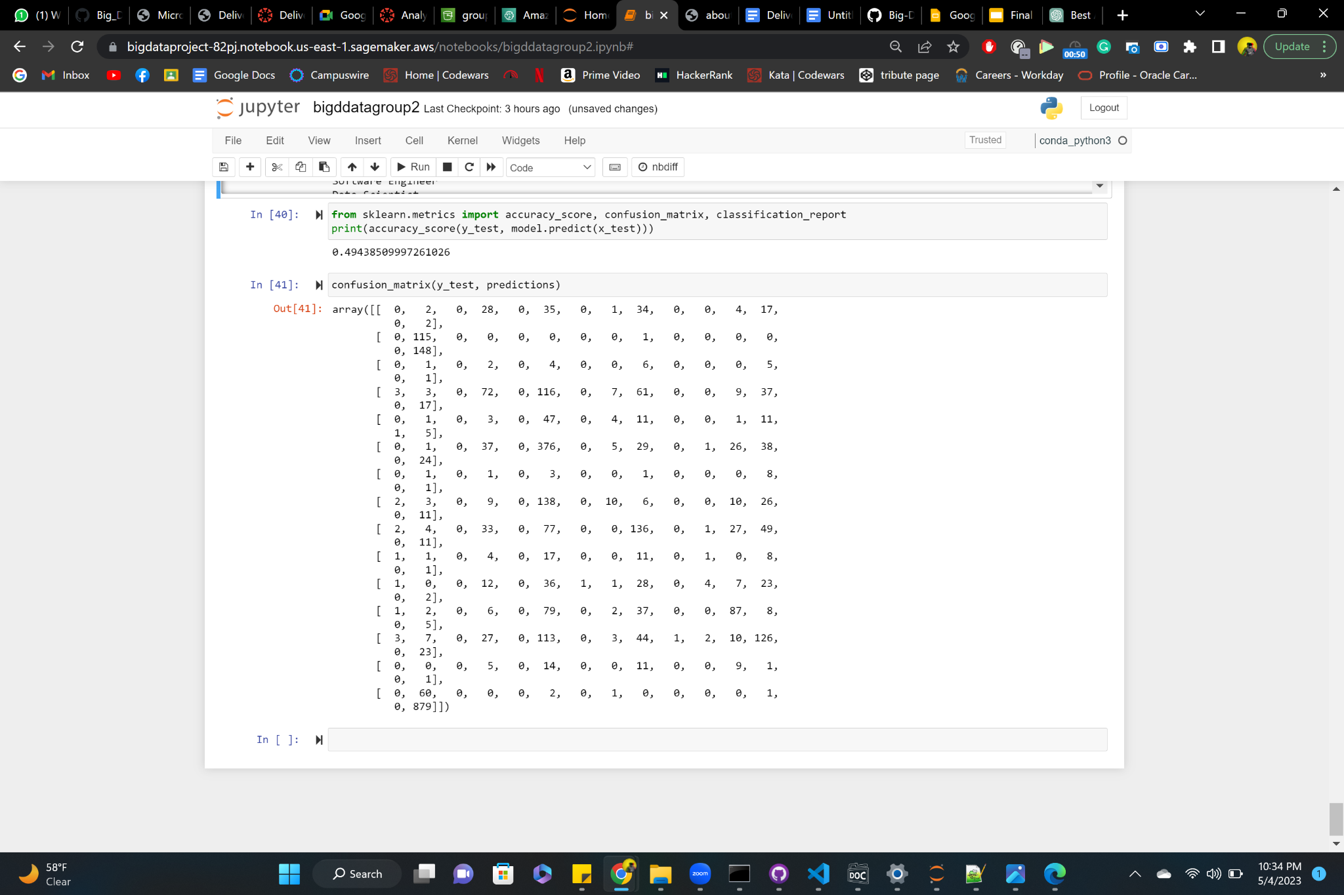
Evaluation & Optimization
Accuracy scores and confusion matrix were used to evaluate the performance of the models. The accuracy metric assesses the proportion of correct predictions, while the confusion matrix summarizes the model's prediction results.
For 40% of the testing data, the model's accuracy score of 0.4943 indicates that it is not accurately identifying the cover type

Slide 17
Results
The Accuracy that we achieved through using Confusion Matrix is 0.4943 which is less yet the best that we can get out of this dataset.
The result of this predictive analysis gives you the result of a job role for which the applied person is the best fit for in the field of Data Science.

Slide 18
Future Work
The current model can be updated and the accuracy can be increased by involving much more clean data and clearing the noise from the dataset.
The predictive analysis model can be used in companies’ hiring process by deciding the role of an applicant.
Other machine learning algorithms that can work good on data with strings can be implemented to get a better accuracy.

Slide 19
Thank you.

