Slide 1


Slide 2
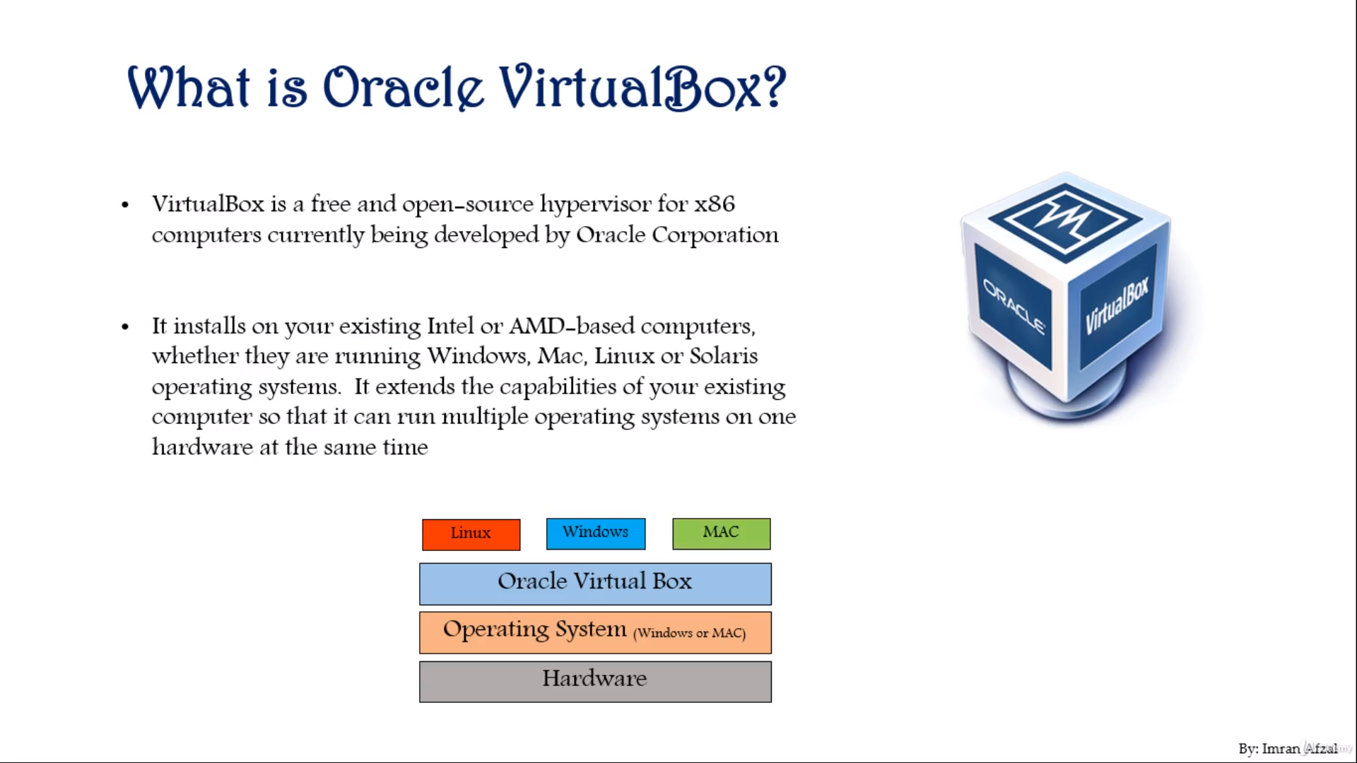

Slide 3


Slide 4
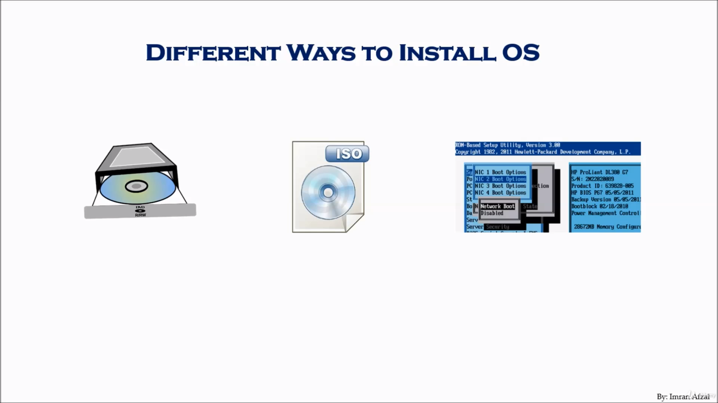

Slide 5
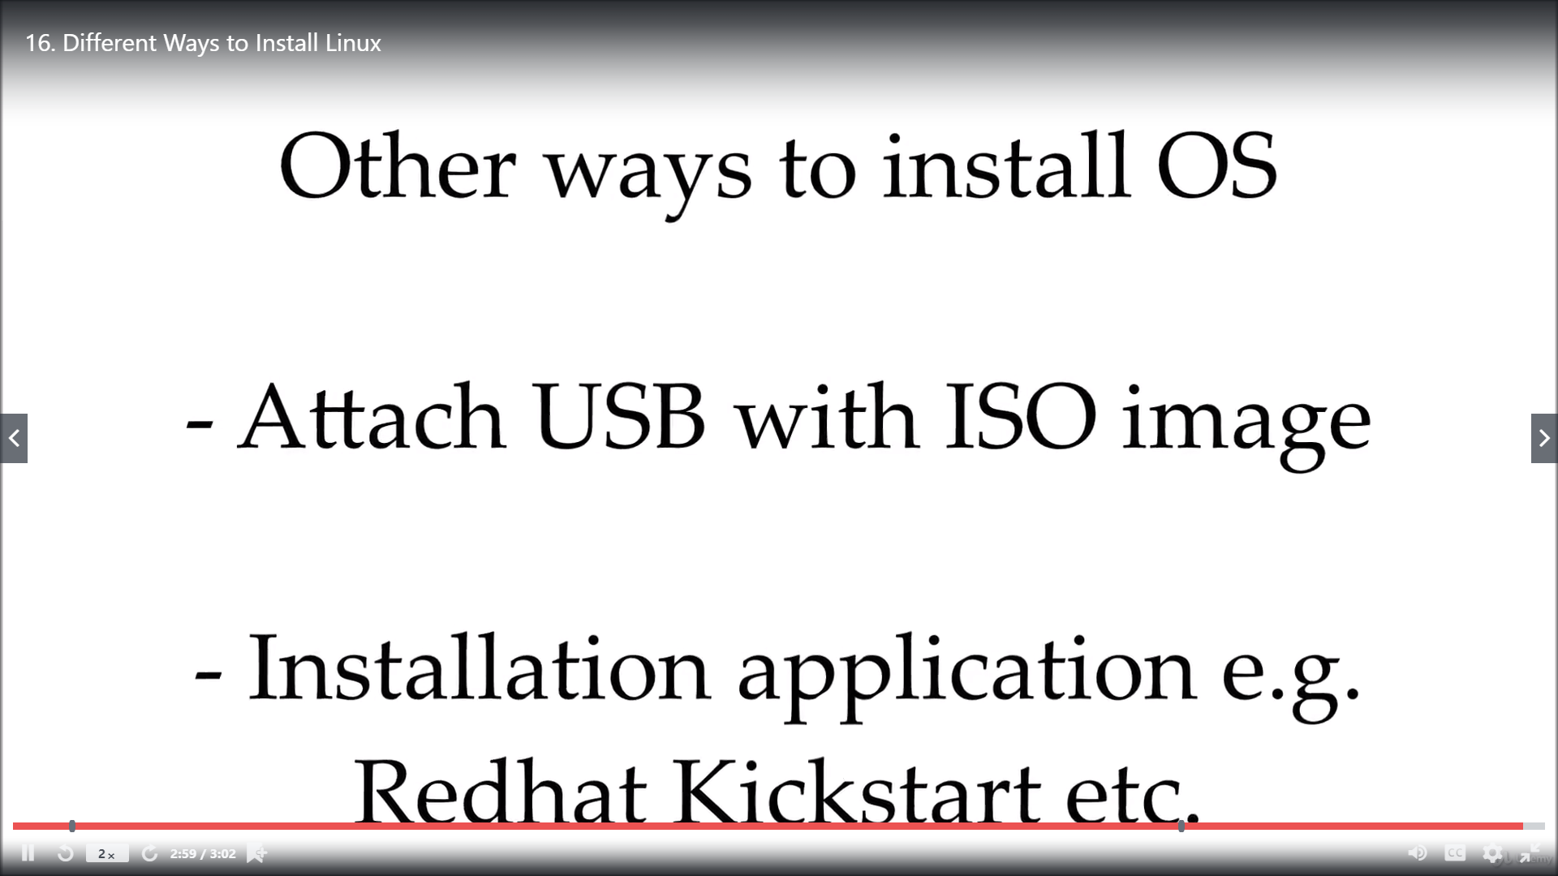

Slide 6
Download AND INSTALLATION
Download and Installation centos7 (7v Recommended).

Slide 7
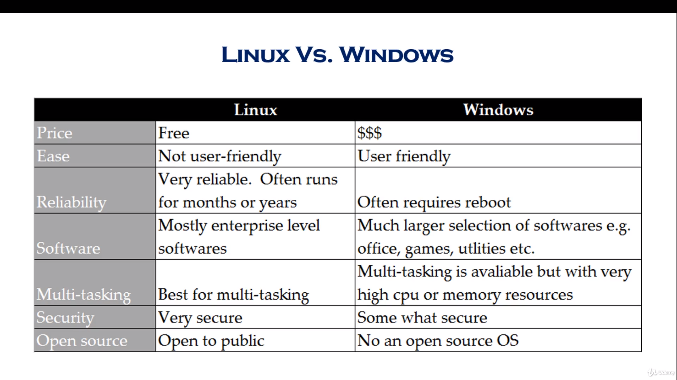

Slide 8
Linux Users
US Government and Agencies (National, State, Federal and International)
NASA
Health Care
The Bullet Trains in Japan runs at the speed of 150-215 m/h
Traffic Control
Financial Institutes e.g. NYSE
Entertainment industries (Cinemas, Production houses etc.)
World e-commerce leaders, including Amazon, eBay, PayPal, and Walmart run their platform on Linux
Other fortune 500 companies e.g. Google, IBM, McDonalds, Facebook etc.

