Slide 1
NETSHIELD AI
Project Study Guide — 12 Deep-Dive Questions & Answers
Dataset · Preprocessing · Architecture · Models · Metrics · Backend · Feedback Loop

Slide 2
Q1
The Dataset — CICIDS2017
Category | Rows
BENIGN | 2,096,484
DoS / DDoS | 321,764
Port Scanning | 90,819
Brute Force | 10,622
Botnet Activity | 1,954
Malware Traffic | 684
Data Exfiltration | 36
8 CSV files, one per capture session (Mon–Fri, some split morning/afternoon)
2,522,363 rows survive after cleaning & de-duplication
One row = one network flow (not one packet) — pre-aggregated by the dataset's own tool (CICFlowMeter)
79 raw columns per file, including a documented duplicate: “Fwd Header Length” appears twice
Raw attack labels are rolled into 6 categories + BENIGN via a fixed mapping table
Data Exfiltration: only 36 raw samples — flagged automatically as too few to trust
02

Slide 3
Q1
What Each Column Captures
Volume
Packet-size stats
Flow Duration, Total Fwd/Bwd Packets & Bytes — how big/long the flow was
Fwd/Bwd Packet Length Max/Min/Mean/Std — shape of the packet-size distribution
Rate
Inter-arrival time (IAT)
Flow/Fwd/Bwd Bytes⁄s, Packets⁄s — throughput
Mean/Std/Max/Min gaps between packets — attacks are often too regular or too rapid
TCP flags
Bulk / Subflow / Window
FIN/SYN/RST/PSH/ACK/URG/CWE/ECE counts — connection-state signals (e.g. SYN floods)
Bulk transfer stats, subflow packets/bytes, Init_Win_bytes — finer flow structure
Active/Idle
Destination Port
Burst vs. quiet periods within the flow
EXCLUDED — documented leakage feature (see Q2)
03

Slide 4
Q2
Data Cleaning — Steps 1–6
1. Column normalization — strip pandas' auto “.1” duplicate suffixes; drop repeated columns keeping the first (fixes the duplicate Fwd Header Length)
2. Label normalization — CICIDS2017 encodes the same attack name inconsistently across files (replacement chars / en-dashes vs. plain hyphens); regex-normalized to one consistent form
3. Row cleaning — drop rows with a null/empty label; tag every row with its source_file
4. Infinity handling — Flow Bytes/s and Flow Packets/s can be inf when Flow Duration = 0; every inf/-inf → NaN
5. Exact-duplicate removal — 10.9% of rows (~308,000) are byte-for-byte duplicates, a capture-tool artifact. Dropped so the same row can't land in both train and test
6. Leakage removal — Destination Port excluded: attacks in this testbed target fixed ports, letting a model “cheat” instead of learning real behaviour
04

Slide 5
Q2
Preprocessing — The Math
Imputation (median)
Standardization (z-score)
Missing value in column c → replaced with median(c)
x' = (x − μ_train) / σ_train
Fit on TRAIN rows only — median chosen for robustness to the heavy right-skew in byte/rate columns.
Every feature rescaled to mean 0, std 1, using ONLY the training set's own mean/std — the “no leakage” rule.
Split — 70% / 15% / 15%, at the WINDOW level, seed = 42
Test carved out first (test_size = 0.15); validation then taken from what's left at 0.15/(1−0.15) ≈ 17.6%, landing at the intended 15% overall
Stratified by class label where class counts allow it — keeps rare categories represented in every split
05

Slide 6
Q2
Feature Engineering
The 76 raw features are already engineered by CICFlowMeter (the dataset's own flow exporter) — not built by this project
This project's own feature engineering:
• Leakage removal (Destination Port)
• Temporal windowing — rows → (10, 76) sequence tensors (the biggest one — see Q8)
• Evaluated: Random Forest importance ranking
Random Forest Importance (evaluated, not adopted)
RandomForestClassifier(200 trees, max_depth=20, class_weight=balanced), up to 150,000 sampled training rows
Ranked by Gini importance (mean decrease in impurity)
Result: helped the Autoencoder, hurt BiLSTM precision on several classes
Not adopted as default — kept as an opt-in --top-k-features flag
06

Slide 7
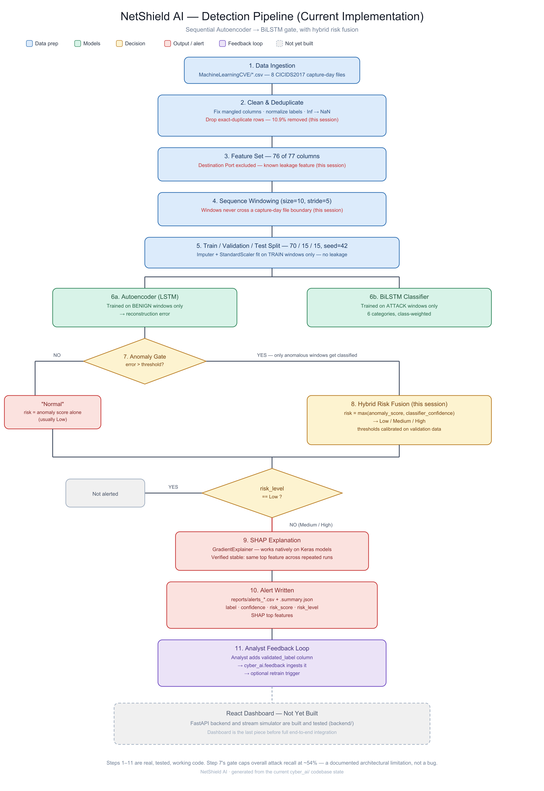
Q3
System Architecture — Step by Step
1. Ingest — CSV(s) loaded, cleaned, deduplicated
2. Feature prep — impute → scale
3. Windowing — rows → (10, 76) sequences, never crossing a file boundary
4. Autoencoder scoring — every window gets a reconstruction-error score
5. Anomaly gate — error > 0.834? No → “Normal”, done. Yes → step 6
6. BiLSTM classification — only anomalous windows reach here
7. Hybrid risk fusion — anomaly score + classifier confidence → Low/Medium/High
8. SHAP explanation — Medium/High alerts only
9. Alert written — CLI CSV, or backend → MySQL
10. Analyst feedback — human validates/corrects
11. Retrain — feedback feeds back into cyber_ai.train, closing the loop
07

Slide 8
Q4
Model 1 — Autoencoder Architecture
Layer | Output shape | Params | Role
Input | (10, 76) | 0 | raw window
encoder_lstm (LSTM 64) | (64,) | 36,096 | compress sequence → summary vector
Dropout 0.25 | (64,) | 0 | regularization
latent_behavior (Dense 32, ReLU) | (32,) | 2,080 | bottleneck — forces only essentials kept
RepeatVector(10) | (10, 32) | 0 | broadcast bottleneck to 10 steps
decoder_lstm (LSTM 64, seq) | (10, 64) | 24,832 | reconstruct a sequence
Dropout 0.25 | (10, 64) | 0 | regularization
TimeDistributed(Dense 76) | (10, 76) | 4,940 | reconstruct all 76 features/step
203,846 total params (67,948 trainable) · Loss: MSE · Optimizer: Adam (lr 0.001)
Trained ONLY on windows where every row is BENIGN — never sees an attack
08

Slide 9
Q4
Model 2 — BiLSTM Classifier Architecture
Layer | Output shape | Params | Role
Input | (10, 76) | 0 | same window shape
bilstm_context (BiLSTM 64/dir) | (10, 128) | 72,192 | reads window forward + backward
Dropout 0.25 | (10, 128) | 0 | regularization
bilstm_summary (BiLSTM 32/dir) | (64,) | 41,216 | compress to summary vector
classification_hidden (Dense 64, ReLU) | (64,) | 4,160 | learned feature combination
Dropout 0.25 | (64,) | 0 | regularization
threat_type (Dense 6, softmax) | (6,) | 390 | probability over 6 categories
353,876 total params (117,958 trainable) · Loss: sparse categorical cross-entropy
Bidirectional matters here: a 10-row window is a fixed, complete slice — the model can legitimately look both ways within it
09

Slide 10
Q4
Shared Hyperparameters & Class Imbalance
Hyperparameter | Value
Window size / stride | 10 / 5 (50% overlap)
Latent dim (AE bottleneck) | 32
LSTM units (first layer) | 64
Dropout | 0.25
Learning rate | 0.001 (Adam)
Batch size | 256
Epochs (each model) | 12
Early stopping | patience 3, monitors val_loss
Train / val / test | 70% / 15% / 15%, seed 42
Class Imbalance (BiLSTM only)
w_c = N / (K × N_c)
N = total training windows, K = number of classes, N_c = windows of class c
sklearn compute_class_weight('balanced')
Rare classes (Data Exfiltration, Botnet) get a much larger loss weight than common ones (DoS/DDoS)
Prevents the model from just always predicting the majority class
10

Slide 11
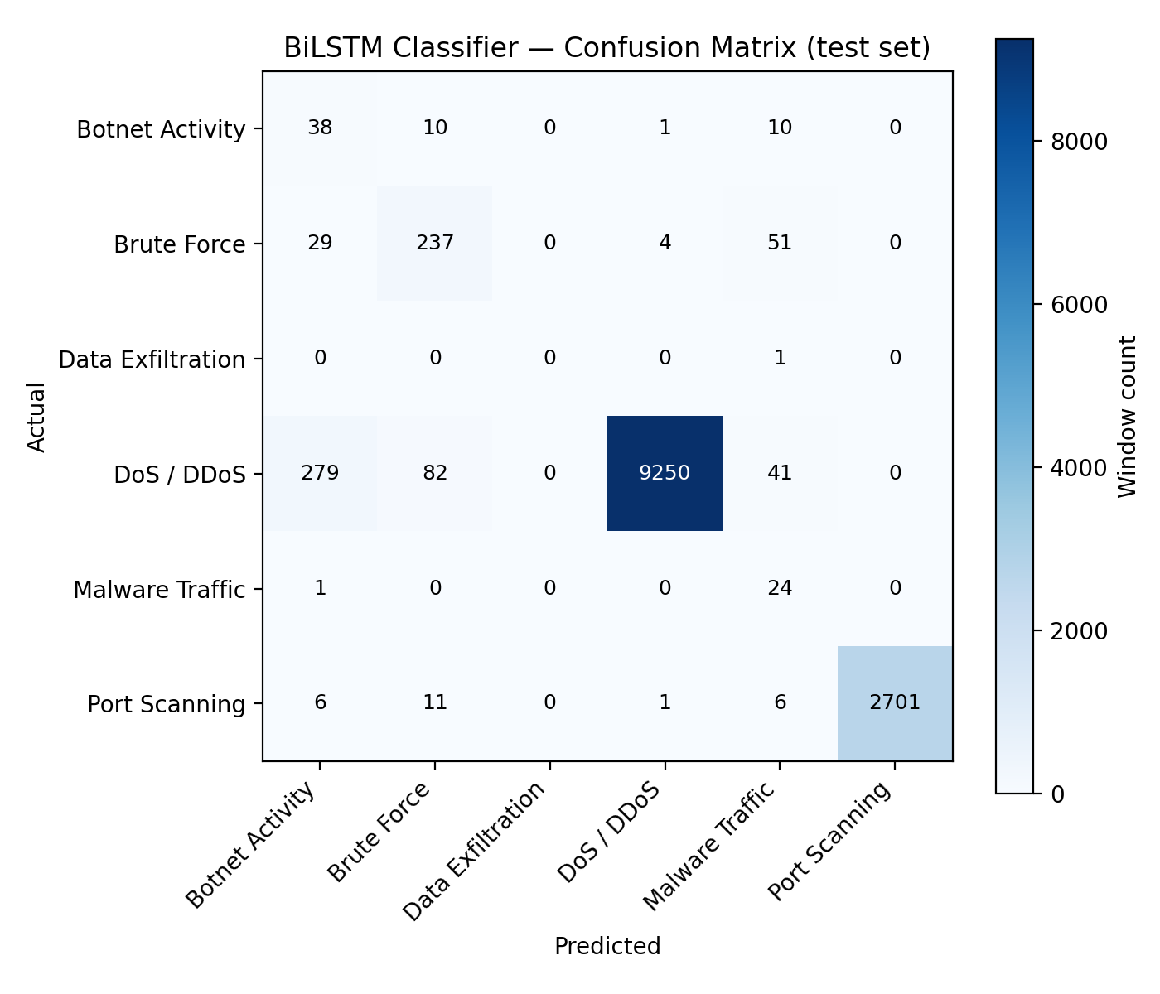
Q5
Confusion Matrix — How To Read It
6×6 grid: row = TRUE category, column = PREDICTED category
Each cell = how many test-set windows had that (true, predicted) pair
The diagonal = correct predictions
Off-diagonal cells show WHAT gets confused with WHAT — e.g. Botnet confuses more with Brute Force/Malware than with DoS/DDoS, because they're behaviourally more similar
9,652 true DoS/DDoS windows — 9,250 correct, only 279+82+41 misclassified
11

Slide 12
Q5
Precision, Recall, F1, ROC-AUC
Precision
Recall
F1 Score
TP / (TP + FP)
TP / (TP + FN)
2PR / (P + R)
“Of what I called it, how much really was?”
“Of what really was it, how much did I catch?”
Harmonic mean — punishes a big P/R gap
Category | Precision | Recall | F1 | AUC
Botnet Activity | 0.108 | 0.644 | 0.184 | 0.983
Brute Force | 0.697 | 0.738 | 0.717 | 0.994
DoS / DDoS | 0.999 | 0.958 | 0.978 | 0.999
Malware Traffic | 0.180 | 0.960 | 0.304 | 0.998
Port Scanning | 1.000 | 0.991 | 0.996 | 0.999
AUC ≈ 1.0 even where precision is weak (Botnet: 0.983 AUC, 0.108 precision) — AUC only measures RANKING, not calibration. Always read it alongside precision/recall, never alone.
12

Slide 13
Q6
Autoencoder vs. BiLSTM vs. SHAP
A
Autoencoder
Learns only “what normal looks like,” never sees an attack label. Cheap, runs on EVERY window. Knows something is wrong, not what.
The gate — unsupervised
B
BiLSTM
Only runs on windows the Autoencoder already flagged. Precise: given “probably something,” says WHAT KIND, from 6 trained categories.
The classifier — supervised
S
SHAP
Doesn't participate in the decision. Applied AFTER a Medium/High alert exists, to answer “why did the model think this?”
The explainer — post-hoc
13

Slide 14
Q7
The Feedback Loop — How It Works
1
2
3
4
5
6
Analyst reviews
Label mapped
Stored
Retrain triggered
Same pipeline
Auto-reloaded
Corrects/confirms a label via POST /api/feedback
“Normal” → BENIGN, so a false-positive correction doesn't become a fake attack label
Appended to data/feedback/validated_traffic.csv in the exact 76-feature layout cyber_ai.train expects
POST /api/retrain → cyber_ai.train --feedback-csv ... runs in background
Feedback rows go through identical cleaning/windowing/splitting as the original data
Backend drops its cached model — next request uses the new weights, no restart
Verified live: submitted feedback → triggered retrain → completed in ~8 minutes → re-scored the demo CSV and got consistent, correct predictions.
14

Slide 15
Q8
The Role of Sequence Windowing
A single row (flow) doesn't show TEMPORAL behaviour — a DDoS burst or scan sweep is a pattern only across several consecutive flows
Window size 10, stride 5 → 50% overlap between consecutive windows — more training examples, smoother coverage
Grouped by source_file first — a window can NEVER splice together the end of Monday's CSV with the start of Tuesday's
A window's label = the label of its LAST row — “what's happening now, given the last 10 rows of context”
Two Different Window Rules
Autoencoder: EVERY row in the window must be BENIGN — checked via a rolling convolution (box filter over a binary BENIGN mask; keep windows where the sum = 10)
BiLSTM: only the LAST row must be a known attack category — lead-up rows can be mixed, since that's what a real attack's run-up looks like
15

Slide 16
Q9
Backend — Every Endpoint
Endpoint | What happens internally
GET /api/health | Checks the cached model; reports degraded instead of crashing if it failed to load
POST /api/ingest/csv | Clean → impute/scale → window → AE → gate → BiLSTM → risk fusion → bulk-insert into alerts
POST /api/ingest/demo | Same, pointed at the repo's curated demo CSV — no upload needed
GET /api/alerts | Filtered (risk_level/category/source/batch), paginated SQL query, newest-first
GET /api/alerts/{id} | One row incl. full raw feature JSON + SHAP top features
The trained model loads ONCE at startup (a cached singleton), not per-request — model load time alone would make per-request loading far too slow.
16

Slide 17
Q9
Backend — Every Endpoint (cont.)
Endpoint | What happens internally
GET /api/stats/summary | COUNT(*) GROUP BY risk_level / predicted_label — dashboard tile numbers
GET /api/stats/timeseries | Buckets ingested_at into fixed windows (bucket_seconds), counts per bucket — trend-chart data
POST /api/feedback | Maps label → writes to feedback table AND appends to the retraining CSV
POST /api/retrain | Spawns cyber_ai.train in a background thread; records a training_runs row; reloads the model on success
GET /api/retrain / {id} | Poll a run's status (running/completed/failed) and resulting metrics
17

Slide 18
Q10
The Output of the Product
One alert record per scored window:
window_start / window_end
source_file
which rows this window covers
which capture file it came from
actual_label / actual_category
predicted_label
ground truth, when known
Normal, or one of the 6 attack categories
confidence
anomaly_score / is_anomaly
classifier's softmax probability (0 if never classified)
raw reconstruction error, and the gate's boolean verdict
pipeline_action
risk_score / risk_level
“Classified and alerted” or “Ignored as normal”
fused 0–1 number and its Low/Medium/High bucket
top_classifier/anomaly_features
full 76-feature vector
SHAP JSON — Medium/High alerts only
via the backend, for retraining / detail view
Delivered as CSV + summary JSON (CLI), or as queryable rows in the alerts MySQL table via the API.
18

Slide 19
Q11
The Stream Simulator
NOT part of detection — a client of the backend
Problem: /api/ingest/csv scores a whole file in one instant — a live dashboard would see nothing, then everything, all at once
Solution: reads a CSV, splits into small chunks (default 15 rows), posts each chunk to /api/ingest/csv with a real sleep() between calls (default 2s)
Confirmed against the demo CSV: plays out the exact scripted scene-by-scene narrative as a live sequence, not one JSON blob
One Accepted Limitation
Each chunk is windowed independently — no state carried between HTTP requests — so a 10-row window straddling a chunk boundary is never scored.
Fine for a demo/dashboard feed; a real production stream would need a server-side stateful buffer instead.
19

Slide 20
Q12
What the Backend Actually Stores
One row per scored window: all output fields from Q10, plus the full 76-feature vector as a single JSON column (schema stays stable if features change), a batch_id, and ingested_at (real insertion time — what the timeseries chart buckets on).
alerts
Analyst-submitted corrections: which alert, the validated label, who submitted it, whether it was written to the retraining CSV.
feedback
One row per retrain triggered via the API: status, feedback rows used, resulting metrics JSON, start/finish times, path to the full training log.
training_runs
20

Slide 21
End of Study Guide
12 questions, answered from the actual code and the actual trained model.

