Slide 1
NETSHIELD AI
An AI-Driven Predictive Analytics Framework for Adaptive Cyber Threat Detection
Autoencoder anomaly detection · BiLSTM classification · Hybrid risk fusion · SHAP explainability · Analyst feedback loop
[Your Name(s)] · [USN] · Guide: [Fill in]

Slide 2
MOTIVATION
Why traditional intrusion detection falls short
Rule / signature-based systems
Blind to unknown, zero-day, or slowly evolving attacks
Classification-only AI models
No temporal behaviour analysis, no explanation of decisions
No adaptive learning
Can't improve from analyst-validated feedback over time
02

Slide 3
PROJECT GOALS
Objectives
01
Collect and preprocess network traffic into meaningful features
02
Autoencoder-based anomaly detection on normal traffic behaviour
03
BiLSTM-based temporal classification of attack types
04
SHAP explainability for interpretable model decisions
05
Alerting & reporting mechanism for security administrators
06
Dynamic feedback loop for continuous model improvement
07
One intelligent, adaptive cybersecurity framework, end to end
03

Slide 4
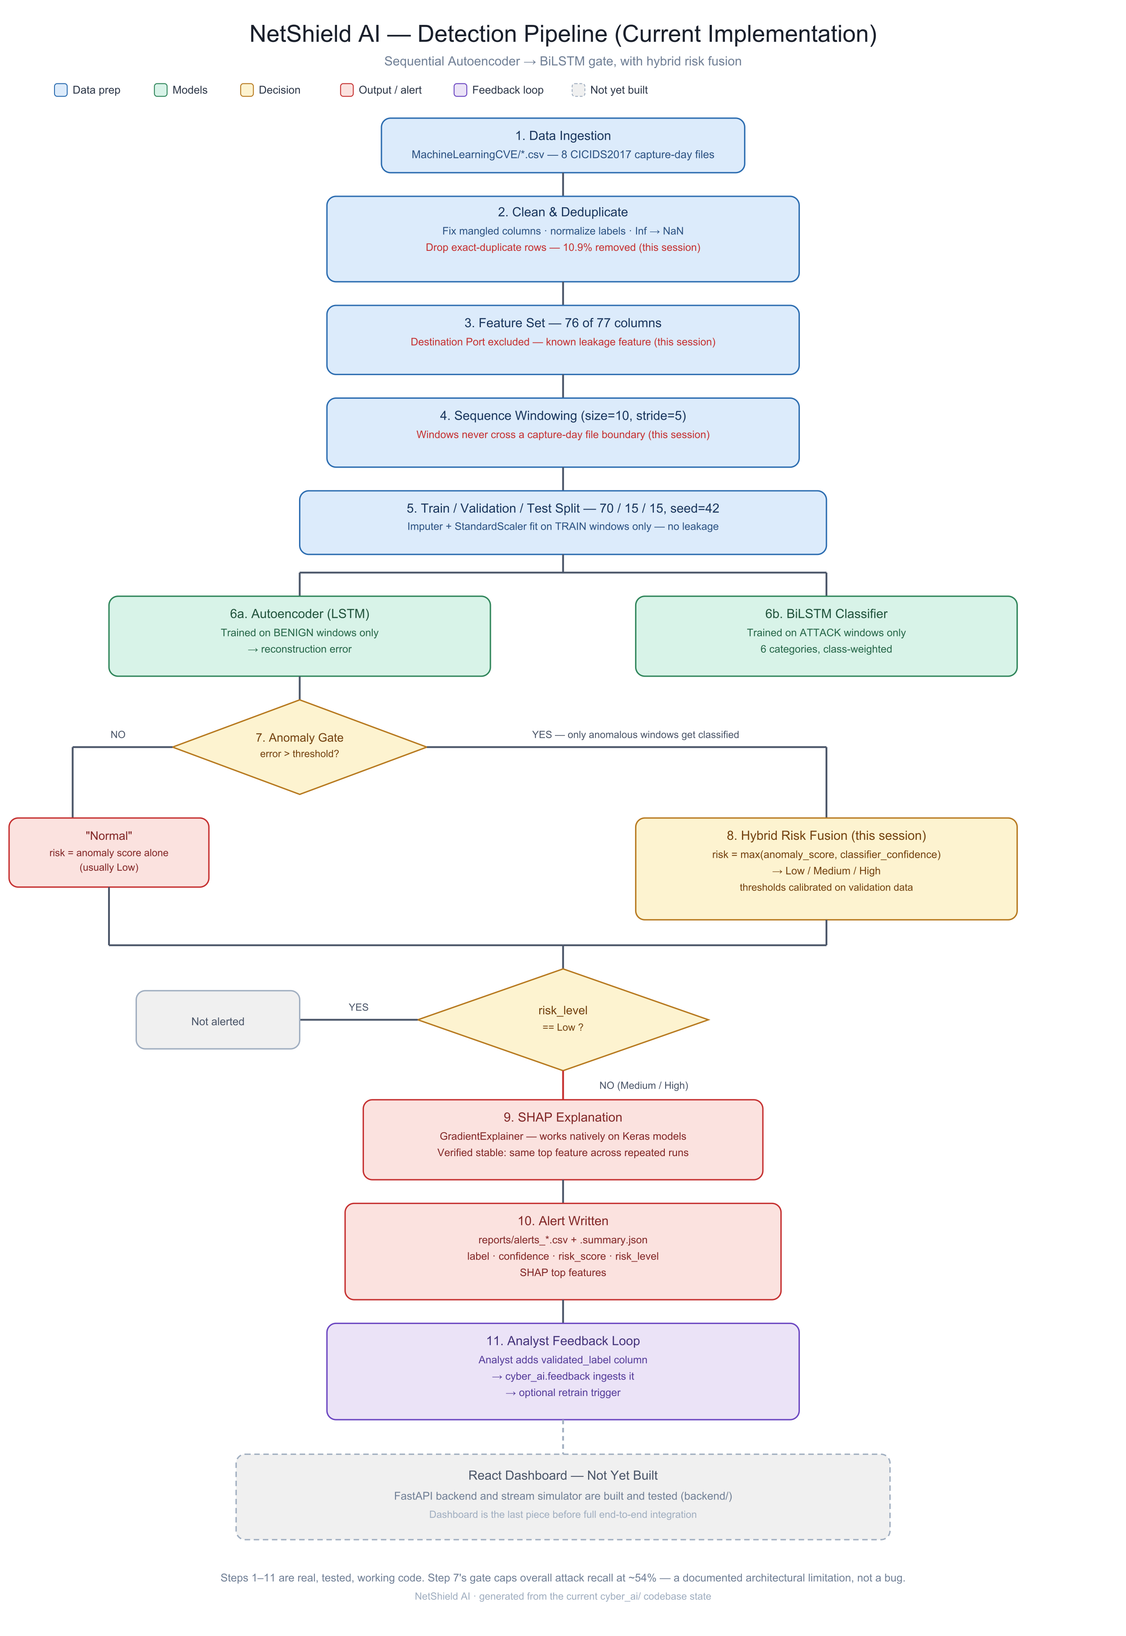
ARCHITECTURE
Sequential-Gate Detection Pipeline
Autoencoder gates every window first
Only anomalous windows reach BiLSTM
Hybrid risk fusion turns model output into Low / Medium / High
SHAP explains Medium/High alerts
Analyst feedback closes the loop back into retraining
Trade-off
The gate caps overall recall at ~54% — a deliberate architectural choice, not a bug.
04

Slide 5
DATA
Dataset — CICIDS2017
2.52M
rows loaded, 8 capture-day files
76
features (Destination Port excluded — leakage)
6 + 1
attack categories, plus BENIGN
05

Slide 6
PREPROCESSING
Data Integrity Fixes
Windowing fix
Leakage removal
Sequence windows never span two different capture-day files
Destination Port excluded — attacks target fixed ports in this testbed
Mislabel handling
Low-sample warning
Unrecognized labels excluded & counted, not silently mis-bucketed
Categories under 200 samples flagged automatically (Data Exfiltration: 36)
Duplicate removal
Feature selection
10.9% exact-duplicate rows dropped before windowing
Evaluated, hurt BiLSTM precision — kept as opt-in, not default
06

Slide 7
MODEL 1
Autoencoder — Anomaly Detection
LSTM encoder → 32-dim latent → LSTM decoder
Trained only on BENIGN windows — learns what “normal” looks like
Reconstruction error = how far a window deviates from normal
Threshold calibrated on validation data (balanced-accuracy strategy), not hardcoded
Anomalous windows are the only ones passed to the BiLSTM classifier
0.834
calibrated anomaly threshold
71.8%
balanced accuracy on test set
07

Slide 8
MODEL 2
BiLSTM — Threat Classification
Bidirectional LSTM, class-weighted for imbalance
Trained only on attack windows — never sees BENIGN
Only runs on windows the Autoencoder already flagged
Classifies into 6 attack categories from the dataset
Per-class quality tracks sample count — a data-scarcity signal, not overfitting
95.8%
accuracy on windows it sees
0.530
0.970
macro-F1
weighted-F1
08

Slide 9
TRIAGE
Hybrid Risk Fusion
risk = max( normalized anomaly score, classifier confidence )
Old logic: every classified window was marked “High” — zero triage value
New: a window can only be pulled UP toward classifier confidence, never below the anomaly gate's own signal
Low/Medium/High thresholds calibrated from real validation-set score distributions
09

Slide 10
EXPLAINABILITY
SHAP — Why the Model Flagged This
GradientExplainer — works natively on the Keras models used here
Replaced KernelExplainer, which was slow and unreliable at practical sample counts on a 770-dim flattened window
Stability verified: ran SHAP twice on the same window → same top feature both times, 7 of top 8 features overlapping
Every Medium/High alert ships with its top contributing features
Cost of explaining
670 ms
mean latency per explained alert
The single most expensive pipeline stage — only run on Medium/High alerts, never on the full traffic stream.
10

Slide 11
RESULTS
Progressive Improvement Across Fixes
BiLSTM's dip after duplicate removal corrects previously inflated numbers — not a real capability loss (weighted-F1 barely moved: 0.994 → 0.970).
11

Slide 12
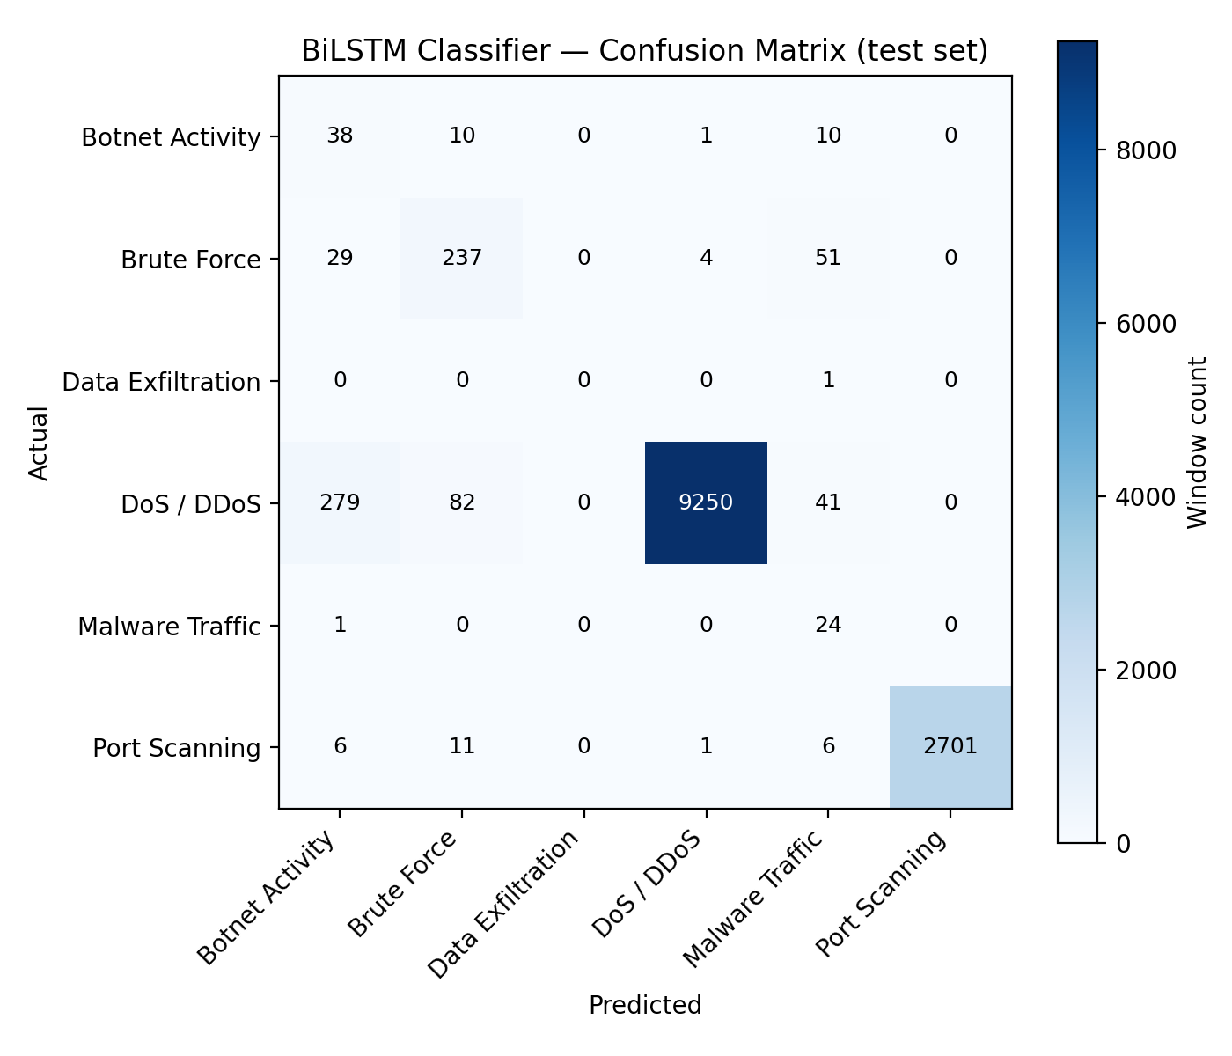
RESULTS
BiLSTM Confusion Matrix (Test Set)
DoS/DDoS and Port Scanning — the well-supported classes — stay strong: F1 0.978 and 0.996
Small classes (Botnet, Malware, Data Exfiltration) show more confusion — tracks sample count, not classic overfitting
Data Exfiltration: only 1 test-set example — not statistically meaningful
12

Slide 13
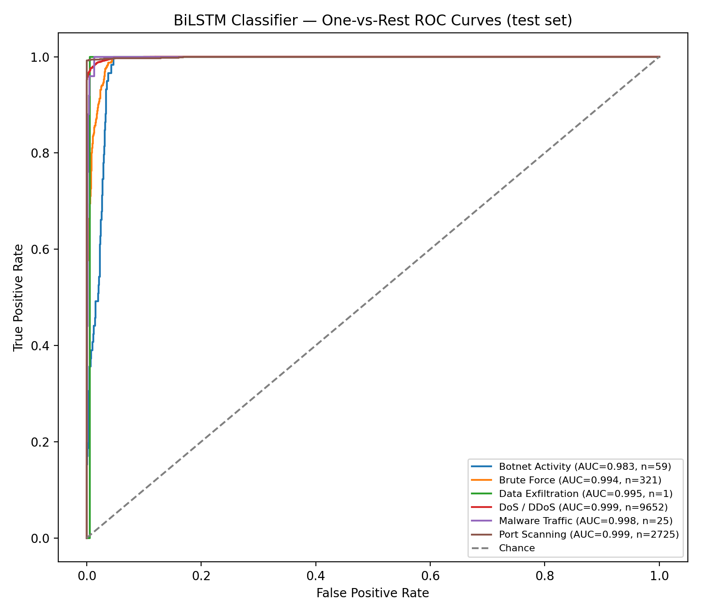
RESULTS
ROC Curves & Per-Class Metrics
Category | Precision | Recall | AUC
Botnet Activity | 0.108 | 0.644 | 0.983
Brute Force | 0.697 | 0.738 | 0.994
DoS / DDoS | 0.999 | 0.958 | 0.999
Malware Traffic | 0.180 | 0.960 | 0.998
Port Scanning | 1.000 | 0.991 | 0.999
AUC looks excellent even where precision is weak — it's a ranking metric, not a substitute for precision/recall on imbalanced data.
13

Slide 14
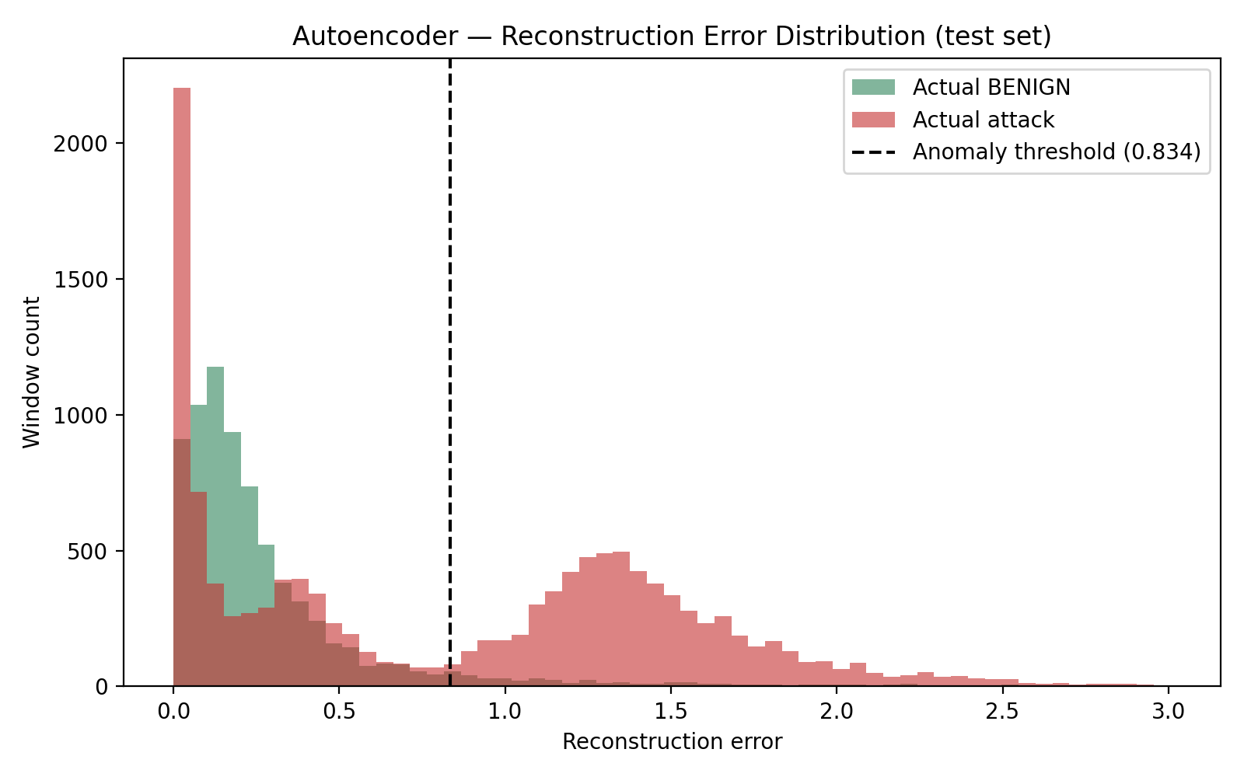
RESULTS
Reconstruction Error Distribution
Calibrated threshold (0.834) sits in the overlap — trading some missed attacks for fewer BENIGN false alarms, by design.
14

Slide 15
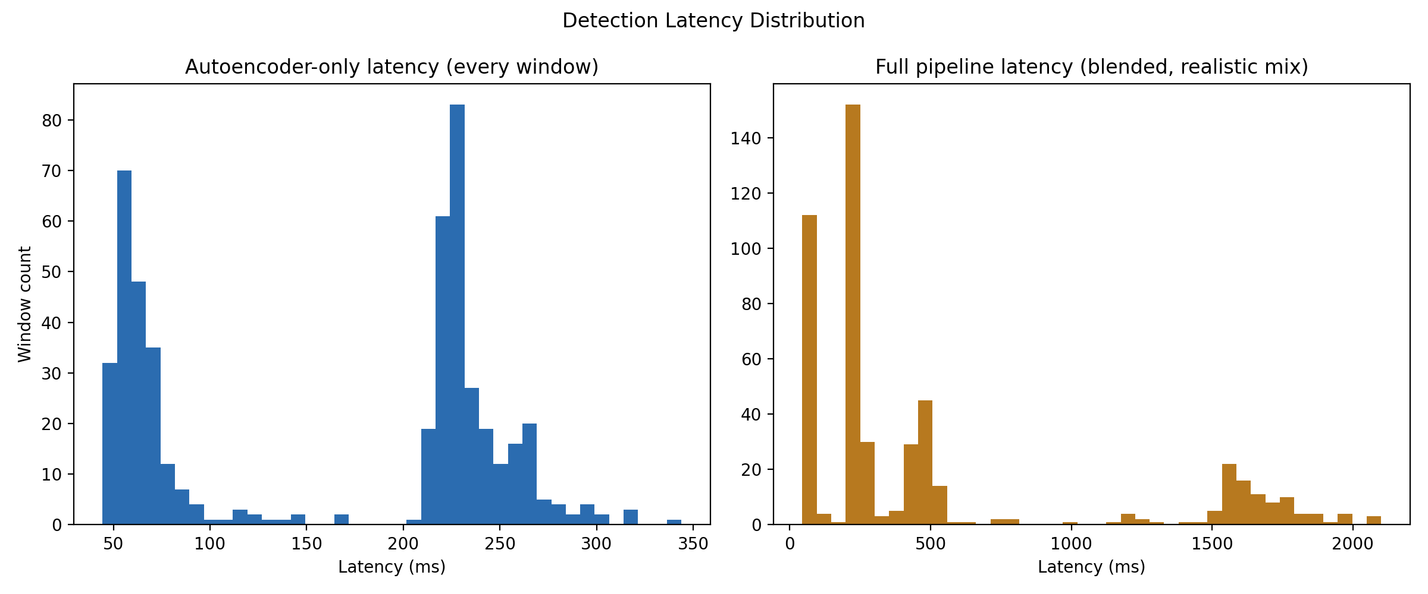
PERFORMANCE
Latency Benchmark
Stage | Mean | P95
Autoencoder only | 161 ms | 268 ms
Autoencoder + BiLSTM | 400 ms | 727 ms
SHAP alone | 670 ms | 1163 ms
Full pipeline (blended) | 521 ms | 1745 ms
Hardware note
Measured on CPU-only hardware (no discrete GPU). Absolute numbers scale with hardware — the relative shape (SHAP costliest, Autoencoder cheapest) is what's architecturally meaningful.
15

Slide 16
INFRASTRUCTURE
Backend API & Stream Simulator
FastAPI + MySQL
Stream Simulator
Loads the trained pipeline once at startup
alerts · feedback · training_runs tables
10 endpoints: ingest, alerts, stats, feedback, retrain
Reuses cyber_ai.predict's exact scoring logic
Replays a CSV in small paced chunks, not one batch
Makes alerts arrive over real time — not one instant
Turns a flat time-series chart into an actual trend
One honest limitation: windows can't span a chunk boundary (no server-side state yet)
16

Slide 17
VERIFIED LIVE
Feedback → Retrain Loop
1
2
3
4
5
Analyst submits
Stored
Retrain triggered
~8 minutes later
Auto-reloaded
POST /api/feedback with a validated label
Appended to the retraining feedback CSV
POST /api/retrain runs cyber_ai.train in the background
Training completes, new metrics recorded
API picks up the new model — no restart needed
Confirmed end to end — not just wired up: re-scored the demo CSV immediately after and got consistent, correct predictions.
17

Slide 18
LIVE DEMO
Panel Demo Walkthrough
185 real (never synthetic) CICIDS2017 rows, re-validated against the currently deployed model — same story holds after retraining.
BENIGN
DDoS burst
BENIGN
Port Scan burst
BENIGN
Botnet burst
BENIGN
quiet
5/6 caught, ~99.99%
quiet
2/6 caught — genuinely mixed
quiet
3/3 caught, 95–98%
quiet
Port Scanning's mixed result is narrated proactively during the live demo, not hidden.
18

Slide 19
WHERE WE ARE
Current Project Status
Area | Status
Data Integrity | DONE
Detection Logic (Hybrid Risk Fusion) | DONE
Explainability (SHAP) | DONE
Report / Demo Assets | DONE
Backend API (FastAPI + MySQL) | DONE
Stream Simulator | DONE
Generalization (UNSW-NB15) | PARTIAL
Full End-to-End Integration | PARTIAL
React Dashboard | NOT STARTED
19

Slide 20
HONEST ASSESSMENT
Known Limitations
Sequential-gate design caps overall recall (~54%) — a deliberate trade-off, not a bug
Data Exfiltration: only 36 raw samples — per-class metrics not statistically meaningful
No cross-dataset (UNSW-NB15) generalization check has been run yet
SHAP remains the slowest pipeline stage, even after the GradientExplainer swap
Absolute latency numbers are hardware-dependent (measured CPU-only here)
20

Slide 21
NEXT STEPS
Future Work
Build the React dashboard on top of the existing, tested backend API
Run a full end-to-end integration pass once the dashboard exists
Source UNSW-NB15 and run a cross-dataset generalization check
Evaluate a parallel (non-sequential) architecture to raise the recall ceiling
21

Slide 22
Thank You
Questions?

