Slide 1
Regression Analysis
By - Vishnu Prakash Singh

Slide 2
What is Regression??
Regression analysis may be the most widely used statistical technique.
Regression analysis is a statistical technique for investigating and modeling the relationship between variables.
The regression technique is used to observe changes in the dependent variable (Y) with changes in the independent variables (X)

Slide 3
Linear Regression
Linear Regression is used to find the relation between dependent/ Response variable(Y) and independent/ explanatory variables (X).
The dependent variable (Y) is continuous in nature where as independent variables (X) can be continuous or categorical in nature.
Relationship between Y and X is statistical not deterministic.
The core idea is to obtain a line that best fits the data.
The best fit line is the one for which total prediction error (all data points) are as small as possible.
Error is the distance between the point to the regression line.
https://towardsdatascience.com/linear-regression-detailed-view-ea73175f6e86

Slide 4
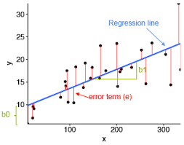
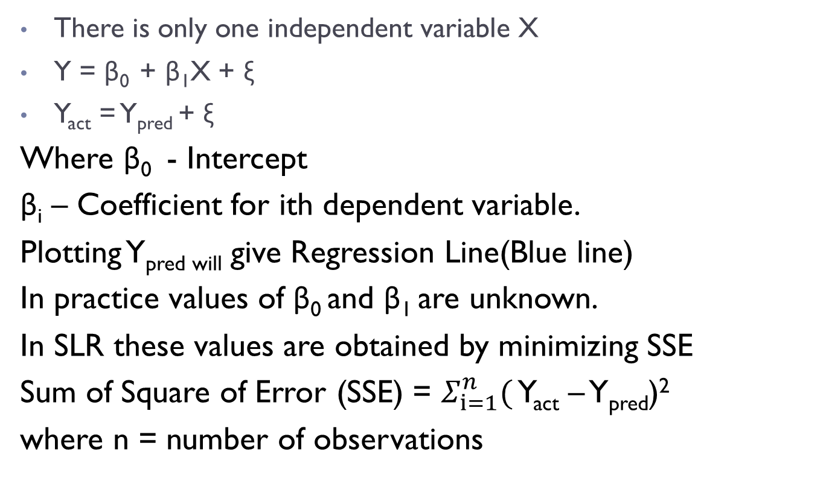
Simple Linear Regression (SLR) –
There is only one independent variable X
Y = β₀ + β₁X + ξ
Y_{act} = Y_{pred} + ξ
Where β₀ - Intercept
β_{i} – Coefficient for ith dependent variable.
Plotting Y_{pred will} give Regression Line(Blue line)
In practice values of β₀ and β₁ are unknown.
In SLR these values are obtained by minimizing SSE
Sum of Square of Error (SSE) = $Σ_{ⅈ=1}^{n}($ Y_{act} – Y_{pred})²
where n = number of observations

Slide 5
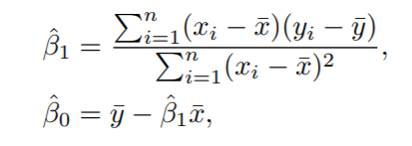
β₀ = Y_{mean} Ȳ - β₁ Ȳ _{mean}

Slide 6
Multiple Linear Regression (MLR) –
If there is more than one X
Y = β₀ + β₁X₁ + β₂X₂ + …… + β _{n}X_{n}

Slide 7
Assumptions of Linear Regression
linear regression requires the relationship between the independent and dependent variables to be linear.A good way to validate is to plot a scatter plot between Y and X.
No Multicollinearity between the Independent variables:
Homoscedasticity Assumption:
Normal distribution of error terms:
Little or No autocorrelation in the residuals:
https://towardsdatascience.com/assumptions-of-linear-regression-algorithm-ed9ea32224e1

Slide 8
What can Linear Regression Do?
Linear Regression can answer following questions -
Is there a relationship between Y and X?
How strong is the relationship between Y and X?
Which X contributes to Y?
How accurately can we estimate the effect of each X on Y?
How accurately can we predict future Y?
Is the relationship between X and Y linear?
Is there synergy/interaction among the X’s?

Slide 9
Linear Regression
Assumptions of regression analysis: • The error term follows normal distribution with mean 0 and constant variance. • There is no correlation between independent variables and error terms. • The error term is same for all values of independent variable. There are two types of regression techniques:

Slide 15
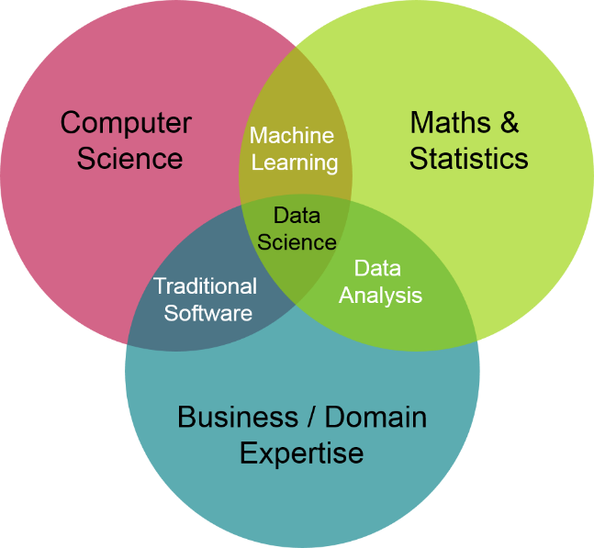
Applications of ML
We all use it on a daily basis. Some Examples are as follow
Spam filtering
Credit card fraud detection
Digit recognition on checks, zip codes
Detecting faces in images
MRI image analysis
Recommendation system
Handwriting recognition

Slide 16
Types of Machine Learning
Supervised
Un Supervised
Reinforced
Source - https://machinelearningmastery.com/supervised-and-unsupervised-machine-learning-algorithms/

Slide 17
Supervised Learning
Supervised learning is where you have input variables (x) and an output variable (Y) and you use an algorithm to learn the mapping (target) function from the input to the output. i.e Y = f(X)
The goal is to approximate the mapping function so well that when you have new input data (x) that you can predict the output variables (Y) for that data.
Supervised learning problems can be further grouped into regression and classification problems.
Classification: A classification problem is when the output variable is a category, such as “red” or “blue” or “disease” and “no disease”. E.g. Logistic Regression
Regression: A regression problem is when the output variable is a continuous value, such as “rupees” or “weight”. E.g. Linear Regression

Slide 18
Unsupervised Learning
Unsupervised learning is where you only have input data (X) and no corresponding output variables.
The goal for unsupervised learning is to model the underlying structure or distribution in the data in order to learn more about the data.
Unsupervised learning problems can be further grouped into clustering and association problems.
Clustering: A clustering problem is where you want to discover the inherent groupings in the data, such as grouping customers by purchasing behavior. e.g K means
Association: An association rule learning problem is where you want to discover rules that describe large portions of your data, such as people that buy X also tend to buy Y. e.g. Apriori Algorithm

Slide 19
Pre work
Define Model windows – Observation/Performance window
Target Definition
Data Preparation, treatment/ management
Feature Engineering or Data transforming

Slide 20
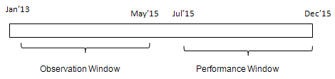
Observation/Performance window
The first step of building a predictive model is to choose period for predictors (independent variables) and target variable (dependent variable)
Observation Period
It is the period from where independent variables /predictors come from.
Performance Period
It is the period from where dependent variable /target come from. It is the period following the observation window.
Source - https://www.listendata.com/2016/08/observation-and-performance-window.html

Slide 21
Target Definition
Definition of Target should be defined clearly to avoid confusion of any sort.
E.g
90+ DPD in past 12 months for Delinquency Tracking

Slide 22
Univariate & Bivariate Analysis
Univariate
Considers 1 variable at a time to understand distribution of variable
Summarizes & finds pattern in a variable using mean, median, mode, range, variance, standard deviation, max, min, quartiles.
Other ways - Frequency Distribution Tables, Bar Charts, Histograms
Bivariate
Considers exactly 2 variables at a time to understand relation between both variables
Summarizes and finds pattern using Scatter Plots, regression Analysis, Correlation Coefficients

Slide 23
Missing value treatment (Imputation)
All the missing values must be filled with an appropriate value. Some examples of missing value treatment are
Missing values in simple count or amount variable are replaced by 0
Missing values in proportion variables are replaced by high values or -1 based on intuition.
Infinite values are generally changed to high numbers as placeholders
Scores of the network where not available are replaced by -1.
Standard deviation and mean variables are treated as -1.
NA values in categorical variable can be treated as new level of that variable.

Slide 24
Feature Engineering
Creating variables from the fields which can not be used directly in the model.
E.g calculating variable ‘vintage’ from account open date,
E.g creating ‘number of numerics’ from address of customers
Summarising few variables using aggregating function to create new variable
Certain surrogate field variable
Scaling & Outlier Treatment
In few models, scaling & outlier treatment is needed.
Practical way to treat outlier is to remove observations more than 99.9 percentile of that variable.
Types of Scaling – Standard scaling , Min max scaling(prone to outliers)

Slide 25
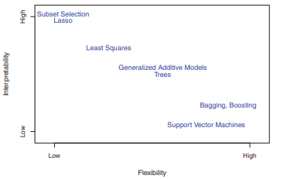
Interpretability vs Flexibility of Models
The process of evaluating a model’s performance is known as model assessment, whereas the process of selecting the proper level of flexibility for a model is known as model selection.

Slide 26

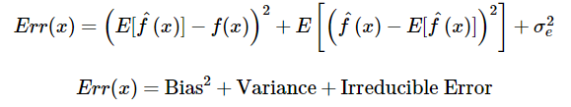
Bias vs Variance Tradeoff
BIAS is the difference between the average prediction of our model and the correct value which we are trying to predict.
It always leads to high error on training and test data.
VARIANCE Variance is the variability of model prediction for a given data point or a value which tells us spread of our data.
Model with high variance pays a lot of attention to training data and does not generalize on the data which it hasn’t seen before
Y = f(x) + e

Slide 27
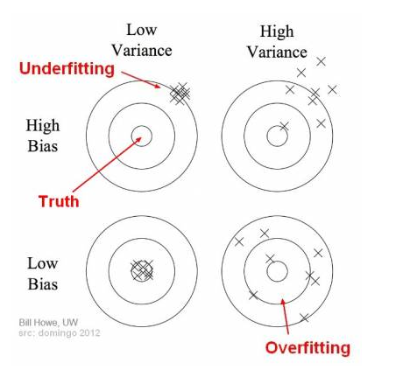
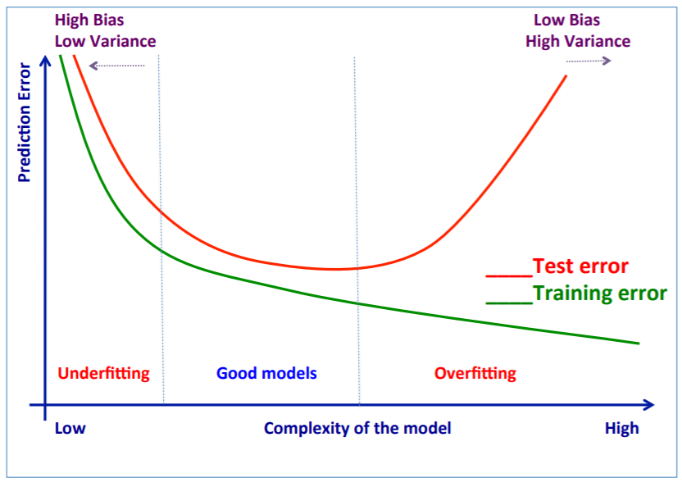
Bias vs Variance Tradeoff
Source https://towardsdatascience.com/understanding-the-bias-variance-tradeoff-165e6942b229

Slide 28
Underfitting & Overfitting
Underfitting - when a model is unable to capture the underlying pattern of the data.
These models usually have high bias and low variance.
It happens when we have very less amount of data to build an accurate model or when we try to build a linear model with a nonlinear data.
Overfitting - when our model captures the noise along with the underlying pattern in data.
It happens when we train our model a lot over noisy dataset.
These models have low bias and high variance.
Models like Decision trees are prone to overfitting.

Slide 29
Resampling methods
Repeatedly drawing samples from a training set and refitting a model of interest on each sample in order to obtain additional information about the fitted model. e.g. Estimating variability of a linear regression
2 common resampling methods - cross-validation and bootstrap.
Bootstrapping - The bootstrap method is a resampling technique used to estimate statistics like mean, sd on a population by sampling a dataset with replacement.
Cross-Validation is a technique for evaluating ML models by training several ML models on training data and evaluating them on the test data. It is used to detect overfitting.

Slide 30
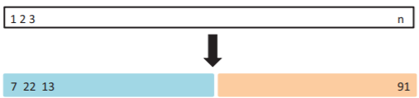
Types of Cross Validation (CV)
Hold out method
we reserve 70% of the dataset for validation and the remaining 30% for model training.(ratios may vary)
Chances of missing out information during training is high
A part of data is stored for testing. Model is trained on the other part of the data (train set)
Leave one out CV
Attempts to address the drawback of Hold out method
Instead of 30% of observation only 1 observation is kept for validation.
N such Models are fit on n-1 training observations.
n Predictions are done on only single observation(left out observation)

Slide 31
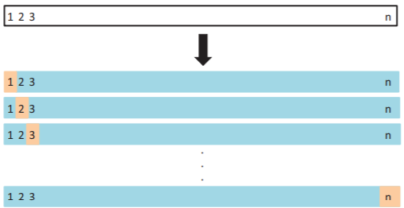
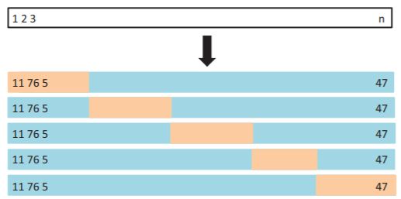
Types of Cross Validation (CV)
Advantage – Far less bias
Disadvantage – computationally extensive
k-Fold Cross-Validation (right image)
data is divided randomly into k equal subsets
holdout method is repeated k times, such that each time, one of the k subsets is used as the test set/ validation set and the other k-1 subsets are put together to form a training set.

Slide 32
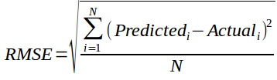
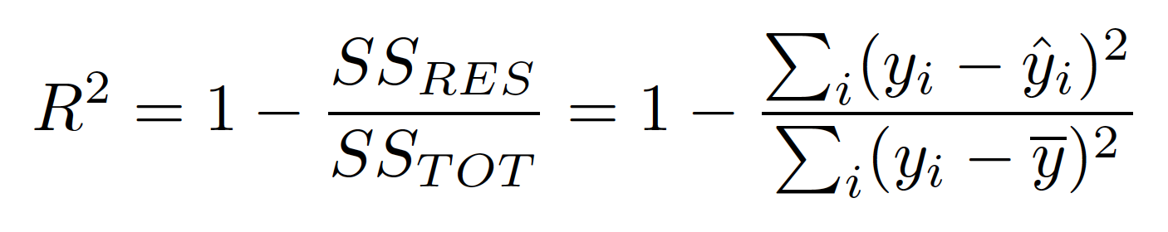
Model Evaluation Metrics for Regression
1. RMSE(root mean square error)
N is total Number of observations
2. R-Square
In R square, SS(TOT)(baseline) was added a benchmark
SS(RES) : Residual Sum of squares of model
SS(TOT) : Total Sum of squares of model (comparing the actual y values to our baseline model the mean)

Slide 33
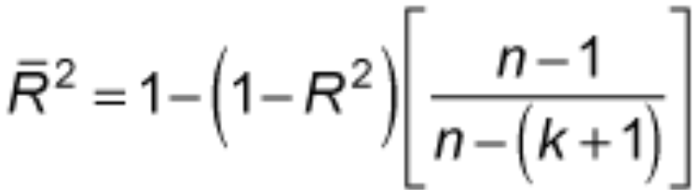
Model Evaluation Metrics for Regression
Adjusted R-Squared
R square will always keep on increasing if a new variable is added
It does not penalize addition of new variables which do not add any information
So adjusted R square was introduced.
k: number of features
n: number of samples
https://www.analyticsvidhya.com/blog/2019/08/11-important-model-evaluation-error-metrics/

Slide 34
Model Evaluation Metrics for Classification
A. Confusion Matrix
It is a matrix of actual and predicted target variable.
Definition of the Terms: • Positive (P) : Observation is positive • Negative (N) : Observation is not positive
• True Positive (TP) : Observation is positive, and is predicted to be positive. • False Negative (FN) : Observation is positive, but is predicted negative. • True Negative (TN) : Observation is negative, and is predicted to be negative • False Positive (FP) : Observation is negative, but is predicted positive.
Confusion Matrix | Predicted Positive | Predicted Negative
Actual Positive | TP | FN
Actual Negative | FP | TN

Slide 35
Model Evaluation Metrics for Classification
1. Accuracy = (TP+TN)/(TP+TN+FP+FN)
2. Specificity(True negative rate) - the proportion of actual negatives, which got predicted as the negative
Specificity = TN/(TN+FP)
3. Recall or sensitivity - proportion of actual positive cases that got predicted as positive
Recall(R) = TP/(TP+FN)
4. Precision indicates an example labeled as positive is indeed positive (small number of FP).
Precision(P) = TP/(TP+FP)
5. F measure is unified representation of recall & precision
The F-Measure will always be nearer to the smaller value of Precision or Recall.
F measure = 2*R*P/(R+P)
https://classeval.wordpress.com/introduction/basic-evaluation-measures/

Slide 36
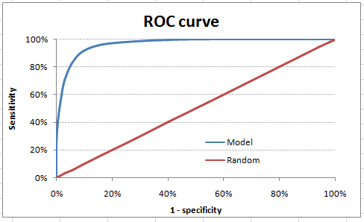
Model Evaluation Metrics for Classification
B) ROC Curve
AUC - ROC curve is a performance measurement for classification problem at various probability threshold settings.
ROC is a probability curve and AUC represents degree or measure of separability.
It tells how much our model is capable of distinguishing between classes.
https://towardsdatascience.com/understanding-auc-roc-curve-68b2303cc9c5

Slide 37
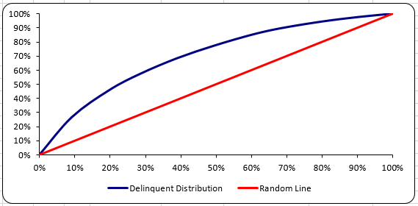
Model Evaluation Metrics for Classification
C) Gini Value & Curve
Gini curve is the plot of cumulative Non Event % vs cumulative Event %
KS value = max(cumulative event % – cumulative non event %) across all bins
Gini Value = 2*Area under curve - 1
THE END

