Slide 1
Regression Analysis
By - Vishnu Prakash Singh

Slide 2
What is Regression??
Regression analysis may be the most widely used statistical technique.
Regression analysis is a statistical technique for investigating and modeling the relationship between variables.
The regression technique is used to observe changes in the dependent variable (Y) with changes in the independent variables (X)

Slide 3
What can Linear Regression Do?
Linear Regression can answer following questions -
Is there a relationship between Y and X?
How strong is the relationship between Y and X?
Which X contributes to Y?
How accurately can we estimate the effect of each X on Y?
How accurately can we predict future Y?
Is the relationship between X and Y linear?
Is there synergy/interaction among the X’s?

Slide 4
Linear Regression
Linear Regression is used to find the relation between dependent/ Response variable(Y) and independent/ explanatory variables (X).
The dependent variable (Y) is continuous in nature where as independent variables (X) can be continuous or categorical in nature. e.g Y can be income and X can be Age / Experience etc
Relationship between Y and X is statistical not deterministic.
The core idea is to obtain a line that best fits the data.
The best fit line is the one for which total prediction error (all data points) are as small as possible.
Error is the distance between the point to the regression line.
https://towardsdatascience.com/linear-regression-detailed-view-ea73175f6e86

Slide 5
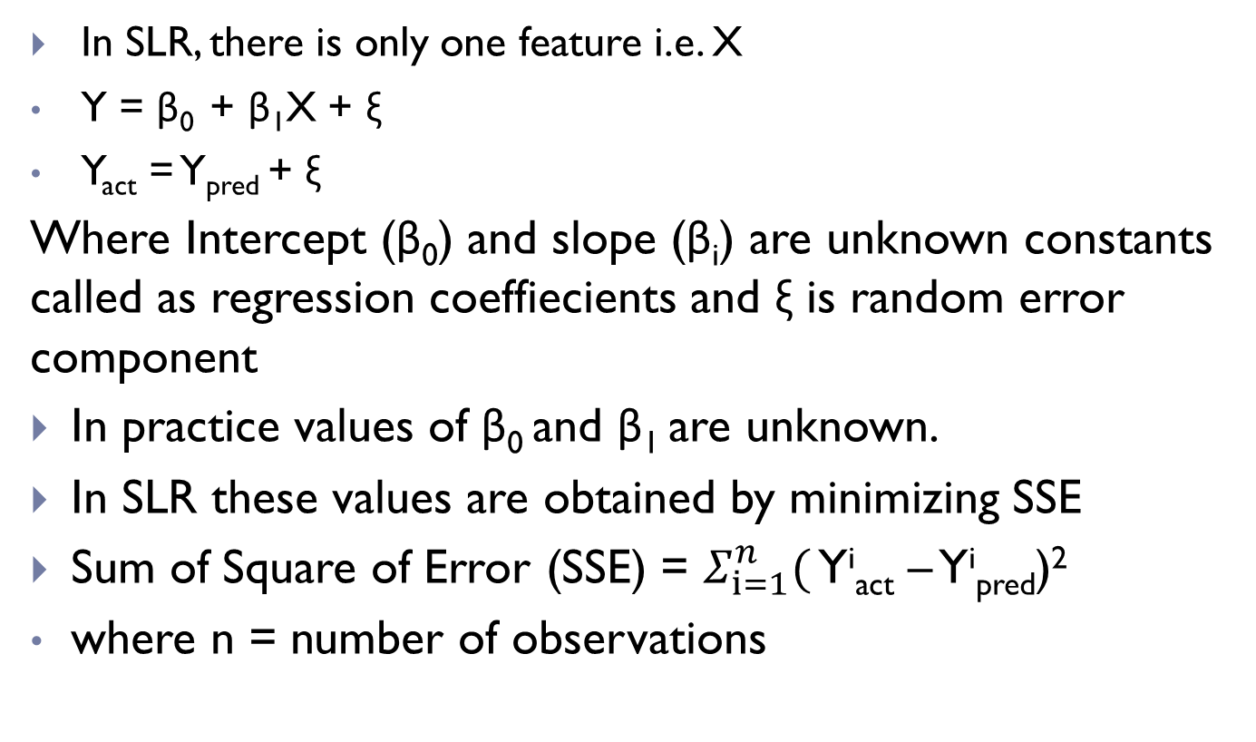
Simple Linear Regression (SLR) –
In SLR, there is only one feature i.e. X
Y = β₀ + β₁X + ξ
Y_{act} = Y_{pred} + ξ
Where Intercept (β₀) and slope (β_{i}) are unknown constants called as regression coeffiecients and ξ is random error component
In practice values of β₀ and β₁ are unknown.
In SLR these values are obtained by minimizing SSE
Sum of Square of Error (SSE) = $Σ_{ⅈ=1}^{n}($ Y^{i}_{act} – Y^{i}_{pred})²
where n = number of observations

Slide 6
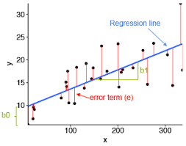
Simple Linear Regression (SLR) –
Blue Line – Regression line (Y_{pred})
Black Dots – Y_{actual}
Red Line – error term (Y_{actual}-Y_{pred})
β₀ - Y_{pred} at X = 0
β₁ – change in Y_{pred} with one unit change in X

Slide 7
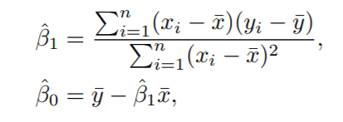
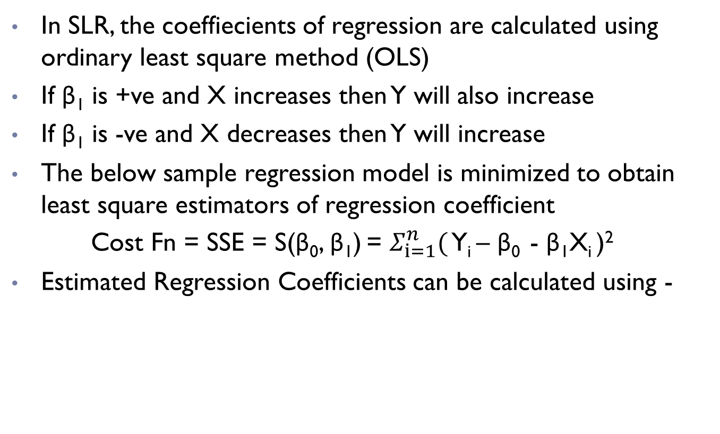
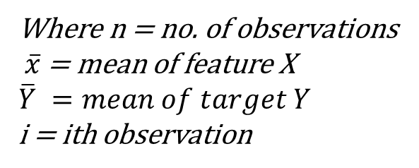
Calculating coefficients of SLR
In SLR, the coeffiecients of regression are calculated using ordinary least square method (OLS)
If β₁ is +ve and X increases then Y will also increase
If β₁ is -ve and X decreases then Y will increase
The below sample regression model is minimized to obtain least square estimators of regression coefficient
Cost Fn = SSE = S(β₀, β₁) = $Σ_{ⅈ=1}^{n}($ Y_{i} – β₀ - β₁X_{i} )²
Estimated Regression Coefficients can be calculated using -
Where n = no. of observations
$\overline{x}$ = mean of feature X
$$\overline{Y} =mean of target Y$$
i = ith observation

Slide 8
Multiple Linear Regression
Multiple Linear Regression (MLR) –
If there is more than one X
Y = β₀ + β₁X₁ + β₂X₂ + …… + β _{n}X_{n} + ξ
Y = dependent variable
X = explanatory variables
β ​= y-intercept (constant term)
β_{i} ​= slope coefficients for each explanatory variable
ξ = the model’s error term (also known as the residuals)​
It is rare that Y is explained by single X. In that case, MLR comes in picture where more than one X are involved

Slide 9
Assumptions of Linear Regression
Relationship between Y and X is linear. Can be checked using scatter plot between Y and X.
No Multicollinearity between the Independent variables, Can be checked by calculating correlation matrix
Homoscedasticity Assumption - error term is same across all values of the independent variable. plot of residual values vs predicted values is a good way to check
The errors are assumed to be normally distributed with mean zero and unknown variance σ² .
Additionally the errors are assumed to be uncorrelated. This means that the value of one error does not depend on the value of any other error.
https://www.jmp.com/en_us/statistics-knowledge-portal/what-is-regression/simple-linear-regression-assumptions.html

Slide 10
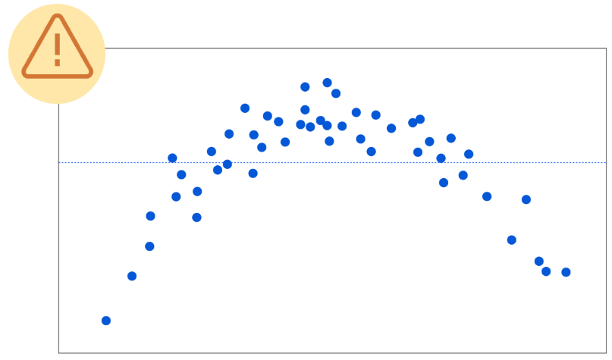
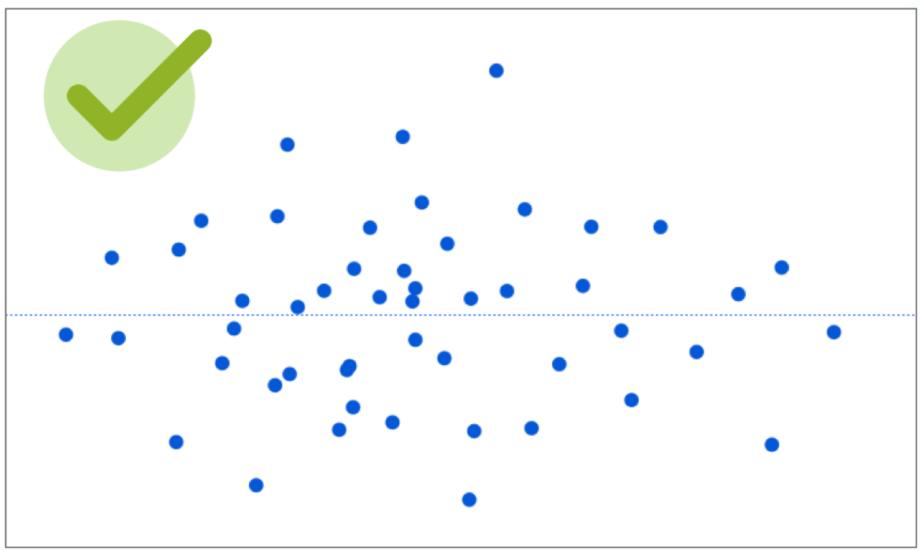
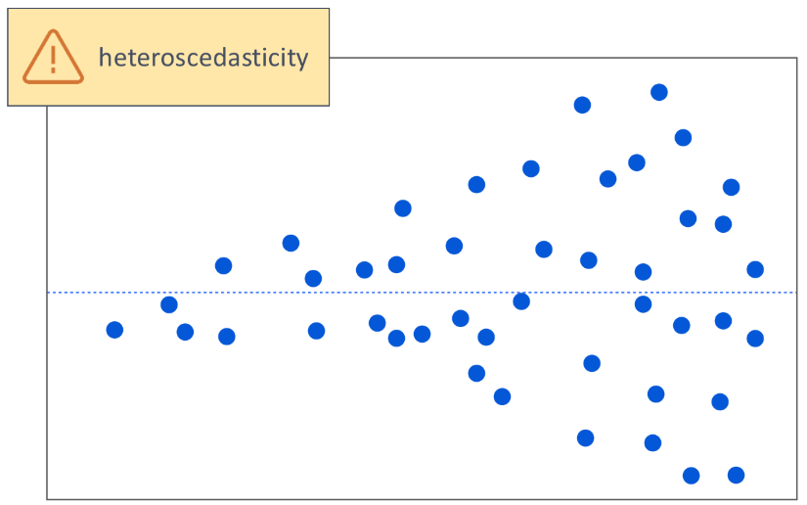
Homoscedasticity
Fig 1
Fig 2
Fig 1- plot of error vs Ypred, errors are scattered with no pattern
Fig 2- plot of error vs Ypred, curvature is present in error
Fig 3 – plot of error vs Ypred, error fans out as Ypred increases
Fig 3

Slide 11
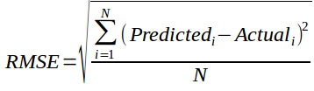
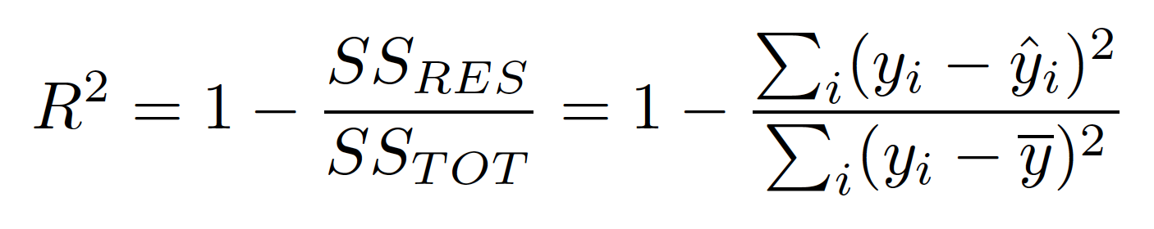
Model Evaluation Metrics for Regression
1. RMSE(root mean square error)
N is total Number of observations
2. R-Square
In R square, SS(TOT)(baseline) was added a benchmark
SS(RES) : Residual Sum of squares of model
SS(TOT) : Total Sum of squares of model (comparing the actual y values to our baseline model the mean)

Slide 12
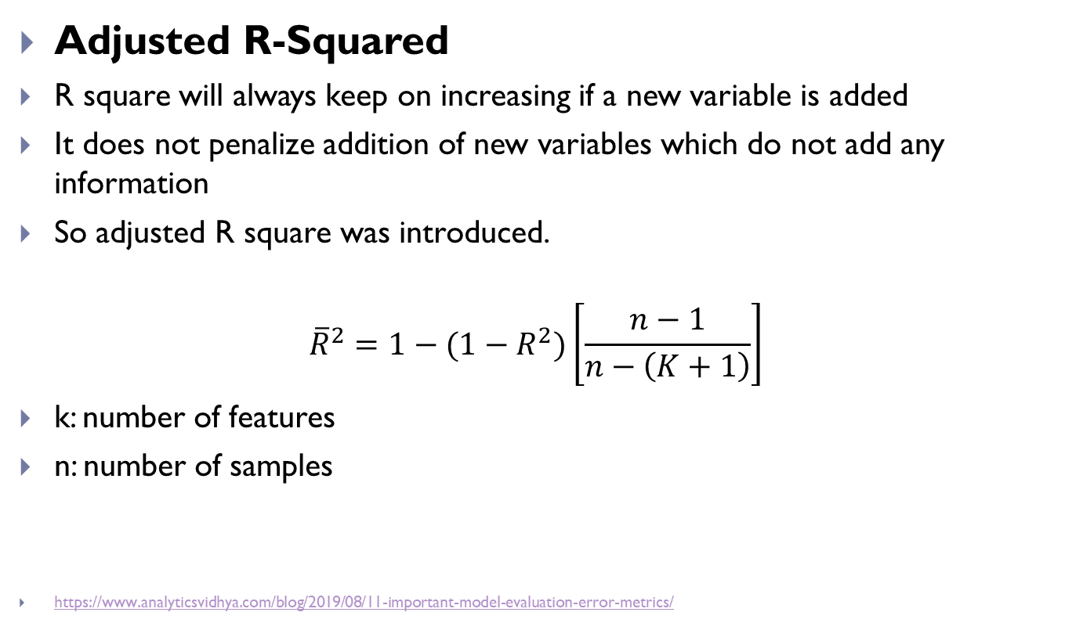
Model Evaluation Metrics for Regression
Adjusted R-Squared
R square will always keep on increasing if a new variable is added
It does not penalize addition of new variables which do not add any information
So adjusted R square was introduced.
$${\overline{R}}^{2}=1−(1−R^{2})\left[\frac{n−1}{n−\left(K+1\right)}\right]$$
k: number of features
n: number of samples
https://www.analyticsvidhya.com/blog/2019/08/11-important-model-evaluation-error-metrics/

Slide 13
Logistic Regression
Logistic Regression is used to predict the probability of categorical dependent variable
E.g. To predict if a customer will default (1) or not (0)
LogReg model predicts P(Y=1) as a function of X.
Binary Logistic regression : where the dependent categorical variable is Binary or Dichotomous.
Multinomial Logistic regression : where dependent categorical variable has more than two classes ( e.g. temperature : High, Medium, Low)

Slide 14
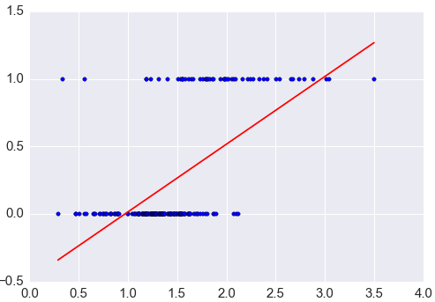
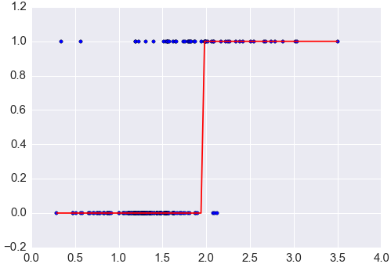
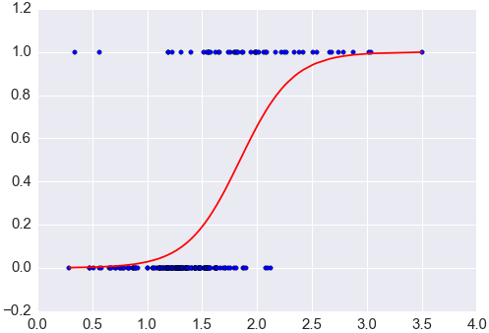
Why can’t LinReg be used???
Fig 1
Fig 2
Fig 1 – Y_{pred} vs X plot using LinReg instead of LogReg
Fig 2 – Binary Y_{pred} vs X plot using LinReg instead of LogReg
Fig 3 – Y_{pred} vs X plot using Logistic Regression
Fig 3

Slide 15
Relation between probability and Odds -
Probability = one outcome / all outcomes
Odds = one outcome / all other outcomes
Odds = probability / (1- probability)
Probability = odds / (1 + odds)
E.g.
probability of getting 2 from a dice throw = 1/6 (all 6 faces)
Odds of getting 2 from a dice throw = 1/5 (all faces but 2)
Using formula, odds = (1/6)/(1-1/6) = 1/5
Using formula, probability = (1/5)/(1-1/5) = 1/6

Slide 16
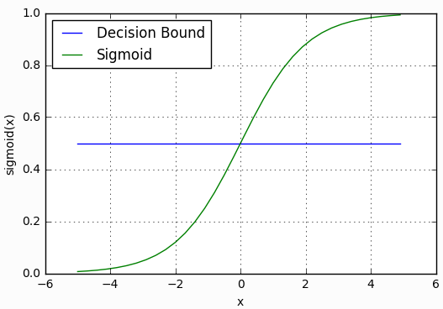

Sigmoid or Logistic Function
In order to map predicted values to probabilities, we use the sigmoid / logistic function.
The sigmoid function maps any real value into another value between 0 and 1.
In machine learning, we use sigmoid function to map predictions to probabilities.
$S\left(z\right)=\frac{1}{1+e^{−z}}$
S(-inf) = 0
S(0) = 0.5
S(inf) = 1
Decision boundary is used to convert
Probabilities to discrete values
S(z) >= 0.5 then y = 1
S(z) < 0.5 then y = 0

Slide 17
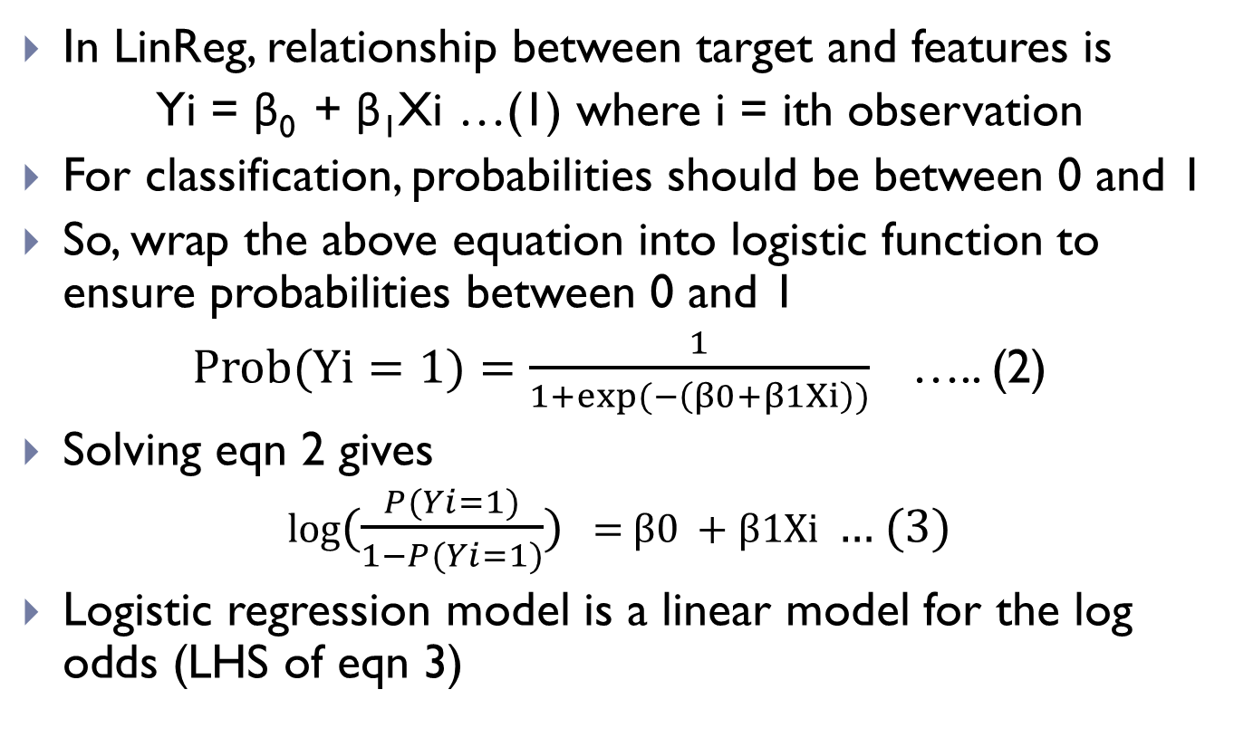
Steps from Linear to Logistic Regression
In LinReg, relationship between target and features is
Yi = β₀ + β₁Xi …(1) where i = ith observation
For classification, probabilities should be between 0 and 1
So, wrap the above equation into logistic function to ensure probabilities between 0 and 1
$Prob(Yi=1)=\frac{1}{1+exp⁡(−\left(β0+β1Xi\right))}$ ….. (2)
Solving eqn 2 gives
log($\frac{P(Yi=1)}{1−P(Yi=1)})$ = β0 + β1Xi … (3)
Logistic regression model is a linear model for the log odds (LHS of eqn 3)

Slide 18
Decision Boundary
Eqn 2 returns probability score (p) for (y = 1) which ranges from 0 to 1.
In order to map this to a discrete class, we select a threshold value such that
If p ≥ threshold, then Y_{pred} = 1
If p < threshold, then Y_{pred} = 0
E.g. if p = 0.4 and threshold = 0.5, then Y_{pred} = 0
The optimum threshold can be taken as that threshold for which Fscore is maximum.

Slide 19
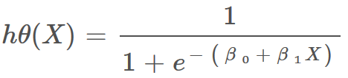
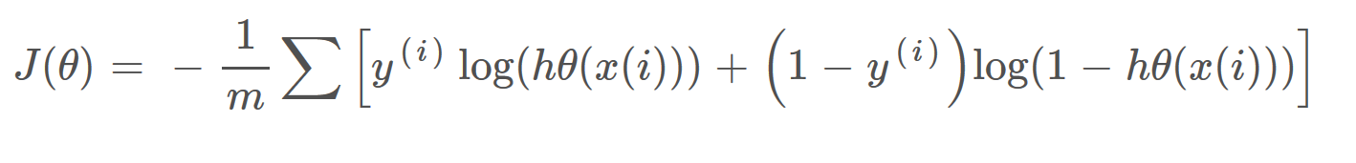
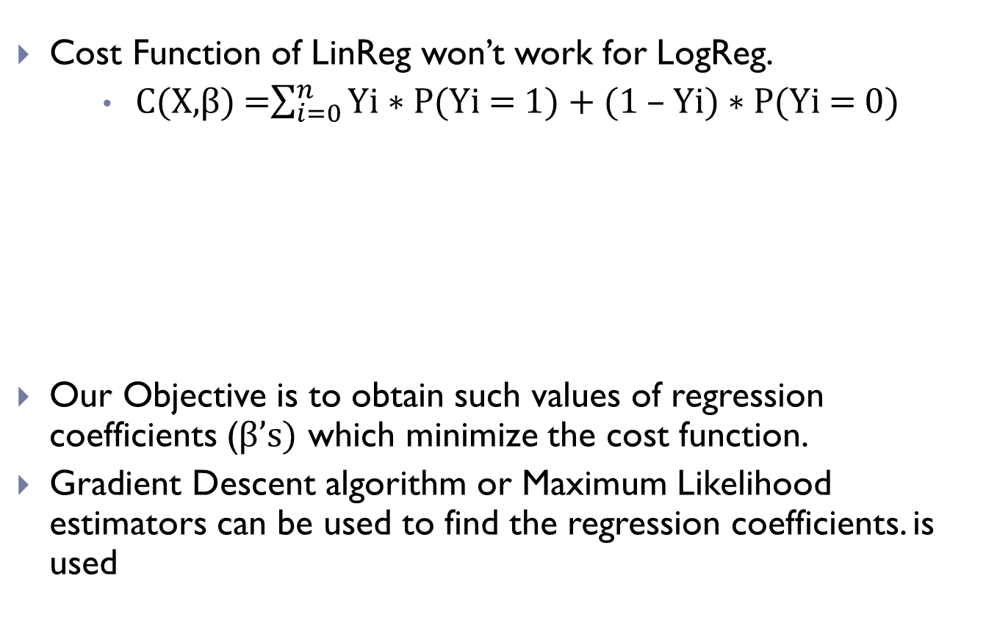
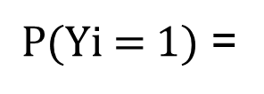
Cost Function of Logistic Regression
Cost Function of LinReg won’t work for LogReg.
C(X,β) =$\sum_{i=0}^{n}{\text{Yi}\text{ ∗ }\text{P}\text{(}\text{Yi}\text{ = 1) + (1 – }\text{Yi}\text{) ∗ }\text{P}\text{(}\text{Yi}\text{ = 0)}}$
Our Objective is to obtain such values of regression coefficients (β’s) which minimize the cost function.
Gradient Descent algorithm or Maximum Likelihood estimators can be used to find the regression coefficients. is used
$\text{P}\text{(}\text{Yi}\text{ = 1)}$ =

Slide 20
Assumptions of Logistic Regression
The logistic regression assumes that there is minimal or no multicollinearity among the independent variables.
The Logistic regression assumes that the independent variables are linearly related to the log of odds.
The Logistic regression assumes the observations to be independent of each other.
The logistic regression usually requires a large sample size to predict properly.
The Logistic regression which has two classes assumes that the dependent variable is binary
The Logistic regression assumes that P(Y=1) is the probability of the event occurring, it is necessary that the dependent variable is coded accordingly.
https://medium.com/@dhiraj8899/top-5-assumptions-for-logistic-regression-96b11d24d357

Slide 21
Model Evaluation Metrics for Classification
A. Confusion Matrix
It is a matrix of actual and predicted target variable.
Definition of the Terms: • Positive (P) : Observation is positive • Negative (N) : Observation is not positive
• True Positive (TP) : Observation is positive, and is predicted to be positive. • False Negative (FN) : Observation is positive, but is predicted negative. • True Negative (TN) : Observation is negative, and is predicted to be negative • False Positive (FP) : Observation is negative, but is predicted positive.
Confusion Matrix | Predicted Positive | Predicted Negative
Actual Positive | TP | FN
Actual Negative | FP | TN

Slide 22
Model Evaluation Metrics for Classification
1. Accuracy = (TP+TN)/(TP+TN+FP+FN)
2. Specificity(True negative rate) - the proportion of actual negatives, which got predicted as the negative
Specificity = TN/(TN+FP)
3. Recall or sensitivity - proportion of actual positive cases that got predicted as positive
Recall(R) = TP/(TP+FN)
4. Precision indicates an example labeled as positive is indeed positive (small number of FP).
Precision(P) = TP/(TP+FP)
5. F measure is unified representation of recall & precision
The F-Measure will always be nearer to the smaller value of Precision or Recall.
F measure = 2*R*P/(R+P)
https://classeval.wordpress.com/introduction/basic-evaluation-measures/

Slide 23
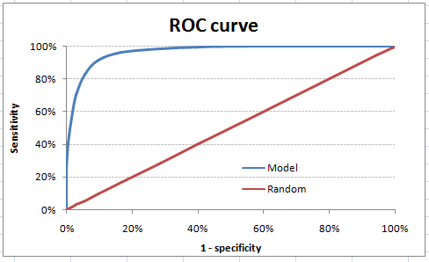
Model Evaluation Metrics for Classification
B) ROC Curve
AUC - ROC curve is a performance measurement for classification problem at various probability threshold settings.
ROC is a probability curve and AUC represents degree or measure of separability.
It tells how much our model is capable of distinguishing between classes.
https://towardsdatascience.com/understanding-auc-roc-curve-68b2303cc9c5

Slide 24
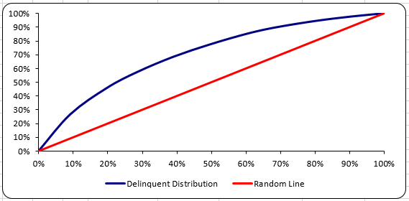
Model Evaluation Metrics for Classification
C) Gini Value & Curve
Gini curve is the plot of cumulative Non Event % vs cumulative Event %
KS value = max(cumulative event % – cumulative non event %) across all bins
Gini Value = 2*Area under curve - 1
THE END

