Slide 1
Intro to Machine Learning
Mamidi Sudheer

Slide 2
Modeling procedure ppt (Train/Test split, missing value imputation, data transformation, scaling etc, over fit/underfit , also we can add normal distribution & confidence interval concepts for outlier detection )
Will be mostly on Sep 21

Slide 3
Definition of Machine Learning
A computer program is said to learn from experience E with some class of tasks T and performance measure P if its performance at tasks in T, as measured by P, improves with experience E.” -Tom M. Mitchell
Machine learning is a type of artificial intelligence (AI) that provides computers with the ability to learn without being explicitly programmed
Problem Type | TASK | Performance | Experience
Regression | Estimating number of calls in a duration | Mean Squared Error | Calls obtained in past
Classification | Estimating if a customer will default or not | Cross Entropy | Customers’ Behavior in past

Slide 4
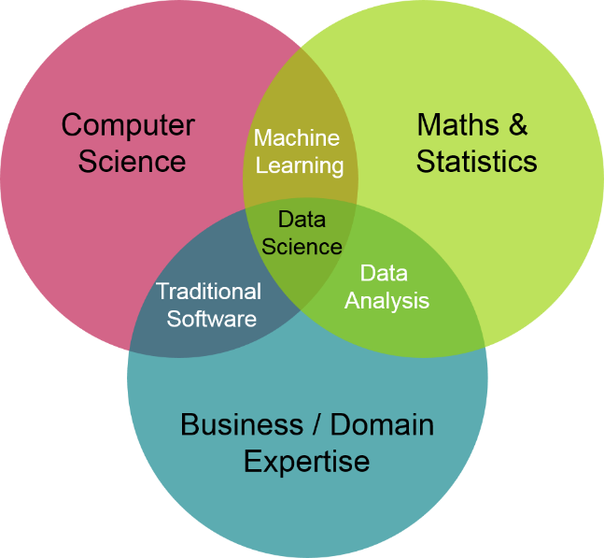
Applications of ML
We all use it on a daily basis. Some Examples are as follow
Spam filtering •
Credit card fraud detection •
Digit recognition on checks, zip codes •
Detecting faces in images •
MRI image analysis •
Recommendation system •
Handwriting recognition •

Slide 5
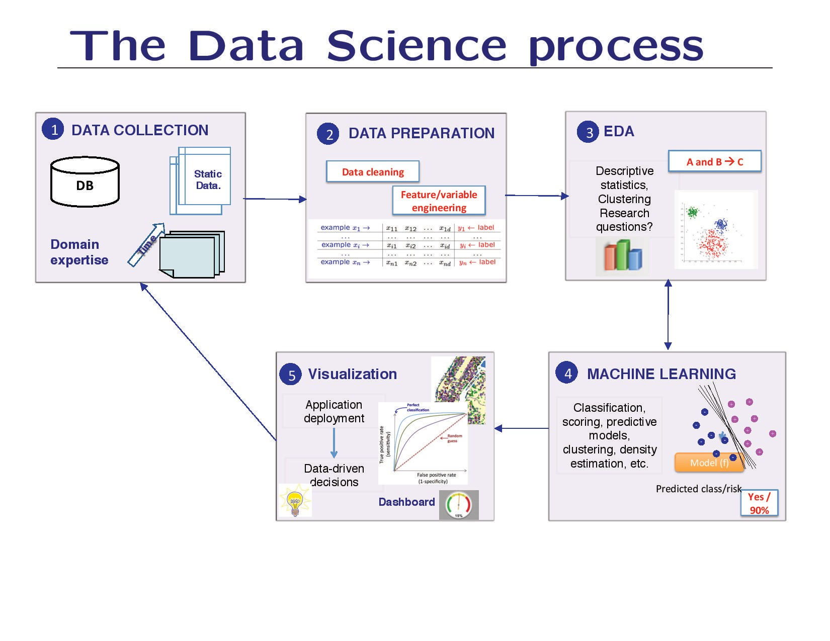

Slide 6
Types of Machine Learning
Supervised
Un Supervised
Reinforced
Source - https://machinelearningmastery.com/supervised-and-unsupervised-machine-learning-algorithms/

Slide 7
Supervised
Supervised learning is where you have input variables (x) and an output variable (Y) and you use an algorithm to learn the mapping function from the input to the output. i.e Y = f(X)
The goal is to approximate the mapping function so well that when you have new input data (x) that you can predict the output variables (Y) for that data.
Supervised learning problems can be further grouped into regression and classification problems.
Classification: A classification problem is when the output variable is a category, such as “red” or “blue” or “disease” and “no disease”. E.g. Logistic Regression
Regression: A regression problem is when the output variable is a real value, such as “dollars” or “weight”. E.g. Linear Regression

Slide 8
Unsupervised
Unsupervised learning is where you only have input data (X) and no corresponding output variables.
The goal for unsupervised learning is to model the underlying structure or distribution in the data in order to learn more about the data.
Unsupervised learning problems can be further grouped into clustering and association problems.
Clustering: A clustering problem is where you want to discover the inherent groupings in the data, such as grouping customers by purchasing behavior. e.g K means
Association: An association rule learning problem is where you want to discover rules that describe large portions of your data, such as people that buy X also tend to buy Y. e.g. Apriori Algorithm

Slide 9
Pros & Cons of Machine Learning
Handles complex relationship between predictor & response
Ability to take larger number of variables
Faster to execute and high accuracy
Interpretation seems difficult for larger set of
audience

Slide 10
Pre work
Define Model windows – Observation/Performance window
Target Definition Good Bad finalization
Data Preparation, treatment/ management
Feature Engineering Data transforming

Slide 11
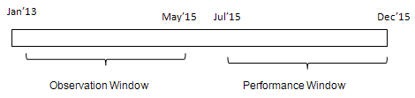
Observation/Performance window
The first step of building a predictive model is to choose period for predictors (independent variables) and target variable (dependent variable)
Observation Period
It is the period from where independent variables /predictors come from. In other words, the independent variables are created considering this period (window) only.
Performance Period
It is the period from where dependent variable /target come from. It is the period following the observation window.
Source - https://www.listendata.com/2016/08/observation-and-performance-window.html

Slide 12
Target Definition
Definition of Target should be defined clearly to avoid confusion of any sort.

Slide 13
Univariate & Bivariate Analysis
Univariate
Considers 1 variable at a time
Summarizes & finds pattern in a variable using mean, median, mode, range, variance, standard deviation, max, min, quartiles.
Other ways - Frequency Distribution Tables, Bar Charts, Histograms
Bivariate
Considers exactly 2 variables at a time
Summarises and finds pattern in 2 variables using
Scatter Plots, regression Analysis, Correlation Coefficients

Slide 14
Missing value treatment (Imputation)
All the missing values must be filled with an appropriate value. Some examples of missing value treatment are
Missing values in simple count or amount variable are replaced by 0
Missing values in proportion variables are replaced by high values or -1 based on intuition.
Infinite values are generally changed to high numbers as placeholders
Scores of the network where not available are replaced by -1.
Standard deviation and mean variables are treated as -1.
NA values in categorical variable can be treated as new level of that variable.

Slide 15
Feature Engineering
Relevance of data / Intuition/Business sense
Summarising using mean etc few fields may give better fields
Certain surrogate field variable
Creating variables from the fields which can not be used directly in the model.
E.g calculating variable ‘vintage’ from account open date,
E.g creating ‘number of numerics’ from address of customers,

Slide 16
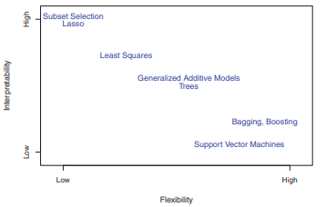
ML
Model Selection/ Error Estimation
The process of evaluating a model’s performance is known as model assessment, whereas model the process of selecting the proper level of flexibility for a model is known as assessment model selection.
Bias Variance trade off
Over fitting – Under fitting

Slide 17
Model Selection/ Error Estimation
Hold out method
Cross validation ( k )

Slide 18
Hold out Method
Train/Test split
Model on train data
Test that on hold out data

Slide 19
K-cross validation
Process carried out k times
Overall performance is avergae of k-test partitions
It doesn’t matter how data divided
Computation complexity

Slide 20
Three way split
Training/ Validation/ Test

Slide 21
Bias Variance tradeoff
Bias is the difference between the average prediction of our model and the correct value which we are trying to predict. It always leads to high error on training and test data
Variance is the variability of model prediction for a given data point or a value which tells us spread of our data. Model with high variance pays a lot of attention to training data and does not generalize on the data which it hasn’t seen before

Slide 22
