Slide 1
Model Evaluation

Slide 2
Table of Contents
Confusion Matrix
Gain Chart
Gini Index
Kolmogorov Smirnov Chart
AUC – ROC
Gini Coefficient

Slide 3
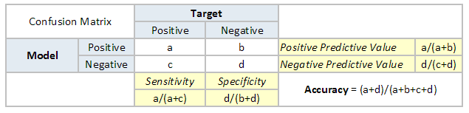
Confusion Matrix

Slide 4
Gain Chart
Rank the scored file, in descending order by estimated probability
Split the ranked file into 10 sections (deciles)
Number of observations in each decile
Number of actual events in each decile
Number of cumulative actual events in each decile
Percentage of cumulative actual events in each decile. It is called Gain Score

Slide 5
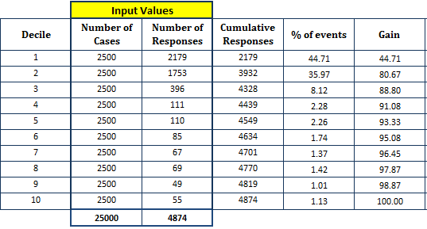
Gain

Slide 6
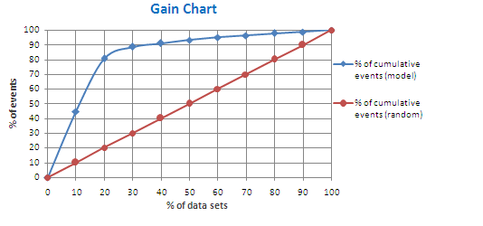
Gain Chart
Gain at a given decile level is the ratio of cumulative number of targets (events) up to that decile to the total number of targets (events) in the entire data set

Slide 7
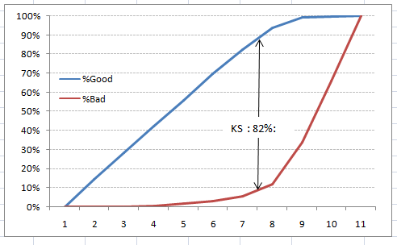
KS curve
discriminatory power of the model in separating “Good” from “Bad”
Highest diff between cumulative good and cumulative bad

Slide 8
ROC curve
AUC - ROC curve is a performance measurement for classification problem at various thresholds settings.
ROC is a probability curve and AUC represents degree or measure of separability.
It tells how much model is capable of distinguishing between classes

Slide 9
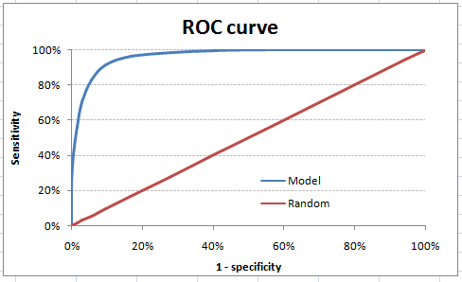
ROC curve
Sensitivity / specificity

Slide 10
ROC
Hence AUC itself is the ratio under the curve and the total area.

