Slide 1
Intro to Machine Learning
Mamidi Sudheer

Slide 2
Definition of Machine Learning
A computer program is said to learn from experience E with some class of tasks T and performance measure P if its performance at tasks in T, as measured by P, improves with experience E.” -Tom M. Mitchell
Machine learning is a type of artificial intelligence (AI) that provides computers with the ability to learn without being explicitly programmed.
Problem Type | TASK | Performance | Experience
Regression | Estimating number of calls in a duration | Mean Squared Error | Calls obtained in past
Classification | Estimating if a customer will default or not | Cross Entropy | Customers’ Behavior in past

Slide 3
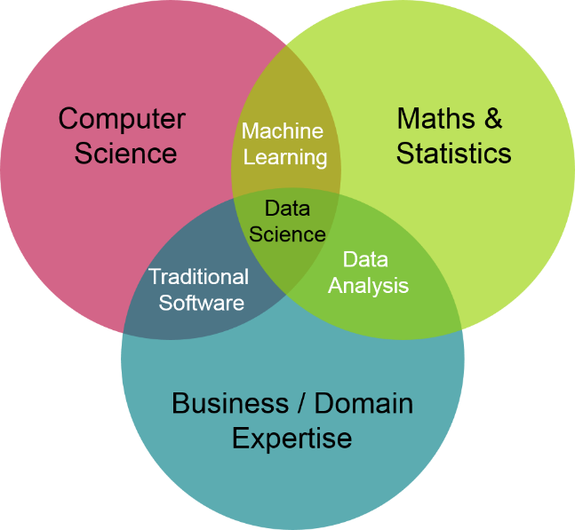
Applications of ML
We all use it on a daily basis. Some Examples are as follow
Spam filtering •
Credit card fraud detection •
Digit recognition on checks, zip codes •
Detecting faces in images •
MRI image analysis •
Recommendation system •
Handwriting recognition •

Slide 4
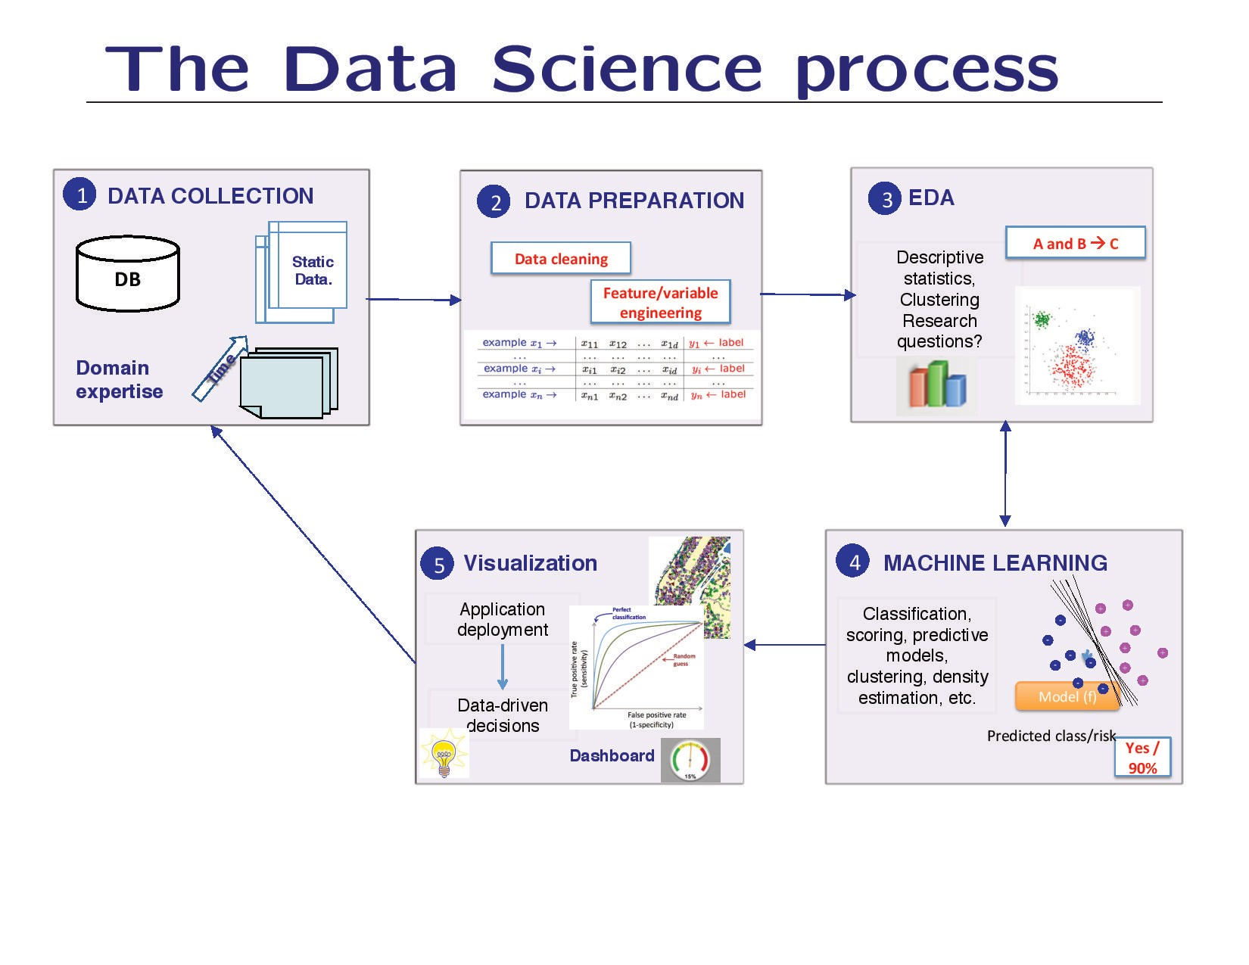

Slide 5
Types of Machine Learning
Supervised
Un Supervised
Reinforced
Source - https://machinelearningmastery.com/supervised-and-unsupervised-machine-learning-algorithms/

Slide 6
Supervised Learning
Supervised learning is where you have input variables (x) and an output variable (Y) and you use an algorithm to learn the mapping function from the input to the output. i.e Y = f(X)
The goal is to approximate the mapping function so well that when you have new input data (x) that you can predict the output variables (Y) for that data.
Supervised learning problems can be further grouped into regression and classification problems.
Classification: A classification problem is when the output variable is a category, such as “red” or “blue” or “disease” and “no disease”. E.g. Logistic Regression
Regression: A regression problem is when the output variable is a real value, such as “dollars” or “weight”. E.g. Linear Regression

Slide 7
Unsupervised Learning
Unsupervised learning is where you only have input data (X) and no corresponding output variables.
The goal for unsupervised learning is to model the underlying structure or distribution in the data in order to learn more about the data.
Unsupervised learning problems can be further grouped into clustering and association problems.
Clustering: A clustering problem is where you want to discover the inherent groupings in the data, such as grouping customers by purchasing behavior. e.g K means
Association: An association rule learning problem is where you want to discover rules that describe large portions of your data, such as people that buy X also tend to buy Y. e.g. Apriori Algorithm

Slide 8
Pros & Cons of Machine Learning
Handles complex relationship between predictor & response
Ability to take larger number of variables
Faster to execute and high accuracy
Interpretation seems difficult for larger set of
audience

Slide 9
Pre work
Define Model windows – Observation/Performance window
Target Definition Good Bad finalization
Data Preparation, treatment/ management
Feature Engineering Data transforming

Slide 10
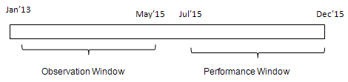
Observation/Performance window
The first step of building a predictive model is to choose period for predictors (independent variables) and target variable (dependent variable)
Observation Period
It is the period from where independent variables /predictors come from. In other words, the independent variables are created considering this period (window) only.
Performance Period
It is the period from where dependent variable /target come from. It is the period following the observation window.
Source - https://www.listendata.com/2016/08/observation-and-performance-window.html

Slide 11
Target Definition
Definition of Target should be defined clearly to avoid confusion of any sort.

Slide 12
Univariate & Bivariate Analysis
Univariate
Considers 1 variable at a time
Summarizes & finds pattern in a variable using mean, median, mode, range, variance, standard deviation, max, min, quartiles.
Other ways - Frequency Distribution Tables, Bar Charts, Histograms
Bivariate
Considers exactly 2 variables at a time
Summarises and finds pattern in 2 variables using
Scatter Plots, regression Analysis, Correlation Coefficients

Slide 13
Missing value treatment (Imputation)
All the missing values must be filled with an appropriate value. Some examples of missing value treatment are
Missing values in simple count or amount variable are replaced by 0
Missing values in proportion variables are replaced by high values or -1 based on intuition.
Infinite values are generally changed to high numbers as placeholders
Scores of the network where not available are replaced by -1.
Standard deviation and mean variables are treated as -1.
NA values in categorical variable can be treated as new level of that variable.

Slide 14
Feature Engineering
Creating variables from the fields which can not be used directly in the model.
E.g calculating variable ‘vintage’ from account open date,
E.g creating ‘number of numerics’ from address of customers
Summarising few variables using aggregating function to create new variable
Certain surrogate field variable

Slide 15
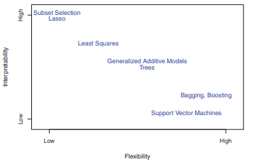
ML
Model Selection/ Error Estimation
The process of evaluating a model’s performance is known as model assessment, whereas model the process of selecting the proper level of flexibility for a model is known as assessment model selection.

Slide 16

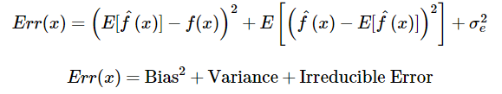
Bias vs Variance Tradeoff
Bias is the difference between the average prediction of our model and the correct value which we are trying to predict. Model with high bias pays very little attention to the training data and oversimplifies the model. It always leads to high error on training and test data.
Variance is the variability of model prediction for a given data point or a value which tells us spread of our data. Model with high variance pays a lot of attention to training data and does not generalize on the data which it hasn’t seen before. As a result, such models perform very well on training data but has high error rates on test data.
Y = f(x) + e

Slide 17
Bias Variance tradeoff
Bias is the difference between the average prediction of our model and the correct value which we are trying to predict. It always leads to high error on training and test data
Variance is the variability of model prediction for a given data point or a value which tells us spread of our data. Model with high variance pays a lot of attention to training data and does not generalize on the data which it hasn’t seen before

Slide 18
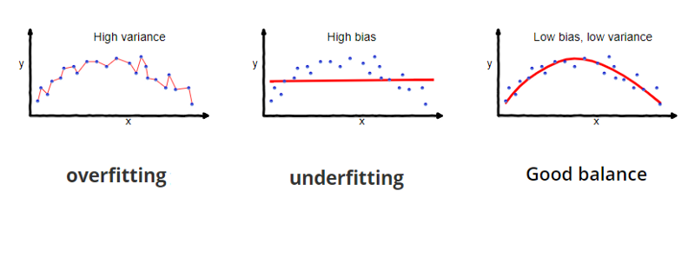
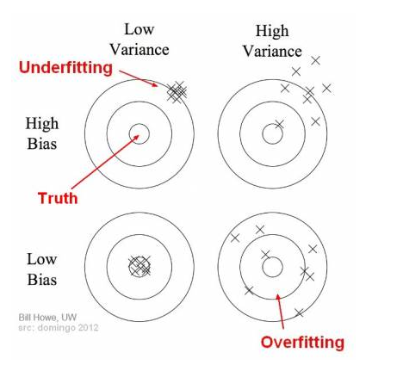
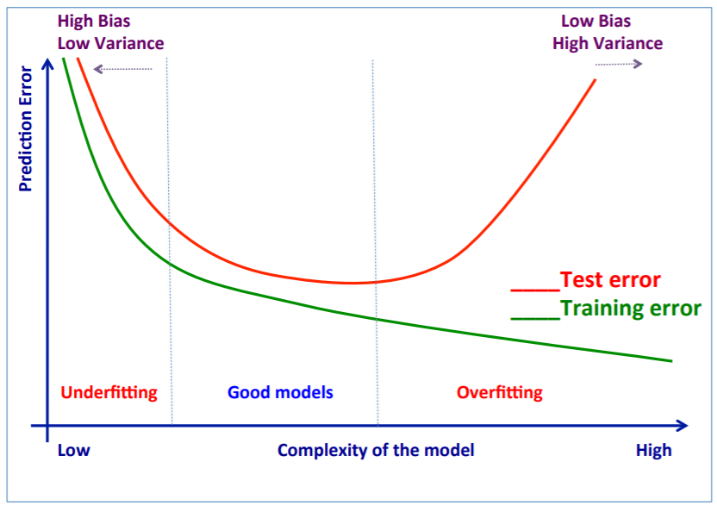
Bias vs Variance Tradeoff
Source https://towardsdatascience.com/understanding-the-bias-variance-tradeoff-165e6942b229

Slide 19
Underfitting & Overfitting
Underfitting - when a model is unable to capture the underlying pattern of the data.
These models usually have high bias and low variance.
It happens when we have very less amount of data to build an accurate model or when we try to build a linear model with a nonlinear data.
Also, these kind of models are very simple to capture the complex patterns in data like Linear and logistic regression.
Overfitting - when our model captures the noise along with the underlying pattern in data.
It happens when we train our model a lot over noisy dataset.
These models have low bias and high variance.
These models are complex like Decision trees which are prone to overfitting.

Slide 20
Resampling methods
Repeatedly drawing samples from a training set and refitting a model of interest on each sample in order to obtain additional information about the fitted model. e.g. Estimating variability of a linear regression
2 common resampling methods - cross-validation and the bootstrap.
Bootstrapping - The bootstrap method is a resampling technique used to estimate statistics like mean, sd on a population by sampling a dataset with replacement.
Cross-Validation is a technique for evaluating ML models by training several ML models on training data and evaluating them on the test data. It is used to detect overfitting.
can be used to estimate the test error associated with a given statistical learning method in order to evaluate its performance, or to select the appropriate level of flexibility.
The process of evaluating a model’s performance is known as model assessment, whereas model the process of selecting the proper level of flexibility for a model is known as assessment model selection

Slide 21
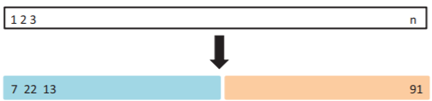
Types of Cross Validation (CV)
Hold out method
we reserve 70% of the dataset for validation and the remaining 30% for model training.(ratios may vary)
Chances of missing out information during training is high
A part of data is stored for testing. Model is trained on the other part of the data (train set)
Leave one out CV
Attempts to address the drawback of Hold out method
Instead of 30% of observation only 1 observation is kept for validn.
N such Models are fit on n-1 training observations.
n Predictions are done on only single observation(left out observation)

Slide 22
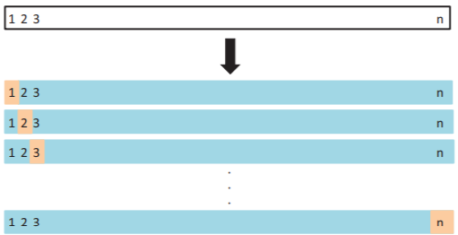
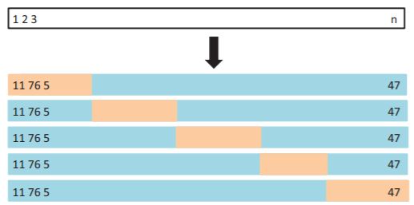
Types of Cross Validation (CV)
Advantage – Far less bias
Disadvantage – computationally extensive
k-Fold Cross-Validation (right image)
the data is divided randomly into k equal subsets
holdout method is repeated k times, such that each time, one of the k subsets is used as the test set/ validation set and the other k-1 subsets are put together to form a training set.

Slide 23
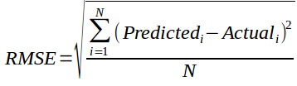
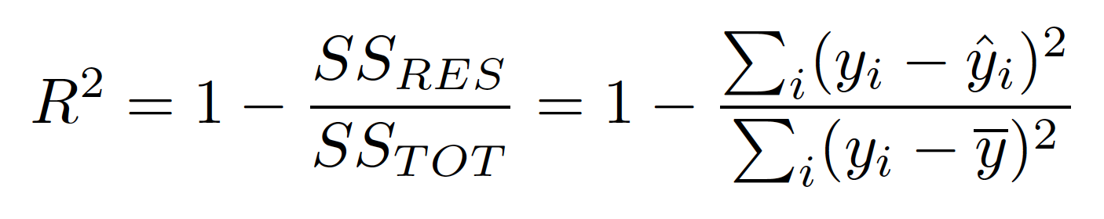
Model Evaluation Metrics for Regression
1. RMSE(root mean square error)
N is total Number of observations
2. R-Square
In R square, MSE(baseline) was added a benchmark
SS(RES) : Residual Sum of squares of model
SS(TOT) : Total Sum of squares of model (comparing the actual y values to our baseline model the mean)

Slide 24
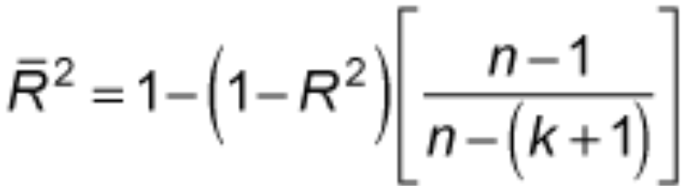
Model Evaluation Metrics for Regression
Adjusted R-Squared
R square will always keep on increasing if a new variable is added
It does not penalize addition of new variables which do not add any information
So adjusted R square was introduced.
k: number of features
n: number of samples
https://www.analyticsvidhya.com/blog/2019/08/11-important-model-evaluation-error-metrics/

Slide 25
Confusion Matrix
Gain Chart
Gini Index
Kolmogorov Smirnov Chart
AUC – ROC
Gini Coefficient

Slide 26
Model Evaluation Metrics for Classification
A. Confusion Matrix
It is a matrix of actual and predicted target variable.
Definition of the Terms: • Positive (P) : Observation is positive • Negative (N) : Observation is not positive
• True Positive (TP) : Observation is positive, and is predicted to be positive. • False Negative (FN) : Observation is positive, but is predicted negative. • True Negative (TN) : Observation is negative, and is predicted to be negative • False Positive (FP) : Observation is negative, but is predicted positive.
 | Predicted Positive | Predicted Negative
Actual Positive | TP | FN
Actual Negative | FP | TN

Slide 27
Model Evaluation Metrics for Classification
1. Accuracy = (TP+TN)/(TP+TN+FP+FN)
2. Specificity(True negative rate) = TN/(TN+FP)
3. Recall or sensitivity - High Recall indicates the class is correctly recognized (small number of FN)
Recall(R) = TP/(TP+FN)
4. Precision indicates an example labeled as positive is indeed positive (small number of FP).
Precision(P) = TP/(TP+FP)
5. F measure is unified representation of recall & precision
The F-Measure will always be nearer to the smaller value of Precision or Recall.
F measure = 2*R*P/(R+P)
https://classeval.wordpress.com/introduction/basic-evaluation-measures/

Slide 28
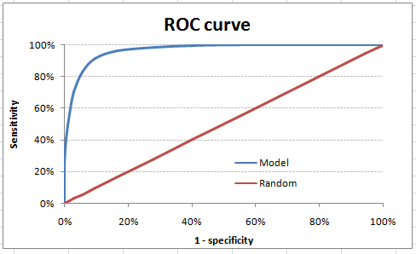
Model Evaluation Metrics for Classification
B. ROC Curve
AUC - ROC curve is a performance measurement for classification problem at various thresholds settings.
ROC is a probability curve and AUC represents degree or measure of separability.
It tells how much model is capable of distinguishing between classes

Slide 29
Gini Value & Curve

