Slide 1
A Comparative and Explainable
Machine Learning System for
AI-Generated Text Detection
PRG4206 Individual Machine Learning Project
I26043592 — Vishnu Vardhan
HC3 benchmark | Classical ML | Explainability
Notes:
Good morning. My project is a comparative and explainable machine learning system for detecting AI-generated text. The goal is to distinguish human-written and AI-generated answers using the HC3 benchmark and compare three classical machine learning approaches. The final system also provides explainability so that predictions are not treated as a black box.

Slide 2
Problem and research gap
PRG4206 Machine Learning | I26043592 — Vishnu Vardhan
• AI-generated text now appears in education, business, and online information.
• Detector performance can depend strongly on the dataset and writing domain.
• This project compares simple, reproducible, and explainable machine learning models.
Research questions
• How accurately can classical ML separate AI and human text?
• Which model performs best, and is the difference statistically meaningful?
• Which linguistic and stylometric signals influence predictions?
02
Notes:
The problem is increasingly important because AI-generated text is now common in education, business and online information. However, detector performance can depend strongly on the dataset and writing domain. My project therefore focuses on a rigorous comparison of simple, reproducible and explainable machine learning models. The main research questions are accuracy, whether differences are statistically meaningful, and which linguistic and stylometric signals influence predictions.

Slide 3
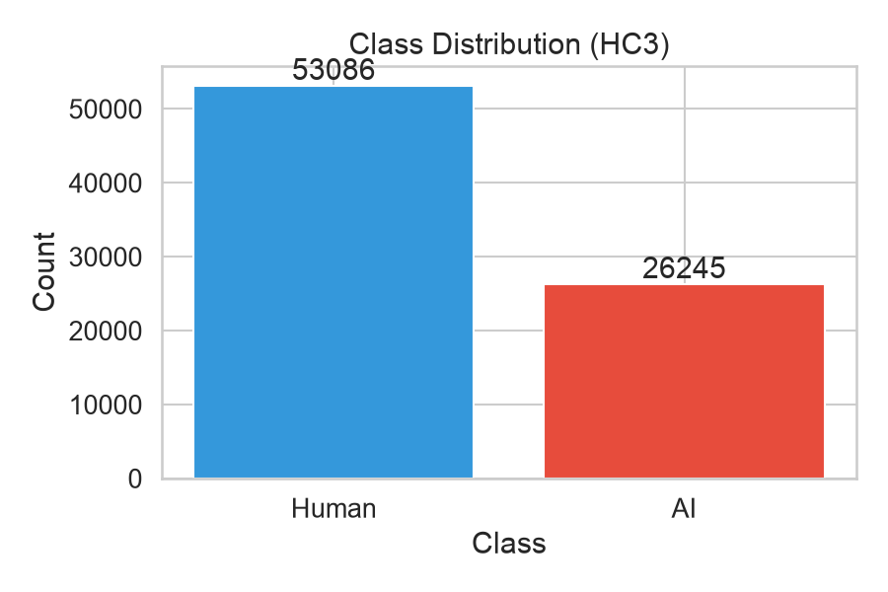
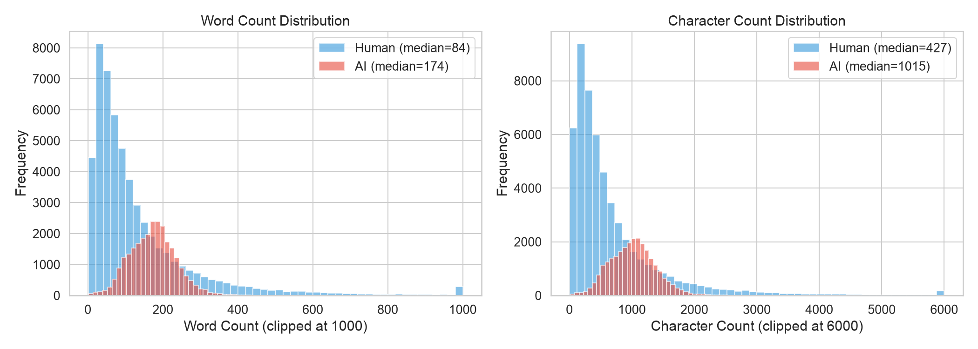
HC3 dataset and exploratory analysis
PRG4206 Machine Learning | I26043592 — Vishnu Vardhan
79,331
clean answer samples
• 53,086 Human samples (66.9%)
• 26,245 AI samples (33.1%)
• Stratified split: 70% train, 15% validation, 15% test
• Held-out test set: 11,900 samples
• Five domains: Reddit ELI5, finance, open QA, medicine, wiki-CSAI
03
Notes:
I used the HC3 Human ChatGPT Comparison Corpus, released in 2023. After cleaning and removing exact duplicates, the final dataset contains 79,331 answer samples. There are 53,086 human samples and 26,245 AI samples. I used a stratified 70 percent training, 15 percent validation and 15 percent test split with random seed 42. The dataset covers five domains: Reddit ELI5, finance, open QA, medicine and wiki-CSAI. The exploratory analysis also showed differences in text length and writing characteristics between human and AI answers.

Slide 4
Methodology and deployed system
PRG4206 Machine Learning | I26043592 — Vishnu Vardhan
TF-IDF lexical models
Stylometric model
• Logistic Regression + TF-IDF
• Linear SVM + TF-IDF
• Five-fold stratified cross-validation
• SVM probabilities calibrated with Platt scaling
• XGBoost
• 21 engineered structural and stylometric features
• Examples: word length, paragraph count, lexical diversity
Training data → feature representation → tuned model → evaluation and XAI → Streamlit prototype
04
Notes:
The system contains three benchmark models. Logistic Regression and Linear SVM use TF-IDF lexical features. XGBoost uses 21 engineered stylometric and structural features, including word length, paragraph count and lexical diversity. Hyperparameters were tuned using five-fold stratified cross-validation. SVM probabilities were also calibrated using Platt scaling. The pipeline then performs quantitative evaluation and explainability, with the trained models exposed through a Streamlit prototype.

Slide 5
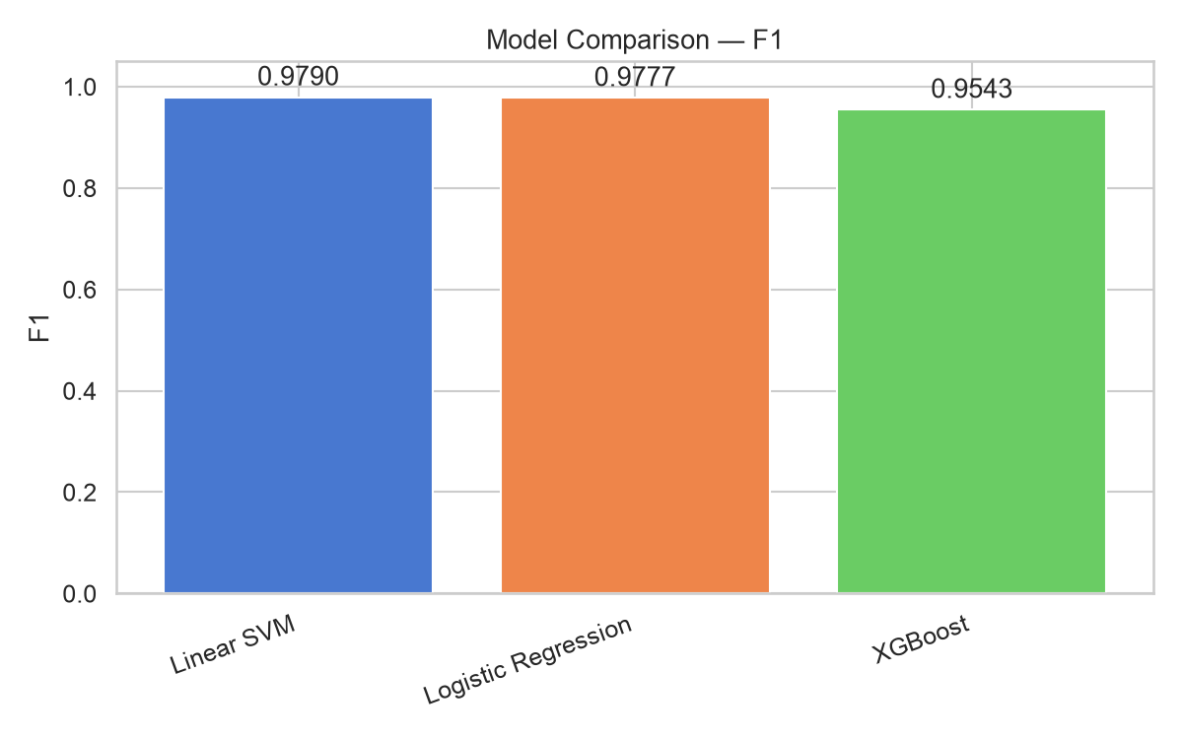
Held-out test results
PRG4206 Machine Learning | I26043592 — Vishnu Vardhan
Linear SVM
98.61% accuracy | 97.90% F1 | 99.86% ROC-AUC
Logistic Regression
98.53% accuracy | 97.77% F1 | 99.87% ROC-AUC
XGBoost
96.95% accuracy | 95.43% F1 | 99.43% ROC-AUC
McNemar: SVM vs LR p = 0.1443. The difference is not statistically significant. Both linear models significantly outperform XGBoost.
05
Notes:
On the held-out test set, Linear SVM achieved 98.61 percent accuracy and 97.90 percent F1. Logistic Regression achieved 98.53 percent accuracy and 97.77 percent F1. XGBoost achieved 96.95 percent accuracy and 95.43 percent F1. All three models achieved ROC-AUC above 99 percent. The corrected McNemar test between SVM and Logistic Regression produced a p-value of 0.1443. Therefore, although SVM has the slightly higher F1 score, the difference is not statistically significant. Both linear models significantly outperform XGBoost in the paired test comparisons.

Slide 6
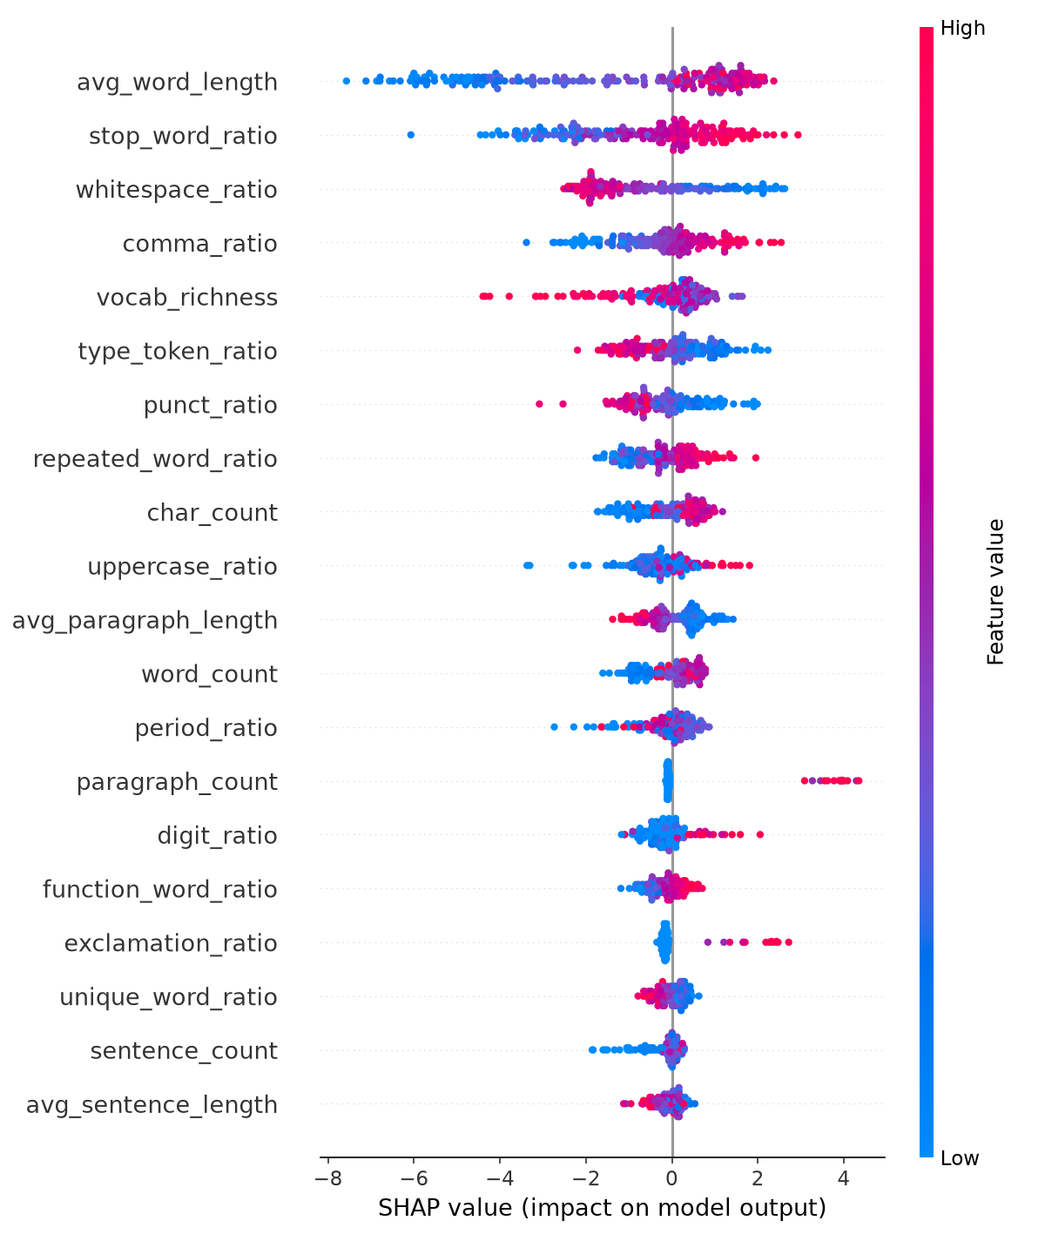
Explainability and error analysis
PRG4206 Machine Learning | I26043592 — Vishnu Vardhan
Top XGBoost features
• Average word length — 22.44%
• Paragraph count — 11.67%
• Unique-word ratio — 11.52%
• Type-token ratio — 6.40%
• Character count — 5.44%
AI-associated patterns: “in summary”, “furthermore”, “overall”, “important to note”. Human-associated patterns: contractions, informal expressions, “ts;dr”, “lol”, emotional punctuation.
These are model-associated patterns, not proof that a phrase is always AI-generated.
06
Notes:
For explainability, the strongest XGBoost feature was average word length, followed by paragraph count and unique-word ratio. The lexical analysis also identified formal transition phrases such as in summary, furthermore and overall as patterns associated with AI predictions. In contrast, contractions, informal expressions and emotional punctuation were more associated with human text. The model also performs differently across domains. Medicine has extremely high performance, while wiki-CSAI is the weakest domain for the SVM model. This shows why domain generalisation is an important limitation.

Slide 7
Live prototype demonstration
PRG4206 Machine Learning | I26043592 — Vishnu Vardhan
Demo sequence
Important demo note
• Select the active model
• Test an informal human-style passage
• Test the supplied structured passage
• Switch among SVM, Logistic Regression, and XGBoost
• Inspect prediction, confidence, statistics, and available word-level explanation
Show the model’s actual output. In verification, the supplied structured sample is classified as Human-Written by all three saved models. Do not describe it as a successful AI detection.
Use the Streamlit application for this section. The deck intentionally does not fabricate app screenshots or prediction outcomes.
07
Notes:
Now I will demonstrate the working prototype. The application allows me to select a trained model, enter text, obtain a prediction and inspect the associated explanation. For the first test case, I am using an informal conversational example. I will submit the text and allow the selected model to make the prediction. For the second test case, I am using a more formal and structured example. Again, I am not manually assigning the label. The trained model produces the prediction. For the final test, I am comparing the models using the same input. SVM and Logistic Regression use TF-IDF lexical representations, while XGBoost uses engineered stylometric features. This demonstrates how different feature representations can lead to different model behaviour. This completes the live demonstration of the detection and explainability workflow.

Slide 8
Conclusion and responsible use
PRG4206 Machine Learning | I26043592 — Vishnu Vardhan
TF-IDF with linear classifiers achieved strong HC3 benchmark performance while remaining fast, reproducible, and explainable.
• Best held-out test F1: 97.90% with Linear SVM
• SVM and Logistic Regression did not differ significantly in paired testing
• Dataset characteristics and domain shift limit generalisation
• Future work: cross-dataset evaluation, robustness, multilingual evaluation, and improved calibration
Treat detector output as decision support, not definitive evidence of authorship.
08
Notes:
In conclusion, the experiments show that TF-IDF with linear classifiers can provide very strong performance on the HC3 benchmark while remaining fast, reproducible and explainable. The best test F1 was 97.90 percent. However, the results should not be interpreted as universal proof of authorship because dataset characteristics and domain shift can affect performance. Future work will focus on cross-dataset evaluation, paraphrase and adversarial robustness, multilingual evaluation and improved calibration. The detector should therefore be treated as decision support rather than definitive evidence of who wrote a piece of text. Thank you.

