Slide 1
AI Side-Channel Attack Model
Cryptographic Hardware Vulnerability Detection
TGG7 –GLITCHTHON-TEAM 20

Slide 2
The Challenge
Encryption Vulnerabilities
Side-channel attacks exploit physical signal leakages
Key Attack Vectors:
• Power consumption analysis
• Timing variations
• Electromagnetic emissions

Slide 3
Technical Approach
Advanced Machine Learning Models
• Neural Network Classifier
• Random Forest Classifier
Signal Analysis Techniques
• Complex feature extraction
• Realistic trace generation

Slide 4
Key Technological Components
Side-Channel Analyzer
• Synthetic trace generation
• Complex signal feature extraction
Attack Simulation Framework
• Multi-vector attack scenarios
• Comprehensive risk assessment

Slide 5
Model Training Insights
Performance Metrics
• High accuracy in vulnerability detection
Risk Level Classification
• Low Risk
• Moderate Risk
• High Critical Risk

Slide 6
Attack Simulation Results
Comprehensive Risk Assessment
• Average risk score calculation
Attack Type Coverage
• Multi-vector attacks
• Power analysis
• Timing attacks

Slide 7
Advanced Visualization Techniques
Model Prediction Alignment
• Sankey Diagram
Vulnerability Analysis
• Multi-Dimensional Heatmap
• Probabilistic Risk Distribution

Slide 8
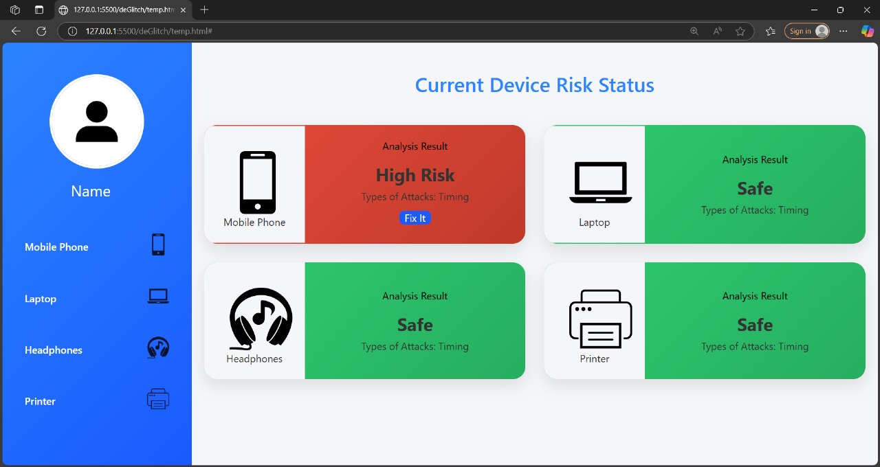

Slide 9
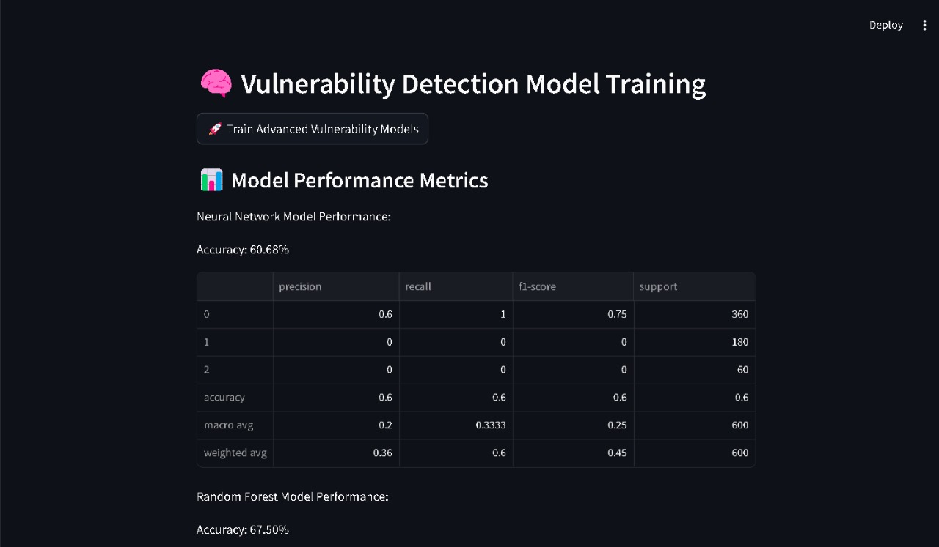

Slide 10
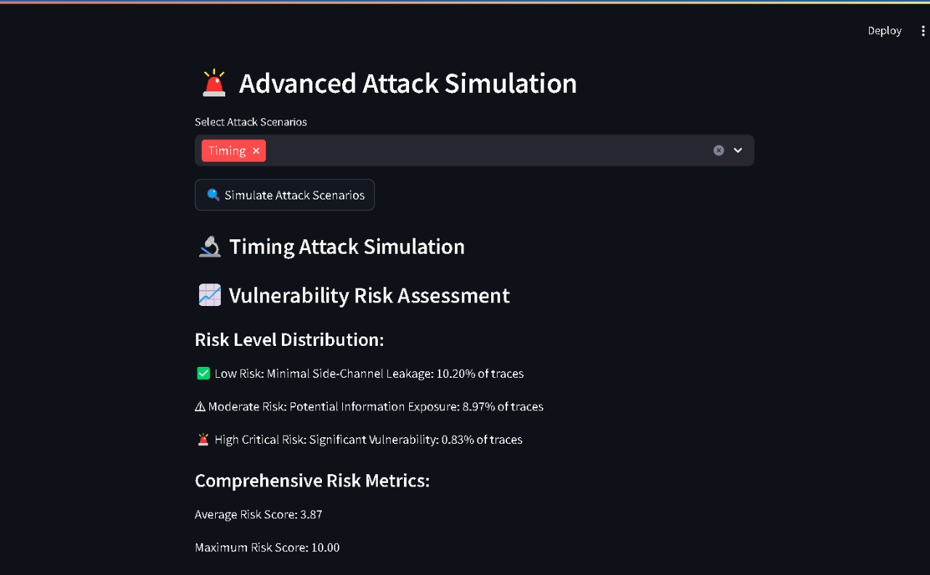

Slide 11
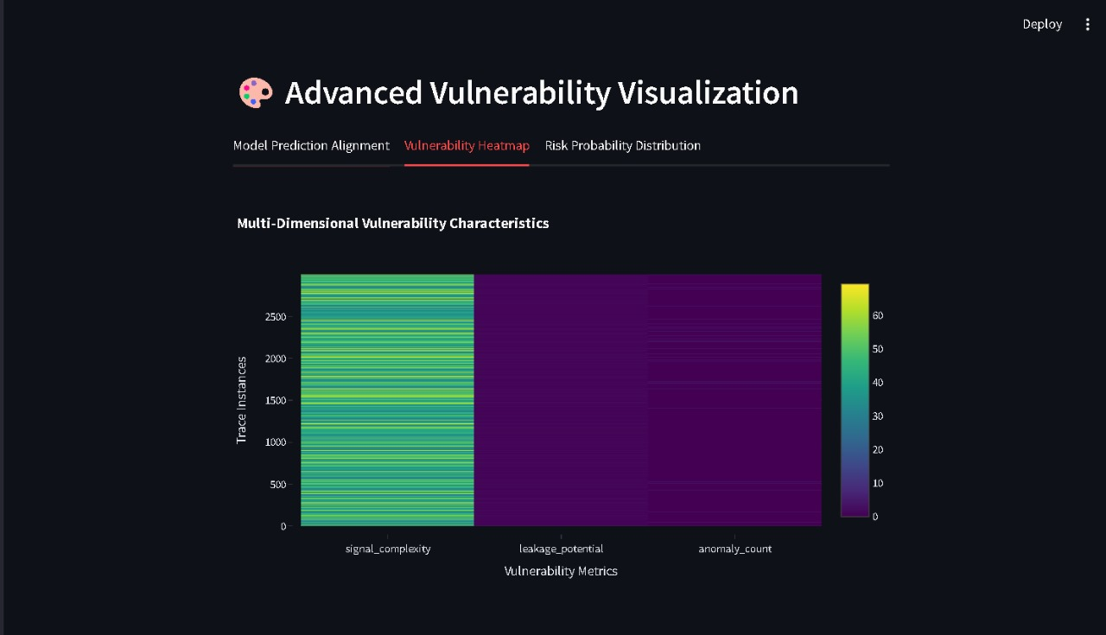

Slide 12
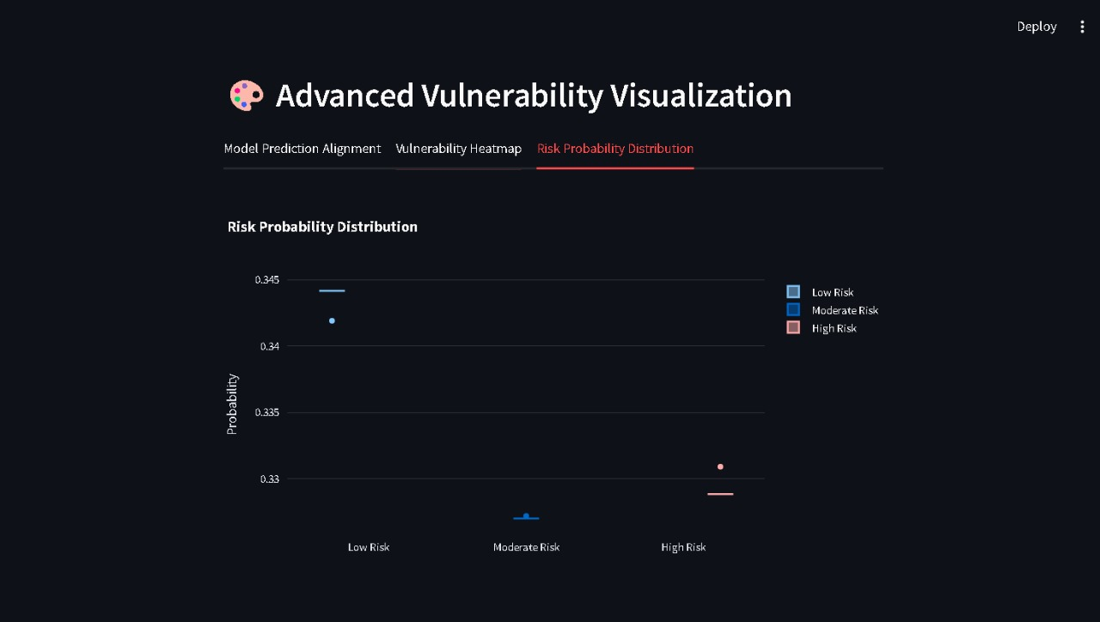

Slide 13
Key Achievements
• Breakthrough in Cryptographic Security Analysis
• AI-Driven Vulnerability Detection
• Proactive Encryption System Hardening

Slide 14
Future Work and Recommendations
• Enhanced Machine Learning Models
• Expanded Attack Scenario Coverage
• Real-World Cryptographic Hardware Integration

