Slide 1

DEPARTMENT OF CSE(IoT) EXPLORING DATA TO ANALYSE TEAM PRODUCITVITY IN GARMENT MANUFACTURING
Presented by:
BATCH-2
A. Vishnu Vardhan(22UJ1A6901)
D. Anusha(22UJ1A6906)
P. Nandini(22UJ1A6916)
Y. Karthik (22UJ1A6920)

Slide 2
TABLE OF CONTENTS
Abstract
Introduction
Problem Definition
Research Motivation
Literature Survey
Existing System
Limitations of Existing System
Proposed System
Advantages of Proposed System
Results
Conclusion
Future Scope
References

Slide 3
ABSTRACT
Team productivity in the garment industry is necessary for meeting production targets, maintaining quality standards, and ensuring timely delivery. Inaccurate or incomplete data leads to misleading conclusions so data collection methods should be reliable and data has to be validated. By using EDA(Exploratory Data Analysis), regression models can help to identify the factors like worker experience, machine downtime, or order complexity. Classification models can be helpful to predict garments with high percentage of defects based on previous data and production. The overall review of the project is to collectively optimize productivity, quality, and efficiency in garment manufacturing, so that companies can meet market demands effectively.

Slide 4
INTRODUCTION
The garment industry is all about taking raw materials and turning them into clothes. It involves everything from growing cotton or making synthetic fibers to sewing shirts and dresses. It's a massive industry that employs millions of people around the world.
The garment industry comprises manufactures of readymade for both domestic and export markets.
Team productivity in garment manufacturing is critical to meeting production targets, ensuring quality, and maintaining competitiveness.
Improving productivity involves optimizing various aspects of the manufacturing process, including workforce management, process efficiency, technology integration, and continuous improvement strategies.

Slide 5
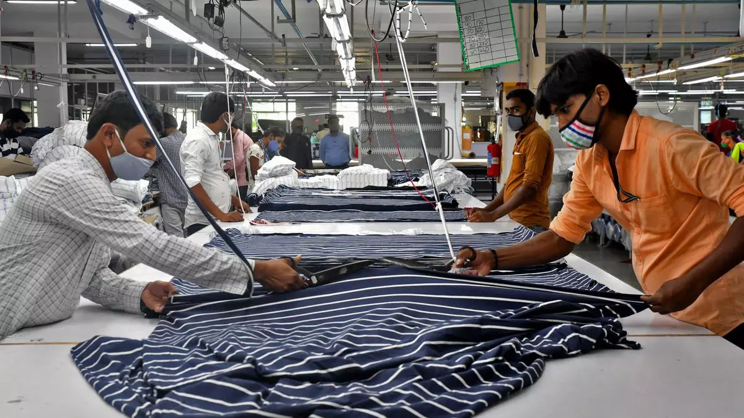
PROBLEM DEFINITION
Misunderstandings between design teams and manufacturers
Lack of clarity within the production
Late deliveries
Inconsistent quality
Power outages
Poorly maintained equipment
Production stoppages.

Slide 6
RESEARCH MOTIVATION
Analyzing team productivity data empowers garment manufacturers to make data-driven decisions.
Data analytics on day-to-day projects create easy analyzing of data which becomes interesting for teammates.
After researching data we can find solutions for the problems so that we can work to gather required necessary information regarding our project.
Gaining a good grip on exploring data in team productivity for a Textile Industry helps in getting deeper insights in Business Development.

Slide 7
LITERATURE SURVEY
S.NO | TITLE | AUTHOR | YEAR | KEY FINDINGS
1 | Productivity improvement techniques in apparel manufacturing | T. Solinger | 2000 | Standard operating procedures, supply chain optimization
2 | Managing productivity in apparel industry | Rajesh Bheda | 2006 | Adaptability to market demands
3 | Case study on productivity improvement in a garment manufacturing unit | International journal of production research | 2011 | Performance monitoring
4 | Improving productivity in apparel manufacturing methods and tools | Mehta P.V | 2013 | Adaption to market trends, cost efficiency measures

Slide 8
5 | Manufacturing Processes for Textile and Fashion Industry | Rob Thomson | 2014 | Technology integration, quality control
6 | Factors Affecting Productivity in the Garment Industry | Md. Shah Alam Sarker | 2015 | Technology and automation, market demand and competition
7 | Global Apparel Manufacturing Productivity Report | McKinsey | 2016 | Data Analytics and digital transformation, automation and technology
8 | Improving productivity in Apparel manufacturing industry | M. Khan, S. Ullah, M. Akter | 2019 | Data-driven decision making
9 | Impact of human resource management practices on employee productivity: a study in garment factories in Bangladesh | T. Rahman, M. Rahman | 2019 | Training and development and workload management
10 | Enhancing productivity in garment manufacturing | Priya Reddy | 2020 | Cost management, sustainable initiatives, process optimization.

Slide 9
EXISTING SYSTEM
In Garment Manufacturing, currently there are two types of Traditional Systems. They are-
1)STATISTICAL METHODS
Measures of central tendency
Measures of dispersion
Hypothesis Testing
Time and Motion Study
Six Sigma Tools

Slide 10
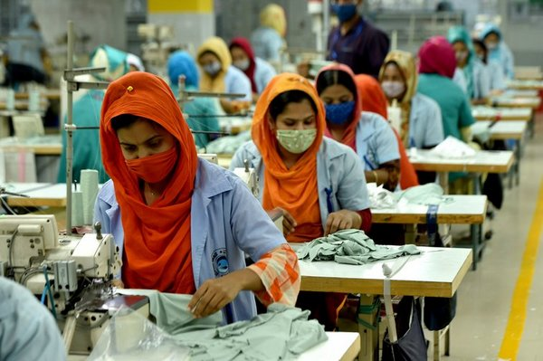
2)MANUAL OPERATIONS
Fabric cutting
sewing
quality control
ironing and pressing
trimming
finishing
embroidery
decorative work
packing
shipping

Slide 11
LIMITATIONS OF EXISTING SYSTEM
Time Consumption
Less Accurate
Less Reliability
Complexity
Skill Dependency
Inconsistency
Assumptions of models
Overfitting
Data quality

Slide 12
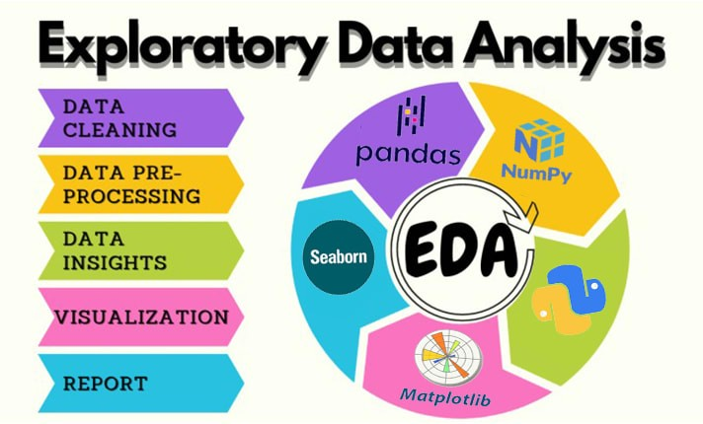
PROPOSED SYSYTEM
The proposed system for resolving the drawbacks observed in the existing system is by using, Exploratory Data Analysis(EDA).
1)DATA ANALYSIS
Data cleaning
Data pre-processing
Data insights
Visualization
Report

Slide 13
2)REGRESSION
Predicts a continuous output variable(e.g., price, temperature, time)
Models the relationship between input variables (features) and the output variable
Output is a numerical value
3)CLASSIFICATION
Predicts a categorical output variable(e.g., class, label, category)
Models the relationship between input variables(features) and the output variable
Output is a class label or category

Slide 14
Import Libraries
Data Importing
(EDA Dataset)
Data
Pre-processing
Data Analysis
Insights
Data Analytics
Data Visualization
Data Exploration
BLOCK DIAGRAM OF PROPOSED SYSTSEM

Slide 15
ADVANTAGES OF PROPOSED SYSTEM
Identify major errors and missing values in their dataset.
Identify the key patterns.
Visualization of data through different types of graphs, ranging through boxplots.
It allows organizations to understand the data in a much better manner.
Tools to derive key insights and conclusions.
Ensures assess data quality

Slide 16
RESULTS
By applying EDA(Exploratory Data Analysis) for team productivity in data analysis of garment manufacturing we can acquire comprehensive understanding.
Using EDA on the given dataset can improve efficiency and implement targeted strategies to enhance overall performance.
It provides a robust foundation for smarter decision-making that drive efficiency, probability, and long-term success.
EDA in garment manufacturing leads to improvement in team work, quality control, work force management and financial profits.

Slide 17
CONCLUSION
Garment performance can be enhanced by appropriate selection of fibre, yarn, fabric combination of production process and team productivity. This exploration holds immense value for a wide range of stakeholders, from garment manufacturers and production managers to industrial engineers. By utilizing the power of data analysis, the garment industry can unlock a future of greater efficiency, a happier workforce, and a stronger competitive position. The overall review of the project is to collectively optimize productivity, quality, and efficiency in garment manufacturing, so that companies can meet market demands effectively.

Slide 18
FUTURE SCOPE
Textile industry has made a major contribution in National employment generation and earn through foreign exchanges by exporting garments.
Expanding and developing the Textile Business directly affect to the world economic growth.
The major textile industry trends are from manufacturing to recycling fabrics, and advanced sustainable manufacturing methods focuses on good productivity so that business will be in demand.
By focusing on both human and technological aspects, manufacturers can create a future where data empowers a more productive, engaged, and sustainable workforce.

Slide 19
REFERENCES
“Productivity Improvement Techniques in Apparel Manufacturing” by T. Solinger published in the year 2000 in Bobbin Media Corp​.
“Managing Productivity in the Apparel Industry” by Rajesh Bheda published in the year 2006 in AbeBooks.
“Case study on Productivity Improvement in a Garment Manufacturing Unit” by International Journal of Production Research published in the year 2011 in Directory of Open Access Journals – DOAJ.
“Improving Productivity in Apparel Manufacturing Methods and Tools” by Mehta P.V published in the year 2013 in (Directory of Open Access Journals – DOAJ)​.
“Manufacturing Processes for Textile and Fashion Industry” by Rob Thomson published in the year 2014 in Thames & Hudson (book).

Slide 20
“Factors Affecting Productivity in the Apparel Industry” by Md. Shah Alam Sarker published in the year 2015 in ResearchGate.
“Global Apparel Manufacturing Productivity Report by McKinsey” in the
year 2016 in McKinsey Company.
“Improving Productivity in Apparel Manufacturing Industry” by M. Khan,
S. Ullah and M. Akter published in the year 2019 in www.eaasjournal.org.
“Impact of Human Resource Management Practices on Employee Productivity: A Study in Garment Manufacturing Factories in Bangladesh” by T. Rahman and M. Rahman published in the year 2019 in International Journal of Progressive Sciences and Technologies​.
x. “Enhancing Productivity in Garment Manufacturing” by Priya Reddy
published in the year 2020 in ResearchGate.

Slide 21
THANK YOU!

