Slide 1

Advanced Phishing Detection and Response System Leveraging Machine Learning for Real-Time Threat Mitigation and Protection.
Department of Computer science and engineering
Batch-11
Phase I Review
Project Coordinators
Dr. G. Soniya Priyatharsini /Prof- CSE
Mr. G. Senthilvelan /Asst.Prof- CSE
Project Guide
Mrs.S.Divya
Presented By
Mr.V.T.Vishnu sah- 211061101505
Mr..M.Vetrivel- 211061101494
Mr.B.Tarun Vikash- 211061101831

Slide 2
Content
Objectives
Abstract
Problem Statement
Literature Survey
Existing System
Proposed System
Working Principle
Conclusion
Reference

Slide 3
Objectives
To detect phishing websites through the application of machine learning by developing a dedicated web application.
To leverage machine learning techniques to continuously improve detection algorithms and enhance response strategies based on real-time phishing trends and incident analysis.
To integrate the developed machine learning model into the web application for behavioral analysis of phishing activities.
To create an automated response system that identifies and provides alerts regarding phishing websites and their associated malicious activities.

Slide 4
Abstract
This system aims to develop a real-time phishing detection system that utilizes machine learning to scan URLs and detect phishing websites.
Key features such as URL length, domain structure, presence of subdomains, and HTTPS usage are extracted to enhance the accuracy of the detection.
Additionally, behavioral analysis is integrated to monitor user interactions, email behaviors, and network sessions, providing advanced detection capabilities.
The system leverages some Machine Learning model to classify phishing threats and deploys this model in a web application for instant URL analysis.
It also incorporates automated alerts and response mechanisms to proactively indicate phishing activities, preventing malicious file downloads and system takeovers.
Continuous learning is employed to keep up with evolving phishing trends.

Slide 5
Problem Statement
The rapid increase in cyber threats, particularly phishing attacks, has exposed individuals and organizations to the risk of significant data breaches, financial losses, and system exploitation.
Traditional phishing detection mechanisms often fail to keep pace with sophisticated techniques used by attackers.
There is a critical need for a real-time phishing detection system that can efficiently analyze URLs, identify phishing patterns, and respond promptly to mitigate the risks.

Slide 6
Literature Survey
S.no | Title | Author | Description | Journal Name
1 | IoT-Driven Phishing Detection and Response System: Architecture and Implementation | Michael Brown, Emily Lee-2024 | The research proposes an architecture for detecting and responding to phishing attacks in IoT environments, considering unique challenges such as resource constraints and diverse communication protocols. | IEEE Internet of Things Journal
2 | Explainable AI Models for Phishing Detection: Interpretability and Performance Evaluation | David Johnson, Sarah Clark-2023 | This study evaluates the effectiveness of explainable AI techniques in phishing detection, focusing on model interpretability and performance metrics. | Journal of Computer Security
3 | Real-Time Phishing Response System Using Stream Processing and Machine Learning | Alex Wang, Lisa Chen-2024 | The paper introduces a real-time phishing response system that leverages stream processing techniques and machine learning algorithms to quickly identify and mitigate phishing threats. | ACM Transactions on Internet Technology
4 | Behavioral Biometrics for Phishing Detection in Mobile Devices: Case Studies and Analysis | Mohammad Khan, Anna Garcia-2023 | This research presents case studies and analyses on the effectiveness of behavioral biometrics in detecting phishing attacks targeting mobile device users, highlighting challenges and mitigation strategies. | International Journal of Information Security

Slide 7
S.no | Title | Author | Description | Journal Name
5 | A Comprehensive Review on Phishing Detection Techniques Using Machine Learning and Natural Language Processing | Kavya Swarup, Aastha Puri, Nandini Vijay-2022 | The review paper discusses various techniques employing machine learning and NLP for detecting phishing attacks across different platforms. | International Journal of Computer Applications
6 | Enhancing Phishing Detection Using Ensemble Machine Learning Techniques | Vijayakumar V, Ramkumar R-2020 | This paper explores the effectiveness of ensemble machine learning techniques in improving the accuracy of phishing detection systems. | International Journal of Scientific & Technology Research
7 | Phishing Detection Using Neural Networks with Dynamic Feature Selection | Shivam Bhardwaj, Mayank Singh, Jyoti Singh-2021 | The paper introduces a neural network-based approach with dynamic feature selection for effective phishing detection. | Journal of Information Assurance and Security
8 | Phishing Websites Detection Using Supervised Machine Learning Algorithms | Bassam A. Al-Mahadeen, Fatima M. A. Abu Salem-2020 | The paper proposes a supervised machine learning approach for detecting phishing websites based on URL features and content analysis. | Journal of King Saud University - Computer and Information Sciences

Slide 8
S.no | Title | Author | Description | Journal Name
9 | Detecting Phishing Domains Using Machine Learning | Shouq Alnemari, Majid Alshammari-2023 | This study compares 4 ML models artificial neural networks (ANNs), support vector machines (SVMs), decision trees (DTs), and random forests (RF)—for detecting phishing domains. Using the UCI phishing domains dataset, the research found that the random forest model was the most accurate, outperforming. | Applied Sciences
10 | Phishing Website Detection using Machine Learning: A Comparative Study | H. U. Nawab, S. M. Shariff, M. Shafiq, M. J. Khan-2021 | This comparative study evaluates the performance of various ML algorithms in detecting phishing websites. The authors analyze different feature sets and classifiers, including decision trees, random forests, vector machines, to determine most effective approach for phishing detection. | International Journal of Advanced Computer Science and Applications (IJACSA)

Slide 9
Existing System
URL Analysis: Uses machine learning to identify malicious URLs based on known patterns and features.
Content Inspection: Analyzes webpage content and structure to detect phishing attempts.
Blacklist/Whitelist Integration: Cross-references URLs with updated lists of known safe or malicious sites.
Real-Time Detection: Monitors and flags potential phishing attacks as they happen for immediate response.
Automated Alerts: Sends alerts to users or administrators when suspicious activity is detected.

Slide 10
Proposed System
Continuous Learning: Updates the detection model with new data to improve accuracy and adapt to evolving phishing tactics.
Automated Response: Takes immediate action, such as blocking access or isolating threats, for real-time phishing detection and mitigation.
Image Analysis: Extracts and scans integrated links within images to detect hidden phishing attempts.
User Interaction Monitoring: Observes how users interact with links and websites to detect unusual behaviors.
Session Analysis: Tracks the user's session data to identify potential phishing attempts.

Slide 11
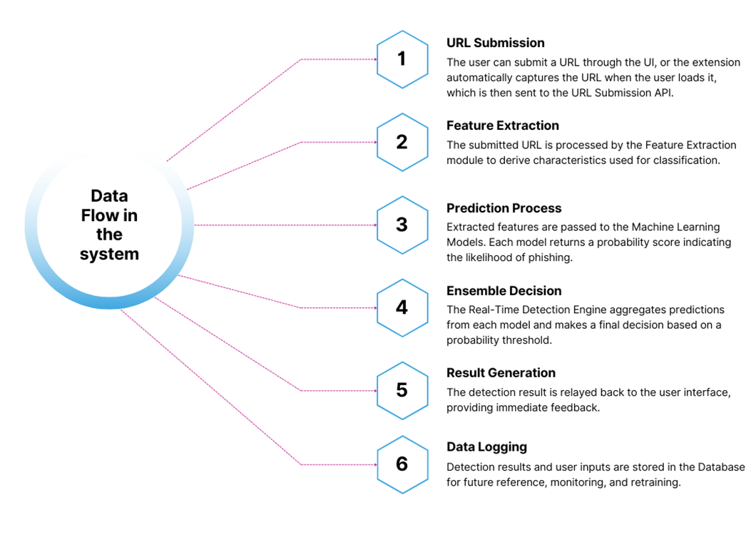
Working Principle

Slide 12
Conclusion
A robust phishing detection and response system is crucial for safeguarding against cyber threats. By integrating advanced machine learning algorithms and real-time monitoring, suspicious activities can be swiftly identified and mitigated. Continuous user education and awareness are essential components, enhancing overall resilience. Automated incident response capabilities streamline reaction times, minimizing potential damage and ensuring swift recovery. Together, these measures create a proactive defense strategy against evolving phishing tactics.

Slide 13
Reference
[1] Difference Between Static Malware Analysis and Dynamic Malware Analysis | Difference Between | Static Malware Analysis vs Dynamic Malware Analysis. (2018).
[2] R. Wang, Y. Zhu, J. Tan, and B. Zhou, “Detection of malicious web pages based on hybrid analysis,” J. Inf. Secur. Appl., vol. 35, 2017.
[3] M. F. Ansari, P. K. Sharma, and B. Dash, “Prevention of phishing attacks using AI-based Cybersecurity Awareness Training,” International Journal of Smart Sensor and Adhoc Network., Mar. 2022.
[4] F. Çolhak, M. İ. Ecevit, B. E. Uçar, R. Creutzburg, and H. Dağ, arXiv “Phishing Website Detection through Multi-Model Analysis of HTML Content,” Aug 2022.
[5] S. H. Ahammad et al., “Phishing URL detection using machine learning methods,” Advances in Engineering Software, vol. 173, p. 103288, Nov. 2022.
[6] R. S. Rao, • Alwyn, and R. Pais, “Detection of phishing websites using an efficient feature based machine learning framework,” Neural Computing and Applications, Mar 2021.
[7] J. Shad and S. Sharma, A Novel Machine Learning Approach to Detect Phishing Websites Jaypee Technology, 2018. Institute of Information
[8] M. Somesha, A. R. Pais, R. S. Rao, and V. S. and H. Dağ, arXiv “Phishing Website Detection through Multi-Model Analysis of HTML Content,” Aug 2022. Rathour, ‘‘Efficient deep learning techniques for the detection of phishing websites,’’ Sadhan ¯ a¯, vol. 45, no. 1, pp. 1–18, Dec. 2020.

Slide 14
[9] B. B. Gupta, K. Yadav, I. Razzak, K. Psannis, A. Castiglione, and X. Chang, ‘‘A novel approach for phishing URLs detection using lexical based machine learning in a real-time environment,’’ Jul. 2021.
[10] Y. Li, Z. Yang, X. Chen, H. Yuan, and W. Liu, ‘‘A stacking model using URL and HTML features for phishing webpage detection,’’ Future Gener. Comput. Syst., vol. 94, pp. 27 39, May 2019.
[11] S. C. H. Hoi, D. Sahoo, J. Lu, and P. Zhao, ‘‘Online learning: A compre hensive survey,’’ Neurocomputing, vol. 459, pp. 249–289, Oct. 2021.
[12] I. Goodfellow, Y. Bengio, and A. Courville, Deep Learning. Cambridge, MA, USA: MIT Press, 2016.
[13] M. Al-Sarem, F. Saeed, Z. G. Al-Mekhlafi, B. A. Mohammed, T. Al-Hadhrami, M. T. Alshammari, A. Alreshidi, and T. S. Alshammari, ‘‘An optimized stacking ensemble model for phishing websites detection,’’ Electronics, vol. 10, no. 11, May 2021, Art. no. 1285.
[14] M. Sameen, K. Han, and S. O. Hwang, ‘‘PhishHaven—An efficient real-time AI phishing URL, 2022.IEEE Access.
[15] A. S. Bozkir and M. Aydos, ‘‘LogoSENSE: A companion HOG based logo detection scheme for phishing web page and E-mail brand recogni tion,’’ Comput. Secur., vol. 95, Aug. 2020, Art. no. 101855.

