Slide 1

CE58201
SUMMER
INTERNSHIP
DPO for Medical VLMs: Efficient CoT Learning & OOD Generalization
Kolathuru Vishnu Vardhan
21CE3AI13

Slide 2

About My Internship
Position: Summer Research Intern (AI/ML), Remote
Host Institution: Shanghai Jiao Tong University (SJTU), China
One of the top research universities in the world
Supervision: Coordinated by Dr. Chaoxiang He
Project Area: AI for medical imaging
Duration: May – August 2025

Slide 3
Problem Statement
  Hospitals generate large numbers of medical scans such as MRI, CT, and X-ray
  Existing AI systems work well only on the type of data they are trained on
  Accuracy drops sharply when they see new or unseen scan types
  There is a need for a system that is reliable, efficient, and generalizes better
Motivation
  Shortage of radiologists, especially in rural and low-resource settings
  AI can act as a support tool, not a replacement
  Faster and more consistent interpretation reduces delay and workload
  Our approach works with low computing, making real deployment practical

Slide 4
WORKFLOW
1.Model Selection
  Qwen2-VL-2B-Instruct → lightweight, multimodal, instruction-tuned
  Chosen for strong reasoning within limited compute budgets
2.Dataset
  OmniMedVQA → Public benchmark for Medical VQA across MRI, CT, X-ray modalities
  Each sample = image + question + 4 options + ground-truth answer
  Split:
• Training: 1,000 MRI (100 validation)
• Testing: 300 MRI (in-domain), 300 CT & 300 X-ray (out-of-domain)
  Covers diverse body regions, making it ideal for generalization studies

Slide 5
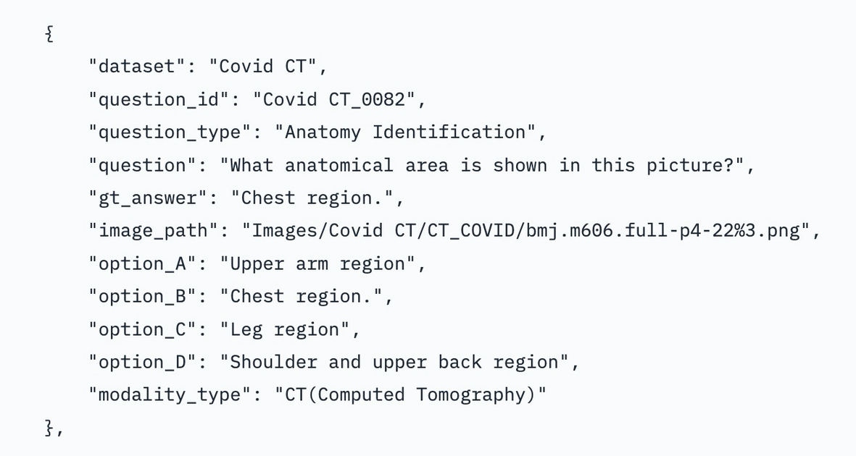
2.1.Dataset Structure
  Converted the dataset into a clean and usable format
Ensured each sample had:
  medical image
  question
  four answer options
  correct answer
2.2.Prompt Format
1. Generate step-by-step reasoning enclosed within <think>...</think> tags.
2. Provide the final single-letter answer (A, B, C, D, …) inside <answer>...</answer> tags.
3. No additional text outside these tags.

Slide 6
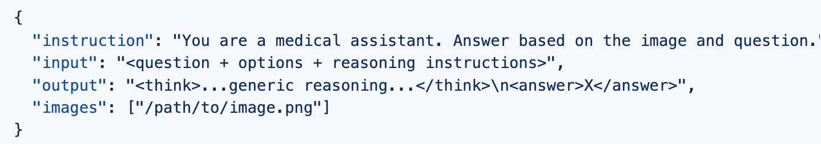
4.STAGE 1: Supervised Fine-Tuning (SFT)
  Adapted our base model (Qwen2-VL-2B-Instruct) to understand MRI scans
  Used a light-weight training method (LoRA) that updates only small parts of the model instead of the whole network
  This makes training faster and memory-efficient
  Trained on 1,000 MRI samples to learn medical patterns
Result:
  High accuracy on MRI, but still limited when scan type changed
Data Format (JSONL):
Data Format (JSONL):

Slide 7
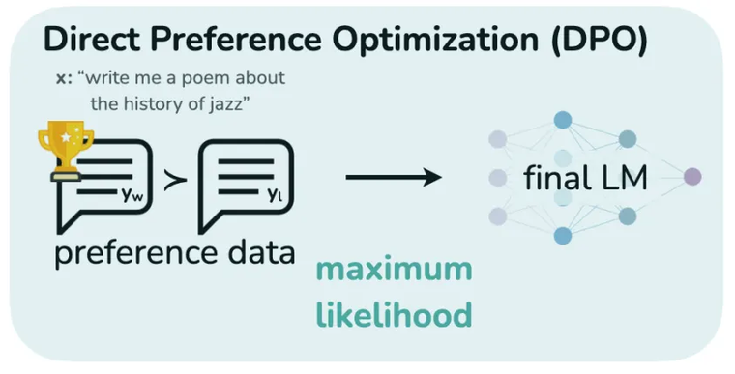
5.STAGE 2: Direct Preference Optimization (DPO)
  Further improved the model using Direct Preference Optimization (DPO)
  DPO teaches the system to prefer better reasoning examples over weaker ones
  No complex reinforcement setup; simple and stable
  Helps the model give more reliable answers
Result:
  Large improvement on CT and X-ray, even though the model was trained only on MRI
Preference Data:
  Chosen: Preferred responses contained detailed, step-by-step reasoning
  Rejected: Non-preferred responses were short, generic answers

Slide 8
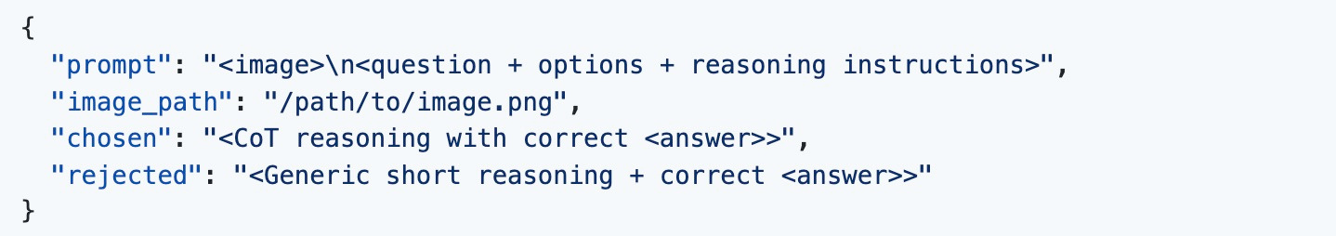
  Used these preference pairs to guide the refinement stage
Converted into the below JSONL format for training:
6.Evaluation Protocol
  Compare Base vs SFT vs DPO based on accuracy on MRI, CT & X-ray
  Compare our lightweight pipeline with GRPO-based SOTA models

Slide 9
RESULTS & DISCUSSION
1.Progressive Improvement
(Base vs SFT vs DPO)
Model | MRI | CT | X-ray
Base | 32.0 | 34.7 | 37.3
SFT | 98.0 | 74.0 | 84.0
DPO | 99.3 | 91.3 | 91.3
  Evaluated on 150 samples per modality
  Base (zero-shot): near random performance
  SFT: strong on MRI, limited generalization
  DPO: further boosts CT & X-ray → strong OOD reasoning
Model | MRI | CT | X-ray
SOTA | 94.7 | 76.7 | 77.3
Our Approach | 94.3 | 76.4 | 76.0
2.Benchmark vs MedVLM-R1
  Evaluated on 300 samples per modality
  Our pipeline ≈ SOTA accuracy
  26× faster training (9 min vs 4 hrs)
  Much more compute-efficient

Slide 10
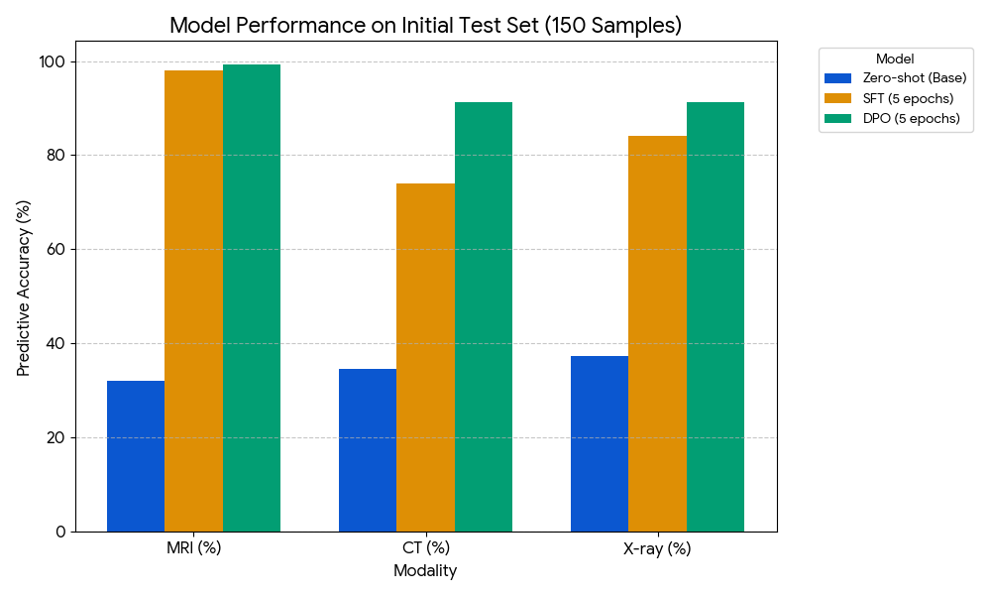
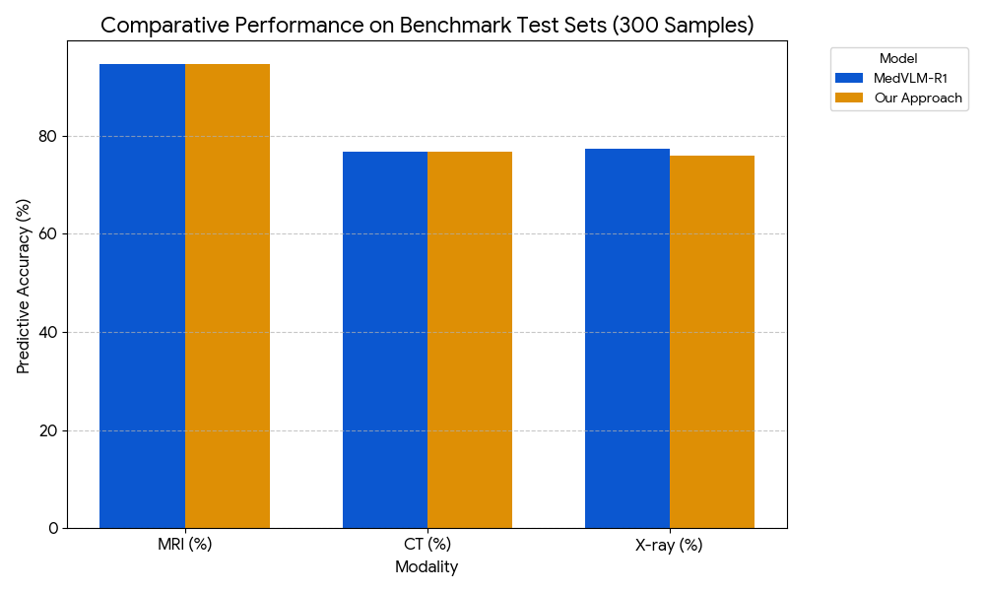
Model | MRI | CT | X-ray
Base | 32.0 | 34.7 | 37.3
SFT | 98.0 | 74.0 | 84.0
DPO | 99.3 | 91.3 | 91.3
Model | MRI | CT | X-ray
SOTA | 94.7 | 76.7 | 77.3
Our Approach | 94.7 | 76.7 | 76.0

Slide 11
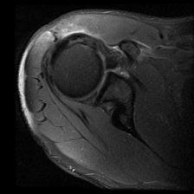
QUALITATIVE ANALYSIS
Example 1: MRI
What is the abnormality that can be seen in this image?
A) Cartilage degeneration
B) Tendonitis
C) Nerve compression
D) Labral pathology
Model Output:
<think>The MRI image shows a shoulder joint with an abnormality in the rotator cuff region. The rotator cuff is a group of muscles and tendons that help stabilize the shoulder joint and provide movement. The abnormality appears as a soft tissue mass, which is characteristic of labral pathology.</think>
<answer>D</answer> Ground Truth: D

Slide 12
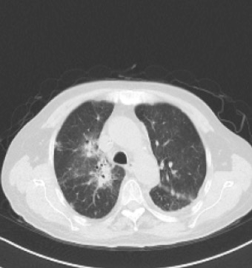
Example 2: CT
What is the term referring to the abnormality observed in the image?
A) Airspace opacity
B) Pleural effusion
C) Lung consolidation
D) Atelectasis
Model Output:
<think>The image shows a cross-sectional view of the chest, which is a common imaging technique used in medical diagnostics. The abnormality observed in the image appears as an area of increased density, which is characteristic of a consolidation or a mass. The presence of airspaces and the normal appearance of the pleura suggest that this is not a pleural effusion or a mass effect. The absence of signs of atelectasis (e.g., air trapping) makes it less likely to be mass effect.
</think>
<answer>A</answer> Ground Truth: A

Slide 13
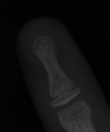
Example 3: X-ray
What is the name of the joint from which the bone in the picture
originates?
A) Glenohumeral Connection
B) Sacroiliac Articulation
C) Radius
D) Distal Interphalangeal
Model Output:
<think>The image shows a bone with a fracture, and the bone appears to be from a human finger. The fracture is located at the joint where the bone meets the finger. To determine the name of the joint, let's analyze the image and the bones present. The bone in the image is a long bone, likely from the finger, given its shape and the context of the fracture. The fracture is at the joint where the bone meets the finger, which is the distal interphalangeal (DIP) joint.</think>
<answer>D</answer> Ground Truth: D

Slide 14
Impact of My Work
  26× faster training → practical even without high-end systems
  Works across MRI, CT, and X-ray, even though trained only on MRI
  Runs on low hardware, making it suitable for smaller or rural hospitals
  Reduces doctors’ workload by giving quick, consistent image support
  Shows that this approach can bring AI into hospitals in a safe way
Limitations
  Preference pairs require high-quality CoT annotations → costly to obtain
  Accuracy is good, but not enough for direct clinical use
  Full deployment requires medical expert validation and regulatory approvals

Slide 15
Future Scope
  Expand to larger and more varied datasets (different hospitals, scanners, patient groups)
  Connect the model with hospital software for real-time use
  Reduce manual work by automating reasoning data collection
Conclusion
  Built a lightweight AI system for medical image understanding
  Achieves high accuracy with much faster training
  Practical for low-resource hospitals and clinics
  Supports reliable and more accessible healthcare using AI

Slide 16
References
  Pan, J., Liu, C., Wu, J., Liu, F., Zhu, J., Li, H.B., Chen, C., Ouyang, C., Rueckert, D.: MedVLM-R1:Incentivizing Medical Reasoning Capability of Vision-Language Models (VLMs) via Reinforcement Learning. arXiv preprint arXiv:2502.17455 (2025).
  Rafailov, R., Sharma, A., Mitchell, E., Ermon, S., Manning, C.D., Finn, C.: Direct Preference Optimization: Your Language Model is Secretly a Reward Model. arXiv preprint arXiv:2305.18290 (2023).
  Chu, T., Zhai, Y ., Yang, J., Tong, S., Xie, S., Schuurmans, D., Le, Q.V ., Levine, S., Ma, Y .: SFT Memorizes, RL Generalizes: A Comparative Study of Foundation Model Post-training. arXiv preprint arXiv:2501.12321 (2025).
  Zanella, M., Ben Ayed, I.: Low-Rank Few-Shot Adaptation of Vision-Language Models. arXiv preprint arXiv:2405.12345 (2024).
  Wang, P., Bai, S., Tan, S., Wang, S., Fan, Z., Bai, J., Chen, K., Liu, X., Wang, J., Ge, W., Fan, Y .,Dang, K., Du, M., Ren, X., Men, R., Liu, D., Zhou, C., Zhou, J., Lin, J.: Qwen2-VL: EnhancingVision-Language Model’s Perception of the World at Any Resolution. arXiv preprint arXiv:2409.12345 (2024)

Slide 17
THANK
YOU

