Slide 1


JDBC
JANUARY 28, 2019

Slide 2
JDBC
The JDBC API is a Java API that can access any kind of tabular data, especially data stored in a Relational Database.
JDBC helps us to write Java applications that manage these three programming activities:
Connect to a data source, like a database
Send queries and update statements to the database
Retrieve and process the results received from the database in answer to your query

Slide 3
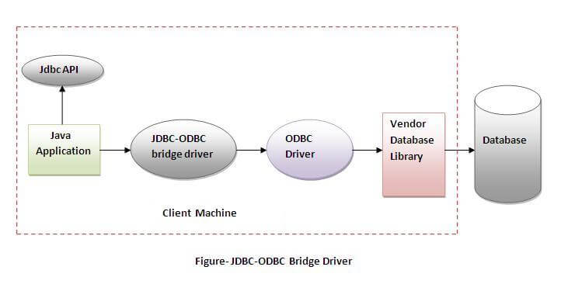
JDBC Drivers
JDBC-ODBC Bridge Driver (Type 1) :
Drivers that implement the JDBC API as a mapping to another data access API, such as ODBC (Open Database Connectivity). Drivers of this type are generally dependent on a native library, which limits their portability.
Advantages :
1. Easy to Use
2. Can be easily connected to any database
Disadvantages :
1. Performance degraded because JDBC method call is converted into the ODBC function calls.
2. The ODBC driver needs to be installed on the client machine.

Slide 4
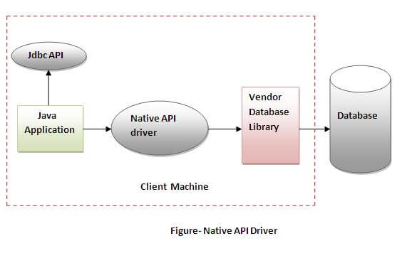
JDBC Drivers
Native Driver (Type 2):
The Native API driver uses the client-side libraries of the database. The driver converts JDBC method calls into native calls of the database API. It is not written entirely in java.
Advantages :
1. performance upgraded than JDBC-ODBC bridge driver.
Disadvantages :
1. The Native driver needs to be installed on the each client machine.
2. The Vendor client library needs to be installed on client machine.

Slide 5
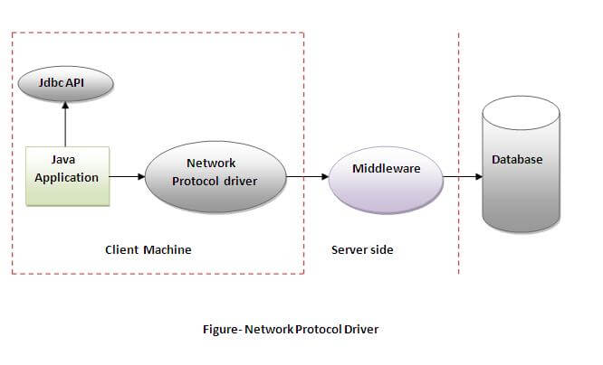
JDBC Drivers
Network Protocol Driver :
The Network Protocol driver uses middleware (application server) that converts JDBC calls directly or indirectly into the vendor-specific database protocol. It is fully written in java.
Advantages :
1. No client side library is required because of application server that can perform many tasks like auditing, load balancing, logging etc.
Disadvantages :
1. Network support is required on client machine.
2. Requires database-specific coding to be done in the middle tier.

Slide 6
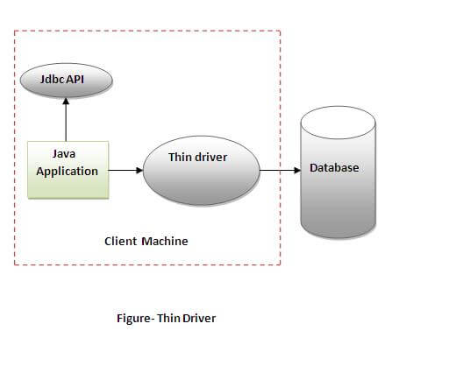
JDBC Drivers
Thin Driver (Type-4):
The thin driver converts JDBC calls directly into the vendor-specific database protocol. That is why it is known as thin driver. It is fully written in Java language.
Advantages :
1. Better performance than all other drivers.
2. No software is required at client side or server side.
Disadvantages :
1. Drivers depend on the Database.

Slide 7
JDBC Interfaces
The java.sql package contains classes and interfaces for JDBC API.
Interfaces | Classes
Driver interface | DriverManager class
Connection interface | Blob class
Statement interface | Clob class
PreparedStatement interface | Types class
CallableStatement interface
ResultSet interface
ResultSetMetaData interface
DatabaseMetaData interface
RowSet interface

Slide 8
Database Connectivity steps in JDBC
Step #1 : Register the Driver class
The forName() method of Class class is used to register the driver class. This method is used to dynamically load the driver class.
Class.forName("com.mysql.jdbc.Driver");
Step #2 : Create connection
The getConnection() method of DriverManager class is used to establish connection with the database.
Connection con=DriverManager.getConnection("jdbc:mysql://localhost:3306/db","root","root");

Slide 9
Database Connectivity steps in JDBC
Step #3 : Creating Statement Object
The createStatement() method of Connection interface is used to create statement. The object of statement is responsible to execute queries with the database.
Statement stmt=con.createStatement();
Step #4 : Execute the Query
The executeQuery() method of Statement interface is used to execute queries to the database. This method returns the object of ResultSet that can be used to get all the records of a table.
ResultSet rs=stmt.executeQuery("select * from emp");

Slide 10
Database Connectivity steps in JDBC
Step #5 : Close the Connection Object
By closing connection object statement and ResultSet will be closed automatically. The close() method of Connection interface is used to close the connection.
Connection.close();

Slide 11
Connection Interface Methods
Method | Comments
public Statement createStatement() | creates a statement object that can be used to execute SQL queries
public Statement createStatement(int resultSetType,int resultSetConcurrency) | Creates a Statement object that will generate ResultSet objects with the given type and concurrency.
public void setAutoCommit(boolean status) | is used to set the commit status.By default it is true.
public void commit() | saves the changes made since the previous commit/rollback permanent.
public void rollback() | Drops all changes made since the previous commit/rollback.
public void close() | closes the connection and Releases a JDBC resources immediately.
Notes:
ResultSet types: TYPE_FORWARD_ONLY, TYPE_SCROLL_INSENSITIVE, TYPE_SCROLL_SENSITIVE
ResultSet concurrency : ResultSet.CONCUR_READ_ONLY, ResultSet.CONCUR_UPDATABLE

Slide 12
Statement Interface Methods
Method | Comments
public ResultSet executeQuery(String sql) | Used to execute SELECT query. It returns the object of ResultSet.
public int executeUpdate(String sql) | Used to execute specified query, it may be create, drop, insert, update, delete etc.
public int[] executeBatch() | used to execute batch of commands

Slide 13
PreparedStatement Interface Methods
PreparedStatement is a sub-interface of Statement and is used to execute parameterized queries.
It improves the performance of the application because the query is compiled only once.
Method | Comments
public int executeUpdate() | Executes the query. It is used for create, drop, insert, update, delete etc.
public ResultSet executeQuery() | Executes the select query. It returns an instance of ResultSet.
public void setInt(int paramIndex, int value) | Sets the integer value to the given parameter index
public void setString(int paramIndex, String value) | Sets the String value to the given parameter index

Slide 14
ResultSet Interface Methods
Method | Comments
public boolean next() | Used to move the cursor to the one row next from the current position
public boolean previous() | Used to move the cursor to the one row previous from the current position
public int[] executeBatch() | Used to execute batch of commands
public boolean first() | Used to move the cursor to the first row in result set object
public boolean last() | Used to move the cursor to the last row in result set object
public int getInt(String columnName) | Used to return the data of specified column name of the current row as int
public String getString(String columnName) | Used to return the data of specified column name of the current row as String

Slide 15
ResultSetMetadata Interface Methods
The metadata means data about data i.e. we can get further information from the data.
If you have to get metadata of a table like total number of columns, column name, column type etc. , ResultSetMetaData interface is useful because it provides methods to get metadata from the ResultSet object.
Method | Comments
public int getColumnCount()throws SQLException | Returns the total number of columns in the ResultSet object.
public String getColumnName(int index)throws SQLException | Returns the column name of the specified column index
public String getTableName(int index)throws SQLException | Returns the table name for the specified column index

Slide 16
CallableStatement Interface Methods
CallableStatement interface is used to call the stored procedures and functions.
The prepareCall() method of Connection interface returns the instance of CallableStatement.
CallableStatement stmt=con.prepareCall("{call procedure(?,?)}");
Method | Comments
public boolean execute() throws SQLException | Used to execute Procedure/Function.
public void registerOutParameter(int parameterIndex, int sqlType) throws SQLException | Registers the OUT parameter in ordinal position parameterIndex to the JDBC type sqlType. All OUT parameters must be registered before a stored procedure is executed.

Slide 17
RowSet Interface
A JDBC RowSet object holds tabular data in a way that makes it more flexible and easier to use than a result set.
All RowSet objects are derived from the ResultSet interface and therefore share its capabilities. What makes JDBC RowSet objects special is that they add these new capabilities
All RowSet objects are JavaBeans components. This means that they have the following:
Properties
JavaBeans Notification Mechanism
Notes:
RowSet objects use the JavaBeans event model, in which registered components are notified when certain events occur. For all RowSet objects, three events trigger notifications:
A cursor movement
The update, insertion, or deletion of a row
A change to the entire RowSet contents

Slide 18
RowSet Interface
Interface | Description
JdbcRowSet | A JdbcRowSet object is an enhanced ResultSet object. It maintains a connection to its data source, just as a ResultSet object does. One of the main uses of a JdbcRowSet object is to make a ResultSet object scrollable and updatable
CachedRowSet | A CachedRowSet object is special in that it can operate without being connected to its data source, that is, it is a disconnected RowSet object.
JoinRowSet | A JoinRowSet implementation lets you create a SQL JOIN between RowSet objects when they are not connected to a data source. This is important because it saves the overhead of having to create one or more connections
FilteredRowSet | A FilteredRowSet object lets you cut down the number of rows that are visible in a RowSet object so that you can work with only the data that is relevant to what you are doing.
WebRowSet | A WebRowSet object is very special because in addition to offering all of the capabilities of a CachedRowSet object, it can write itself as an XML document and can also read that XML document to convert itself back to a WebRowSet object.
Notes:
RowSet objects use the JavaBeans event model, in which registered components are notified when certain events occur. For all RowSet objects, three events trigger notifications:
A cursor movement
The update, insertion, or deletion of a row
A change to the entire RowSet contents

Slide 19
Batch Processing
Instead of executing a single query, we can execute a batch (group) of queries. It makes the performance fast.
The java.sql.Statement and java.sql.PreparedStatement interfaces provide methods for batch processing.
Method | Comments
public void addBatch(String query) | Adds query into batch
public int[] executeBatch() | Executes the batch of queries
Statement statement=connection.createStatement();
statementt.addBatch("insert into employee values(8840,‘Durga',35)");
statement.executeBatch()
Notes:
RowSet objects use the JavaBeans event model, in which registered components are notified when certain events occur. For all RowSet objects, three events trigger notifications:
A cursor movement
The update, insertion, or deletion of a row
A change to the entire RowSet contents

Slide 20
Example
import java.sql.*;
class JdbcExample{
public static void main(String args[]){
try{
Class.forName("com.mysql.jdbc.Driver");
Connection con=DriverManager.getConnection("jdbc:mysql://localhost:3306/mydb","root","root");
Statement stmt=con.createStatement();
ResultSet rs=stmt.executeQuery("select * from emp");
while(rs.next())
System.out.println(rs.getInt(1)+" "+rs.getString(2)+" "+rs.getString(3));
con.close();
} catch(Exception e) {
System.out.println(e);
}
}
}
Notes:
RowSet objects use the JavaBeans event model, in which registered components are notified when certain events occur. For all RowSet objects, three events trigger notifications:
A cursor movement
The update, insertion, or deletion of a row
A change to the entire RowSet contents

Slide 21
References
https://docs.oracle.com/javase/tutorial/jdbc/basics/index.html

