Slide 1




INTRODUCTION TO
MAVEN
DURGA ADIMULAM
May 27, 2019

Slide 2

PURPOSE OF THE SESSION
The purpose of this Maven session is to make you understand how Maven works. Therefore this tutorial focuses on the core concepts of Maven.
Once you understand the core concepts, it is much easier to lookup detailed information in the Maven documentation, or search for it on the internet.

Slide 3
WHAT IS MAVEN?
Maven is a powerful build tool that provides developers a complete build lifecycle framework.
A build tool is a tool that automates everything related to building the software project.
Building a software project typically includes one or more of these activities:
Generating source code (if auto-generated code is used in the project).
Generating documentation from the source code.
Compiling source code.
Packaging compiled code into JAR files or ZIP files.

Slide 4
Common Problems and Activities
Multiple Jars
Dependencies and Versions
Project Structure
Building, Publishing and deploying

Slide 5
Maven Build Lifecycle
A Maven Build follows a lifecycle.
Default lifecycle
generate-sources/generate-resources
Compile
Test
Package
Install
Deploy
Clean lifecycle
Site lifecycle

Slide 6
Maven Build Lifecycle Phases
validate - validate the project is correct and all necessary information is available
compile - compile the source code of the project
test - test the compiled source code using a suitable unit testing framework. These tests should not require the code be packaged or deployed
package - take the compiled code and package it in its distributable format, such as a JAR.
verify - run any checks on results of integration tests to ensure quality criteria are met
install - install the package into the local repository, for use as a dependency in other projects locally
deploy - done in the build environment, copies the final package to the remote repository for sharing with other developers and projects.

Slide 7
Maven Archetype
Maven standard Directory Structure
Pom.xml

Slide 8
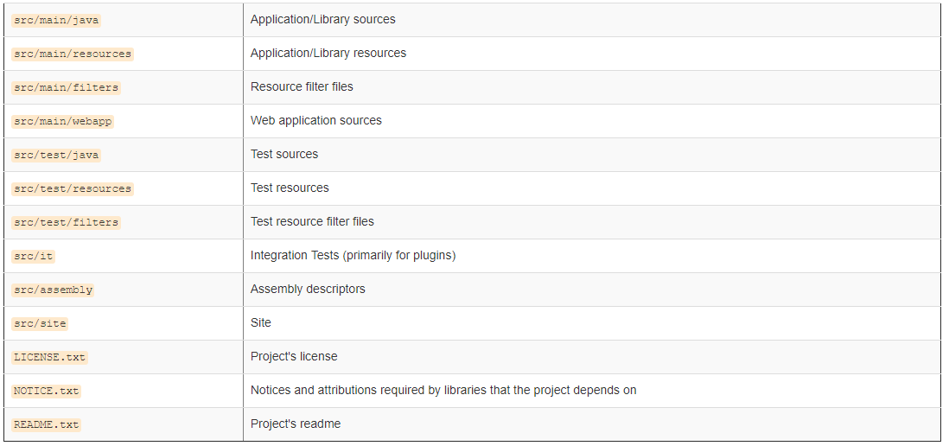
Maven Standard Directory Structure

Slide 9
POM.xml
A Project Object Model or POM is the fundamental unit of work in Maven. It is an XML file that contains information about the project and configuration details used by Maven to build the project.
When executing a task or goal, Maven looks for the POM in the current directory. It reads the POM, gets the needed configuration information, then executes the goal.

Slide 10
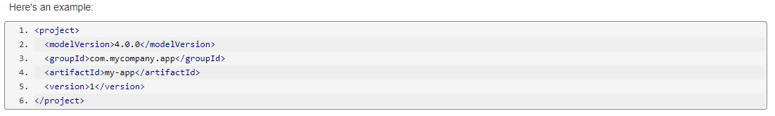
POM.xml
Minimal POM
The minimum requirement for a POM are the following:
project root
modelVersion - should be set to 4.0.0
groupId - the id of the project's group.
artifactId - the id of the artifact (project)
version - the version of the artifact under the specified group

Slide 11
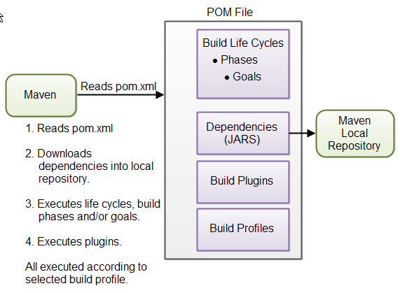
How Maven uses POM.xml

Slide 12
Example Maven Goals
To Invoke a Maven build we need to set lifecycle “goal”
mvn install
Invokes generate* and compile, test, package, integration-test, install
mvn clean
Invokes just clean
mvn clean compile
Cleans old builds and execute generate* and compile
mvn compile install
Invokes generate*, compile, test, integration-test, package, install
mvn test clean
- Invokes generate*, compile, test then cleans the build

Slide 13
DEMO of Maven
Installation
Setting environment variable – M2_HOME
Setting PATH variable
Creating the Project using Maven
Compiling the source code using Maven
Packaging the source code using Maven
Running the sample code

Slide 14
Task
Create a sample maven project from command prompt with quick start archetype
Also use Maven life cycle to execute and verify the files/folders generated.

Slide 15
Resources
https://maven.apache.org/

Slide 16
Q & A

Slide 17
THANK YOU
DURGA ADIMULAM

