Slide 1



Slide 2

Team No : 2
20KP1A4404 – YAMINI
20KP1A4456 – VISHNU
20KP1A4437 – SOWMYA
20KP1A4447 – IRFAN

Slide 3
ABSTRACT :
The aim of this project is to analyze the sentiments of expressed in tweets, categorizing them as positive , negative or neutral. The data will consists of Twitter data, and the analysis will provide insights into public opinions ,trendsand emotions on different topics. The project contributes to the field of social media analytics and showcases the practical application of machine learning in understanding sentiment patterns on a large scale.
Sentimental analysis is a fast track area of research in high demand for business giving them the ability to understand and adapt their business stratagies. This research contributes to the application of machine learning in business intelligence,fostering a more informed and responsive approach to customer satisfaction and market trends.

Slide 4
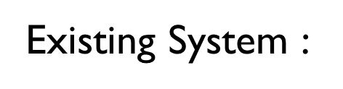

The current scenario often lacks an efficient mechanism for businesses to guage and understand customer sentiments on social media,particularly on twitter.Manual analysis is time consuming,subjective and may be provide a comprehensive overview of the sentiments expressed. Business may struggle to extract actionable insights from the vast amount of twitter data

Slide 5
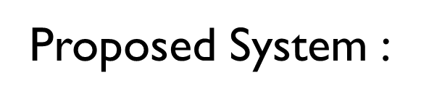
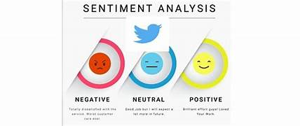
Advanced Feature Extraction :
1. NLP Techiques : Advanced NLP techniques like word embedding for more semantic representations
2. Deep Learning : Experiment with deep leaning models like Recurrent Neural Netwok to capture context and dependencies
Real-time Analysis and Visualization :
Real-time pipeline : Implement a real time analysis pipeline used to handle the incoming tweets
Visualization : provide visualization tools for sentiment trends,wors clouds,and other insights in real-time

Slide 6
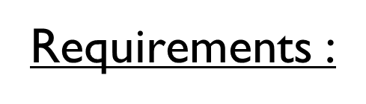

Software Requirements :
Programming Language :
Python : Widely used for Machine learning and natural language processing
Libraries and Frameworks :
TensorFlow for machine learning algorithms
Pandas and Numpy for data manipulation and analysis
Visualization :
Data visualization to gain insights from the analyzed sentiments
Web Frameworks :
Django for creating a web-based interface to interact with the sentiment analysis system
Cloud Services
AWS,Microsoft Azure for cloud-based storage,computing and deployment

Slide 7

Hardware Requirements :
Processor (CPU) : A muti-core processor for efficient parallel processing during data preprocessing and model training
Random Access Memory(RAM) : 8GB of RAM to handle the data processing and model train tasks effectively
Storage : To store collected Twitter data,preprocessing data ans machine learning model files
Network Connection : Internet connection for accessing the Twitter API,downloading datasets and potentially deploying the model on cloud platforms
Operating System(OS) : Compatible with windows ,Linux,depending on the preferred development environment and toolset
Backup and Redundancy : Backup system for critical data,and consider redundancy for continuous availability in case of hardware failures

Slide 8

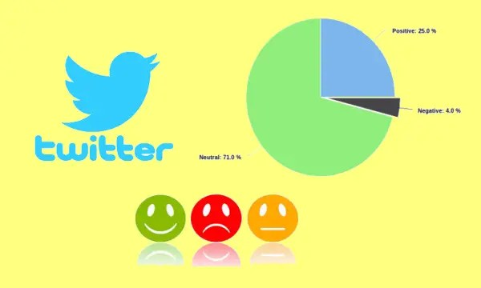
The utilization of machine learning algorithms allows for the automation of sentiment classification, enabling businesses to efficiently process large volumes of Twitter data. This not only saves time but also enhances the accuracy of sentiment identification, providing a more reliable basis for decision-making. The implementation of sentiment analysis on Twitter data for business using machine learning holds significant promise and potential for enhancing decision-making processes and customer relations. Through the analysis of user sentiments expressed on Twitter, businesses can gain valuable insights into public opinions, preferences, and trends related to their products or services.

Slide 9

THANK YOU

