Slide 1
PROJECT REVIEW - 2
TEAM - 13
Investigation of mental stress detection with an 8-channel EEG system using KNN, SVM and EEGNet

Slide 2
TEAM-13
20KP1A4459-V.Venkata karthik
20KP1A4407-Ch.Vishnupriya
20KP1A4428-N.Usharani
20KP1A4406-Ch.Sravani

Slide 3
ABSTRACT
This study explores mental stress detection using EEG data with traditional classifiers with machine learning on an 8-channel EEG dataset. Traditional classifiers achieved up to 87.50% accuracy, while machine learning algorithms showed promise for capturing stress patterns . Today our agenda to describe about design of my project;
System architecture
Methodologies , algorithms
Dataflow diagrams

Slide 4
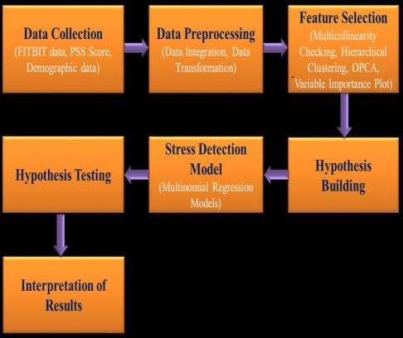
System architecture
process

Slide 5
Fp1
Fp2
F7
F3
F
4
F8
Fz
FT9
FT10
FC5
FC1
FC2
FC6
T7
C3
Cz
C4
T8
CP5
CP1
CP2
CP6
DRL
CMS
P
3
Pz
P4
P8
P7
PO9
O1
Oz
O2
PO10

Slide 6
methadologies
SVM
EEGNET
KNN

Slide 7
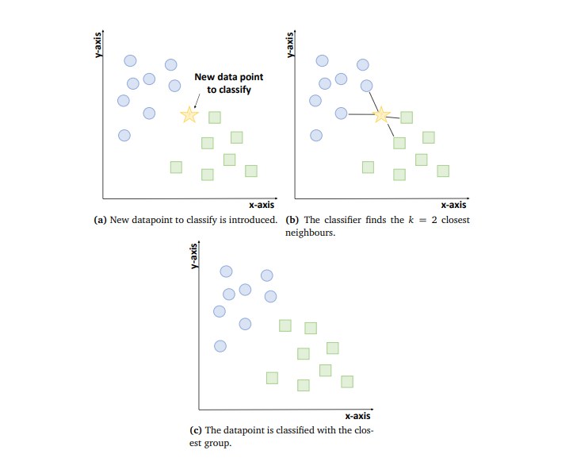
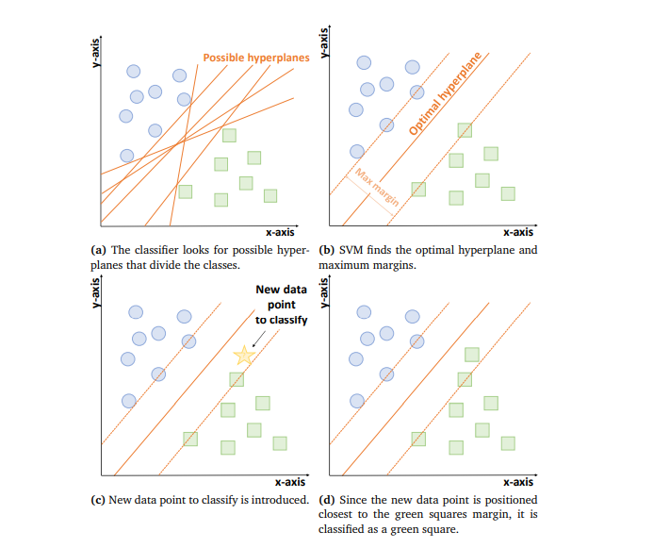
ALGORITHMS
KNN
SVM

Slide 8
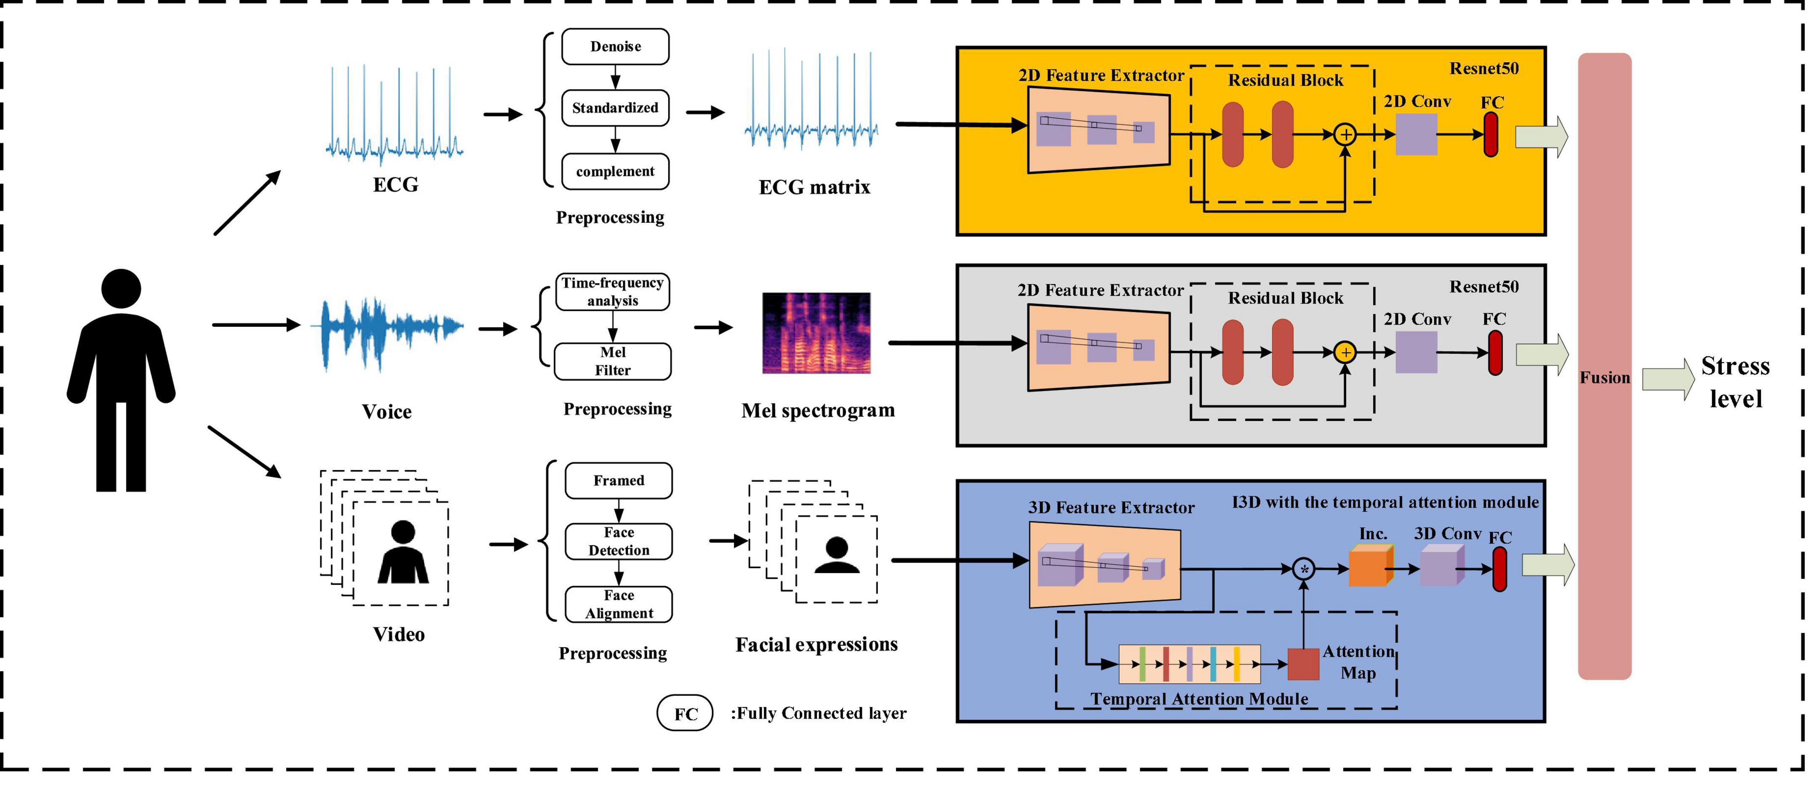

Slide 9
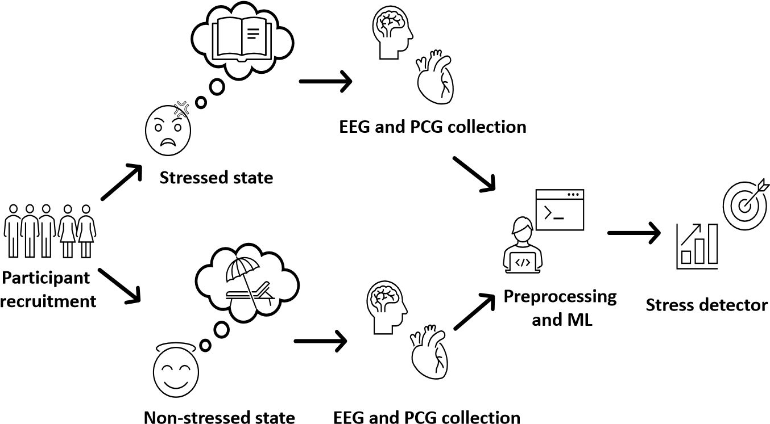
CREATE INITIAL
POPULATION
RANK POPULATION
BY FITNESS
SELECT
ELIT
E
SELECT PARENTS
PRODUCE OFFSPRING
AND MUTATION
S

Slide 10
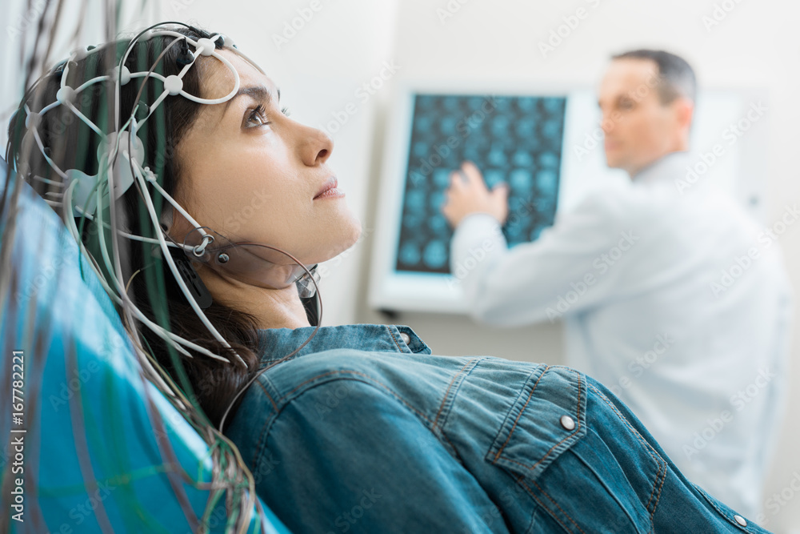
feasibility STUDY
The feasibility study examines the practicality and viability of implementing the proposed project. It assesses technical, economic, and operational factors to determine if the project is achievable. By analyzing resources, costs, potential risks, and benefits, the study helps stakeholders make informed decisions regarding project initiation. Key considerations include resource availability, technological capabilities, market demand, and financial feasibility. Through this comprehensive evaluation, the feasibility study ensures that the project aligns with organizational goals and has the potential to deliver value to stakeholders.

Slide 11
GOALS FOR NEXT REVIEW
Goals for Next Review
Level Up ML Magic: Sprinkle our project with fancy ML algorithms like deep learning and ensemble methods to boost our stress-detecting powers.
Polish Data Diamonds: Buff up our dataset with some fancy preprocessing techniques to make sure our algorithms are seeing the clearest signals.
Test Drive & Tweak: Take our models for a spin, fine-tune them, and see how they handle new data. Let's make sure they're ready to tackle real-world stressors with style!

Slide 12
THANK YOU

