Slide 1
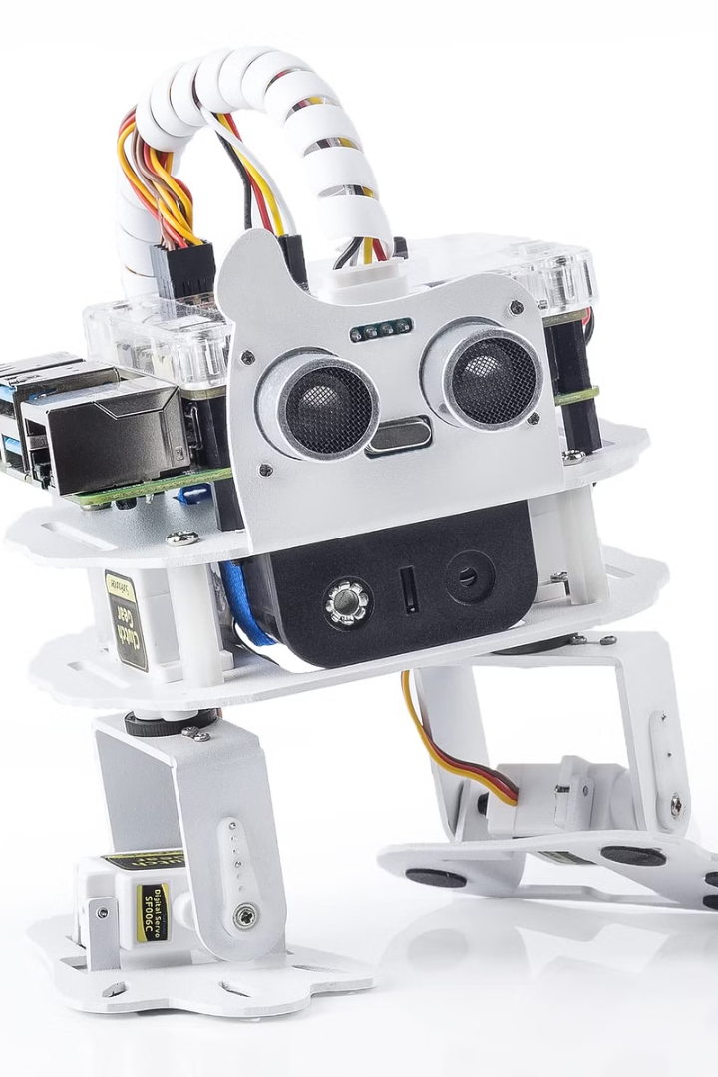
AI-Powered Indoor Obstacle Avoidance
PRESENTED BY
Muvvala Viswakiran
20691A28I4
Madanapalle Institute of Technology And Science
Computer Science and Technology

Slide 2
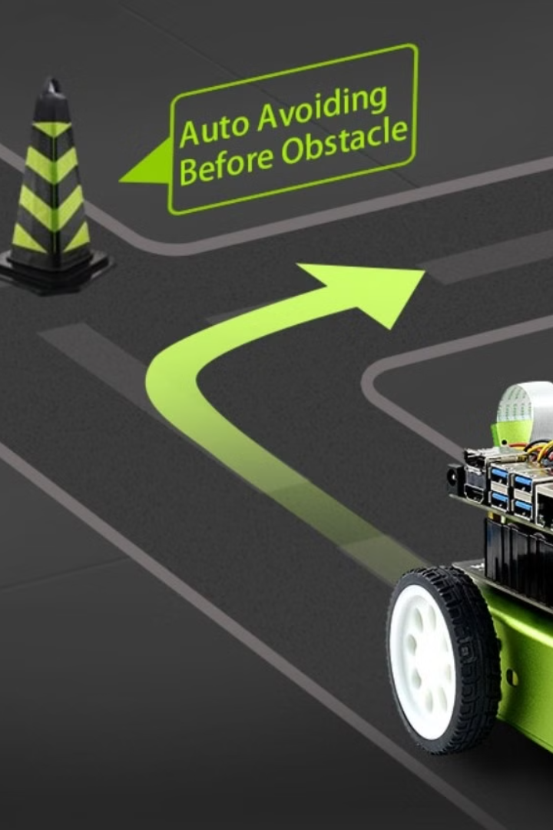
Introduction to AI-Powered Indoor Obstacle Avoidance
AI-powered indoor obstacle avoidance refers to the use of artificial intelligence and advanced sensory technology to navigate and avoid obstacles within indoor environments. This innovative technology has a wide range of applications, from assisting individuals with visual impairments to enhancing the safety and autonomy of robots and drones. By leveraging cutting-edge AI algorithms and real-time data processing, these systems can identify, analyze, and respond to obstacles in dynamic indoor settings, ultimately advancing the possibilities for safer and more efficient navigation.

Slide 3

How AI Technology is Revolutionizing Obstacle Avoidance
Advanced Sensory Integration
Dynamic Path Planning
Machine Vision Capabilities
By leveraging machine learning algorithms, AI-powered obstacle avoidance systems can analyze environmental data and dynamically plan navigation paths, proactively avoiding obstacles while adapting to changes in the surroundings.
AI technology has enabled the seamless integration of advanced sensors such as LiDAR, ultrasonic sensors, and depth cameras to accurately perceive and map complex indoor environments, empowering obstacle avoidance systems with real-time spatial awareness.
The use of machine vision enables AI systems to interpret visual data, identify obstacles, and differentiate between various objects in indoor environments, providing a comprehensive understanding of the surroundings.

Slide 4
Key Components of an AI-Powered Obstacle Avoidance System
1
High-Performance Sensors
2
Real-Time Data Processing
3
Machine Learning Algorithms
These systems utilize advanced sensors, including LiDAR, depth cameras, and ultrasonic sensors, to accurately perceive and map the indoor environment, facilitating effective obstacle detection and avoidance.
AI-powered obstacle avoidance relies on real-time data analysis to swiftly detect obstacles, calculate optimal navigation trajectories, and execute responsive movements, ensuring efficient and obstacle-free navigation.
Machine learning models are essential for predicting and handling dynamic obstacles, as these algorithms can continuously improve navigation strategies based on experience and environmental feedback.

Slide 5



Training and Data Collection for AI Algorithms
Data Collection
Machine Learning
Algorithm Optimization
Accumulating diverse and representative data sets is crucial for training AI algorithms to recognize and respond to a wide array of indoor obstacles, ensuring robust and adaptive obstacle avoidance capabilities.
Effective training of machine learning models involves exposing AI systems to a variety of obstacle scenarios, enabling them to learn and refine obstacle recognition and navigation strategies.
Continuous optimization of AI algorithms based on performance data and user feedback is essential for ensuring the ongoing accuracy and reliability of obstacle avoidance systems.

Slide 6

Real-World Applications of AI-Powered Indoor Obstacle Avoidance
Autonomous Robots
Assistive Devices
Unmanned Aerial Vehicles (UAVs)
AI-powered obstacle avoidance technology is integral to the successful deployment of autonomous robots in various indoor settings, including warehouses, hospitals, and manufacturing facilities, where precise and safe navigation is essential.
These systems have transformative applications in assistive devices for individuals with visual impairments, contributing to increased mobility, independence, and safety during indoor navigation.
In the realm of UAVs, AI-powered obstacle avoidance ensures safe and efficient flight operations in indoor environments, opening possibilities for applications in surveillance, inspection, and security.

Slide 7
Future Developments and Potential Advancements in the Field
1
2
Enhanced Multi-Sensory Integration
Behavioral Adaptability
Integrating a wider array of sensory inputs, including thermal imaging and radar technologies, to further enhance obstacle detection and spatial awareness.
Advancing AI algorithms to exhibit adaptive behaviors, enabling them to learn, anticipate, and effectively respond to evolving indoor obstacle scenarios.
Human-Robot Collaboration
Developing seamless human-robot interaction models that leverage AI-powered obstacle avoidance, facilitating safe and cooperative indoor navigation in shared environments.

Slide 8
Overview of AI-Powered Obstacle Avoidance
In this presentation, we have explored the fascinating world of AI-powered obstacle avoidance. We have discussed the key components of an AI-powered obstacle avoidance system, the training and data collection process for AI algorithms, real-world applications, challenges, limitations, and future developments in the field.
By leveraging the power of AI, we can revolutionize the way we navigate through complex environments and ensure safer and more efficient operations. AI-powered obstacle avoidance opens up possibilities for various industries, including robotics, autonomous vehicles, drones, and more.
Thank you for joining us on this journey into the exciting realm of AI-powered obstacle avoidance!

Slide 9

THANK YOU

