Slide 1
Predicting Energy Loads in Buildings

Slide 2
Outline
Data Preparation
Descriptive Analytics
Feature Selection
Building Models
Results
Conclusion

Slide 3
Introduction:
The basic principle of building energy efficiency is to use less energy for operations including heating, cooling, lighting and other appliances, without affecting the health and comfort of its occupants.
Improving the energy efficiency of functional buildings brings many environmental and economic benefits such as reduced greenhouse gas emissions and operational cost savings.
In many developed and developing countries, energy efficiency has become the main way to meet a rising energy demand.

Slide 4
Dataset Description:
The raw data contains 768 rows each row represent a structure of the building.
8 Input Variables.
Heating Load and Cooling load are our output variables.

Slide 5
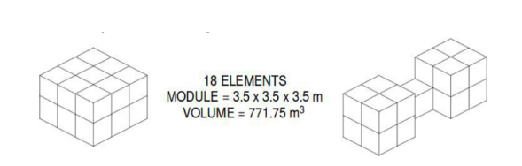
Dataset Description:
A modular geometry system was derived based on an elementary cube
(3.5 × 3.5 × 3.5m). In order to generate different building shapes, eighteen such elements were used according to Figure.

Slide 6
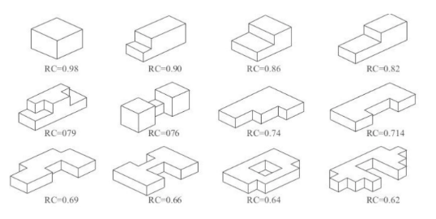
Dataset Description:
Then generated 12 structures with different shapes and Relative Compactness.

Slide 7
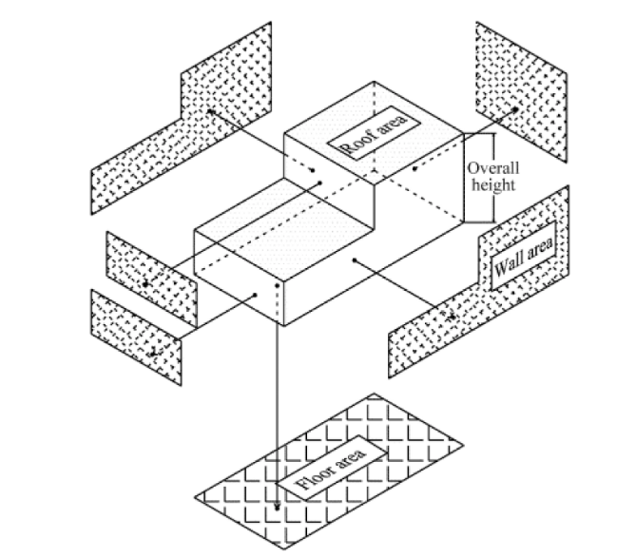
Dataset Description:
X1 - Relative Compactness
X2 - Surface Area
X3 - Wall Area
X4 - Roof Area
X5 - Overall Height
X6 - Orientation
X7 - Glazing Area
X8 - Glazing Area Distribution

Slide 8
Data Preparation:
The Dataset doesn’t have any missing values.
Both input and Output features are normalized using min - max scaler.
As the training data has normalized y values. Model predicts normalized y values.
To check the performance of the model we denormalize the results and then calculated the metrics.

Slide 9
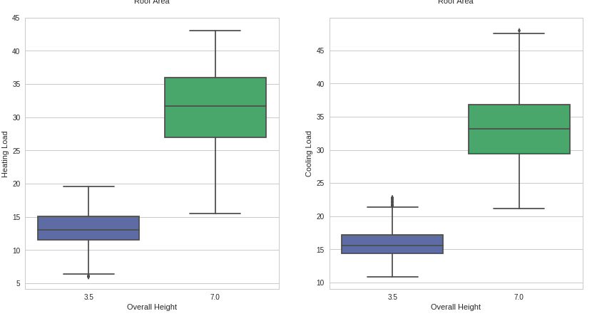
Descriptive Analytics:

Slide 10
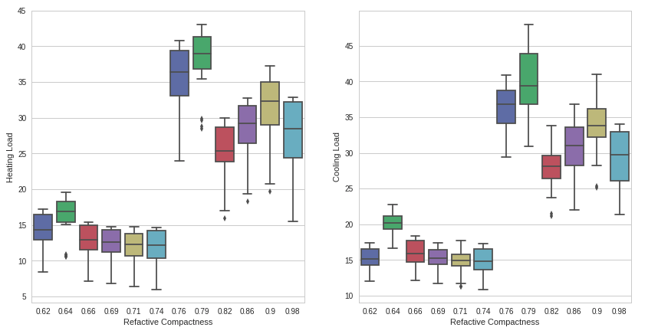

Slide 11
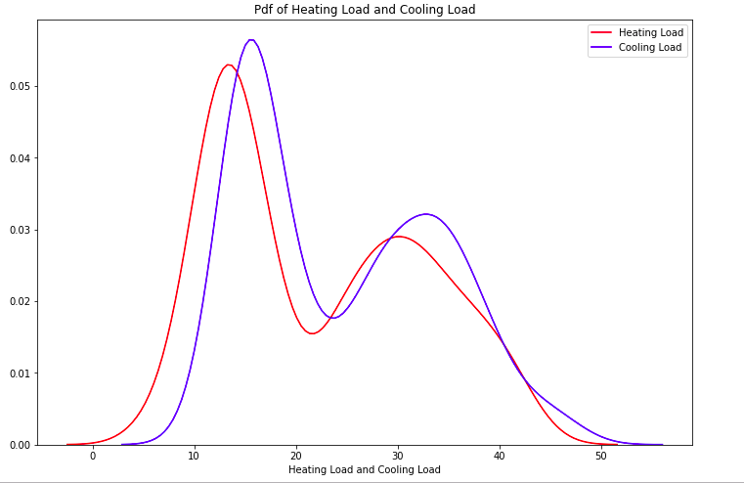
Descriptive Analytics for y values:

Slide 12
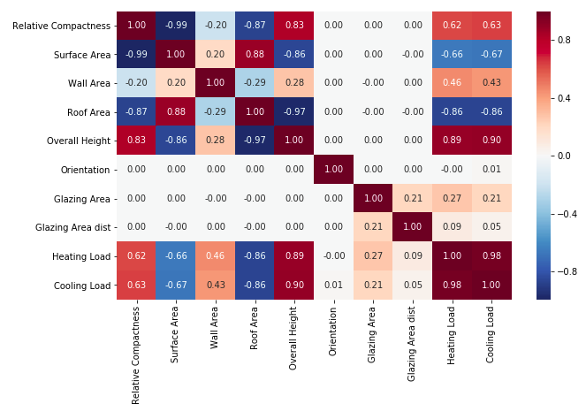
Correlation Matrix:

Slide 13
Conclusions from Descriptive analysis:
From above correlation matrix we can say that Relative Compactness and Surface Area have a correlation of -0.99.
If the Overall Height of a structure is 3.5 then Cooling Load is less than 22.
If the Relative Compactness of a structure is less than 0.75 then cooling load is always less than 22.

Slide 14
Data Partitioning Techniques:
To partition the dataset we used two approaches.
Hold out with Train CV and Test split as (80 - 20)
5 fold CV.

Slide 15
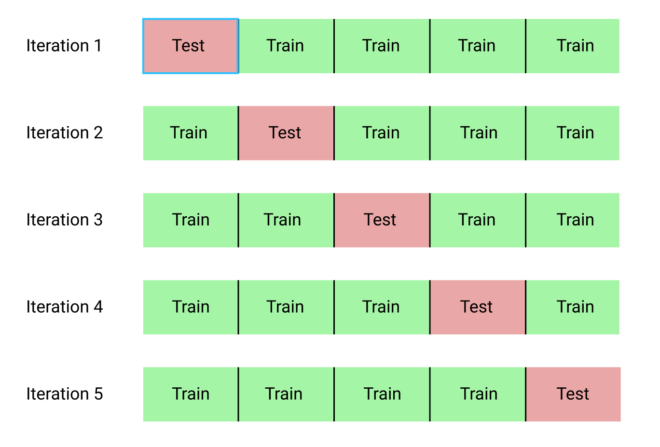
5 FOLD CV

Slide 16
Data Mining Task:
The dataset contain Input variables are 8 features and two output variables(heating load and cooling load). This falls under Multi Input and Multi Output (MIMO) problem.
We can use multi layer perceptron(MLP) with 2 output nodes to forecast two output variables.

Slide 17
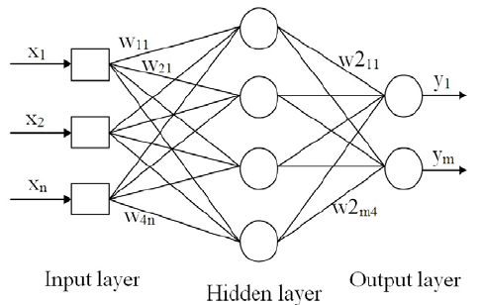
Multi Layer Perceptron (MLP):

Slide 18
Hyperparameters for MLP:
Number of Epochs
Number of Hidden Layers
Batch Size
Number of Neurons in each hidden layer
Learning Rate
Activation Function
Optimization Function
SGD => momentum
RMS Prop => rho
Adam => β1 and β2

Slide 19



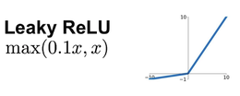
Activation Functions:

Slide 20
Metrics:
Mean Square Error (MSE)
Root Mean Square Error (RMSE)
Normalized Root Mean Square Error (NRMSE)
Mean Absolute Percentage Error (MAPE)
Symmetric Mean Absolute Percentage Error (SMAPE)
Median Absolute Deviation (MAD)
R^2 value or Coefficient of determination

Slide 21

Feature Selection or Dimensionality Reduction:
From Domain Knowledge we removed relative index feature.
Filter Based
Forward Feature Selection
Surface Area, Wall Area, Roof Area, Glazing Area

Slide 22
With 7 Features(No Feature selection)
Activation functions | Optimizer | mad | mape | mse | nrmse | R^2 | rmse | smape
Leaky RELU | Adam | 1.998 | 0.093 | 8.43 | 0.084 | 0.897 | 2.903 | 0.092
Linear | Adam | 2.084 | 0.103 | 8.626 | 0.085 | 0.897 | 2.937 | 0.1
RELU | Adam | 1.976 | 0.096 | 8.005 | 0.085 | 0.901 | 2.829 | 0.094
Sigmoid | Adam | 2.327 | 0.111 | 10.259 | 0.095 | 0.875 | 3.203 | 0.109
tanh | Adam | 2.121 | 0.119 | 8.407 | 0.072 | 0.899 | 2.9 | 0.106
Leaky RELU | RMS Prop | 2.062 | 0.094 | 8.747 | 0.086 | 0.892 | 2.958 | 0.094
Linear | RMS Prop | 2.181 | 0.098 | 8.981 | 0.085 | 0.893 | 2.997 | 0.1
RELU | RMS Prop | 8.909 | 0.375 | 94.671 | 0.826 | 0.88 | 9.73 | 0.405
Sigmoid | RMS Prop | 1.993 | 0.092 | 8.41 | 0.085 | 0.896 | 2.9 | 0.091
tanh | RMS Prop | 1.72 | 0.078 | 6.746 | 0.075 | 0.916 | 2.597 | 0.076
Leaky RELU | SGD | 2.004 | 0.091 | 8.373 | 0.081 | 0.897 | 2.894 | 0.09
Linear | SGD | 2.101 | 0.1 | 8.799 | 0.085 | 0.893 | 2.966 | 0.098
RELU | SGD | 8.922 | 0.377 | 94.776 | 1.206 | 0.85 | 9.735 | 0.406
Sigmoid | SGD | 2.393 | 0.11 | 11.2 | 0.097 | 0.865 | 3.347 | 0.109
tanh | SGD | 1.805 | 0.084 | 7.038 | 0.074 | 0.913 | 2.653 | 0.082
LR=0.001
With 1 Hidden layer
Hold Out(80-20)

Slide 23
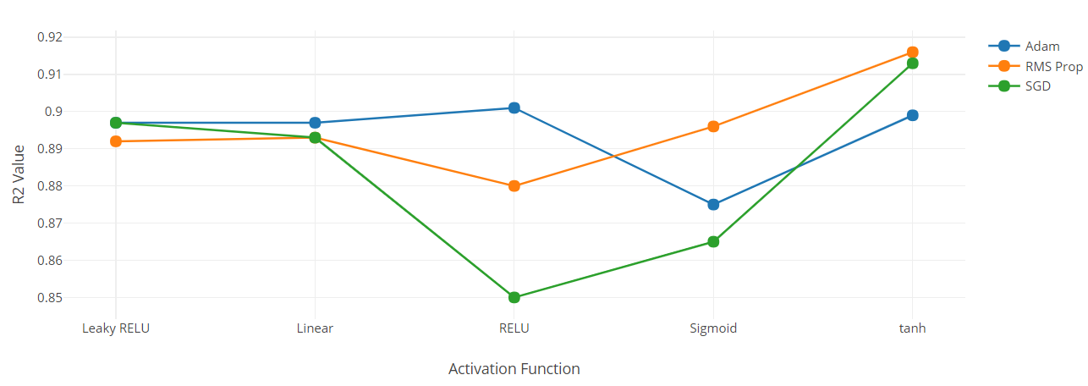
Plot for R^2 values with various Optimizers and Activation Functions
LR=0.001
With 1 Hidden layer
Hold Out(80-20)

Slide 24
2. With 7 Features(No Feature selection)
Activation functions | Optimizer | mad | mape | mse | nrmse | R^2 | rmse | smape
Leaky RELU | Adam | 1.652 | 0.079 | 5.08 | 0.065 | 0.94 | 2.254 | 0.079
Linear | Adam | 2.103 | 0.103 | 8.693 | 0.086 | 0.893 | 2.948 | 0.1
RELU | Adam | 1.823 | 0.083 | 7.412 | 0.084 | 0.907 | 2.722 | 0.082
Sigmoid | Adam | 1.855 | 0.084 | 7.271 | 0.083 | 0.908 | 2.696 | 0.084
tanh | Adam | 1.566 | 0.071 | 4.808 | 0.063 | 0.942 | 2.193 | 0.074
Leaky RELU | RMS Prop | 1.974 | 0.088 | 8.08 | 0.085 | 0.9 | 2.843 | 0.089
Linear | RMS Prop | 2.087 | 0.102 | 8.685 | 0.085 | 0.893 | 2.947 | 0.1
RELU | RMS Prop | 1.885 | 0.086 | 7.101 | 0.081 | 0.915 | 2.665 | 0.086
Sigmoid | RMS Prop | 2.143 | 0.102 | 9.161 | 0.091 | 0.888 | 3.027 | 0.099
tanh | RMS Prop | 1.772 | 0.081 | 7.34 | 0.079 | 0.909 | 2.709 | 0.079
Leaky RELU | SGD | 2.099 | 0.103 | 8.774 | 0.082 | 0.893 | 2.962 | 0.1
Linear | SGD | 2.304 | 0.107 | 10.217 | 0.098 | 0.875 | 3.196 | 0.107
RELU | SGD | 2.546 | 0.113 | 12.151 | 0.12 | 0.856 | 3.486 | 0.115
Sigmoid | SGD | 3.256 | 0.147 | 19.055 | 0.16 | 0.679 | 4.365 | 0.151
tanh | SGD | 2.12 | 0.098 | 9.338 | 0.104 | 0.882 | 3.056 | 0.098
LR=0.001
With 2 Hidden layer
Hold Out(80-20)

Slide 25
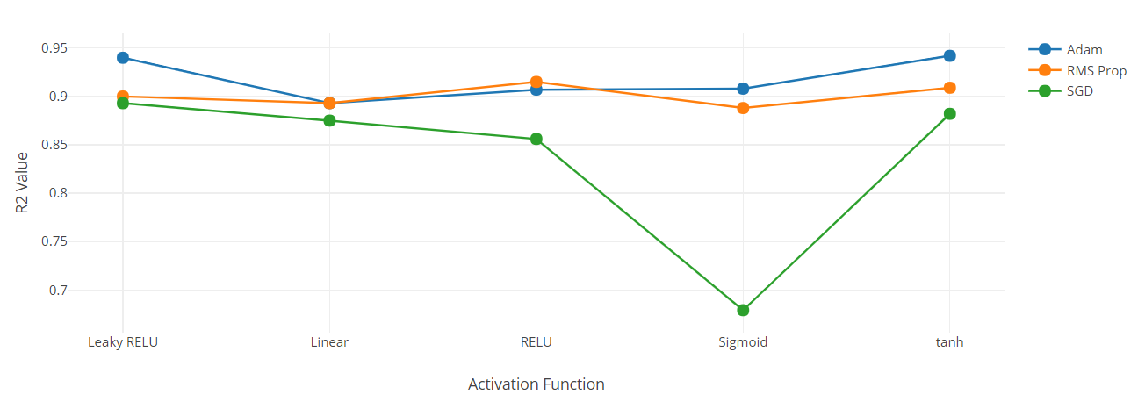
Plot for R^2 values with various Optimizers and Activation Functions
LR=0.001
With 2 Hidden layer
Hold Out(80-20)

Slide 26
3. With 7 Features(No Feature selection)
Activation functions | Optimizer | mad | mape | mse | nrmse | R^2 | rmse | smape
Leaky RELU | Adam | 2.172 | 0.109 | 9.123 | 0.089 | 0.889 | 3.02 | 0.106
Linear | Adam | 2.211 | 0.103 | 9.781 | 0.09 | 0.881 | 3.127 | 0.101
RELU | Adam | 2.57 | 0.119 | 12.222 | 0.129 | 0.835 | 3.496 | 0.122
Sigmoid | Adam | 2.442 | 0.109 | 11.805 | 0.104 | 0.858 | 3.436 | 0.108
tanh | Adam | 1.819 | 0.082 | 7.332 | 0.074 | 0.909 | 2.708 | 0.081
Leaky RELU | RMS Prop | 2.152 | 0.102 | 8.803 | 0.086 | 0.896 | 2.967 | 0.102
Linear | RMS Prop | 2.076 | 0.102 | 8.555 | 0.084 | 0.896 | 2.925 | 0.099
RELU | RMS Prop | 1.769 | 0.087 | 6.215 | 0.083 | 0.922 | 2.493 | 0.087
Sigmoid | RMS Prop | 1.988 | 0.088 | 8.058 | 0.084 | 0.901 | 2.839 | 0.088
tanh | RMS Prop | 1.826 | 0.085 | 7.653 | 0.083 | 0.904 | 2.766 | 0.084
Leaky RELU | SGD | 1.886 | 0.087 | 8.012 | 0.083 | 0.9 | 2.831 | 0.086
Linear | SGD | 2.112 | 0.1 | 8.769 | 0.085 | 0.892 | 2.961 | 0.099
RELU | SGD | 2.155 | 0.092 | 10.309 | 0.092 | 0.875 | 3.211 | 0.091
Sigmoid | SGD | 2.277 | 0.11 | 9.747 | 0.092 | 0.88 | 3.122 | 0.108
tanh | SGD | 2.313 | 0.105 | 10.594 | 0.096 | 0.871 | 3.255 | 0.104
LR=0.01
With 1 Hidden layer
Hold Out(80-20)

Slide 27
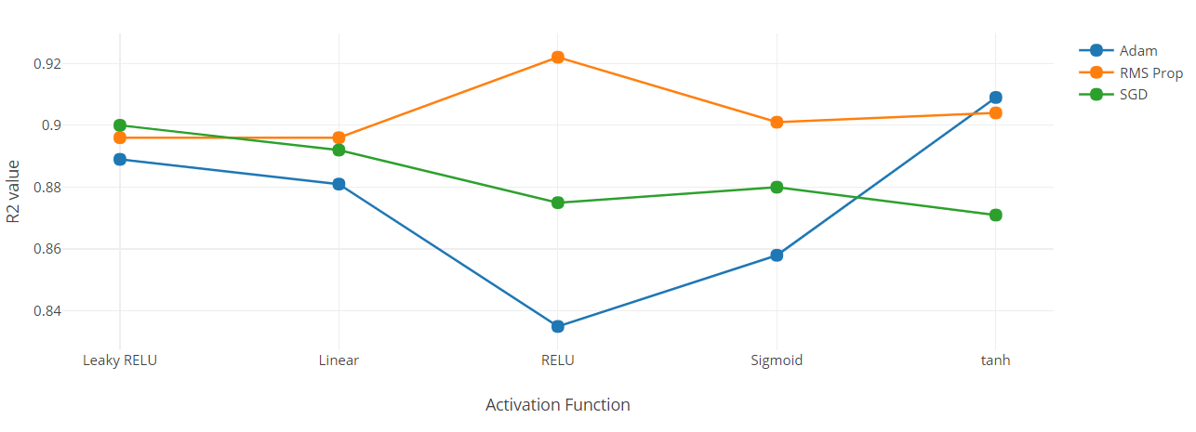
Plot for R^2 values with various Optimizers and Activation Functions
LR=0.01
With 1 Hidden layer
Hold Out(80-20)

Slide 28
4. With 7 Features(No Feature selection)
Activation functions | Optimizer | mad | mape | mse | nrmse | R^2 | rmse | smape
Leaky RELU | Adam | 1.849 | 0.083 | 7.148 | 0.081 | 0.914 | 2.674 | 0.083
Linear | Adam | 1.727 | 0.082 | 5.345 | 0.07 | 0.932 | 2.312 | 0.083
RELU | Adam | 1.782 | 0.08 | 7.789 | 0.077 | 0.902 | 2.791 | 0.077
Sigmoid | Adam | 2.097 | 0.095 | 7.707 | 0.083 | 0.904 | 2.776 | 0.099
tanh | Adam | 1.666 | 0.078 | 6.575 | 0.072 | 0.918 | 2.564 | 0.075
Leaky RELU | RMS Prop | 2.152 | 0.102 | 8.803 | 0.086 | 0.896 | 2.967 | 0.102
Linear | RMS Prop | 2.076 | 0.102 | 8.555 | 0.084 | 0.896 | 2.925 | 0.099
RELU | RMS Prop | 1.769 | 0.087 | 6.215 | 0.083 | 0.922 | 2.493 | 0.087
Sigmoid | RMS Prop | 1.988 | 0.088 | 8.058 | 0.084 | 0.901 | 2.839 | 0.088
tanh | RMS Prop | 1.826 | 0.085 | 7.653 | 0.083 | 0.904 | 2.766 | 0.084
Leaky RELU | SGD | 2.291 | 0.105 | 10.164 | 0.081 | 0.873 | 3.188 | 0.104
Linear | SGD | 2.414 | 0.113 | 11.044 | 0.099 | 0.864 | 3.323 | 0.115
RELU | SGD | 2.1 | 0.097 | 9.149 | 0.097 | 0.887 | 3.025 | 0.097
Sigmoid | SGD | 3.035 | 0.137 | 17.189 | 0.163 | 0.768 | 4.146 | 0.139
tanh | SGD | 2.084 | 0.099 | 8.505 | 0.085 | 0.898 | 2.916 | 0.097
LR=0.01
With 2 Hidden layer
Hold Out(80-20)

Slide 29
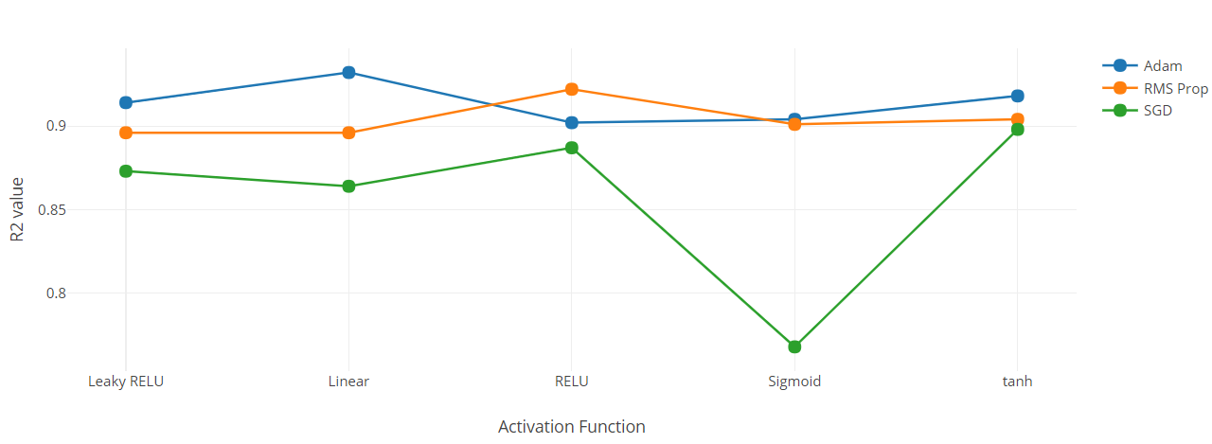
Plot for R^2 values with various Optimizers and Activation Functions
LR=0.01
With 2 Hidden layer
Hold Out(80-20)

Slide 30
5. With 7 Features(No Feature selection)
Activation functions | Optimizer | mad | mape | mse | nrmse | R^2 | rmse | smape
Leaky RELU | Adam | 1.775 | 0.075 | 6.831 | 0.08 | 0.92 | 2.606 | 0.074
RELU | Adam | 1.832 | 0.08 | 6.662 | 0.079 | 0.923 | 2.576 | 0.081
Sigmoid | Adam | 2.016 | 0.084 | 8.407 | 0.088 | 0.901 | 2.888 | 0.084
tanh | Adam | 1.907 | 0.081 | 7.625 | 0.082 | 0.909 | 2.753 | 0.081
Leaky RELU | RMS Prop | 2.065 | 0.086 | 8.994 | 0.089 | 0.894 | 2.99 | 0.086
RELU | RMS Prop | 1.954 | 0.086 | 7.548 | 0.083 | 0.912 | 2.742 | 0.085
Sigmoid | RMS Prop | 2.152 | 0.09 | 8.951 | 0.087 | 0.896 | 2.987 | 0.091
tanh | RMS Prop | 1.968 | 0.083 | 7.801 | 0.081 | 0.91 | 2.784 | 0.083
Leaky RELU | SGD | 2.109 | 0.09 | 9.071 | 0.091 | 0.894 | 3.006 | 0.09
RELU | SGD | 1.896 | 0.082 | 7.29 | 0.081 | 0.915 | 2.698 | 0.082
Sigmoid | SGD | 2.561 | 0.111 | 12.881 | 0.11 | 0.842 | 3.576 | 0.11
tanh | SGD | 2.158 | 0.091 | 9.484 | 0.092 | 0.889 | 3.075 | 0.091
LR=0.001
With 1 Hidden layer
5 fold CV

Slide 31
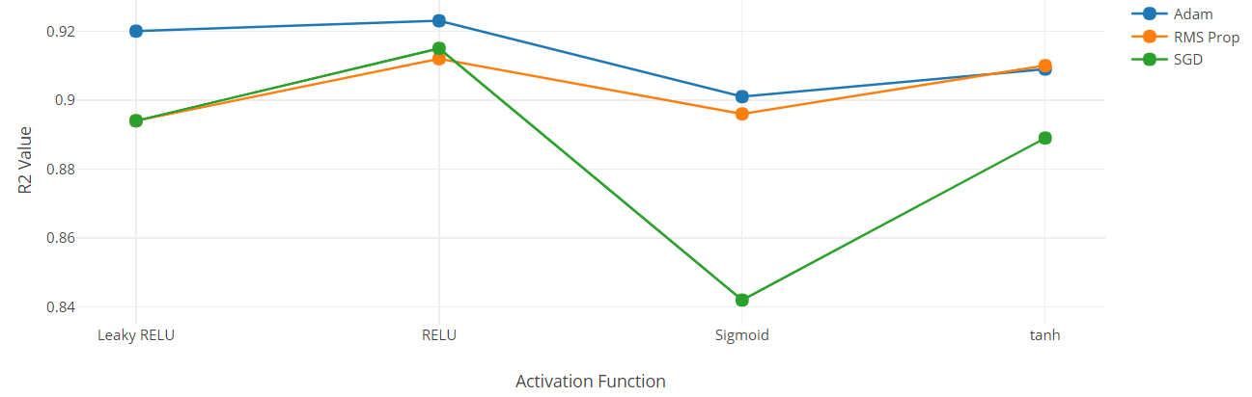
Plot for R^2 values with various Optimizers and Activation Functions
LR=0.001
With 1 Hidden layer
5 fold CV

Slide 32
6. With 7 Features(No Feature selection)
Activation functions | Optimizer | mad | mape | mse | nrmse | R^2 | rmse | smape
Leaky RELU | Adam | 1.917 | 0.083 | 7.893 | 0.083 | 0.907 | 2.796 | 0.082
RELU | Adam | 1.824 | 0.08 | 6.565 | 0.073 | 0.923 | 2.555 | 0.08
Sigmoid | Adam | 2.203 | 0.097 | 9.756 | 0.096 | 0.884 | 3.116 | 0.096
tanh | Adam | 1.963 | 0.086 | 8.109 | 0.086 | 0.905 | 2.831 | 0.084
Leaky RELU | RMS Prop | 1.821 | 0.079 | 6.69 | 0.078 | 0.921 | 2.58 | 0.079
RELU | RMS Prop | 1.658 | 0.074 | 5.629 | 0.072 | 0.936 | 2.345 | 0.075
Sigmoid | RMS Prop | 2.149 | 0.091 | 8.99 | 0.092 | 0.894 | 2.989 | 0.092
tanh | RMS Prop | 1.898 | 0.08 | 7.842 | 0.081 | 0.903 | 2.779 | 0.079
Leaky RELU | SGD | 2.752 | 0.118 | 14.915 | 0.124 | 0.816 | 3.836 | 0.119
RELU | SGD | 2.375 | 0.103 | 11.114 | 0.109 | 0.866 | 3.323 | 0.103
Sigmoid | SGD | 2.825 | 0.121 | 15.304 | 0.128 | 0.777 | 3.868 | 0.122
tanh | SGD | 2.171 | 0.095 | 9.185 | 0.097 | 0.892 | 3.023 | 0.095
LR=0.001
With 2 Hidden layer
5 fold CV

Slide 33
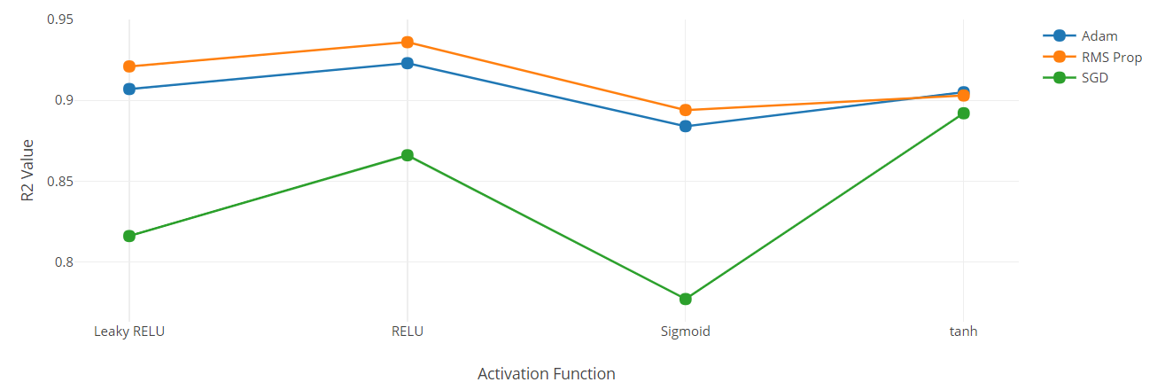
Plot for R^2 values with various Optimizers and Activation Functions
LR=0.001
With 2 Hidden layer
5 fold CV

Slide 34
7. With 7 Features(No Feature selection)
Activation functions | Optimizer | mad | mape | mse | nrmse | R^2 | rmse | smape
Leaky RELU | Adam | 2.053 | 0.085 | 8.877 | 0.089 | 0.896 | 2.971 | 0.085
RELU | Adam | 1.983 | 0.081 | 8.312 | 0.082 | 0.904 | 2.872 | 0.08
Sigmoid | Adam | 1.965 | 0.083 | 8.239 | 0.085 | 0.903 | 2.857 | 0.083
tanh | Adam | 1.961 | 0.083 | 7.857 | 0.083 | 0.906 | 2.791 | 0.084
Leaky RELU | RMS Prop | 2.138 | 0.092 | 9.517 | 0.091 | 0.888 | 3.077 | 0.09
RELU | RMS Prop | 2.017 | 0.084 | 8.672 | 0.088 | 0.898 | 2.936 | 0.084
Sigmoid | RMS Prop | 1.929 | 0.083 | 7.774 | 0.08 | 0.909 | 2.777 | 0.082
tanh | RMS Prop | 1.945 | 0.083 | 8.11 | 0.083 | 0.905 | 2.835 | 0.083
Leaky RELU | SGD | 2.23 | 0.096 | 9.875 | 0.098 | 0.883 | 3.135 | 0.096
RELU | SGD | 2.334 | 0.105 | 10.438 | 0.097 | 0.875 | 3.226 | 0.104
Sigmoid | SGD | 2.423 | 0.106 | 11.185 | 0.105 | 0.863 | 3.337 | 0.105
tanh | SGD | 2.118 | 0.09 | 9.03 | 0.088 | 0.893 | 2.997 | 0.089
LR=0.01
With 1 Hidden layer
5 fold CV

Slide 35
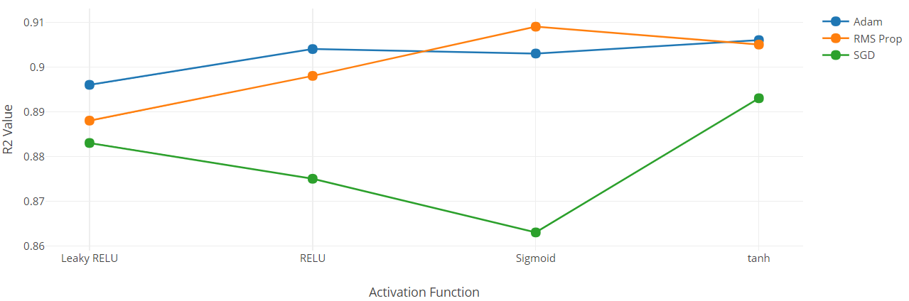
Plot for R^2 values with various Optimizers and Activation Functions
LR=0.01
With 1 Hidden layer
5 fold CV

Slide 36
8. With 7 Features(No Feature selection)
Activation functions | Optimizer | mad | mape | mse | nrmse | R^2 | rmse | smape
Leaky RELU | Adam | 2.113 | 0.088 | 8.98 | 0.09 | 0.894 | 2.991 | 0.088
RELU | Adam | 1.706 | 0.073 | 6.178 | 0.078 | 0.928 | 2.422 | 0.073
Sigmoid | Adam | 2.143 | 0.093 | 9.312 | 0.092 | 0.89 | 3.046 | 0.092
tanh | Adam | 1.904 | 0.083 | 7.371 | 0.088 | 0.913 | 2.707 | 0.084
Leaky RELU | RMS Prop | 1.815 | 0.079 | 6.667 | 0.081 | 0.923 | 2.577 | 0.08
RELU | RMS Prop | 2.051 | 0.086 | 8.033 | 0.094 | 0.904 | 2.827 | 0.088
Sigmoid | RMS Prop | 2.227 | 0.096 | 9.588 | 0.093 | 0.887 | 3.093 | 0.096
tanh | RMS Prop | 1.865 | 0.082 | 7.215 | 0.083 | 0.917 | 2.675 | 0.082
Leaky RELU | SGD | 2.335 | 0.101 | 10.678 | 0.095 | 0.872 | 3.257 | 0.101
RELU | SGD | 2.346 | 0.104 | 10.264 | 0.1 | 0.876 | 3.198 | 0.104
Sigmoid | SGD | 2.442 | 0.107 | 11.442 | 0.105 | 0.855 | 3.373 | 0.107
tanh | SGD | 2.651 | 0.11 | 13.479 | 0.105 | 0.836 | 3.657 | 0.111
LR=0.01
With 2 Hidden layer
5 fold CV

Slide 37
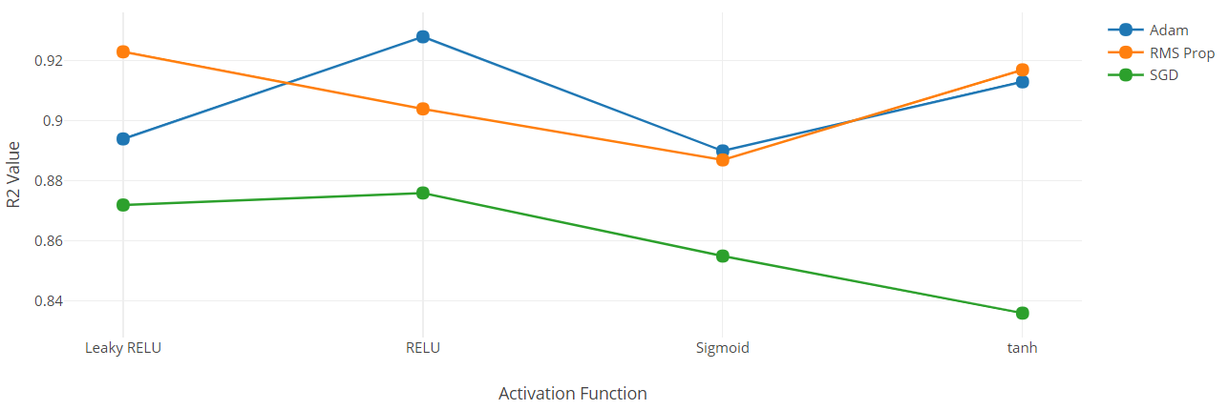
Plot for R^2 values with various Optimizers and Activation Functions
LR=0.01
With 2 Hidden layer
5 fold CV

Slide 38
9. With 4 Features(Forward Feature selection)
Activation functions | Optimizer | mad | mape | mse | nrmse | R^2 | rmse | smape
Leaky RELU | Adam | 2.161 | 0.093 | 9.66 | 0.092 | 0.886 | 3.103 | 0.092
RELU | Adam | 2.548 | 0.102 | 15.107 | 0.122 | 0.806 | 3.871 | 0.102
Sigmoid | Adam | 2.689 | 0.114 | 14.853 | 0.118 | 0.811 | 3.839 | 0.113
tanh | Adam | 2.028 | 0.087 | 8.464 | 0.089 | 0.9 | 2.903 | 0.086
Leaky RELU | RMS Prop | 1.836 | 0.08 | 6.776 | 0.08 | 0.921 | 2.597 | 0.081
RELU | RMS Prop | 2.194 | 0.092 | 10.301 | 0.098 | 0.88 | 3.204 | 0.091
Sigmoid | RMS Prop | 2.276 | 0.096 | 10.758 | 0.098 | 0.872 | 3.263 | 0.096
tanh | RMS Prop | 2.03 | 0.087 | 8.412 | 0.089 | 0.901 | 2.896 | 0.088
Leaky RELU | SGD | 2.664 | 0.11 | 15.332 | 0.119 | 0.803 | 3.898 | 0.109
RELU | SGD | 2.776 | 0.11 | 15.682 | 0.153 | 0.801 | 3.945 | 0.111
Sigmoid | SGD | 2.698 | 0.114 | 15.405 | 0.12 | 0.802 | 3.909 | 0.113
tanh | SGD | 2.251 | 0.095 | 10.559 | 0.099 | 0.872 | 3.238 | 0.095
LR=0.001
With 1 Hidden layer
5 fold CV

Slide 39
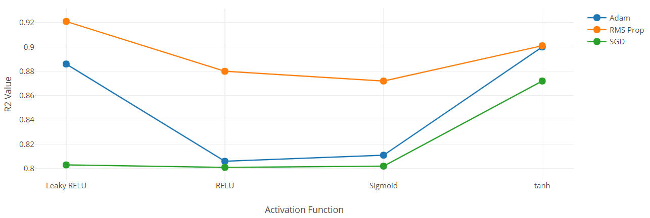
Plot for R^2 values with various Optimizers and Activation Functions
LR=0.001
With 1 Hidden layer
5 fold CV

Slide 40
10. With 4 Features(Forward Feature selection)
Activation functions | Optimizer | mad | mape | mse | nrmse | R^2 | rmse | smape
Leaky RELU | Adam | 1.866 | 0.081 | 6.933 | 0.079 | 0.917 | 2.629 | 0.082
RELU | Adam | 1.558 | 0.072 | 4.58 | 0.064 | 0.948 | 2.118 | 0.072
Sigmoid | Adam | 2.783 | 0.117 | 15.699 | 0.124 | 0.8 | 3.952 | 0.116
tanh | Adam | 1.909 | 0.081 | 7.54 | 0.081 | 0.911 | 2.733 | 0.081
Leaky RELU | RMS Prop | 1.924 | 0.086 | 7.436 | 0.086 | 0.913 | 2.723 | 0.086
RELU | RMS Prop | 1.803 | 0.079 | 6.759 | 0.084 | 0.921 | 2.596 | 0.08
Sigmoid | RMS Prop | 2.675 | 0.114 | 14.623 | 0.113 | 0.815 | 3.8 | 0.113
tanh | RMS Prop | 1.882 | 0.082 | 7.334 | 0.08 | 0.916 | 2.703 | 0.081
Leaky RELU | SGD | 2.371 | 0.103 | 10.677 | 0.104 | 0.873 | 3.253 | 0.103
RELU | SGD | 2.318 | 0.101 | 10.427 | 0.097 | 0.874 | 3.214 | 0.101
Sigmoid | SGD | 4.222 | 0.176 | 33.081 | 0.372 | 0.832 | 5.413 | 0.184
tanh | SGD | 2.465 | 0.103 | 12.189 | 0.11 | 0.848 | 3.473 | 0.103
LR=0.001
With 2 Hidden layer
5 fold CV

Slide 41
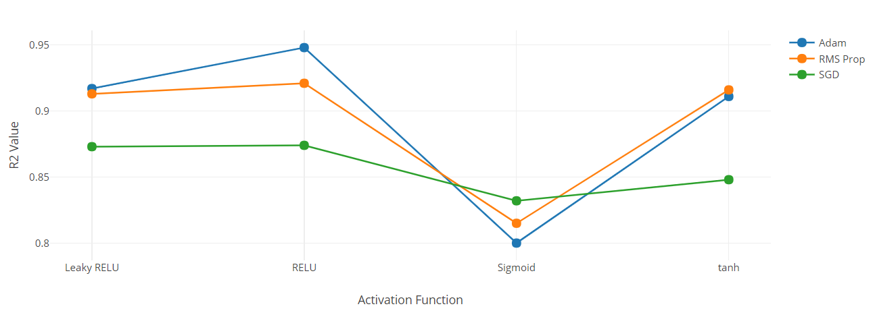
Plot for R^2 values with various Optimizers and Activation Functions
LR=0.001
With 2 Hidden layer
5 fold CV

Slide 42
11. With 4 Features(Forward Feature selection)
Activation functions | Optimizer | mad | mape | mse | nrmse | R^2 | rmse | smape
Leaky RELU | Adam | 2.1 | 0.089 | 8.474 | 0.083 | 0.9 | 2.901 | 0.089
RELU | Adam | 2.716 | 0.114 | 15.456 | 0.125 | 0.801 | 3.915 | 0.113
Sigmoid | Adam | 2.623 | 0.112 | 14.358 | 0.114 | 0.819 | 3.759 | 0.11
tanh | Adam | 2.053 | 0.087 | 8.58 | 0.088 | 0.899 | 2.921 | 0.087
Leaky RELU | RMS Prop | 1.522 | 0.072 | 4.375 | 0.062 | 0.95 | 2.085 | 0.071
RELU | RMS Prop | 1.939 | 0.087 | 7.219 | 0.083 | 0.916 | 2.681 | 0.087
Sigmoid | RMS Prop | 2.283 | 0.098 | 11.421 | 0.105 | 0.862 | 3.343 | 0.097
tanh | RMS Prop | 1.969 | 0.084 | 8.194 | 0.09 | 0.901 | 2.85 | 0.084
Leaky RELU | SGD | 2.703 | 0.113 | 15.489 | 0.124 | 0.801 | 3.919 | 0.113
RELU | SGD | 2.121 | 0.088 | 9.307 | 0.091 | 0.889 | 3.044 | 0.088
Sigmoid | SGD | 2.676 | 0.114 | 14.892 | 0.115 | 0.811 | 3.845 | 0.113
tanh | SGD | 2.248 | 0.095 | 10.202 | 0.098 | 0.877 | 3.184 | 0.095
LR=0.01
With 1 Hidden layer
5 fold CV

Slide 43
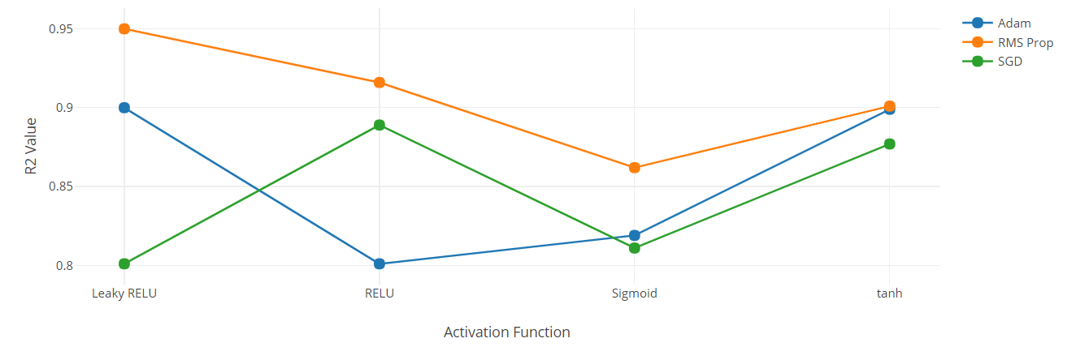
Plot for R^2 values with various Optimizers and Activation Functions
LR=0.01
With 1 Hidden layer
5 fold CV

Slide 44
12. With 4 Features(Forward Feature selection)
Activation functions | Optimizer | mad | mape | mse | nrmse | R^2 | rmse | smape
Leaky RELU | Adam | 1.93 | 0.09 | 7.61 | 0.09 | 0.91 | 2.75 | 0.09
RELU | Adam | 1.51 | 0.07 | 4.41 | 0.07 | 0.95 | 2.08 | 0.07
Sigmoid | Adam | 2.26 | 0.1 | 10.55 | 0.1 | 0.87 | 3.23 | 0.1
tanh | Adam | 1.89 | 0.09 | 7.12 | 0.09 | 0.92 | 2.66 | 0.09
Leaky RELU | RMS Prop | 2.02 | 0.1 | 7.61 | 0.09 | 0.92 | 2.75 | 0.09
RELU | RMS Prop | 2.01 | 0.09 | 8.03 | 0.1 | 0.91 | 2.83 | 0.09
Sigmoid | RMS Prop | 2.18 | 0.09 | 9.71 | 0.1 | 0.89 | 3.11 | 0.09
tanh | RMS Prop | 1.72 | 0.07 | 6.07 | 0.08 | 0.93 | 2.46 | 0.07
Leaky RELU | SGD | 2.9 | 0.12 | 16.4 | 0.13 | 0.79 | 4.04 | 0.12
RELU | SGD | 2.47 | 0.1 | 12.49 | 0.13 | 0.84 | 3.51 | 0.1
Sigmoid | SGD | 8.89 | 0.38 | 96.67 | 4.28 | 0.82 | 9.83 | 0.39
tanh | SGD | 2.31 | 0.1 | 10.86 | 0.11 | 0.87 | 3.28 | 0.1
LR=0.01
With 2 Hidden layer
5 fold CV

Slide 45
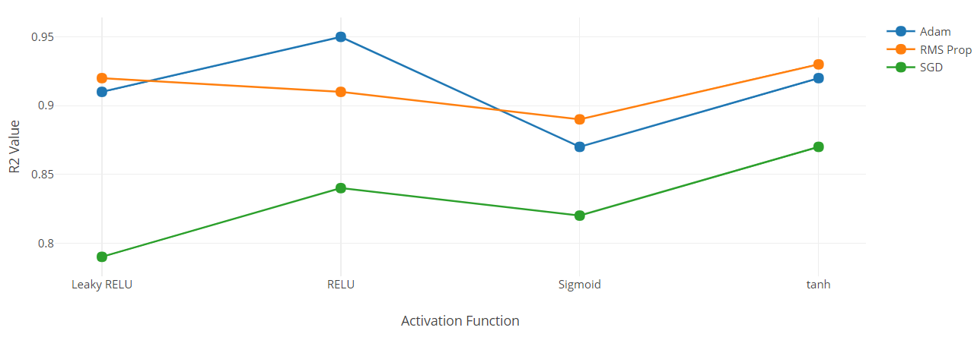
Plot for R^2 values with various Optimizers and Activation Functions
LR=0.01
With 2 Hidden layer
5 fold CV

Slide 46
Final Conclusions:
From the above hyper parameters with and without feature selection using MLP.
We compare MLP with different hyperparameters with and without feature selection using t-test value on R^2 value.
This gives the statistical significance between different hyper parameters with and without feature selection.
We calculate t-statistic with 1% level of significance and 5+5-2 = 8 degree of freedom. T - statistic value at 8 degree of freedom and 1% level of significance is 2.896.

Slide 47
Final Conclusions:
S. No | Features | Hidden Layers | Activation Function | Optimizer | Learning Rate | R^2 value | T-Statistic
1 (a) | 7 | 1 | ReLU | Adam | 0.001 | 0.92 | 3.573
1(b) | 4 | 1 | ReLU | Adam | 0.001 | 0.81
2(a) | 7 | 1 | Leaky ReLU | RMS Prop | 0.01 | 0.88 | 3.465
2(b) | 4 | 1 | Leaky ReLU | RMS Prop | 0.01 | 0.95
3(a) | 7 | 2 | ReLU | Adam | 0.01 | 0.93 | 0.942
3(b) | 4 | 2 | ReLU | Adam | 0.01 | 0.95
4(a) | 7 | 2 | ReLU | RMS Prop | 0.001 | 0.94 | 1.856
4(b) | 4 | 2 | ReLU | RMS Prop | 0.001 | 0.92
T - Test with respect to R^2 value with and without feature selection

Slide 48
Final Conclusions:
From the above table 3 and 4 hyper parameters are having t-test score less than 2.896, so with these hyper parameters are having statistically good R^2 values.
MLP with Hidden Layers = 2 and Activation Function = ReLU and Optimizer = Adam with Learning Rate = 0.01 with 4 features is good model and is giving 0.95 R^2 value.

Slide 49
References:
https://archive.ics.uci.edu/ml/datasets/Energy+efficiency
http://people.maths.ox.ac.uk/tsanas/Preprints/ENB2012.pdf
http://www.scielo.br/scielo.php?script=sci_arttext&pid=S1678-86212017000300103#e01
http://people.maths.ox.ac.uk/tsanas/Preprints/ENB2012.pdf
https://suw.biblos.pk.edu.pl/downloadResource&mId=504384
http://scikit-learn.org
https://docs.scipy.org/doc/scipy-0.19.0/reference/index.html
https://docs.scipy.org/doc/numpy-1.15.0/reference/generated/numpy.interp.html
https://pandas.pydata.org/pandas-docs/stable/index.html

Slide 50


