Slide 1

ATM Simulator

Slide 2
Team:-6
Srujan A S-PES1UG19CS509
Vishnu J G-PES1UG19CS574
Suraj K V-PES1UG19ME088
Sheshadri J-PES1UG19CV044

Slide 3

Functions of the program

Slide 4
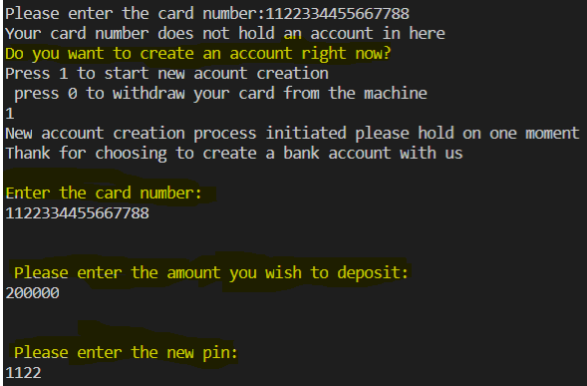
New card Number

Slide 5

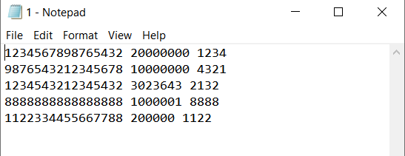
Read and write function and the information storing text file

Slide 6
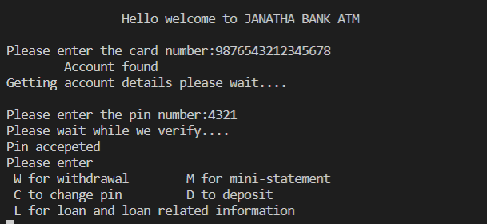
Main sequence of programs

Slide 7
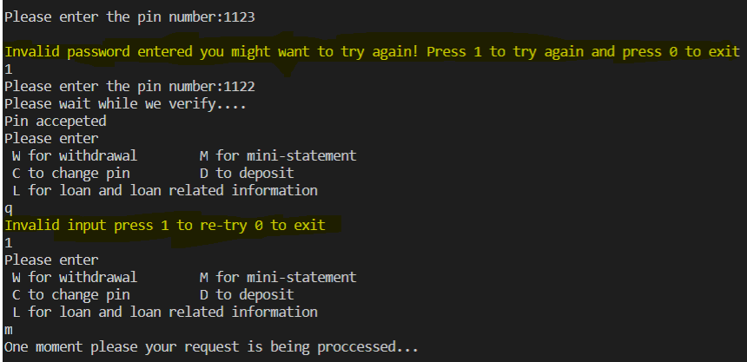
Invalid input handling

Slide 8
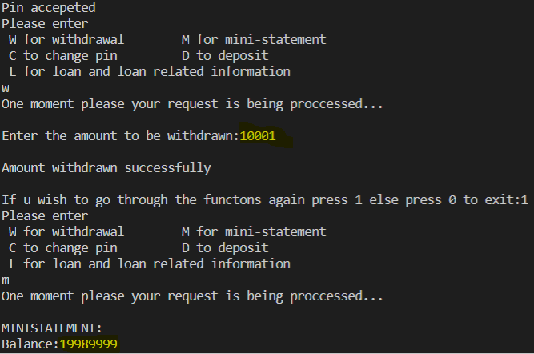
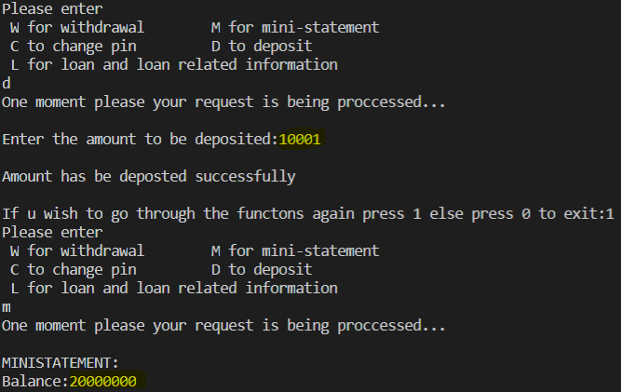
Withdraw and Deposit

Slide 9
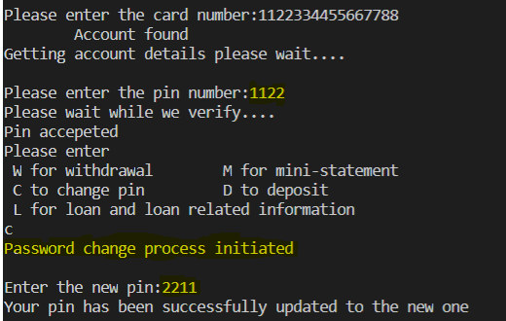
PIN Change

Slide 10
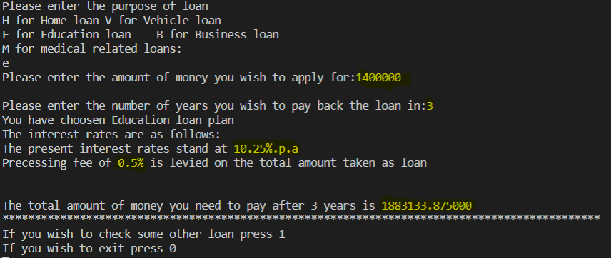
LOAN

Slide 11
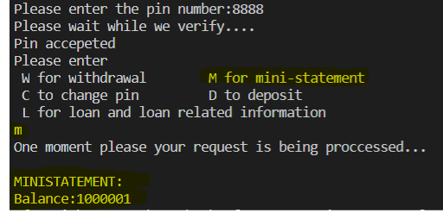
Ministatement

Slide 12
THANK YOU

