Slide 1
Team Merchandising Revenue System project
Using Python

Slide 2
Believers
Vishnu Joshi
3BR22CS182
Mallikarjun
3BR22CS084
R Raghavendra
3BR22CS132
R S Hareesh
3BR22CS133

Slide 3

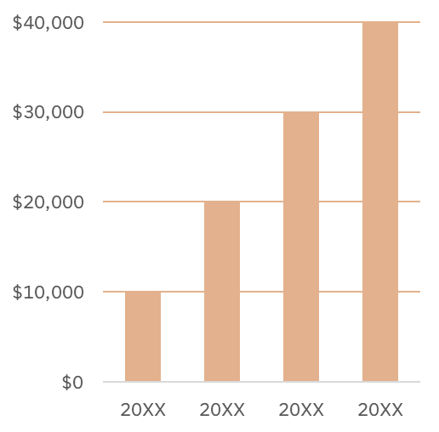
Introduction
REPORT
The Team Merchandising Revenue System project aims to automate the management of merchandise sales of different teams.
It provides functionalities to input, modify, and delete merchandise data, along with capabilities to analyze sales data of each team and generate comprehensive revenue reports.
Thus, the system aims to optimize tasks like data entry, sales tracking, and revenue analysis, and it also improve decision-making processes.

Slide 4

Abstract:
The project implements Team Merchandising Revenue System using Python.
It is developed using object-oriented programming (OOP),Inbuilt methods , Functions and CRUD operations
It allows for the creating, reading, updating, and deleting (CRUD) operations on merchandise items, as well as tracking team merchandise sales and analyzing revenue streams.
unit tests are included to ensure the functionality of the system and with the help of File handling it generates a report.

Slide 5
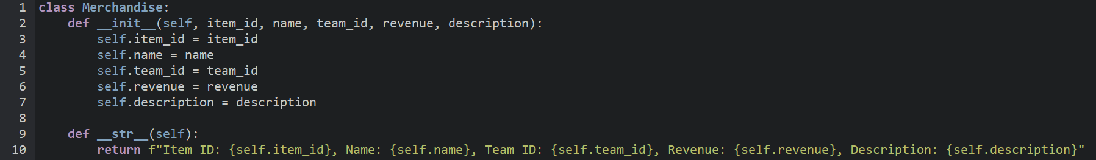
Module description
In Merchandise class, instance of the Merchandise class contains merchandise item, including its item ID, name, team ID, revenue, and description. when the parameter are passed then they are assigned to the variables.
The f-string formatting syntax is used to embed the values of the object's attributes into the string. The __str__ method returns a string representation of the merchandise item.

Slide 6
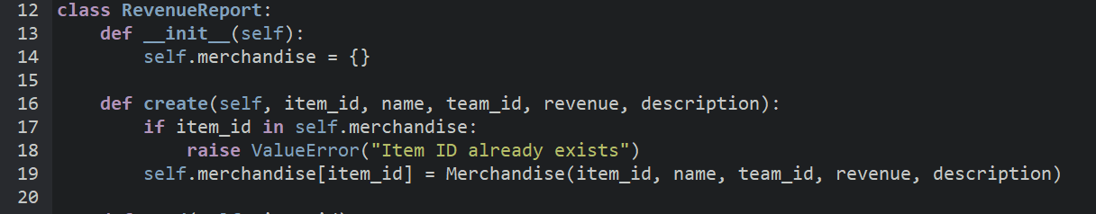
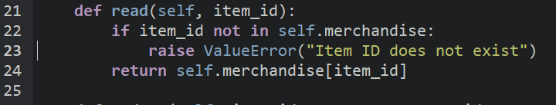
In RevenueReport Class Contains an a merchandise dictionary and Methods of CRUD operations.
Create:
In create method, It verifies the item_id, If it is already present then it rises value error. If not it adds a new merchandise item to the collection.
Read:
In read method, It verifies the item_id, If it is not present then it rises value error. if not it retrieves a merchandise item based on its ID.

Slide 7
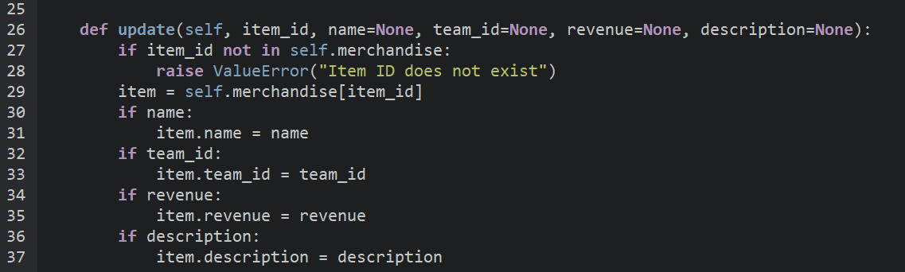
Update:
In update method, It verifies the item_id, If it is not present then it rises value error else it modifies and updates the attributes of a merchandise item by newly Provided name, team ID, revenue, and description.

Slide 8
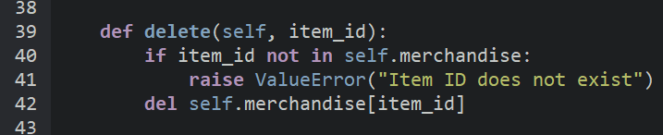
Delete:
In Delete method, when the item_id is not present in the merchandise dictionary then it raises value error or else it removes a merchandise item_id and its information from the collection.

Slide 9
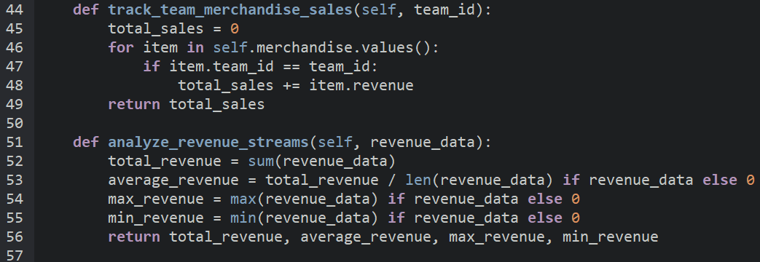
Track team merchandise sales:
This method calculates the total sales for a given team based on their team_id.
For each item, it checks if the team ID matches the provided team_id.
- If a match is found, it adds the revenue of that item to the total_sales by iterating.
- Finally, it returns the total sales for the specified team.
Analyze revenue streams:
- This method analyzes the revenue data provided as a list of revenue values.
- It calculates the total revenue, average revenue, maximum revenue, and minimum revenue from the provided data by using built-in methods.

Slide 10
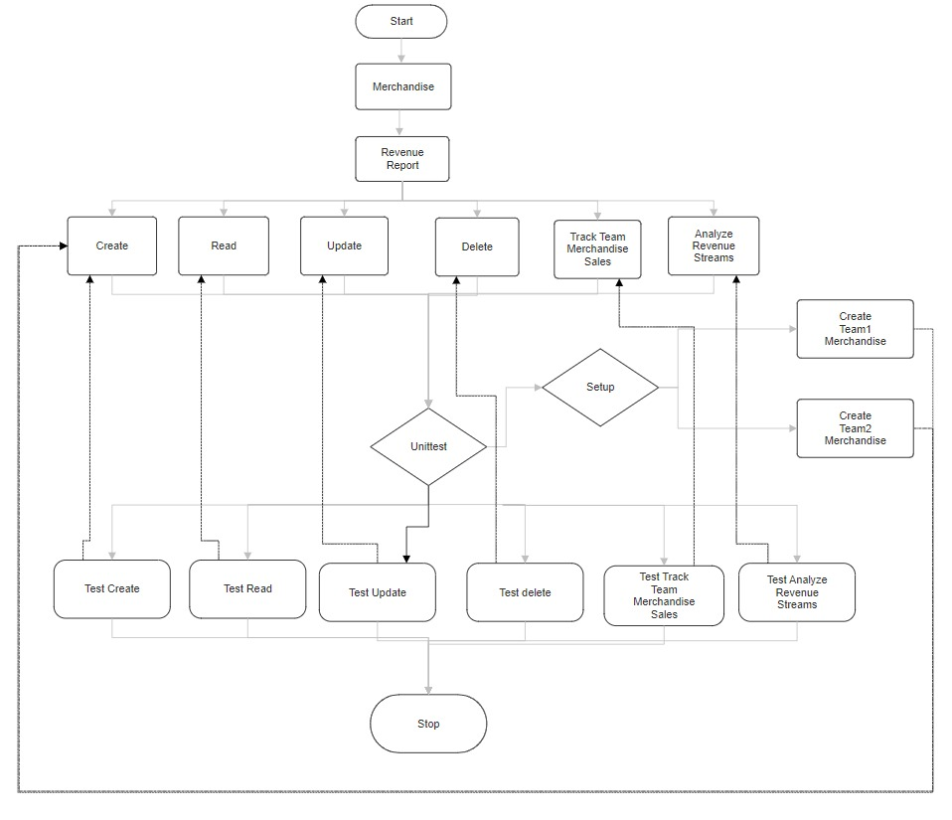
flowchart

Slide 11
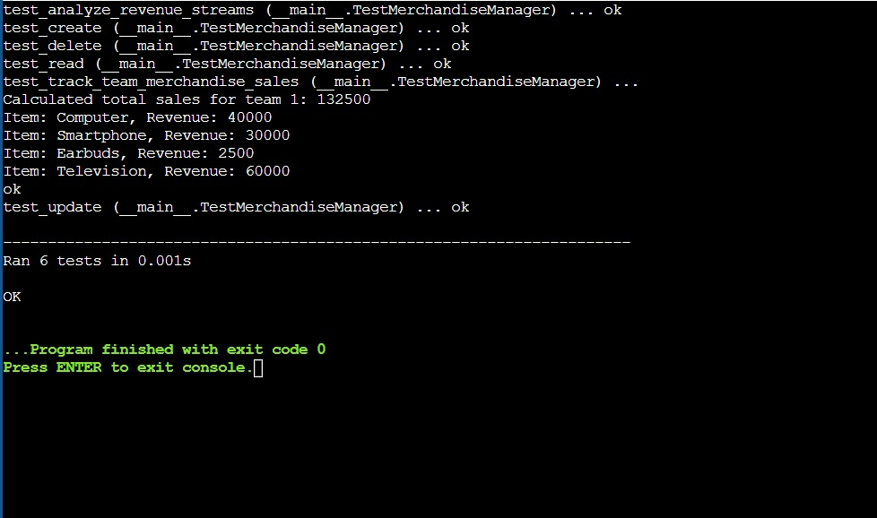
Output:
When unit test is used.

Slide 12
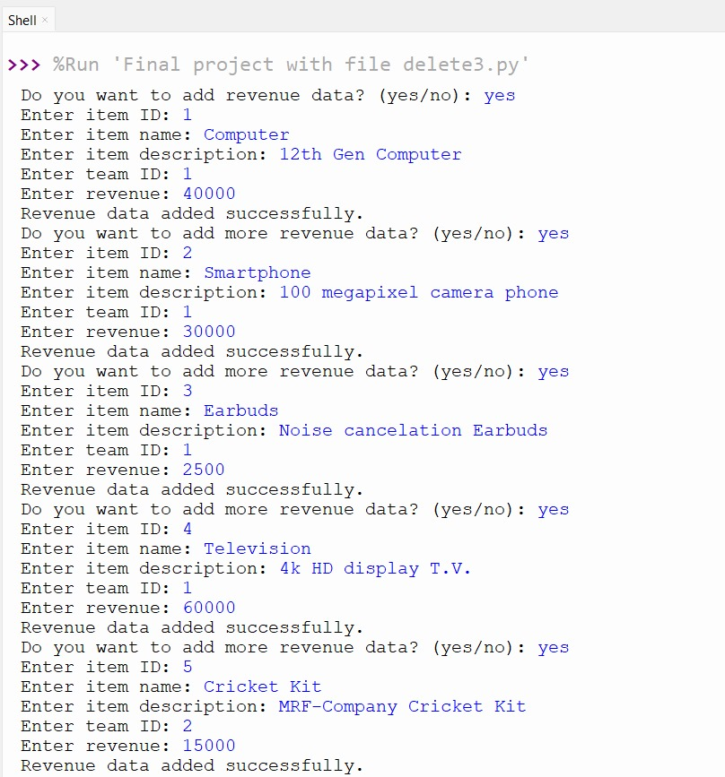

User Input:
Project implemented using File handling.

Slide 13
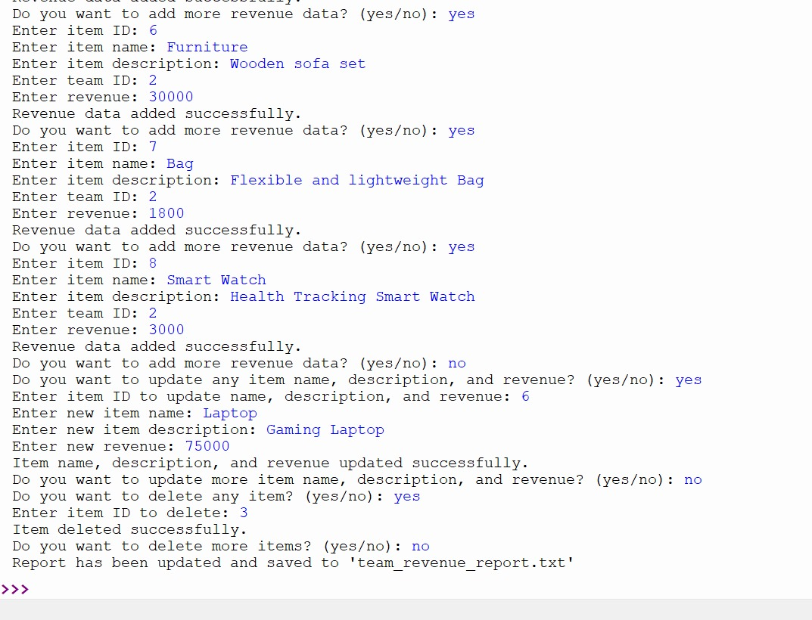

Slide 14
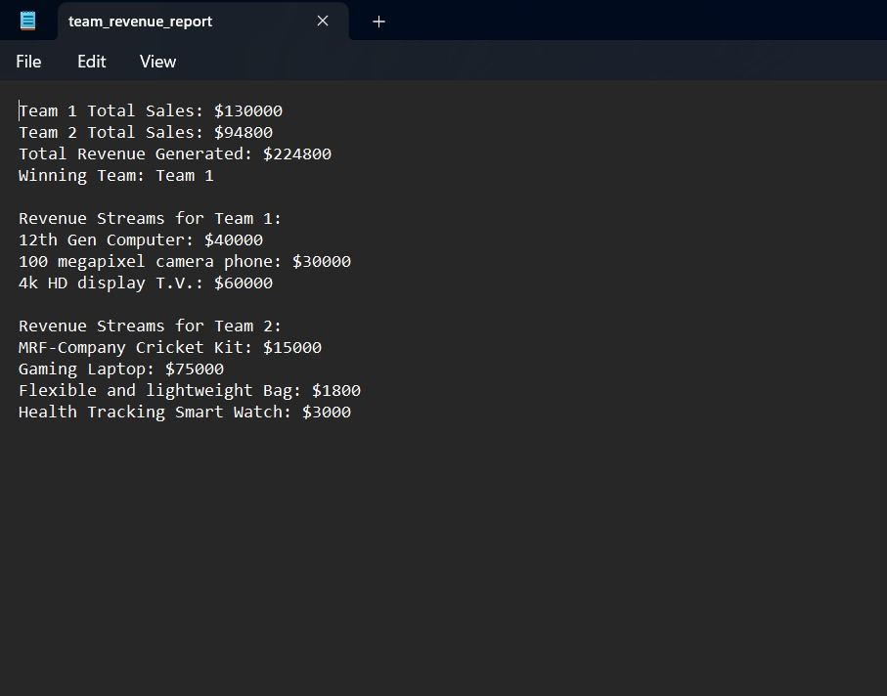
Output:

Slide 15

BIBLIOGRAPHY:
Google
https://www.w3schools.com/python/
https://www.programiz.com/
https://lucid.app/documents#/templates
https://github.com/VishnuJoshi24
https://github.com/MallikarjunSure
https://github.com/RRaghu12
https://github.com/Hareesh-21

Slide 16
Thank You

