Slide 1

EMPLOYEE MANAGEMENT SYSTEM (EMS)
PRESENTED BY : VISHNU S NAIR

Slide 2

INTRODUCTION :
The Employee Management System (EMS) is designed to streamline the management of employee data, job roles, and departmental information within an organization. This system allows for efficient tracking of employee details, job assignments, qualifications, and performance metrics.
OBJECTIVE : The objective of this project is to design and implement an Employee Management System that efficiently stores and manages employee-related data within an organization. This system helps to track various aspects of employee information, including personal details, job roles, salary structures, qualifications, leave records, and payroll data.
TOOLS USED : SQL , CSV , PowerPoint
DATA SOURCE : Internal CSV Datasets

Slide 3

TABLE DESCRIPTIONS :
This project includes 6 interrelated tables:
Table name | Description
JobDepartment | Stores job roles, departments, and related salary ranges
SalaryBonus | Contains salary, bonus, and annual pay linked to specific job roles.
Employee | Maintains personal, contact, and login details of all employees.
Qualification | Records qualifications and required skills for employee job positions.
Leaves | Tracks employee leave records with reasons and dates.
Payroll | Combines employee, job, salary, and leave data to calculate net payments.

Slide 4
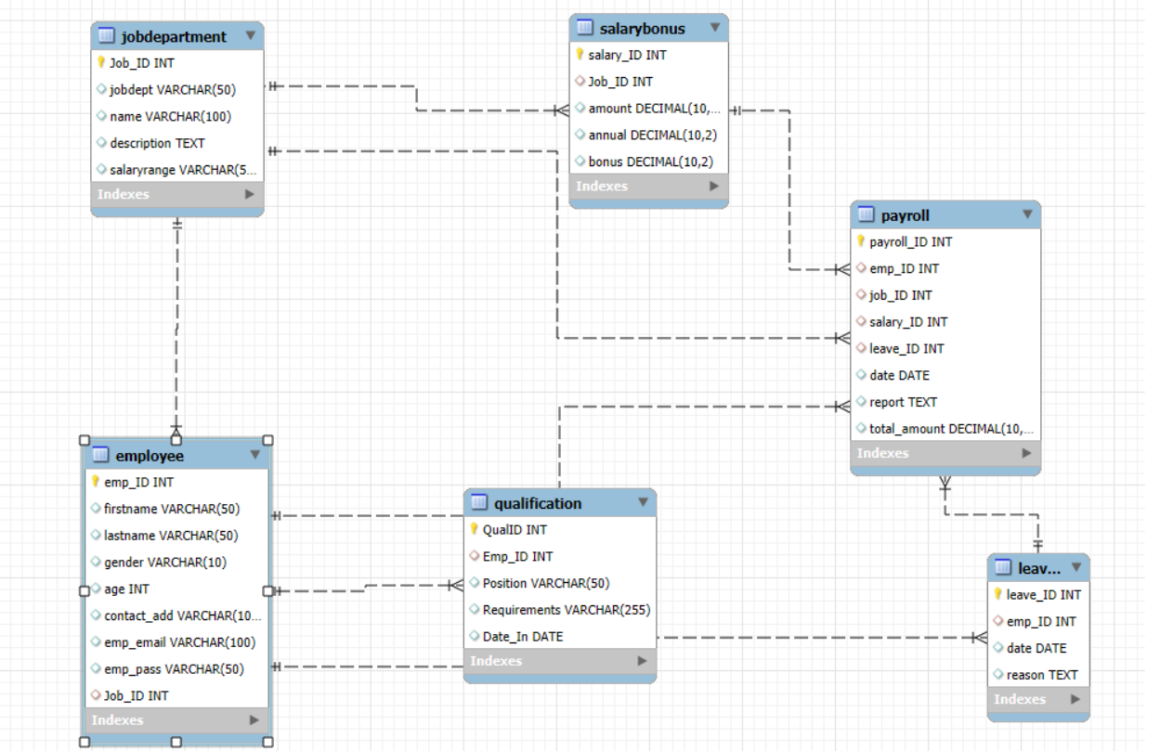
ER Diagram :

Slide 5
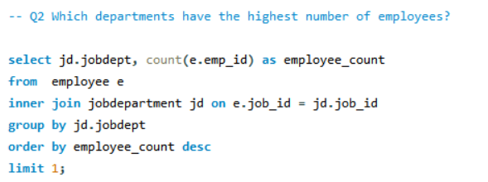
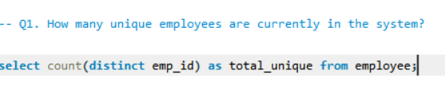
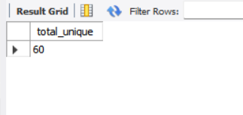

Analysis Questions
EMPLOYEE INSIGHTS :

Slide 6
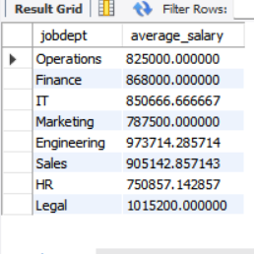
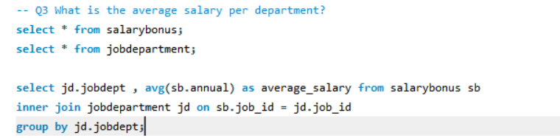
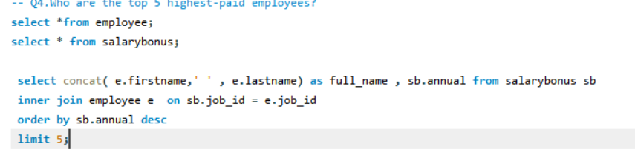
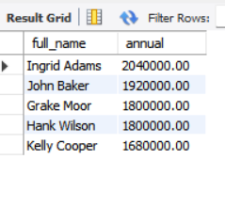



Slide 7
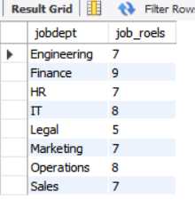
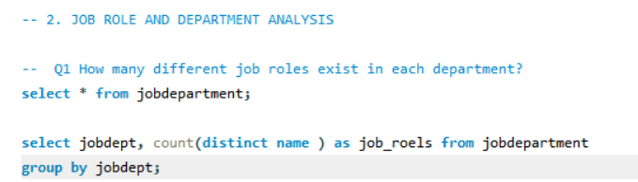
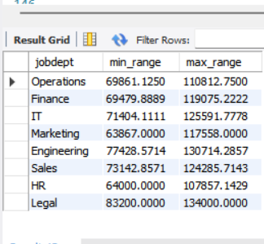
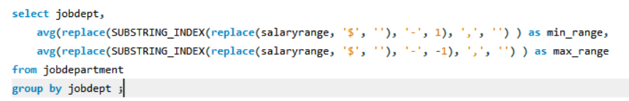
2. JOB ROLE AND DEPARTMENT ANALYSIS :
What is the average salary range per department?

Slide 8
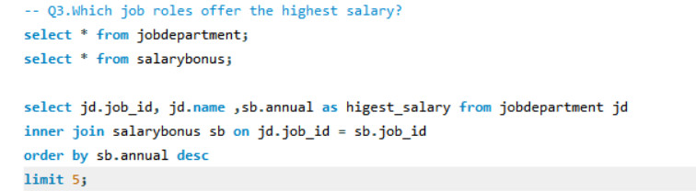
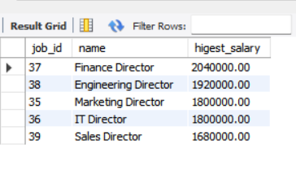
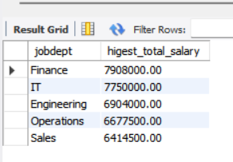
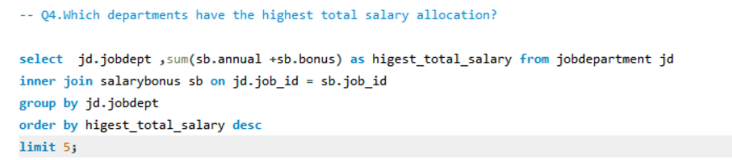

Slide 9
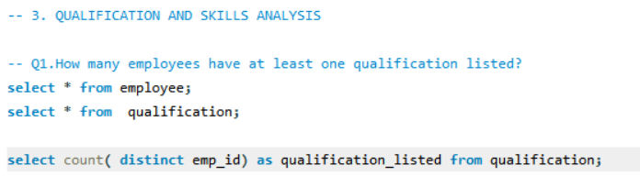
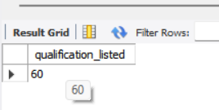
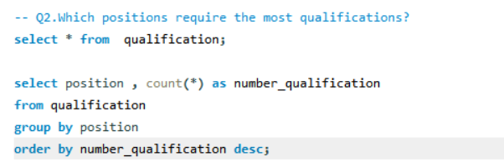
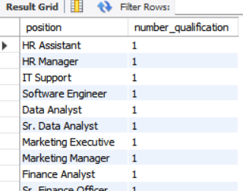
3. QUALIFICATION AND SKILLS ANALYSIS :

Slide 10
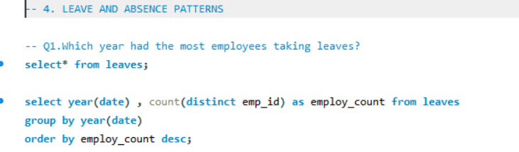
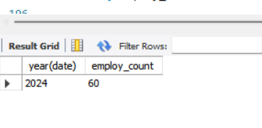
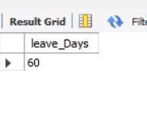
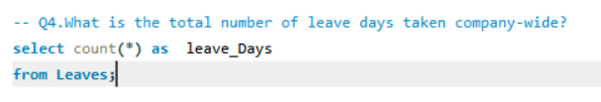
4. LEAVE AND ABSENCE PATTERNS :

Slide 11
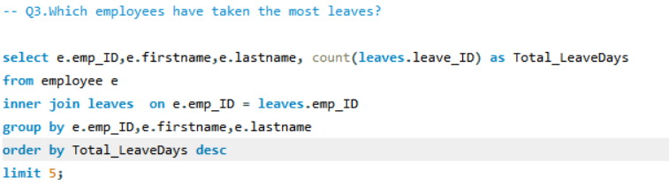
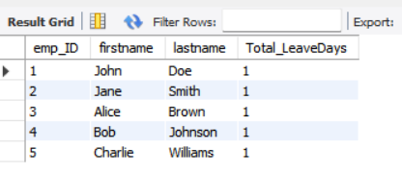
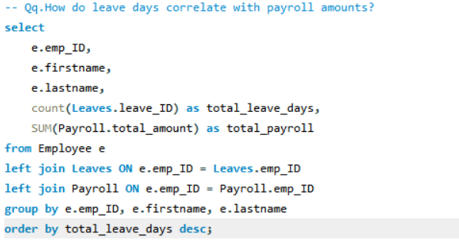
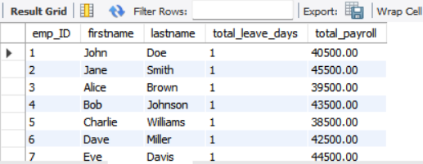

Slide 12
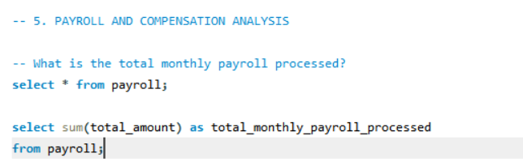
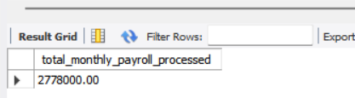
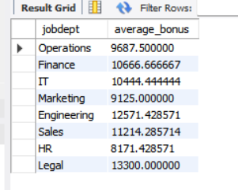
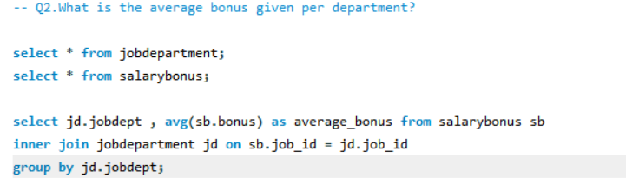
5. PAYROLL AND COMPENSATION ANALYSIS :

Slide 13
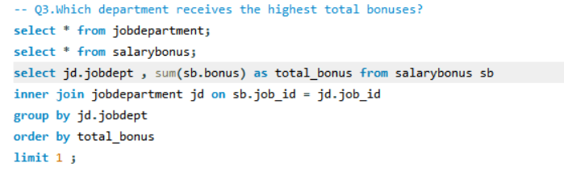


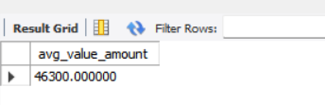

Slide 14
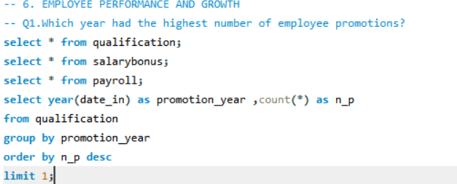
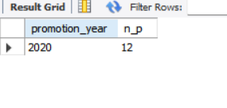
6. EMPLOYEE PERFORMANCE AND GROWTH :

Slide 15
Conclusion
The analysis provided valuable insights into the operations for storing, managing, and analyzing employee data.
The analysis helped to easily track employee records, payroll calculations, leave patterns, and job roles, making Employee management more transparent .
The analytical queries help organizations optimize salary allocations, understand employee qualifications, monitor absences, and assess performance trends, leading to informed decision-making.
Demonstrated the power of SQL in solving real-world problems.
Future Work : Further analysis using python or Power BI for advanced analytics and dashboards that can give even deeper insights into employee data and trends

Slide 16


