Slide 1

f

Slide 2
ABSTRACT
The primary objective is to provide personalized and accurate song recommendations by leveraging user inputs, such as preferences, mood and context, through conversational interface.
This aims to enhance the user's music discovery experience and make it more engaging and interactive.
This chatbot aims to enhance user interaction by seamlessly integrating music recommendations that match the context of the conversation.

Slide 3

Introduction
The project focuses on developing a custom chatbot tailored for casual conversations.
The chatbot can analyze user inputs to detect mood, sentiment providing song suggestions that align with the current atmosphere.
Whether the user is feeling joyful, reflective, or in need of a mood lift, the chatbot’s dynamic approach adds a personalized and engaging layer to user interactions.

Slide 4
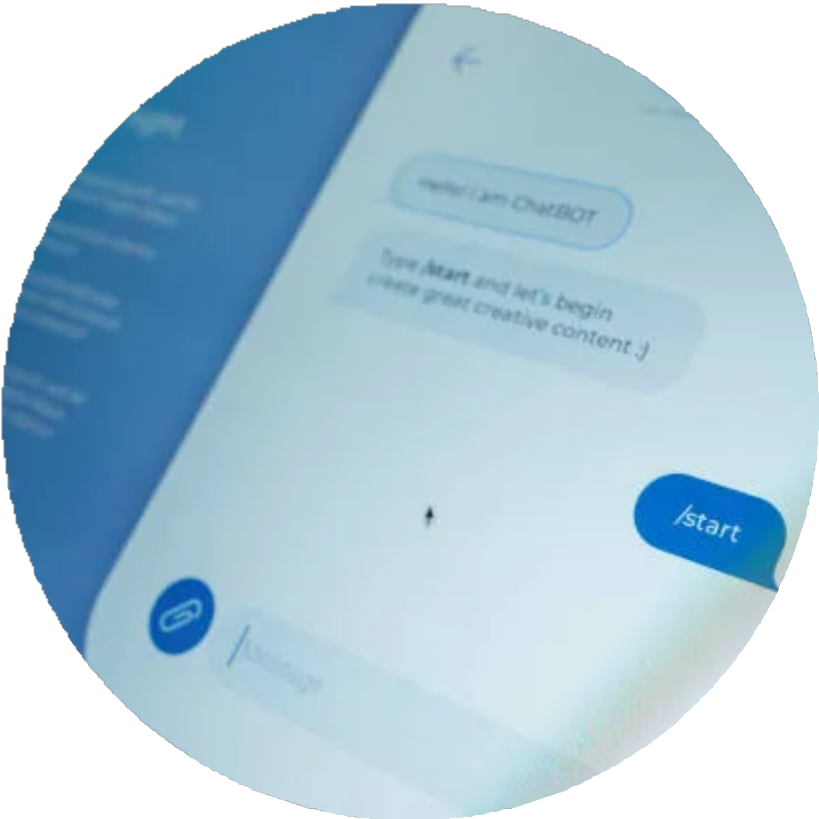
Problem statement
This project addresses the need for an intelligent, conversational chatbot capable of providing real-time, tailored song recommendations through a natural and user-friendly interface.

Slide 5
Existing system
Generic Recommendations : Many systems provide general recommendations without truly adapting to a user’s unique mood or conversation.
Dependence on User Input: Existing systems often require explicit input about music tastes or mood, limiting spontaneous and natural interactions. Limited Contextual
Understanding : Most chatbots struggle with deeper conversational context, leading to less accurate recommendations.

Slide 6
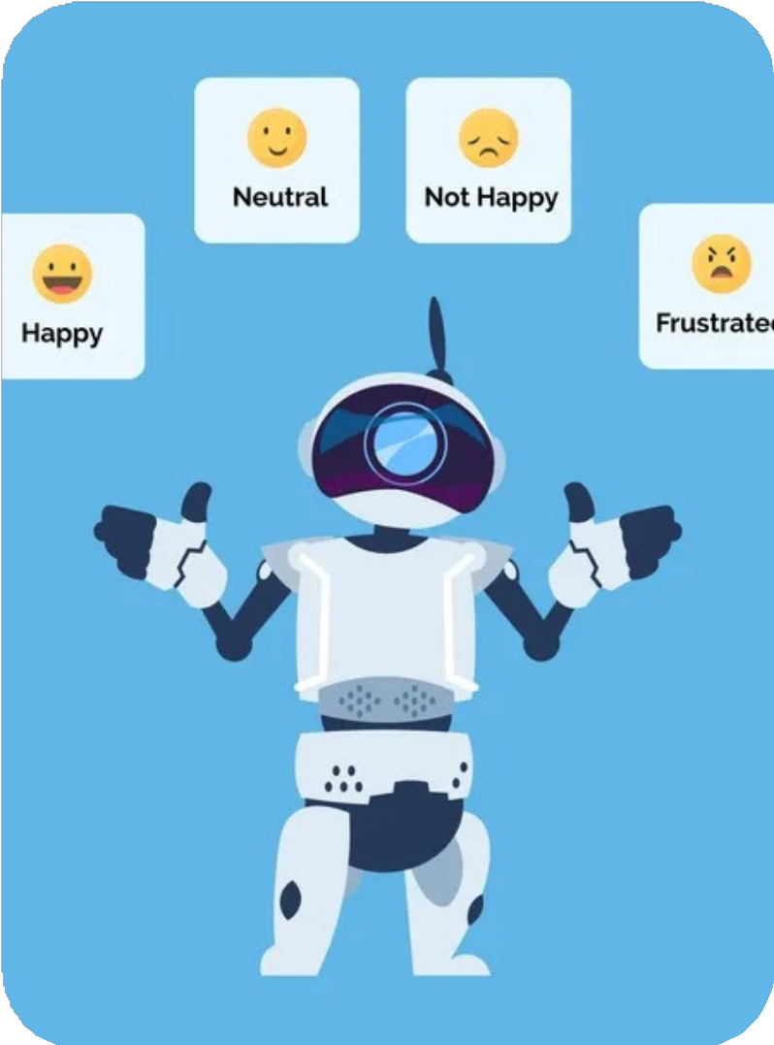
Proposed objective
In this project, we would be combining multiple services and open-source tools to make a Chatbot that recommends songs based on the conversation which the user is having with the chatbot.
Having a real-world chatbot, to which you can literally chat like you chatting to a real person and enjoying the music recommended by the system

Slide 7





TECHNOLOGIES USED
Front-end
Back-end
API

Slide 8
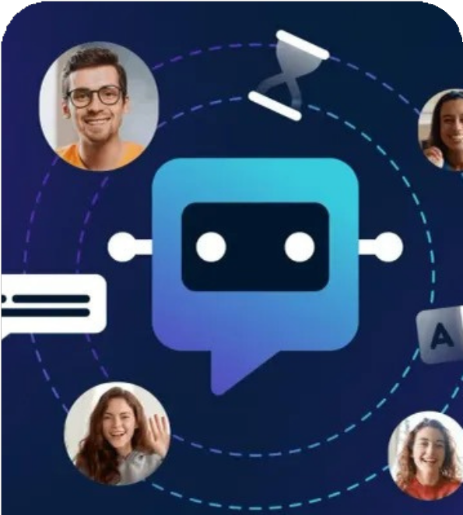
Advantages
Personalized Recommendations
Interactive and User-Friendly
Mood-Based Suggestions
Streamlined Music Discovery
Enhanced Engagement

Slide 9
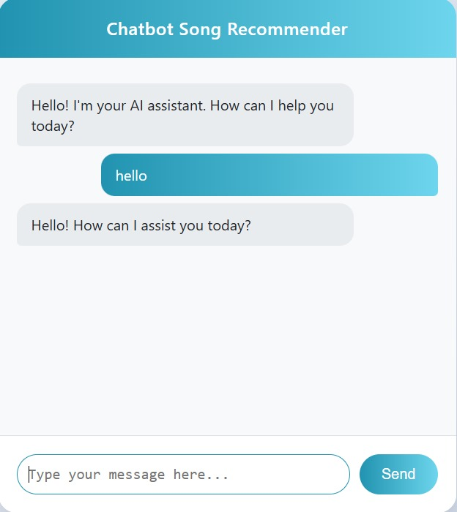

Slide 10
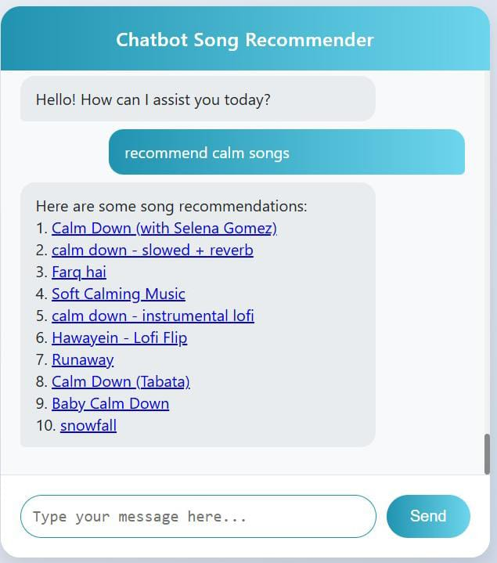
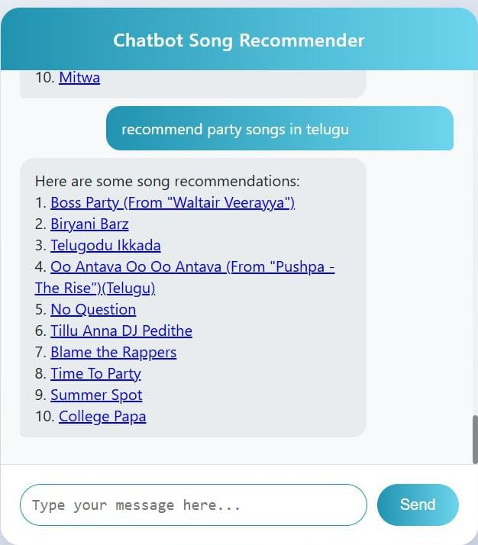

Slide 11
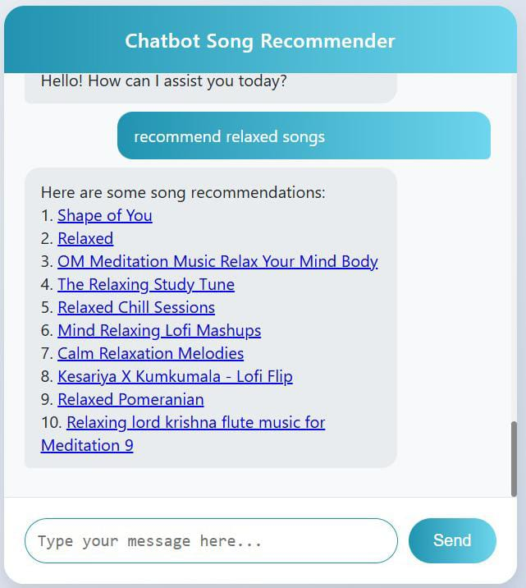
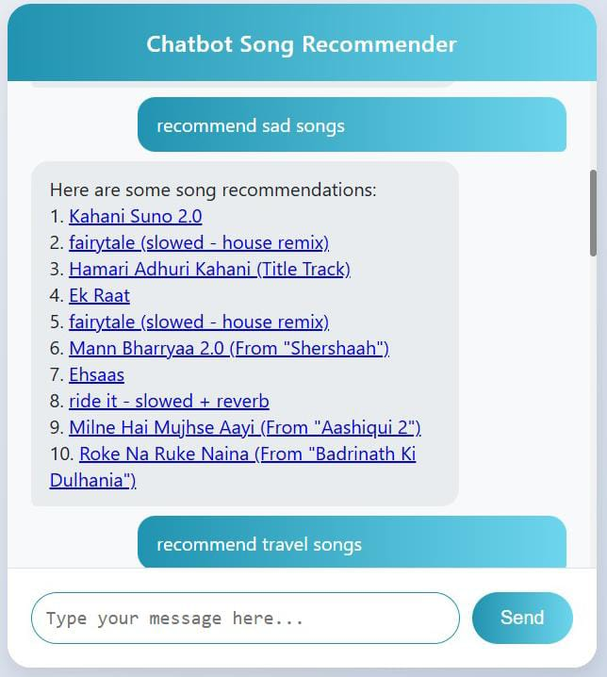

Slide 12
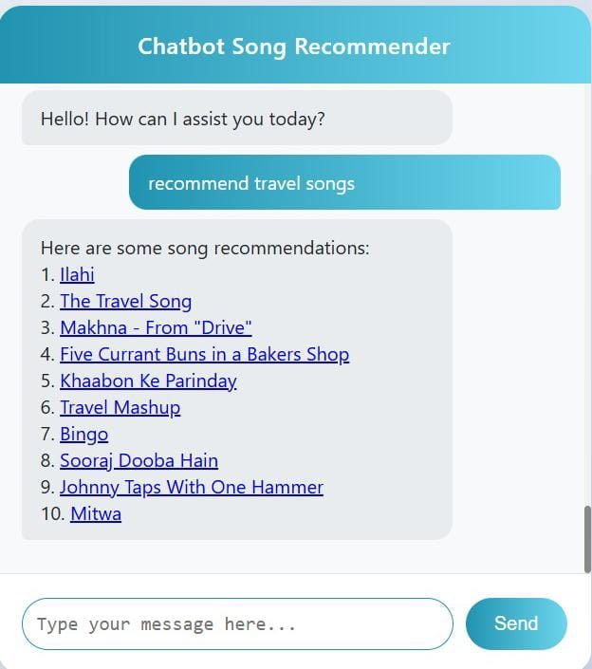
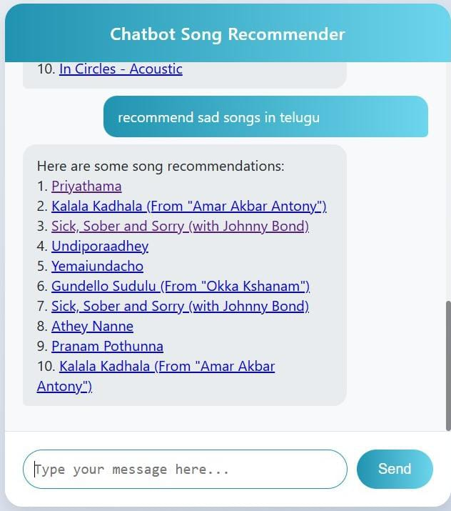

Slide 13
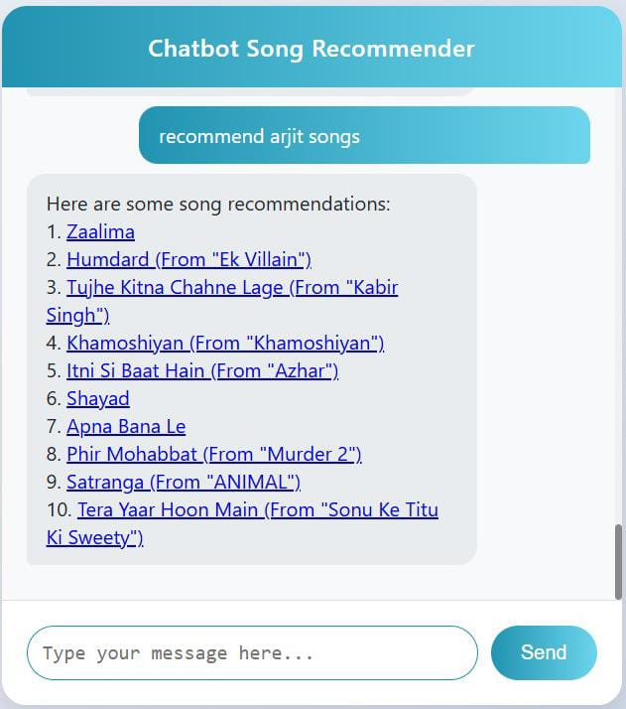
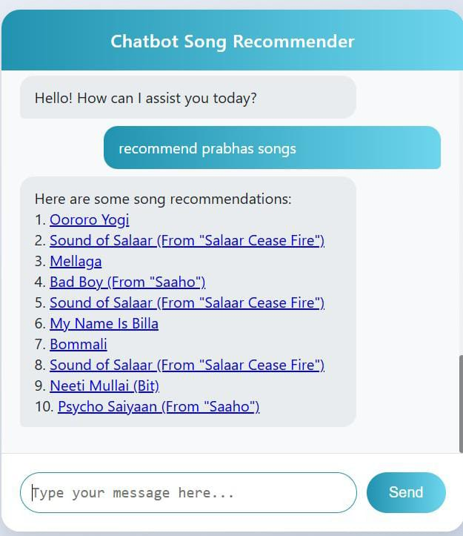

Slide 14
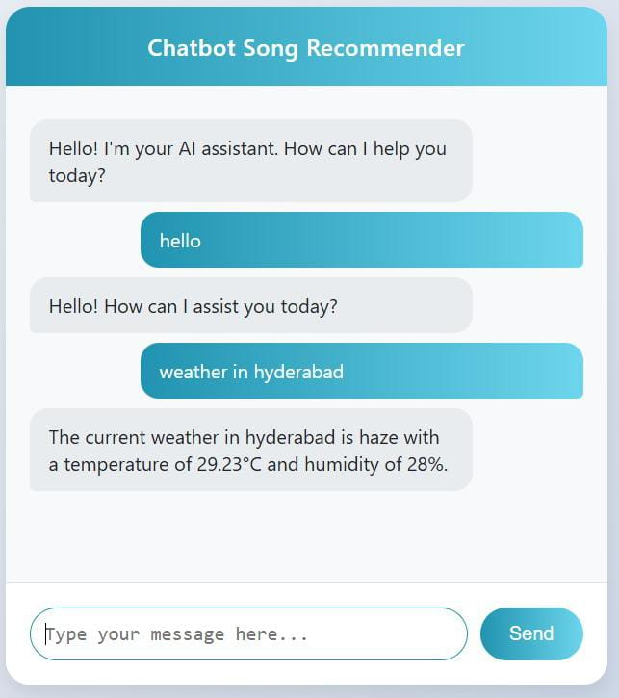

Slide 15
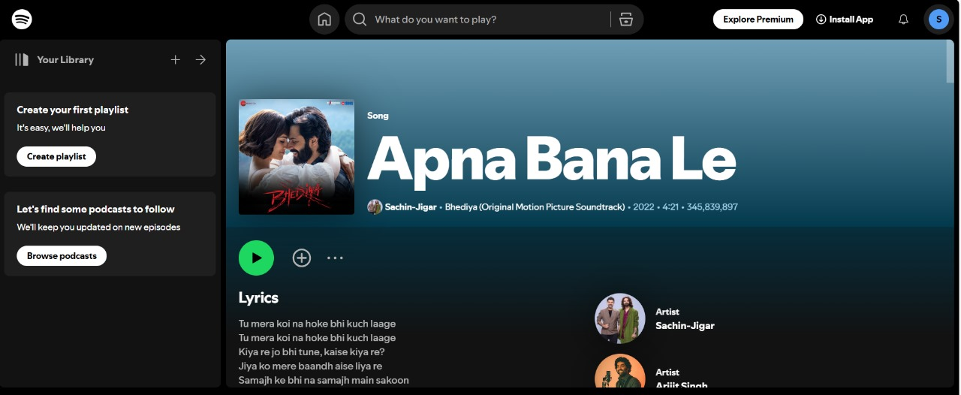

Slide 16
FUTURE SCOPE
Custom chatbot answering general conversations.
Flexiblity in giving inputs to chatbot.
REFERENCES
Spotify API
Open Weather API

Slide 17
THANK YOU

