Slide 1

G2M Case Study
12-Jan-2025

Slide 2
Background –G2M(cab industry) case study
XYZ is a private equity firm in US. Due to remarkable growth in the Cab Industry in last few years and multiple key players in the market, it is planning for an investment in Cab industry.
Objective: Provide actionable insights and recommendations based on your analysis
Tasks: Summarize key findings, highlight strengths and weaknesses of each company, and suggest potential investment opportunities.

Slide 3
Data Exploration
The dataset Cab_Data.csv contains 359,392 entries and the following columns:
Transaction ID: Unique identifier for each trip.
Date of Travel: Numeric format of the travel date. * Changed type of the numeric format to Date format.
Company: Cab service provider (e.g., "Pink Cab").
City: Location where the service was provided.
KM Travelled: Distance covered during the trip (in kilometers).
Price Charged: Fare charged to the customer (in currency units).
Cost of Trip: Operational cost incurred by the company.
The Customer_ID.csv contains below columns and Rows
Columns:
Customer ID: Unique identifier for customers.
Gender: Customer gender.
Age: Customer age.
Income (USD/Month): Customer monthly income.
Rows: 49,171.
The Transaction_ID.csv contains below columns and Rows
Transaction_ID.csv
Columns:
Transaction ID: Unique identifier for transactions.
Customer ID: Links transactions to customers.
Payment Mode: Method of payment (e.g., Card, Cash).
Rows: 440,098.

Slide 4
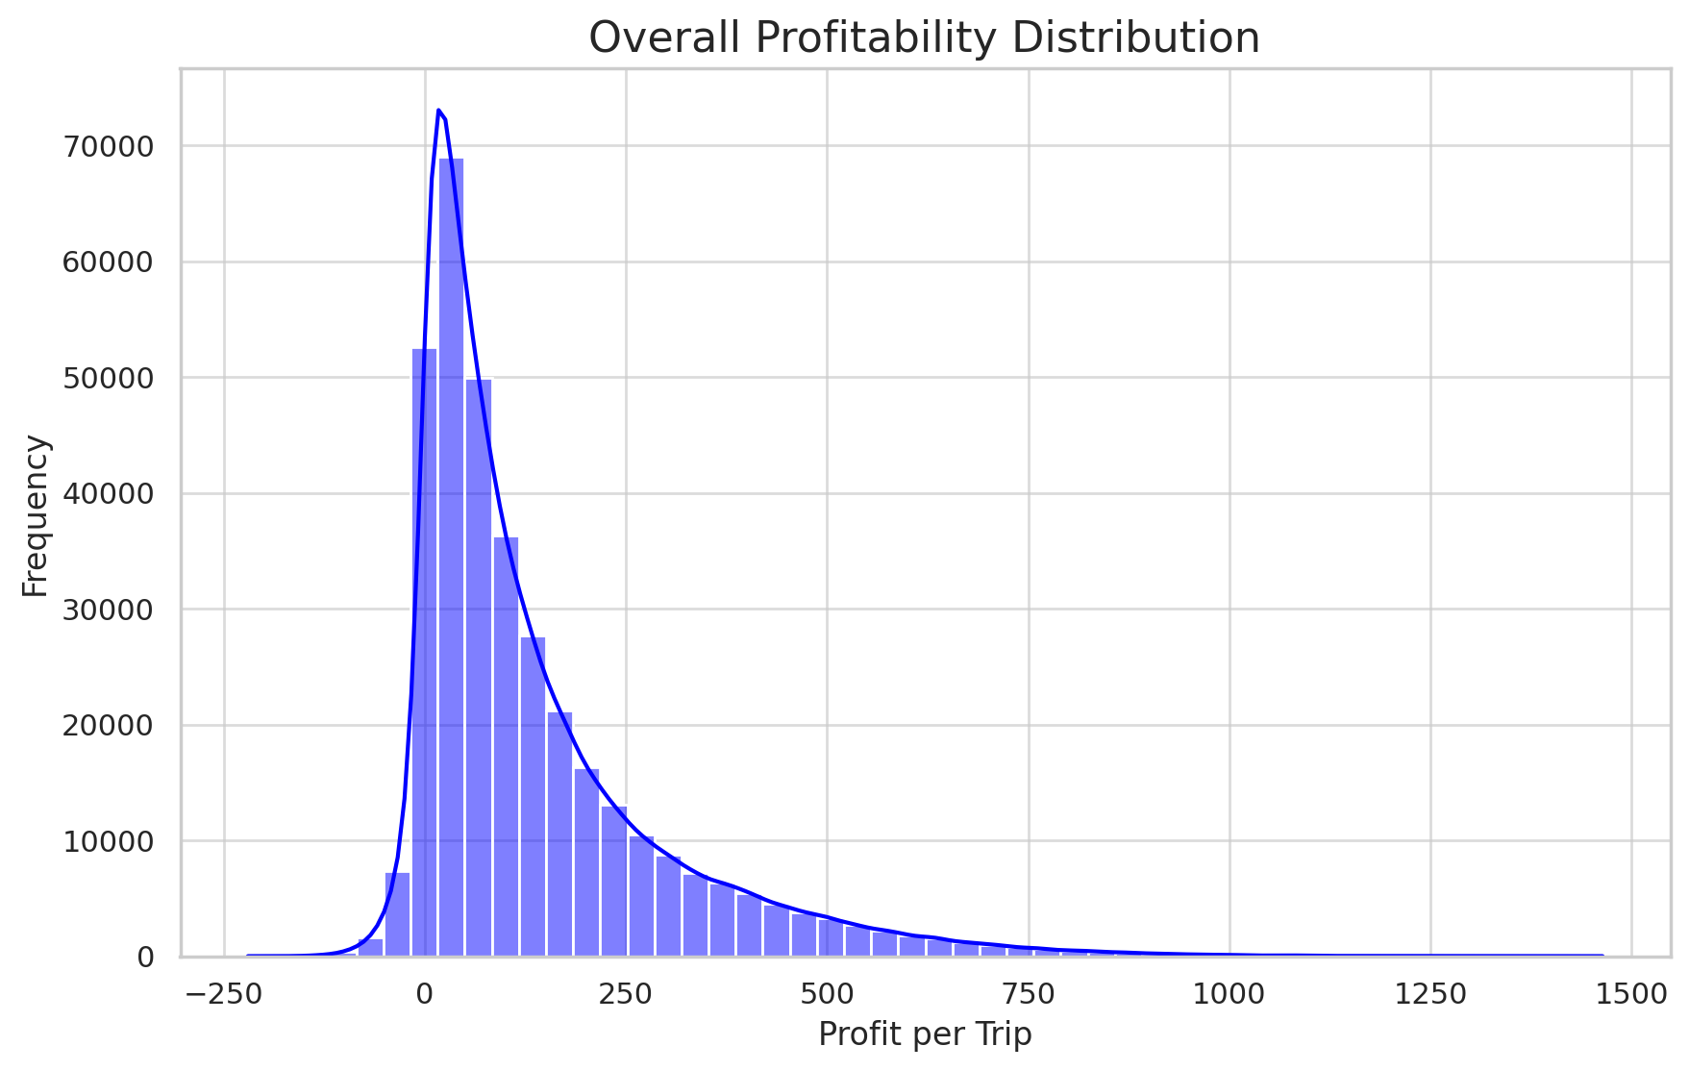
Profit Analysis
Overall Profitability Distribution:
Shows the distribution of profit per trip across the dataset.
Most trips cluster around a specific profit range, with some outliers.

Slide 5
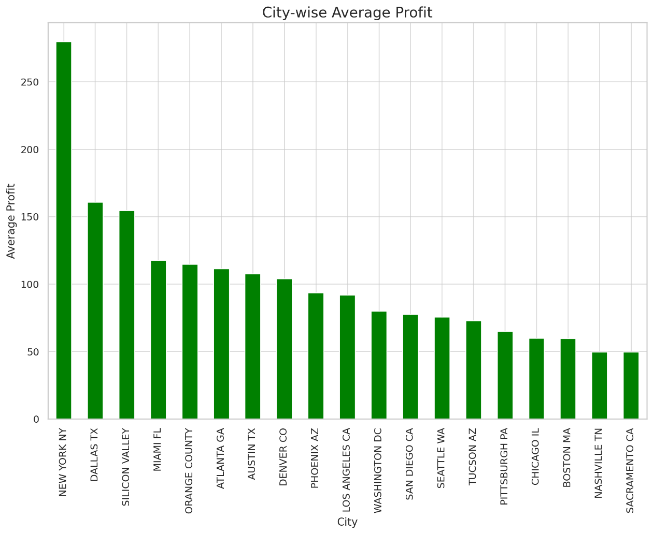
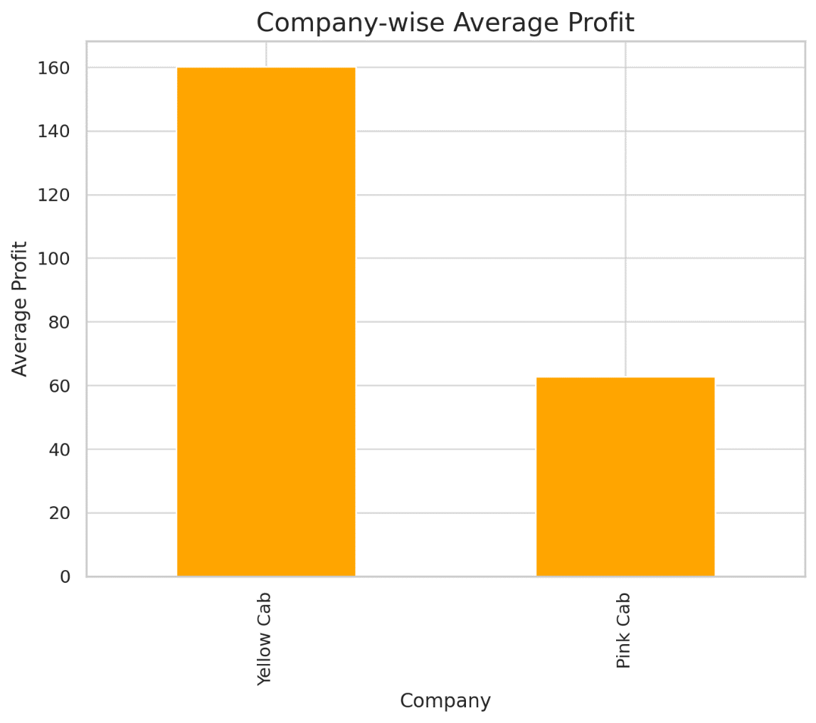
Profit Analysis
City-wise Average Profit:
Highlights the average profit per trip in each city.
Cities with higher average profits can be identified as potentially more lucrative.
Company-wise Average Profit:
Compares the average profit per trip across different companies.
Yellow Cab company generates more profit on average than Pink Cab company.

Slide 6
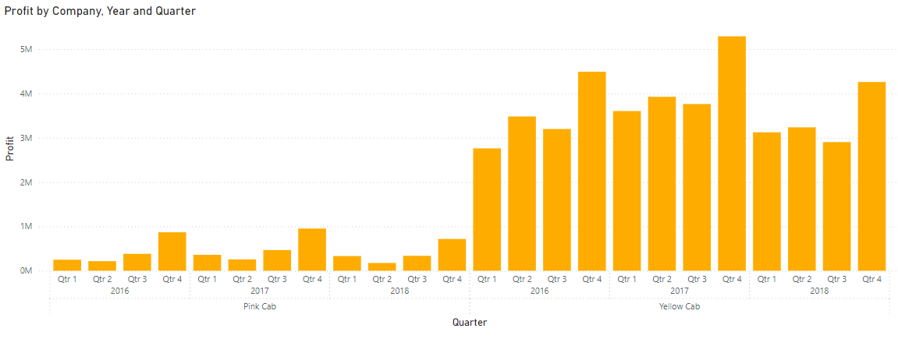
Profit Analysis
Profit by Pink and Yellow Cab in Millions for 4 quarters in the year 2016, 2017, 2018
Yellow Cab profit cross >5 Million in the Q4 of 2017
Q4 has more profits in a calendar year for Pink and Yellow cab companies

Slide 7
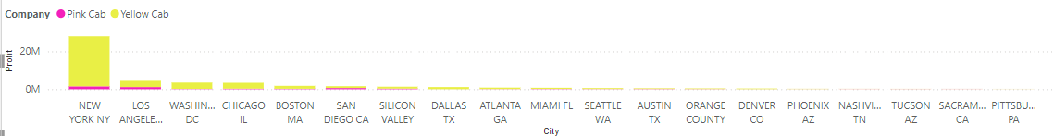
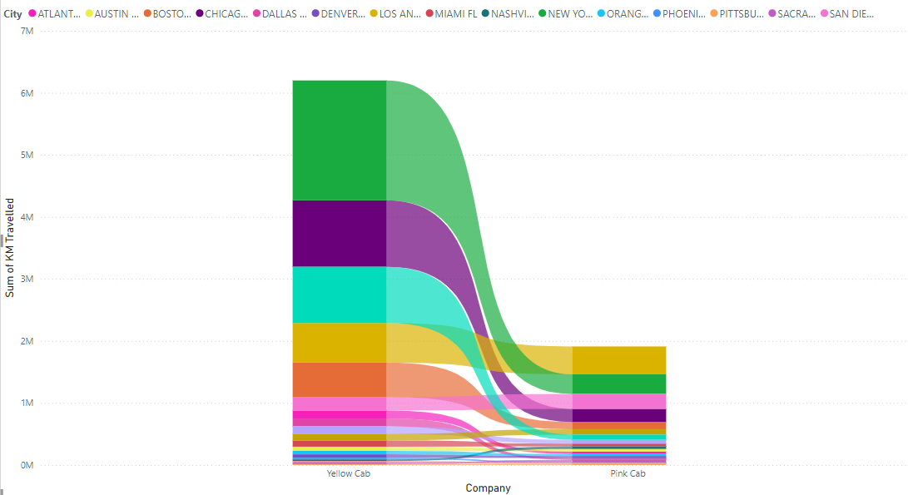
Profit Analysis
Yellow Cab company has travelled more KMs than Pink Cab company
Yellow Cab company has more profits in NewYork NY city.

Slide 8
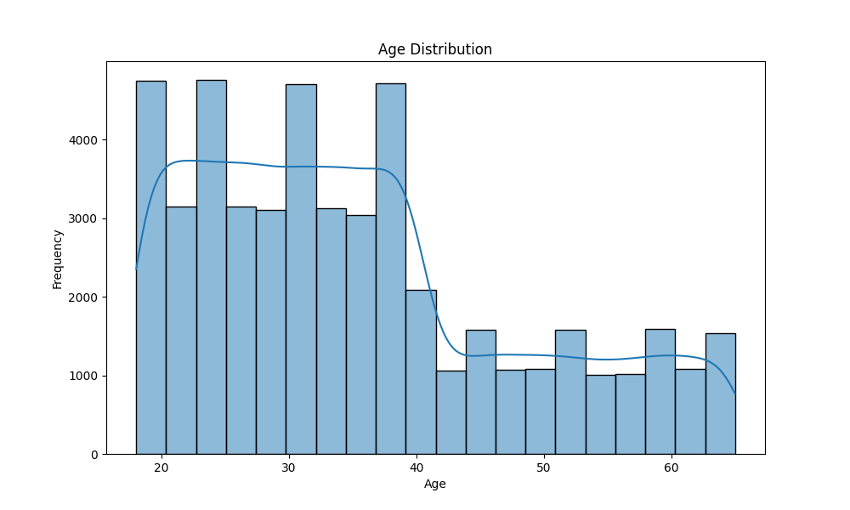
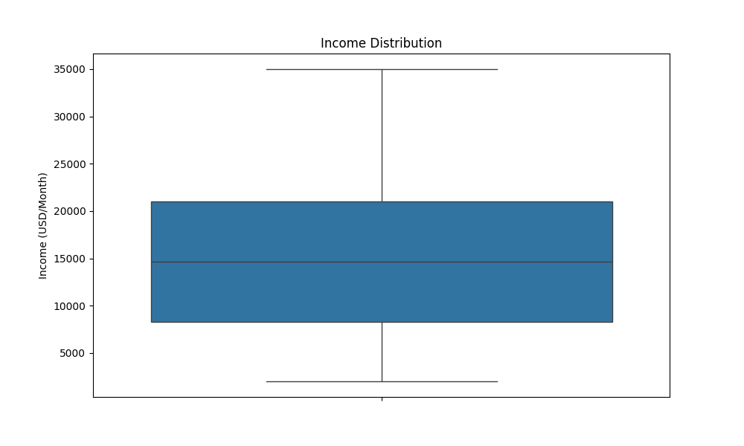
Customer Age & Income Distribution

Slide 9
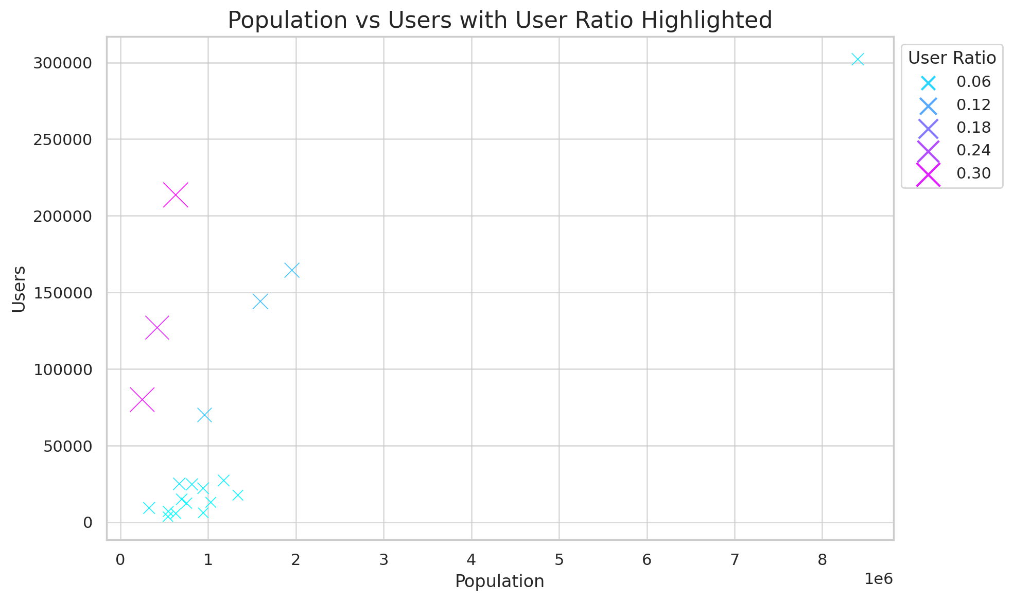
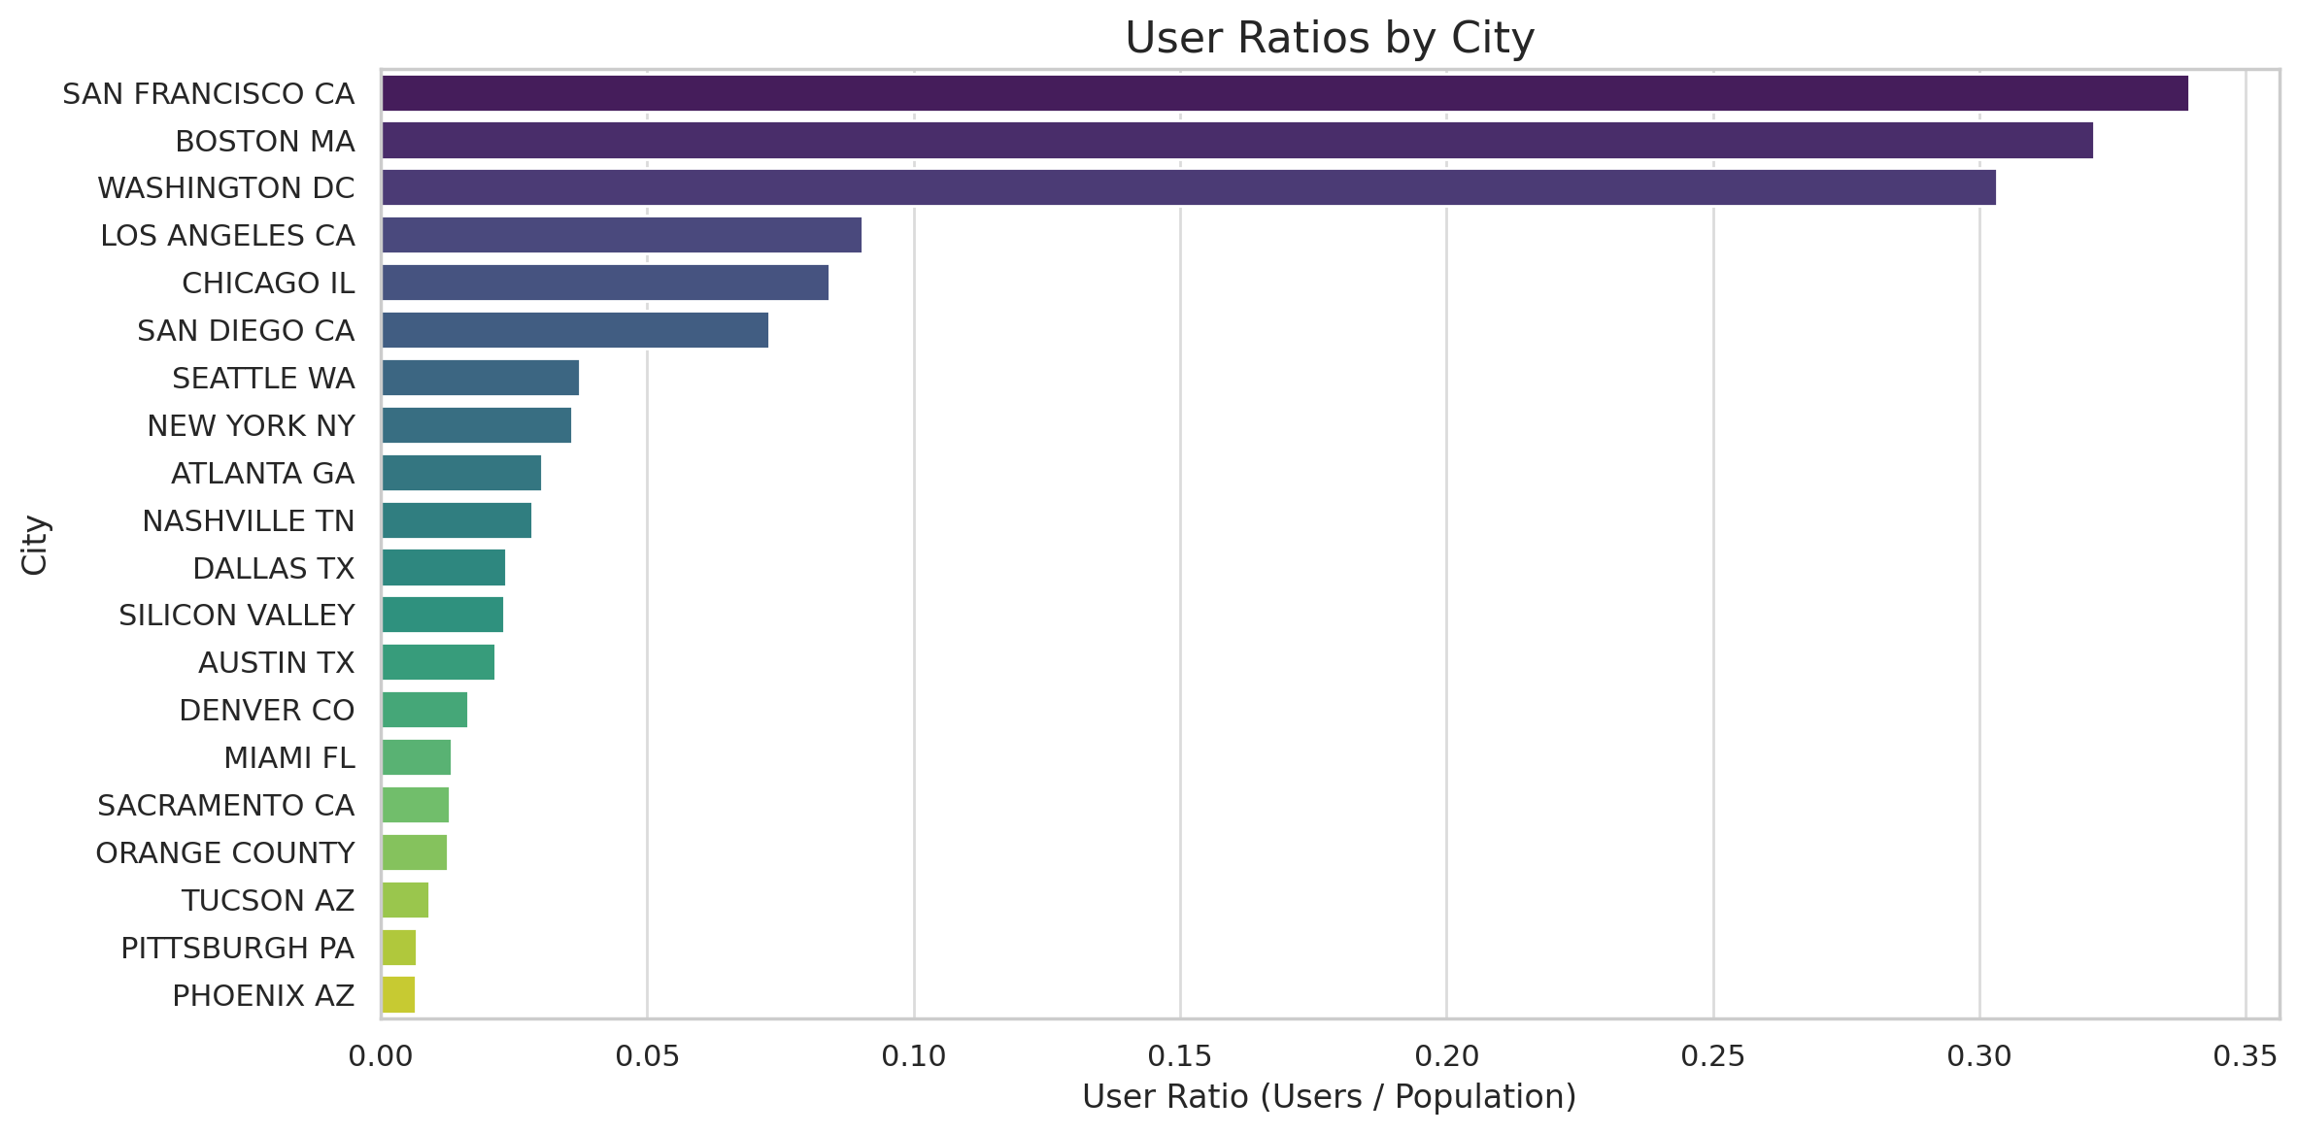
Users Ratio
User Ratios by City:
Cities like San Francisco, Boston, and Washington, DC clearly stand out with high user ratios.
Most other cities have relatively low user ratios, with notable gaps between outliers and the rest.

Slide 10
Recommendations
Evaluated both the cab companies and below are the key insights supporting investment in Yellow Cab company:
Extensive Customer Reach:
Yellow Cab operates successfully in 25 cities, compared to only 4 cities for Pink Cab.
It demonstrates strong performance in attracting users from competing cab services.
Superior Customer Retention:
Analysis of repeat customers reveals Yellow Cab outperforms Pink Cab in retaining customers who complete at least 5 or 10 rides with the same company.
Broad Age Group Appeal:
Yellow Cab attracts a diverse customer base, with strong representation across all age groups.
It is equally popular among younger (18–25 years) and older (60+ years) demographics, highlighting its wide appeal.
Higher Profitability:
Yellow Cab achieves nearly three times the average profit per kilometer compared to Pink Cab, underscoring its operational efficiency and revenue-generating potential.
Income-Class Coverage:
While both companies are popular with medium and high-income groups, Yellow Cab excels in catering to all income classes, including low-income customers.

Slide 11

Thank You

