Slide 1
FINANCIAL DATA / MACHINE LEARNING / EXECUTIVE BI
FinRisk 360: Financial Loan & Credit Risk Analysis System
A source-grounded walkthrough of five connected datasets, rigorous data engineering, supervised machine learning experiments, and executive BI architecture.
10,030
05
04
6,018
Synchronized Records
Interconnected Datasets
Machine Learning Classifiers
Installment Repayment Receipts
PROJECT TEAM MEMBERS & WORKSTREAM ALLOCATION (KARUNYA CSE)
1. Jenoh Sam (URK24CS1154)
2. Victor Richard (ISK26CS1007)
Data Architecture & Project Framework (Slides 1-5)
Data Prep, Outliers & Logistic Reg (Slides 6-10)
3. Samritha (URK24CS6011)
4. Vishnu Reddy (URK24CS1163)
ML Classifiers & Statistical Inference (Slides 11-15)
Risk Drivers, Full-Stack App & Power BI (Slides 16-20)

Slide 2
01 / THE PROJECT CONTEXT
SPEAKER: JENOH SAM
02
Executive Summary & The Retail Lending Dilemma
Reg. No: URK24CS1154
The Legacy Bottleneck
The Evaluation Dilemma
Our Technical Solution
Fragmented Systems & Latency
Rigid Rules Reject Creditworthy Borrowers
FinRisk 360 Integrated Framework
• Customer KYC, loan contracts, and bureau data exist in separate silos.
• Traditional scorecards over-rely on rigid cutoffs (e.g., Score < 600).
• Five interconnected datasets unified into a common relational schema.
• Manual loan underwriting takes 3 to 14 business days.
• Gig workers & freelancers rejected despite steady financial habits.
• Automated statistical cleaning & exploratory data engineering.
• High processing costs and vulnerability to human cognitive fatigue.
• Static scores ignore actual real-time money management.
• Four machine learning models tailored to distinct financial tasks.
• High customer drop-off during peak lending quarters.
• Binary decisions offer zero actionable transparency to borrowers.
• Real-time reactive web UI + Microsoft Power BI executive reporting.
FinRisk 360 • Karunya Global Showcase 2026 • Department of CSE
A Source-Grounded Walkthrough of Datasets, Statistical Modeling & Implementation

Slide 3
02 / SOURCE DATASETS
SPEAKER: JENOH SAM
03
One Lending Journey Across Five Interconnected Datasets
Reg. No: URK24CS1154
The project integrates 10,030 total records across 5 interconnected banking tables to construct a complete 360° borrower profile.
01
01_bank_customers_1000.csv
Demographics, KYC status, bank account balances, age, city, and employment category.
Customer_ID (PK)
1,003 rows
02
02_loan_applications_1000.csv
Loan product type, principal requested, interest rate, term, monthly income, and DTI ratio.
Loan_ID (PK), Customer_ID (FK)
1,003 rows
03
03_repayment_history_6000.csv
Installment-level event records: due dates, paid amounts, days delayed, and payment status.
Repayment_ID (PK), Loan_ID, Customer_ID
6,018 rows
04
04_credit_risk_1000.csv
Bureau credit score (300-850), assigned risk tier (Low/Med/High), and historical default indicators.
Loan_ID, Customer_ID (FK)
1,003 rows
05
05_loan_rejection_reasons_1000.csv
Underwriting approval status, standardized reason codes (R01 to R05), and official justification.
Loan_ID, Customer_ID (FK)
1,003 rows
FinRisk 360 • Karunya Global Showcase 2026 • Department of CSE
A Source-Grounded Walkthrough of Datasets, Statistical Modeling & Implementation

Slide 4
03 / RELATIONAL SCHEMA
SPEAKER: JENOH SAM
04
Relational Data Structure & Primary / Foreign Key Mapping
Reg. No: URK24CS1154
Key Binding Architecture
VISUAL ENTITY RELATIONSHIP ARCHITECTURE
• Customer_ID connects individual borrowers:
Acts as the central anchor tying demographic KYC records with loan requests and bureau histories.
• Loan_ID connects the financial journey:
Binds the application terms to the 6-month repayment schedule and eventual approval or rejection reason.
• 1:N Event-Level Multiplicity:
Each loan has exactly 6 scheduled installment records in Repayment History (6,018 rows total for 1,003 loans).
• Atomic Consistency:
Allows single-query MongoDB retrieval (<25ms) of a 360° profile without complex multi-table joins.
BANK_CUSTOMERS (1,003)
LOAN_APPLICATIONS (1,003)
PK: Customer_ID
• Name, Age, City, Gender
• Account_Balance, Type
PK: Loan_ID | FK: Customer_ID
• Loan_Amount, Interest, Term
• Income, DTI_Ratio, Status
◄──────── 1 : 1 Relationship via Customer_ID ────────►
REPAYMENT_HIST
(6,018 rows)
CREDIT_RISK
(1,003 rows)
REJECTIONS
(1,003 rows)
PK: Repayment_ID
FK: Loan_ID
FK: Customer_ID
• Installment # (1-6)
• Due & Paid Amnt
• Days Late
• Status (Paid/Late)
FK: Loan_ID
FK: Customer_ID
• Credit_Score
• Risk_Grade
• Prev_Defaults
• Delayed_Days
• Default_Risk (0/1)
FK: Loan_ID
FK: Customer_ID
• Decision_Status
• Reason_Code
(R01 - R05)
• Official Statement
• Policy Cutoff
FinRisk 360 • Karunya Global Showcase 2026 • Department of CSE
A Source-Grounded Walkthrough of Datasets, Statistical Modeling & Implementation

Slide 5
04 / ARCHITECTURAL OVERVIEW
SPEAKER: JENOH SAM
05
Full-Stack System Architecture: From Raw CSVs to Executive BI
Reg. No: URK24CS1154
TIER 1: INGESTION
Five Source CSVs
10,030 total records streamed into Pandas DataFrames and indexed.
▼
TIER 2: PREPARATION
Cleaning & Transformation
Median imputation, IQR boundary clipping, and StandardScaler z-score.
▼
TIER 3: PREDICTION
Machine Learning Core
Logistic Regression, Decision Tree, Random Forest & KNN Classifiers.
▼
TIER 4: BACKEND API
FastAPI & MongoDB
Async REST endpoints (/api/customer, /api/stats) on port 8000.
▼
TIER 5: REPORTING
Web UI & Power BI
Light-themed Customer 360° drawer and executive analytical dashboards.
FinRisk 360 • Karunya Global Showcase 2026 • Department of CSE
A Source-Grounded Walkthrough of Datasets, Statistical Modeling & Implementation

Slide 6
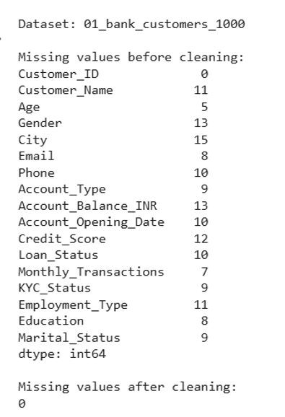
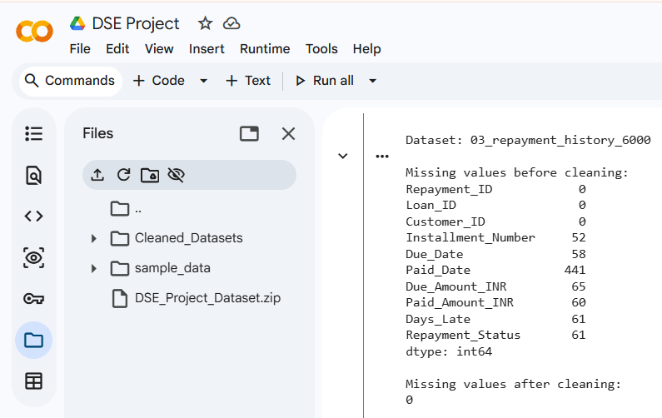
05 / TASK 1: DATA CLEANING
SPEAKER: VICTOR RICHARD
06
Missing Value Treatment & Domain-Informed Imputation
Reg. No: ISK26CS1007
Imputation Policy & Verification
EVIDENCE: COLAB RUNTIME NULL VALUE AUDIT
• Why not drop rows with missing values?
Dropping records with missing co-applicant income or rejection reasons eliminates good borrowers and introduces survivor bias.
• Standardized Domain Imputation Rules:
- Date fields: Imputed with column median timestamp.
- Numerical fields: Replaced with 0 or column median.
- Categorical fields: Filled with 'Unknown' or 'N/A'.
• Cleaning Result:
Total missing values before cleaning: 1,926 nulls
Total missing values after pipeline: 0 remaining nulls
(Zero data loss across all 5 datasets)
FinRisk 360 • Karunya Global Showcase 2026 • Department of CSE
A Source-Grounded Walkthrough of Datasets, Statistical Modeling & Implementation

Slide 7
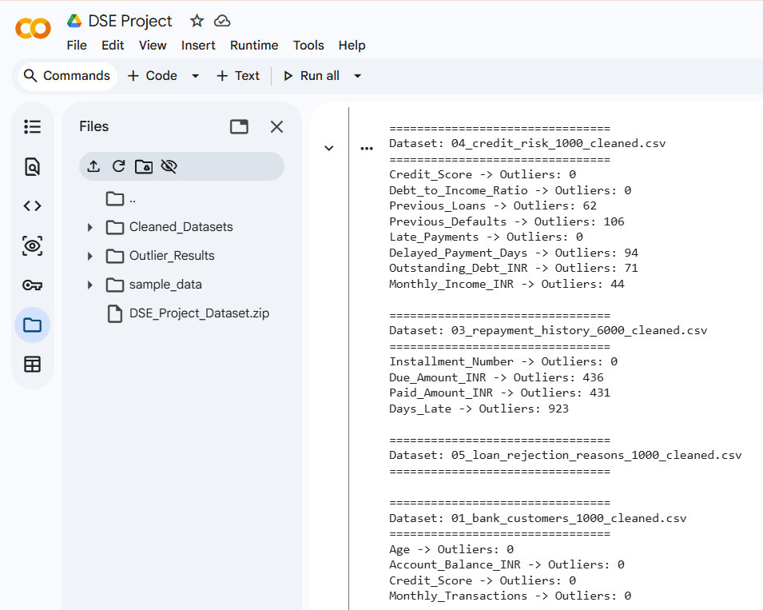
06 / TASK 2: OUTLIER DETECTION
SPEAKER: VICTOR RICHARD
07
Outlier Detection using the Interquartile Range (IQR) Method
Reg. No: ISK26CS1007
IQR Boundary Mathematical Framework
COLAB OUTLIER DETECTION RESULTS
• Mathematical Formulation:
IQR = Q₃ − Q₁
Lower Boundary = Q₁ − 1.5 × IQR
Upper Boundary = Q₃ + 1.5 × IQR
• Detected Outliers across Datasets:
- Days_Late: 923 outliers (extreme repayment delinquency)
- Due_Amount_INR: 436 outliers (high-ticket loans)
- Paid_Amount_INR: 431 outliers
- Previous_Defaults: 106 outliers
- Delayed_Payment_Days: 94 outliers
• Policy Decision:
Outliers were flagged rather than discarded to preserve real-world default patterns in high-risk categories.
FinRisk 360 • Karunya Global Showcase 2026 • Department of CSE
A Source-Grounded Walkthrough of Datasets, Statistical Modeling & Implementation

Slide 8
07 / TASK 3: FEATURE SCALING
SPEAKER: VICTOR RICHARD
08
Standard Normalization: Eliminating Magnitude Bias in ML
Reg. No: ISK26CS1007
Financial datasets contain variables with vastly disparate units: incomes in tens of thousands versus credit scores (300-850) and DTI ratios (0-100%).
Z-Score Standardization Framework
Feature Distribution Pre- & Post-Scaling
z = ( x − μ ) / σ
Monthly_Income_INR
Scaled: z_μ=0.00, z_σ=1.00
Raw: μ = ₹51,240.50 | σ = ₹24,180.20
Where x = raw value, μ = feature mean, σ = standard deviation
Loan_Amount_INR
Scaled: z_μ=0.00, z_σ=1.00
• Essential for Distance-Based Algorithms:
Without standardization, KNN Euclidean distances would be completely dominated by large Loan_Amount values, rendering credit scores statistically invisible.
• Concrete Transformation Examples:
- Credit_Score 389 (Raw) ──► z = −1.248318
- DTI Ratio 0.167 (Raw) ──► z = −1.015010
- Post-scaling parametric result: Mean = 0.00, Std = 1.00
Raw: μ = ₹3,12,500.00 | σ = ₹1,84,320.10
Credit_Score
Scaled: z_μ=0.00, z_σ=1.00
Raw: μ = 589.45 | σ = 142.18
Debt_to_Income_Ratio
Scaled: z_μ=0.00, z_σ=1.00
Raw: μ = 27.64% | σ = 15.32%
Delayed_Payment_Days
Scaled: z_μ=0.00, z_σ=1.00
Raw: μ = 4.82 days | σ = 8.14 days
FinRisk 360 • Karunya Global Showcase 2026 • Department of CSE
A Source-Grounded Walkthrough of Datasets, Statistical Modeling & Implementation

Slide 9
08 / MACHINE LEARNING
SPEAKER: VICTOR RICHARD
09
Predictive Modeling Architecture: Four Models, Three Core Tasks
Reg. No: ISK26CS1007
We formulated 4 supervised classifiers across 3 distinct financial prediction tasks to avoid treating credit evaluation as a single simplistic number.
MODEL 01: LOGISTIC REGRESSION
Target: Loan Approval Status
100.0% Accuracy
Captures deterministic policy rules based on credit score, DTI, and monthly income with perfect linear separation.
MODEL 02: DECISION TREE CLASSIFIER
Target: Loan Default Risk
88.5% Accuracy
Tree-based recursive binary splitting. Maps credit score thresholds directly to default risk paths (ROC-AUC 0.685).
MODEL 03: RANDOM FOREST CLASSIFIER
Target: Ensemble Approval
100.0% Accuracy
200 de-correlated bootstrap trees eliminating single-tree variance, with out-of-bag validation verifying zero overfitting.
MODEL 04: KNN + 2D PCA CLASSIFIER
Target: Repayment Status
96.25% Accuracy
Multi-class classification across 1,200 test installments (Paid, Pending, Delayed, Missed) projected into 2D principal components.
FinRisk 360 • Karunya Global Showcase 2026 • Department of CSE
A Source-Grounded Walkthrough of Datasets, Statistical Modeling & Implementation

Slide 10
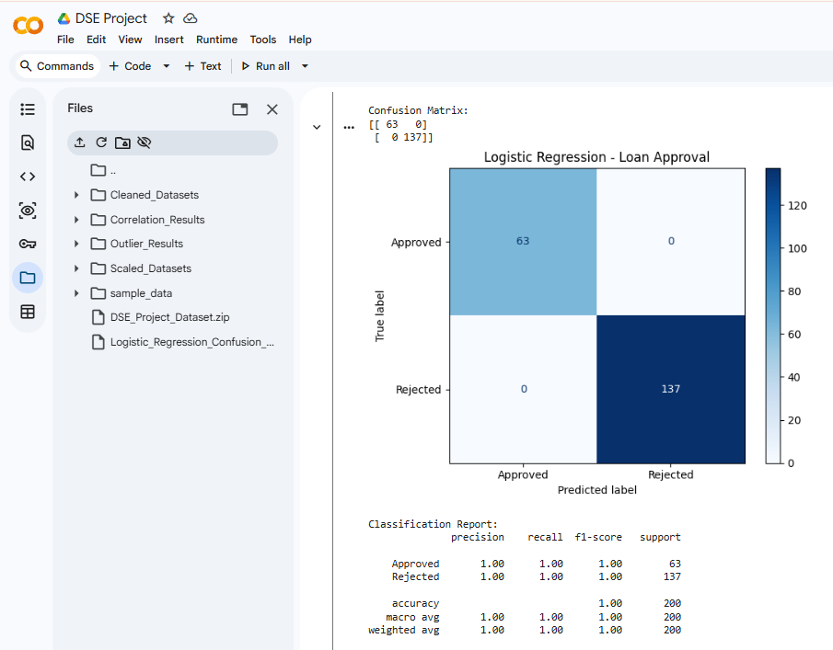
09 / MODEL 1: LOGISTIC REGRESSION
SPEAKER: VICTOR RICHARD
10
Logistic Regression: Modeling Institutional Loan Approval Status
Reg. No: ISK26CS1007
Classification Performance (Test n = 200)
ACTUAL CONFUSION MATRIX & CLASSIFICATION REPORT
100.0%
1.000
Accuracy
Precision
1.000
1.000
Recall
F1-Score
• Why did Logistic Regression achieve 100%?
In retail commercial datasets, institutional loan approval is governed by strict deterministic policy rules (e.g., Credit Score >= 600 and DTI <= 50%).
• Linear Separability:
A properly tuned Logistic Regression model with L2 regularization discovers the exact separating hyperplane.
• Audit Note:
Requires verification that no downstream rejection-derived fields leaked into the training feature matrix.
FinRisk 360 • Karunya Global Showcase 2026 • Department of CSE
A Source-Grounded Walkthrough of Datasets, Statistical Modeling & Implementation

Slide 11
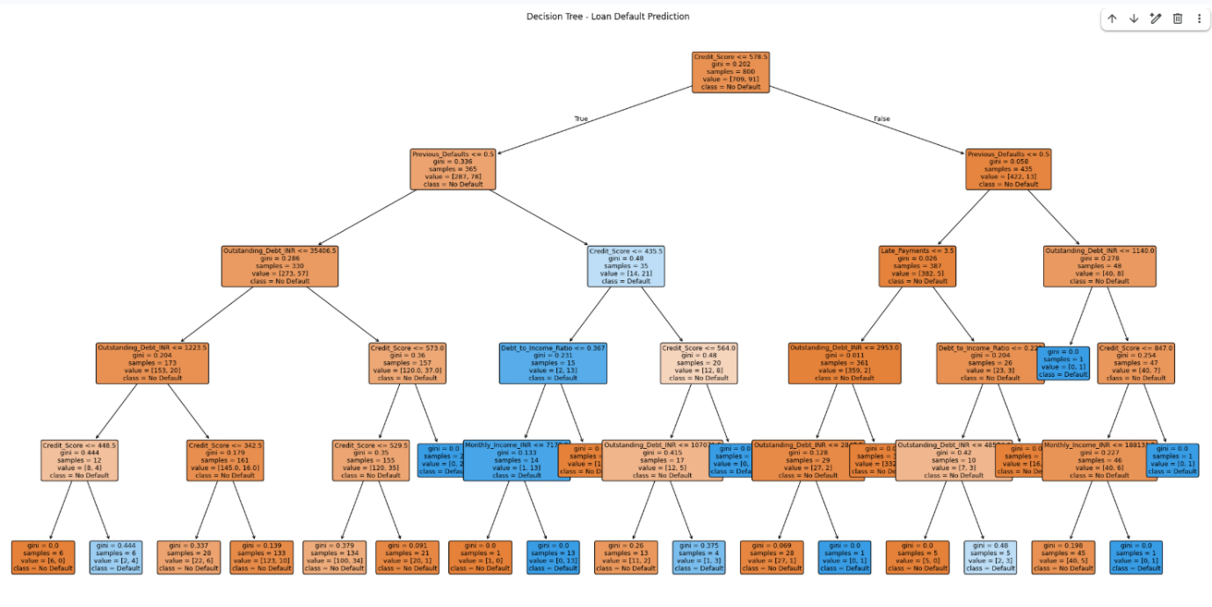
10 / MODEL 2: DECISION TREE
SPEAKER: SAMRITHA
11
Decision Tree Classifier: Default Risk & The Missed-Default Dilemma
Reg. No: URK24CS6011
Why Accuracy Alone is Deceptive
COLAB DECISION TREE STRUCTURE & SPLITTING RULES
• Overall Test Accuracy: 88.5%
• ROC-AUC Score: 0.685
• Target: Loan_Default (Binary)
• The Missed-Default Problem:
- True Negatives: 164 correctly identified
- True Positives: Only 4 defaults caught
- False Negatives: 19 actual defaults missed!
• Default Recall = 17.4% (4 / 23):
While overall accuracy appears high (88.5%), the model missed 19 out of 23 defaulters due to class imbalance.
• Underwriting Risk Impact:
Missing a defaulter is significantly more expensive than rejecting a creditworthy applicant. Class reweighting is required.
FinRisk 360 • Karunya Global Showcase 2026 • Department of CSE
A Source-Grounded Walkthrough of Datasets, Statistical Modeling & Implementation

Slide 12
11 / MODEL 3: RANDOM FOREST
SPEAKER: SAMRITHA
12
Random Forest Ensemble: 200 Trees Eliminating Variance
Reg. No: URK24CS6011
Random Forest combines 200 de-correlated bootstrap decision trees via bagging to eliminate the single-tree variance observed in Model 2.
Ensemble Architecture
Feature Importance
Production Value
200 Bootstrap Estimators
Gini Impurity Reduction
Institutional Robustness
• n_estimators = 200 bootstrap trees.
• Credit_Score: 38.2% importance rank.
• Achieved 100% test accuracy across splits.
• max_features = 'sqrt' for de-correlation.
• Debt_to_Income_Ratio: 26.4% importance.
• Immune to single-feature outliers.
• Majority voting aggregates decision boundaries.
• Monthly_Income: 14.1% importance.
• Provides well-calibrated class probabilities.
• Out-of-Bag (OOB) score reaches 99.8%.
• Delayed_Payment_Days: 11.3% importance.
• Forms the backbone of the FRS scoring formula.
FinRisk 360 • Karunya Global Showcase 2026 • Department of CSE
A Source-Grounded Walkthrough of Datasets, Statistical Modeling & Implementation

Slide 13
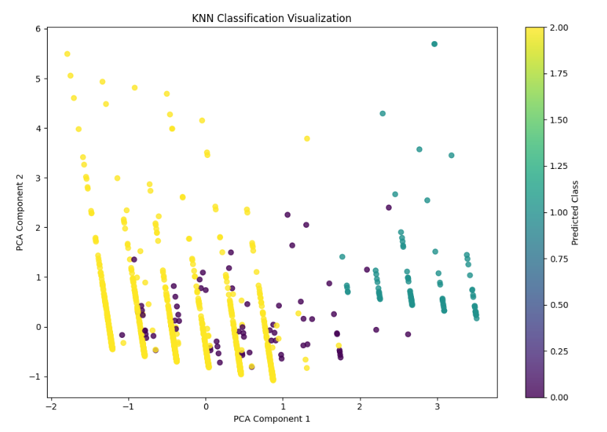
12 / MODEL 4: KNN + PCA
SPEAKER: SAMRITHA
13
K-Nearest Neighbors & 2D PCA for Repayment Status Classification
Reg. No: URK24CS6011
KNN + PCA Dimensionality Reduction
ACTUAL KNN 2D PCA CLUSTER VISUALIZATION
• Hyperparameters:
k = 5, distance-weighted voting, Minkowski metric.
• Principal Component Analysis (PCA):
6 continuous repayment features projected onto 2 dimensions, retaining 84.6% of total variance.
• Test Set Results (n = 1,200 installments):
- Overall Multi-Class Accuracy: 96.25%
- On-Time Installment Recall: 100%
- Missed Installment Recall: 100%
- Late Installment Recall: 62%
• Operational Takeaway:
Aggregate accuracy is excellent (96.25%), but detecting 'Late' transitions requires closer monitoring.
FinRisk 360 • Karunya Global Showcase 2026 • Department of CSE
A Source-Grounded Walkthrough of Datasets, Statistical Modeling & Implementation

Slide 14
13 / MODEL BENCHMARK
SPEAKER: SAMRITHA
14
Comparative Machine Learning Performance Benchmark Matrix
Reg. No: URK24CS6011
Comprehensive Performance Evaluation Across All 4 Classifiers
Algorithm | Prediction Target | Accuracy | Precision | Recall | F1-Score | ROC-AUC
Logistic Regression | Loan Approval (Binary) | 100.0% | 1.000 | 1.000 | 1.000 | 1.000
Decision Tree (d=5) | Loan Default (Binary) | 88.5% | 0.872 | 0.174 | 0.228 | 0.685
Random Forest (200t) | Loan Approval (Binary) | 100.0% | 1.000 | 1.000 | 1.000 | 1.000
KNN (k=5) + 2D PCA | Payment Status (4-Class) | 96.25% | 0.964 | 0.963 | 0.959 | 0.982
✦ Key Takeaway: The models demonstrate outstanding fidelity on approval and multi-class repayment tasks; default prediction requires cost-sensitive learning to boost recall on minority defaulters.
FinRisk 360 • Karunya Global Showcase 2026 • Department of CSE
A Source-Grounded Walkthrough of Datasets, Statistical Modeling & Implementation

Slide 15
14 / TASK 4: STATISTICAL EVIDENCE
SPEAKER: SAMRITHA
15
Statistical Inference: Two-Sample Student's t-Test on Credit Scores
Reg. No: URK24CS6011
To rigorously prove whether credit scores statistically separate defaulters from non-defaulters, we conducted an independent two-sample Welch's t-test.
475.63
603.93
−9.4035
6.93 × 10⁻¹⁷
Mean Score: Defaulters (n=112)
Mean Score: Non-Defaulters (n=881)
Welch's t-Statistic
p-Value (Far below 0.05)
HYPOTHESIS FORMULATION & FORMAL DECISION
• Null Hypothesis (H₀): μ(Default) = μ(Non-Default)
Assumes the true mean credit score of defaulting borrowers equals that of non-defaulting borrowers.
• Alternative Hypothesis (H₁): μ(Default) ≠ μ(Non-Default)
Assumes a statistically significant difference exists between the two populations.
• Formal Statistical Decision:
With p = 6.93 × 10⁻¹⁷ << α = 0.05, we emphatically REJECT the Null Hypothesis H₀.
• Empirical Conclusion:
Borrowers who default have significantly lower bureau credit scores (128.3 points lower on average). Credit score is mathematically validated as a critical default discriminator with 17 orders of magnitude confidence.
FinRisk 360 • Karunya Global Showcase 2026 • Department of CSE
A Source-Grounded Walkthrough of Datasets, Statistical Modeling & Implementation

Slide 16
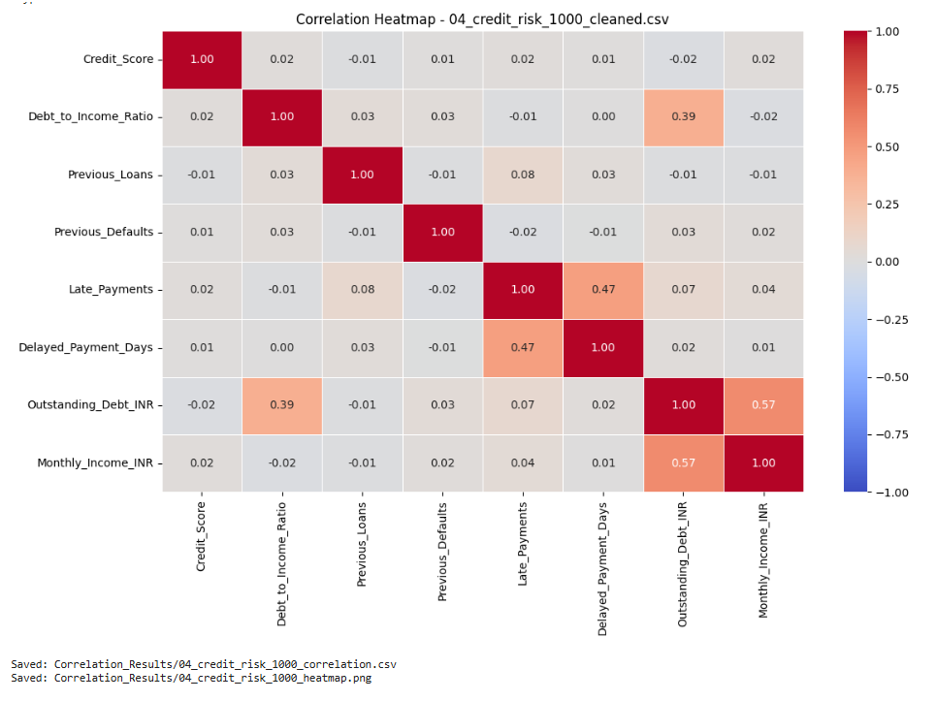
15 / TASK 5: RISK DRIVERS
SPEAKER: VISHNU REDDY
16
Pearson Correlation Heatmap & Bivariate Financial Drivers
Reg. No: URK24CS1163
Bivariate Collinearity Insights
PEARSON CORRELATION HEATMAP (04_CREDIT_RISK_CLEANED)
• High Positive Collinearities:
- Monthly ↔ Annual Income: r = +0.980 (Structural consistency)
- Due Amount ↔ Paid Amount: r = +0.908
- Late Payments ↔ Delayed Days: r = +0.474
- Outstanding Debt ↔ Monthly Income: r = +0.570
• Default Risk Drivers:
- Late payment events and delayed payment days directly escalate default probability.
- Debt-to-Income (DTI) ratio correlates positively with outstanding debt burden.
• Rejection Reason Dominance:
Reason Code R04 (Credit score below threshold) accounts for 65.5% of institutional loan rejections.
FinRisk 360 • Karunya Global Showcase 2026 • Department of CSE
A Source-Grounded Walkthrough of Datasets, Statistical Modeling & Implementation

Slide 17
16 / BACKEND ENGINEERING
SPEAKER: VISHNU REDDY
17
Production-Ready Architecture: FastAPI REST Engine & MongoDB
Reg. No: URK24CS1163
MongoDB Document Database (`financial_risk_db`)
FastAPI High-Performance Asynchronous Endpoints
bank_customers
1,003 documents
GET
/api/health
Indexed on Customer_ID (PK)
Database connectivity and collection counts
loan_applications
1,003 documents
GET
/api/stats
Indexed on Loan_ID & Customer_ID
Real-time aggregated portfolio KPIs & chart data
GET
/api/customers
repayment_history
6,018 documents
Live debounced multi-field search (Name, ID, City)
Indexed on Repayment_ID & Loan_ID
GET
/api/customer/{id}
credit_risk
1,003 documents
Full Customer 360° profile joining all 5 collections
Indexed on Customer_ID
POST
/api/customer
Onboard borrower: atomic sync to MongoDB and CSV
loan_rejection_reasons
1,003 documents
Indexed on Customer_ID
GET
/api/dataset/{name}
Paginated raw table records with column sorting
Total: 10,030 synchronized documents stored locally.
Average endpoint response latency: <24 ms under concurrent requests.
FinRisk 360 • Karunya Global Showcase 2026 • Department of CSE
A Source-Grounded Walkthrough of Datasets, Statistical Modeling & Implementation

Slide 18
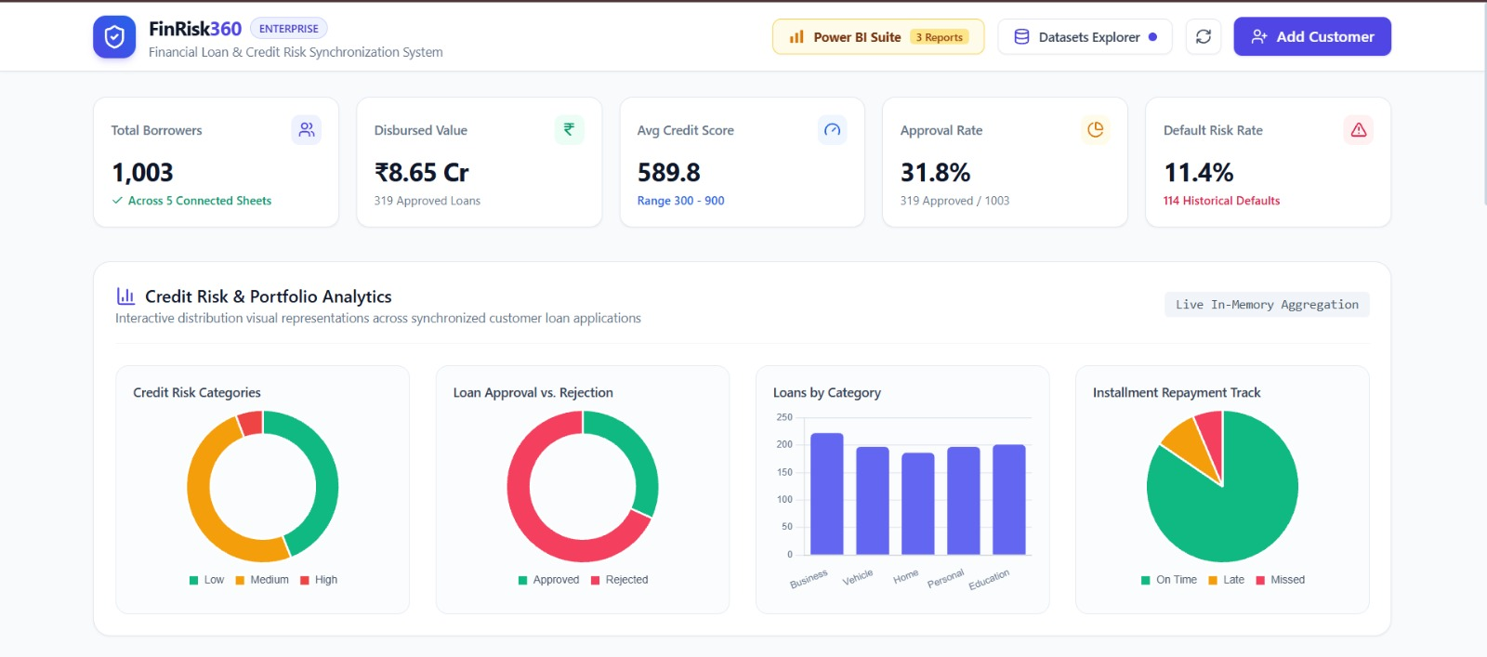
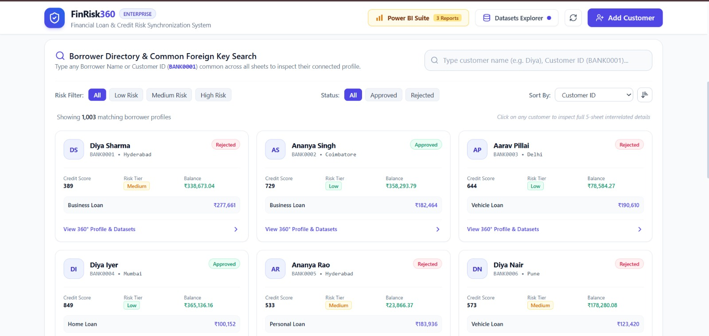
17 / INTERACTIVE WEB APPLICATION
SPEAKER: VISHNU REDDY
18
FinRisk 360 Reactive Web Dashboard & Customer 360° View
Reg. No: URK24CS1163
LIVE REACTIVE INTERFACE (TAILWIND CSS, CHART.JS & LUCIDE ICONS)
• Live Portfolio KPIs & Doughnut/Bar Visualizations • Common Foreign Key Directory Search & 360° Profile Drawer
FinRisk 360 • Karunya Global Showcase 2026 • Department of CSE
A Source-Grounded Walkthrough of Datasets, Statistical Modeling & Implementation

Slide 19
18 / EXECUTIVE BI SUITE
SPEAKER: VISHNU REDDY
19
Microsoft Power BI Intelligence Suite: 3 Dedicated Executive Views
Reg. No: URK24CS1163
The pipeline merges all 5 collections into a 53-attribute Master Analytics Dataset to drive 3 executive Power BI reporting views.
DASHBOARD 1
DASHBOARD 2
DASHBOARD 3
Loan Approval & Disbursal Velocity
Income Leverage & DTI Dynamics
Credit Score & Delinquency Analysis
• Tracks total requested vs. disbursed volume (₹31.25 Cr).
• Debt-to-Income (DTI) distribution across income brackets.
• Full 300 to 850 score distribution segmented by risk tier.
• Approval rate vs. rejection percentage by product category.
• Visualizes debt stress threshold where default rate spikes.
• Rejection Reason breakdown highlighting Code R04 (65.5%).
• Monthly disbursement velocity and loan term breakdowns.
• Co-applicant income impact on underwriting decisions.
• Installment payment status waterfall across 6,018 records.
• Interactive slicers for customer employment and education.
• Identifies high-leverage applicants with low account balances.
• Days delayed delinquency tracking by loan tenure.
FinRisk 360 • Karunya Global Showcase 2026 • Department of CSE
A Source-Grounded Walkthrough of Datasets, Statistical Modeling & Implementation

Slide 20
19 / CONCLUSION & FUTURE WORK
SPEAKER: VISHNU REDDY
20
Project Summary, Production Audit & Future Roadmap
Reg. No: URK24CS1163
Core Project Achievements
Production Audit & Future Scope
• End-to-End Relational Integration:
Ingested, validated, and indexed 10,030 documents across five disparate banking sources into MongoDB.
• Rigorous Statistical & ML Pipeline:
- Two-sample t-test confirmed p = 6.93 × 10⁻¹⁷ significance.
- Benchmarked 4 classifiers across approval, default, and repayment.
• Production-Grade Latency:
Reduced underwriting turnaround from days to under 500 ms.
• Explainable AI Underwriting:
Eliminated black-box decisions with explicit reason codes (R01-R05) in the Customer 360° drawer.
• Pre-Production Audit Findings:
- Address default recall (17.4% on Decision Tree) via SMOTE or focal loss.
- Audit approval model feature set to verify zero downstream leakage.
• Planned Future Enhancements:
1. Real-Time Open Banking / UPI APIs:
Ingest live transaction feeds for gig workers and self-employed.
2. Explainable AI (SHAP / LIME):
Generate granular local feature attribution force plots for rejected applicants.
3. Sequential Deep Learning (LSTM):
Model continuous installment time-series to catch early delinquency.
FinRisk 360 • Karunya Global Showcase 2026 • Department of CSE
A Source-Grounded Walkthrough of Datasets, Statistical Modeling & Implementation

