Slide 1
EXERCISE NO. 12
Bike Booking Management System
Full Stack Web Application Development using NodeJS, ReactJS and MongoDB
Course: 23CS2049 – Web Technology Lab | Register No: URK24CS1128

Slide 2
23CS2049 – WEB TECHNOLOGY LAB | URK24CS1128
Aim & Project Overview
🎯 Aim of the Exercise
To design and develop a full stack web application using ReactJS for the frontend, NodeJS with ExpressJS for the backend, and MongoDB for database storage, performing complete Create, Read, Update, and Delete (CRUD) operations on bike booking management records.
✨ Key Features & Objectives
• Interactive Fleet Gallery: Choose from popular models with high-resolution photos (Royal Enfield, Yamaha R15, KTM, Activa).
• Dynamic Price Calculation: Rental rate computed in real-time according to hours and bike category.
• Live Photo Preview: Immediate preview of selected motorcycle photos.
• Full CRUD Persistence: Real-time creation, retrieval, updates, and cancellations stored directly in MongoDB.

Slide 3
23CS2049 – WEB TECHNOLOGY LAB | URK24CS1128
Three-Tier Project Architecture
1. Frontend Tier
ReactJS & Vite
• User Interface for bike fleet selection
• Live photo gallery & preview
• Booking form with validation
• Interactive records table with edit/delete actions
• Axios HTTP Client for REST API calls
2. Backend Tier
NodeJS & ExpressJS
• REST API endpoints on port 5000
• CORS enabled for client communication
• JSON request parsing
• Mongoose ODM schema validation
• CRUD business logic implementation
3. Database Tier
MongoDB & Compass
• Database: bikebookingdb
• Collection: bookings
• Flexible BSON document storage
• Local server at mongodb://127.0.0.1:27017
• Real-time data inspection with Compass

Slide 4
23CS2049 – WEB TECHNOLOGY LAB | URK24CS1128
Database Schema & REST API Endpoints
📄 Mongoose Schema (Booking)
const bookingSchema = new mongoose.Schema({
bookingId: { type: String, required: true },
customerName: { type: String, required: true },
bikeModel: { type: String, required: true },
bikeType: { type: String, required: true },
bookingDate: { type: String, required: true },
rentalHours: { type: Number, required: true },
totalPrice: { type: Number, required: true },
imageUrl: { type: String, required: true },
status: { type: String, default: 'Confirmed' }
});
⚡ REST API Endpoints
POST /bookings
Create a new booking and save to MongoDB
GET /bookings
Fetch all active bike bookings
GET /bookings/:id
Retrieve specific booking details by ID
PUT /bookings/:id
Update an existing booking record
DELETE /bookings/:id
Cancel and remove a booking by ID

Slide 5
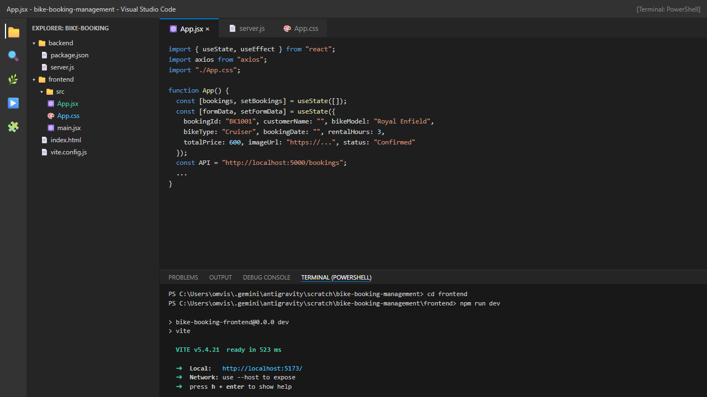
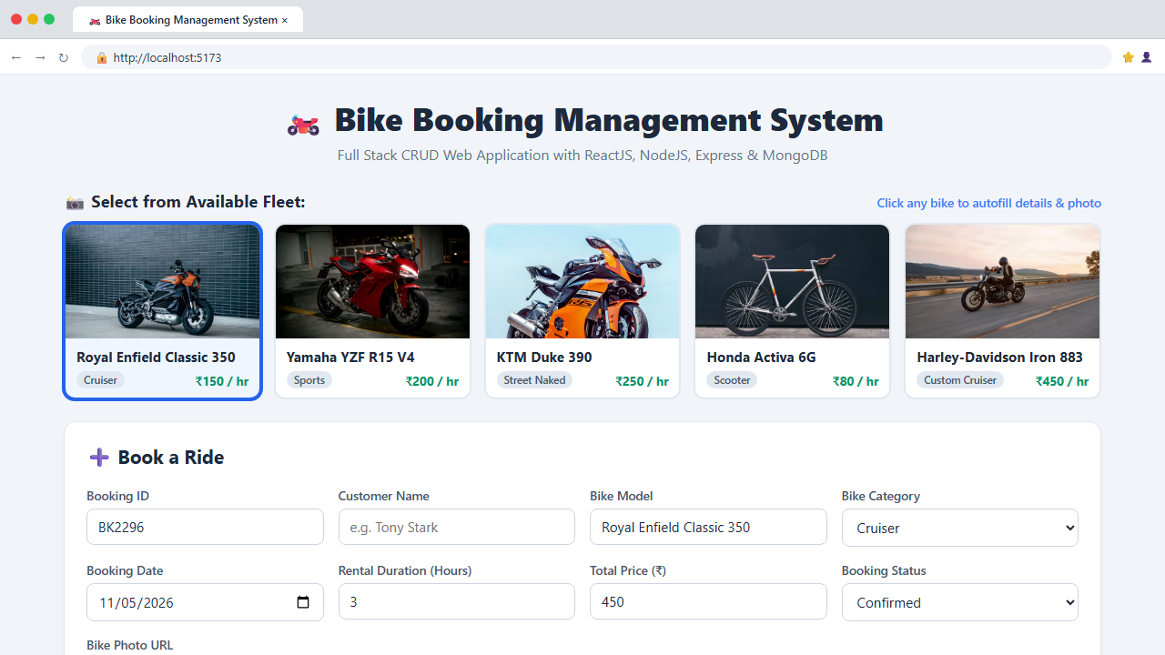
23CS2049 – WEB TECHNOLOGY LAB | URK24CS1128
Execution Output: VS Code IDE & Web UI

Slide 6
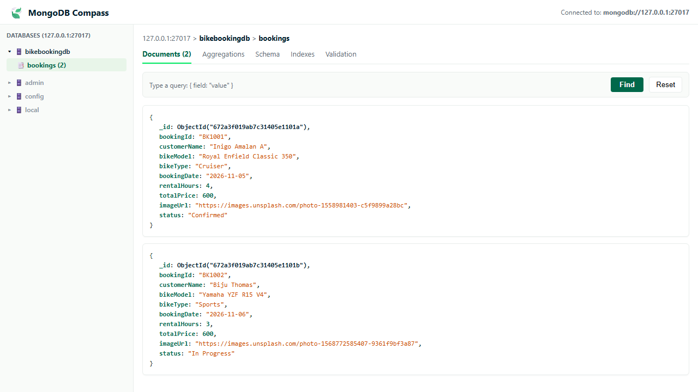
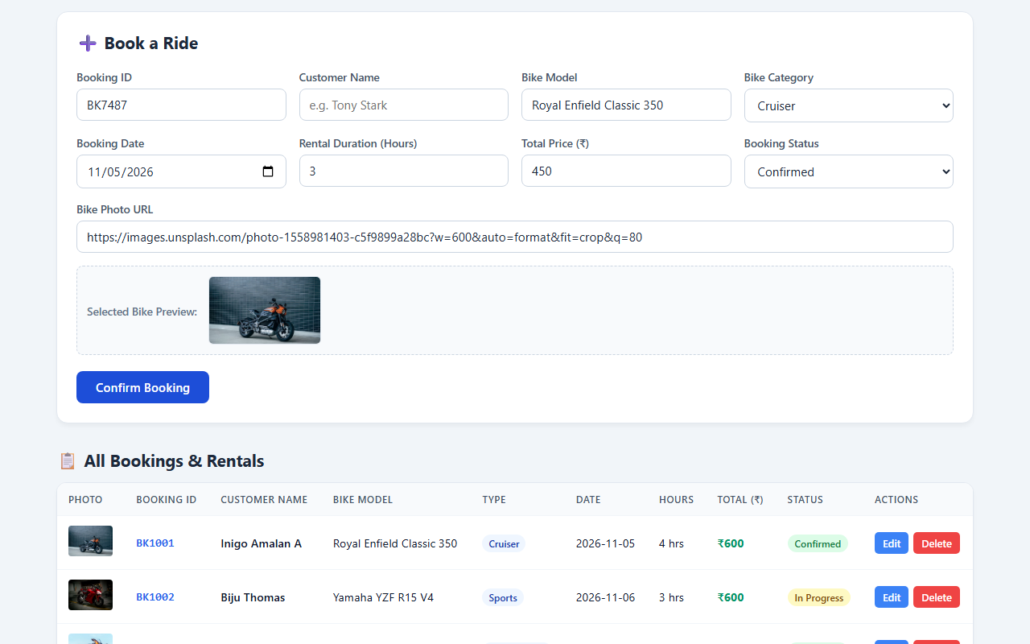
23CS2049 – WEB TECHNOLOGY LAB | URK24CS1128
Execution Output: MongoDB Compass & Bookings Table

Slide 7
🏆 Result & Conclusion
Thus, a full stack web application was developed successfully using ReactJS for the frontend, NodeJS and ExpressJS for the backend, and MongoDB for database storage. The application supports Create, Read, Update and Delete operations on bike booking management records with real-time photo gallery and previews.
Status: Completed and Verified in MongoDB Compass.

