Slide 1
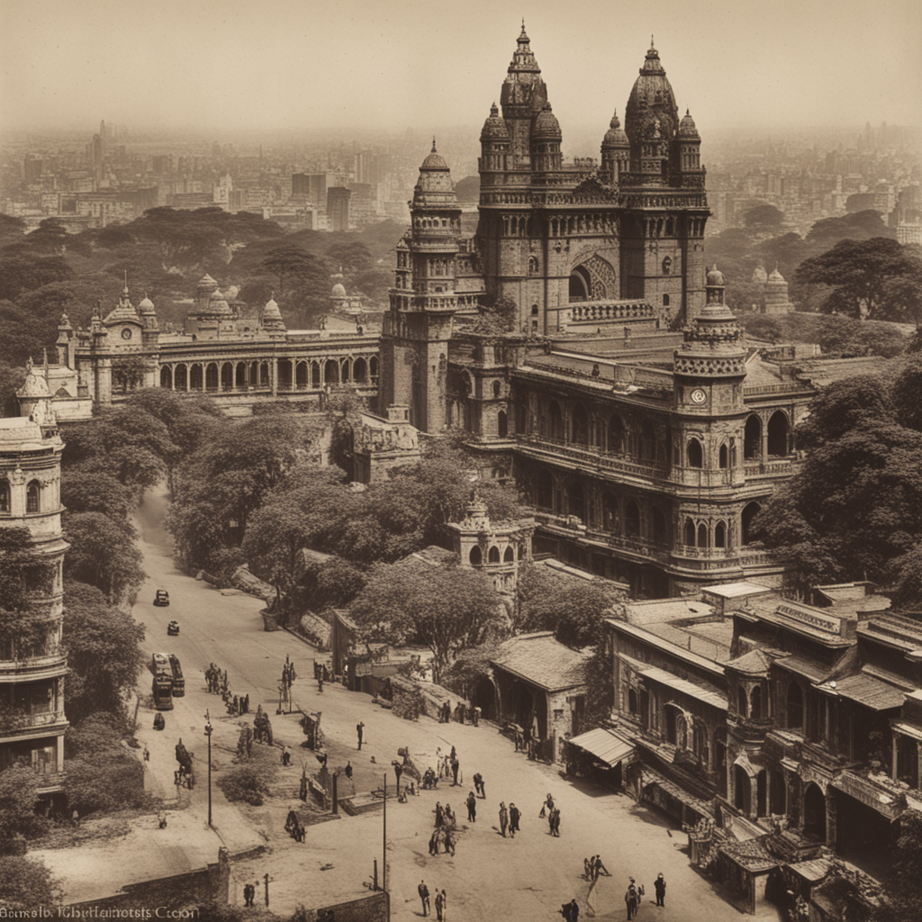
BOMBAY CITY AND ITS HISTORY
BOMBAY CITY AND ITS HISTORY

Slide 2
Bombay's Early History
Bombay was originally seven islands inhabited by Koli fishermen. The islands were first ruled by the Portuguese in the 16th century, and then by the British in the 17th century.

Slide 3
The Growth of Bombay
Bombay grew rapidly in the 19th century, due to its strategic location on the Arabian Sea and its status as a major trading port. The city became the capital of British India in 1911.

Slide 4
The Partition of India and the Creation of Mumbai
After India's independence in 1947, Bombay became the capital of the state of Bombay. The city was renamed Mumbai in 1995.

Slide 5
Mumbai Today
Mumbai is the most populous city in India and one of the most populous cities in the world. It is a major financial and commercial center, and is home to the Bollywood film industry.

Slide 6
Thank You

