Slide 1
Sensitivity Is Not Fragility:
Decomposing Prompt Effects in Instruction-Tuned and Base Models
Presentation by:
Mudit Khandelwal, Vishnu Talwar, Neha L Konchady
HC-NLP : Group 13

Slide 2
Agenda
Motivation
Research Questions
Models, Datasets & Perturbations
Evaluation Pipeline & Metrics
Results
Base Model Failure Modes
Sensitivity vs. Fragility
Statistical Significance
Conclusion & Limitations

Slide 3
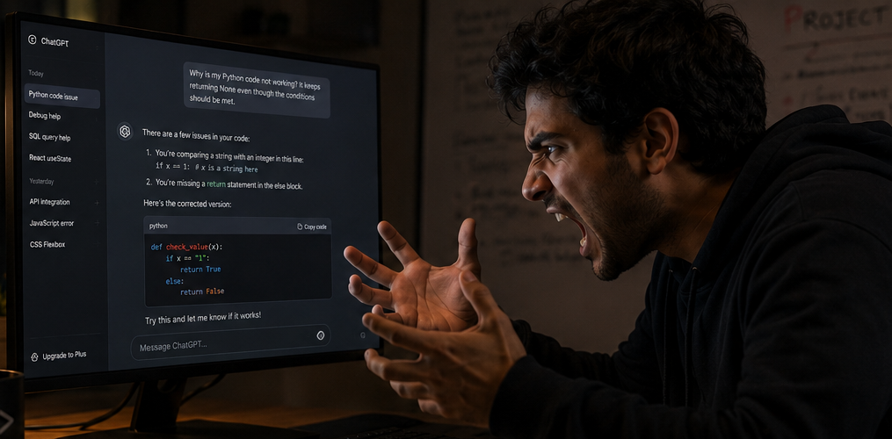
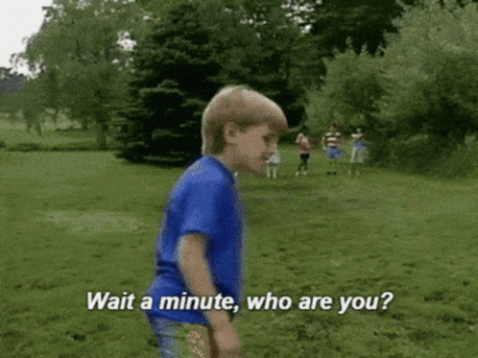
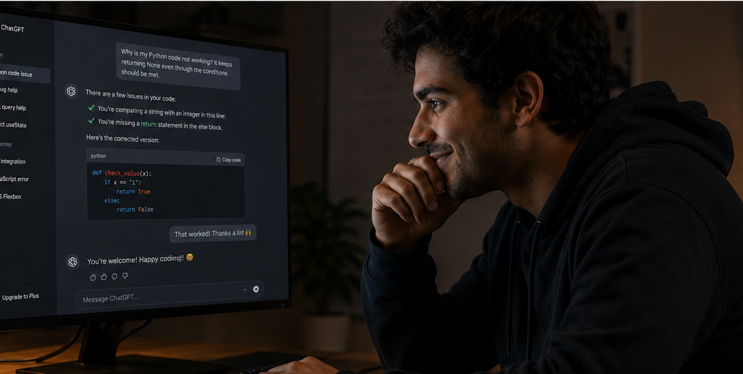

Slide 4
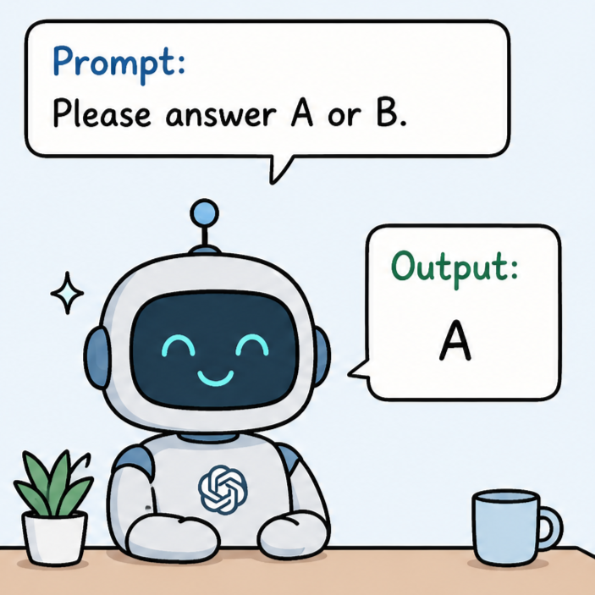
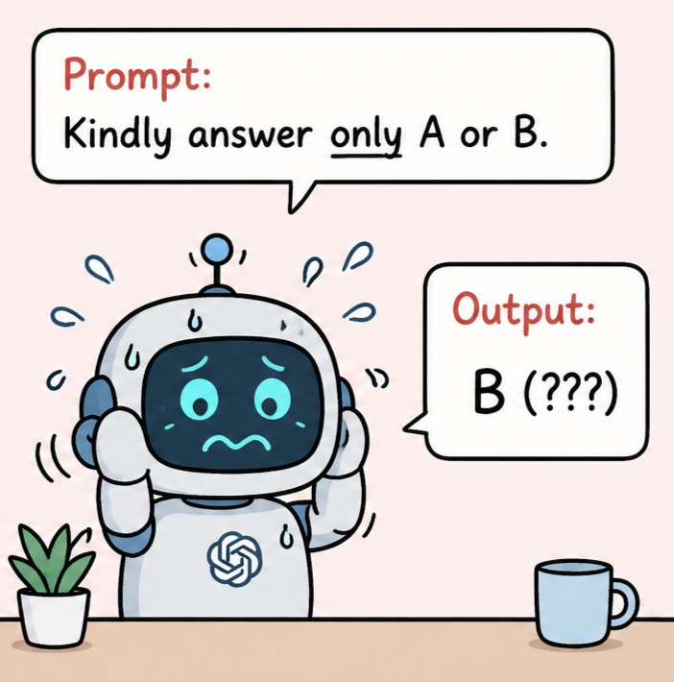
Motivation
Why do small prompt changes matter?
Even when the task remains the same, LLMs can react strongly to small changes in the instruction.
Small edits in wording, order, or formatting can change accuracy and label behavior.
Prior work conflates sensitivity (how much behavior changes) with fragility (harmful brittleness)
No paired audit across model families + base/instruct variants under a shared protocol

Slide 5



Research Questions
Perturbation effects
RQ1 - How much do minimal instruction perturbations change instruction-tuned model behavior under a shared baseline, and how does this differ across model families and tasks?
Statistical Effects
RQ2 - Which perturbation effects survive paired statistical testing after Holm correction, and which apparent null results are simply underpowered?
Base model failure
RQ3 - Do base models behave as a uniform robustness contrast, or do they exhibit qualitatively distinct failure modes?

Slide 6
Dataset and Models
The Models | The Datasets(850 total examples)
Llama 3.1 (8B) - Instruct & Base variant | Multi-Genre Natural Language Inference (300 items)-MultiNLI
Gemma 2 (9B) – Instruct & Base variant | Big-Bench Hard Date Understanding (250 items) - BBH
Qwen 2.5 (7B) – Instruct & Base variant | AI2 Reasoning Challenge (300 items) - ARC challenge
Premise: The surgeon completed the procedure without any complications and the patient was moved to the recovery ward.
Hypothesis: The operation was successful.
Gold label: A (entailment)
Input: Today is Tuesday, March 14, 2023.what day is exactly 3 weeks from today?
Options: (A) April 4, 2023 (B) April 5, 2023 (C) March 28, 2023 (D) April 3, 2023
Gold label: A(April 4, 2023)
Question: Which of the following is the primary source of energy for almost all life on Earth?
Options: (A) Sunlight (B) Gravity (C) Wind (D) Geothermal heat
Gold label: A (Sunlight)
MNLI
BBH
ARC

Slide 7
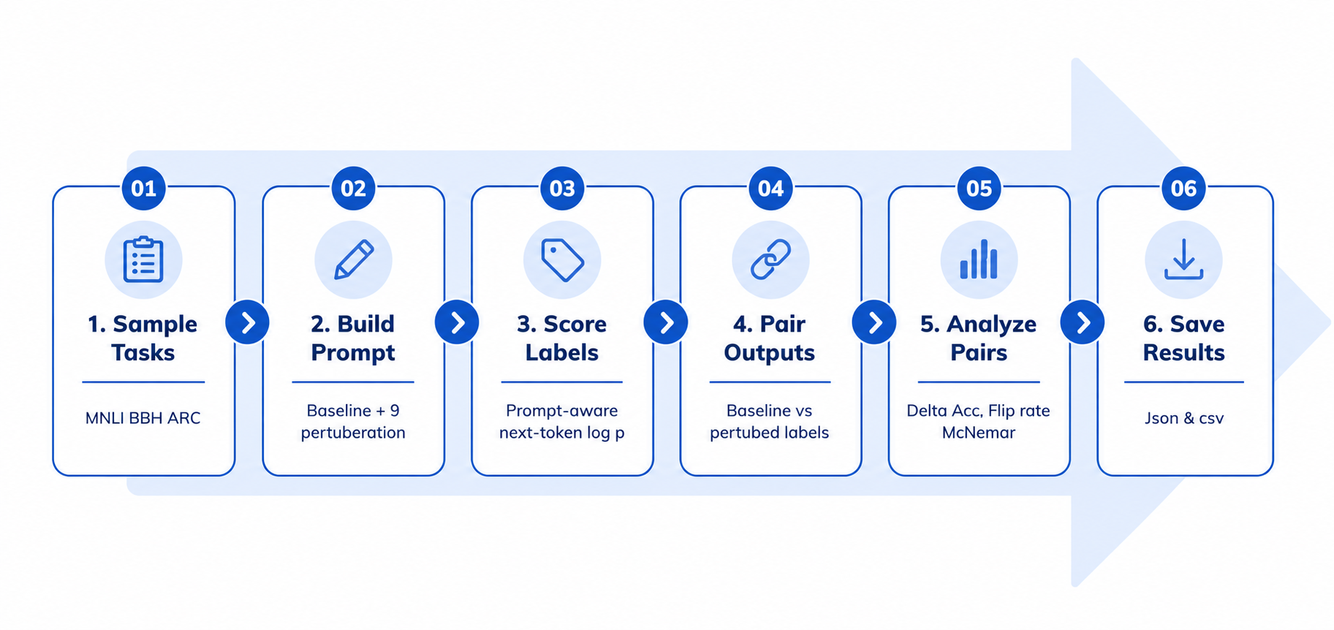
Evaluation pipeline

Slide 8
Perturbations taxonomy
Perturbation | Operational intent
lex_rewrite | Reword the instruction while preserving label mapping.
lex_typo | Inject realistic character-level typos via nlpaug.
lex_lowercase | Lowercase the instruction; restore answer letters.
struct_inst_first | Move the instruction block before the task body.
ctx_role | Add a role priming preamble.
ctx_irrelevant | Add a semantically irrelevant evaluation note.
fmt_caps | Capitalize the instruction text.
fmt_separators | Replace newlines with visible separators.
instruction_rewrite | Stronger paraphrase keeping the output constraint.
The Baseline: One shared "drop-in" prompt per task.
The Constraint: Nine minimal perturbations that strictly preserve the core task, answer options, and label mapping.
The Goal: Test the prompt interface, not to find the optimized prompt.
Notes:
Give examples here as well

Slide 9
Baseline
MNLI
Premise: The surgeon completed the procedure without any complications and the patient was moved to the recovery
ward.
Hypothesis: The operation was successful.
Does the premise entail, contradict, or is it neutral to the hypothesis?
Answer with one letter only: A for entailment, B for neutral, C for contradiction.
Lexical Rewrite
MNLI
Premise: The surgeon completed the procedure without any complications and the patient was moved to the recovery ward.
Hypothesis: The operation was successful.
What is the relationship between the premise and the hypothesis?
Answer with one letter only: A for entailment, B for neutral, C for contradiction.
Lexical Typo
MNLI
Premise: The surgeon completed the procedure without any complications and the patient was moved to the recovery ward.
Hypothesis: The operation was successful.
Deos teh premiss ential, contradict, or is it nuteral to teh hypothesiss?
Answar with one lettar only: A for entailmant, B for neitral, C for contradition.

Slide 10
Lexical Lowercase
MNLI
Premise: The surgeon completed the procedure without any complications and the patient was moved to the recovery ward.
Hypothesis: The operation was successful.
does the premise entail, contradict, or is it neutral to the hypothesis?
answer with one letter only: A for entailment, B for neutral, C for contradiction.
Structure Instruction First
MNLI
Does the premise entail, contradict, or is it neutral to the hypothesis?
Answer with one letter only: A for entailment, B for neutral, C for contradiction.
Premise: The surgeon completed the procedure without any complications and the patient was moved to the recovery ward.
Hypothesis: The operation was successful.
Context Role
MNLI
You are an expert linguist and logician. Premise: The surgeon completed the procedure without any complications and the patient was moved to the recovery ward.
Hypothesis: The operation was successful.
Does the premise entail, contradict, or is it neutral to the hypothesis?
Answer with one letter only: A for entailment, B for neutral, C for contradiction.

Slide 11
Context Irrelevant
MNLI
Note: This is part of a larger evaluation suite. Premise: The surgeon completed the procedure without any complications and the patient was moved to the recovery ward.
Hypothesis: The operation was successful.
Does the premise entail, contradict, or is it neutral to the hypothesis?
Answer with one letter only: A for entailment, B for neutral, C for contradiction.
Format Caps
MNLI
Premise: The surgeon completed the procedure without any complications and the patient was moved to the recovery ward.
Hypothesis: The operation was successful.
DOES THE PREMISE ENTAIL, CONTRADICT, OR IS IT NEUTRAL TO THE HYPOTHESIS?
ANSWER WITH ONE LETTER ONLY: A FOR ENTAILMENT, B FOR NEUTRAL, C FOR CONTRADICTION.
Format Separators
MNLI
Premise: The surgeon completed the procedure without any complications and the patient was moved to the recovery ward.|Hypothesis: The operation was successful.|Does the premise entail, contradict, or is it neutral to the hypothesis?|Answer with one letter only: A for entailment, B for neutral, C for contradiction.

Slide 12
Instruction Rewrite
MNLI
Premise: The surgeon completed the procedure without any complications and the patient was moved to the recovery ward.
Hypothesis: The operation was successful.
Determine the relation between the premise and the hypothesis.
Answer with one letter only: A for entailment, B for neutral, C for contradiction.
Instruction Rewrite
BBH
Today is Tuesday, March 14, 2023. Jane's birthday is exactly 3 weeks from today. What is the date of Jane's birthday?
(A) April 4, 2023
(B) April 5, 2023
(C) March 28, 2023
(D) April 3, 2023 Select the correct option. Write only the corresponding letter.
Instruction Rewrite
ARC
Question: Which of the following is the primary source of energy for almost all life on Earth?
(A) Sunlight
(B) Gravity
(C) Wind
(D) Geothermal heat
Which option is correct? Write just the letter.

Slide 13
Metrics and Scoring
Δacc | Acc_{base} − Acc_{pert}: pp; positive = harm, negative = improvement
Flip Rate (FR) | Flip rate: fraction of examples where prediction changes
Sensitivity Score (SS) | FR × |Δacc|: bounded composite; requires both many flips and large accuracy shift
Semantic distance (dₛₑₘ) | Cosine distance between SBERT embeddings of baseline vs. perturbed instruction
Scoring: Constrained letter outputs scored via next token log probabilities; chat-template continuation validation for instruct models

Slide 14
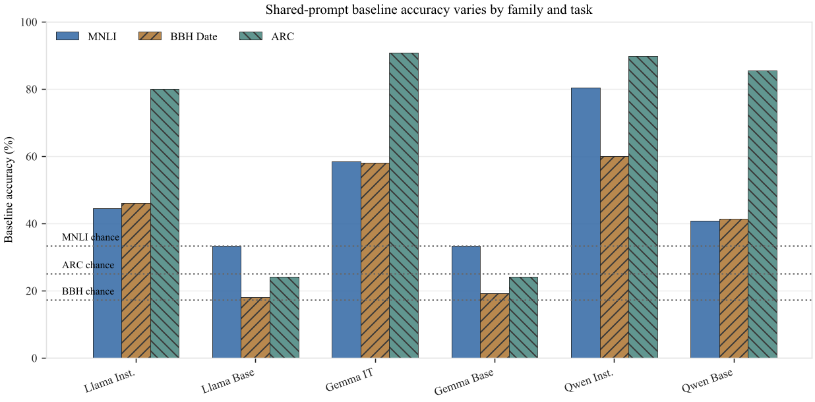
The Before: Baseline accuracy
Instruct models generally outperform base models under the shared prompt.
Qwen Instruct gives the strongest overall baseline, especially on MNLI.
Qwen Base is unusually strong on ARC, so its later drop is not just “base models are weak.”

Slide 15
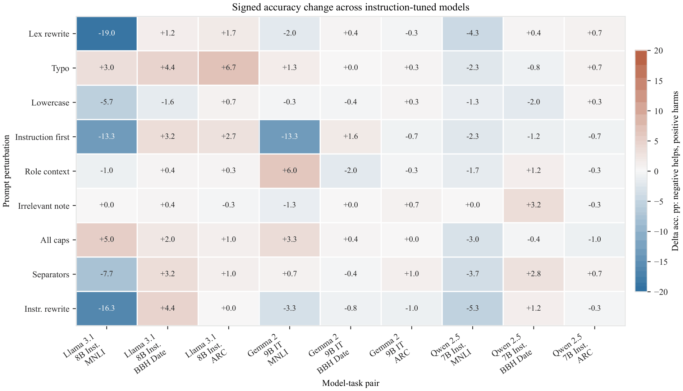
The After: Where Prompt Changes Help vs. Hurt
Large prompt effects exist, but they are model and task specific.
MNLI shows the largest improvements, especially for Llama Instruct and Gemma Instruct.
Positive Δacc values indicate harm; negative values indicate recovery.
Therefore, sensitivity must be interpreted with direction, not only magnitude.
Blue = improvement, red = harm. Positive Δacc means the perturbation hurt accuracy

Slide 16
Llama on lex_rewrite
Task: ARC | Model: llama3.1-8b-instruct
Base Accuracy | 80.00%
Perturbed Accuracy | 78.3%
Δacc | +1.7pp
FR | 0.040
SS | 0.07
dₛₑₘ | 0.2872
Task: MNLI | Model: llama3.1-8b-instruct
Base Accuracy | 44.33%
Perturbed Accuracy | 63.3%
Δacc | -19pp
FR | 0.403
SS | 7.7
dₛₑₘ | 0.1114
Task: BBH | Model: llama3.1-8b-instruct
Base Accuracy | 46.0%
Perturbed Accuracy | 44.8%
Δacc | +1.2pp
FR | 0.028
SS | 0.03
dₛₑₘ | 0.068
Same perturbation, completely different outcomes - sensitivity is a model × task × perturbation interaction.
Δacc: base accuracy - Pert accuracy FR: Flip Rate SS: Sensitivity Score dₛₑₘ: Semantic Distance

Slide 17
Case Study 1: Llama Inst. on MNLI recovers from a weak baseline
Condition | MNLI accuracy | Meaning
Baseline | 44.3% | Weak prompt model fit
lex_rewrite | 63.3% | -19.0 pp improvement
instruction_rewrite | 60.7% | -16.3 pp improvement
struct_inst_first | 57.7% | -13.3 pp improvement
This is sensitivity, but not fragility: the prompt change improves behavior.

Slide 18
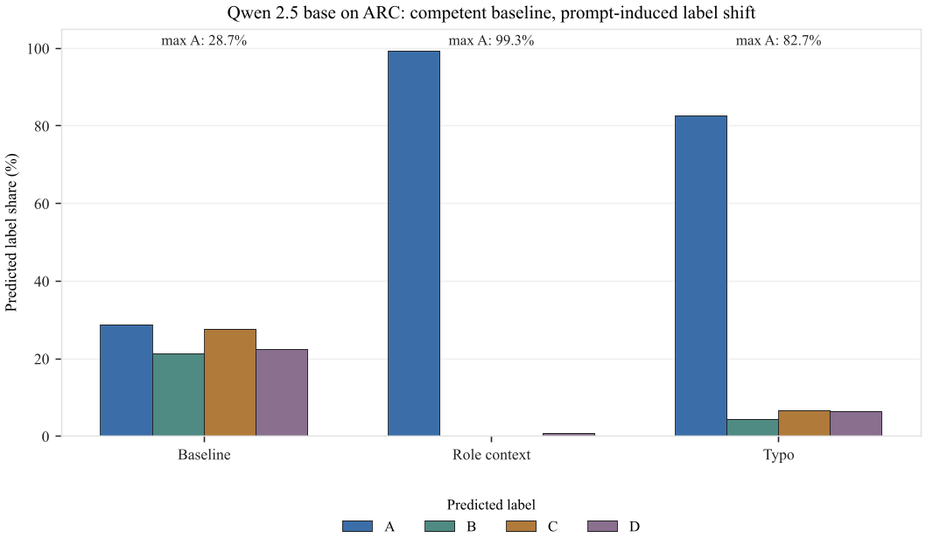
Case Study 2: Qwen Base collapses on ARC
Condition | ARC accuracy | Label behavior
Baseline | 85.3% | Balanced A/B/C/D predictions
ctx_role | 24.7% | Almost all predictions become A
lex_typo | 40.7% | Strong skew toward A
This is genuine fragility: high flip rate + harmful Δacc + label collapse.

Slide 19
Case Study 3: Base models are not one phenomenon
Base models do not behave as a clean robustness control group.
Base-model behavior | Example | Interpretation
Non-engagement near chance | Llama Base, Gemma Base | Low sensitivity does not mean robustness
Competent baseline | Qwen Base on ARC, BBH, MNLI | Can solve the task under the shared prompt
Prompt-induced collapse | Qwen Base + ctx_role for ARC | Small prompt change causes degenerate label behavior
Base-model results are useful as case studies, but not as a clean robustness comparison.

Slide 20
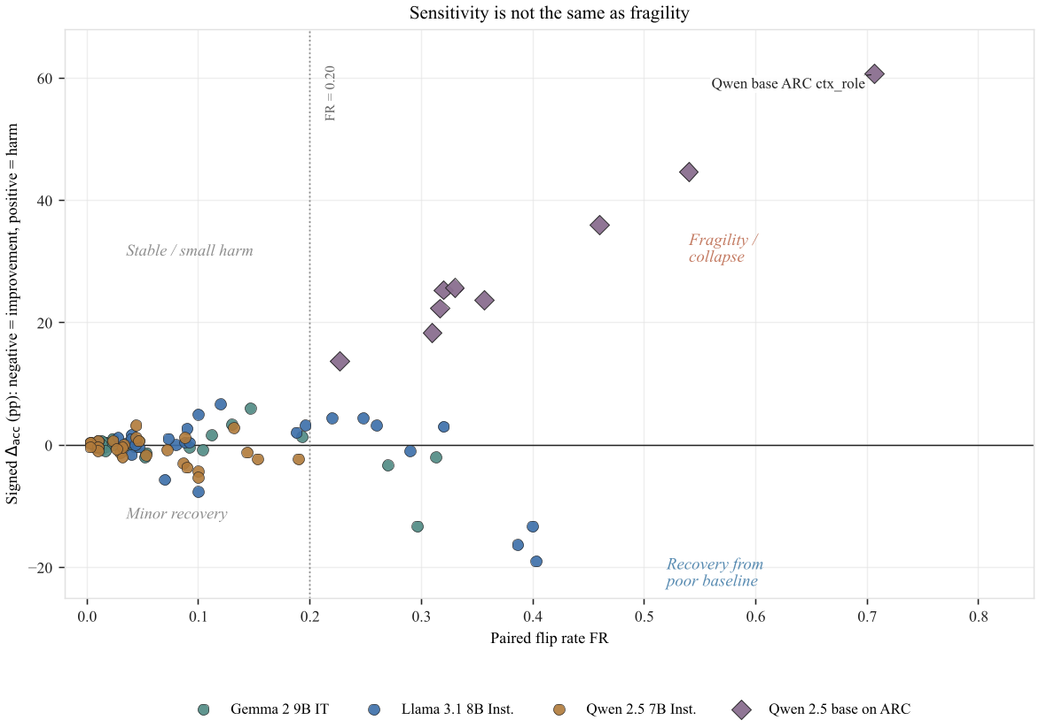
Mapping Recovery and Collapse
Recovery from poor baseline : High FR + large negative Δacc (improvement).
Llama-MNLI cluster.
Fragility / collapse: High FR + large positive Δacc (harm). Qwen base ARC ctx_role:
accuracy 85.3% to 24.7%, FR = 0.71
Stable / small harm: Low FR + small positive Δacc. Most BBH and ARC effects.
Minor recovery: Low FR + small negative Δacc. Qwen-Instruct across all tasks.

Slide 21
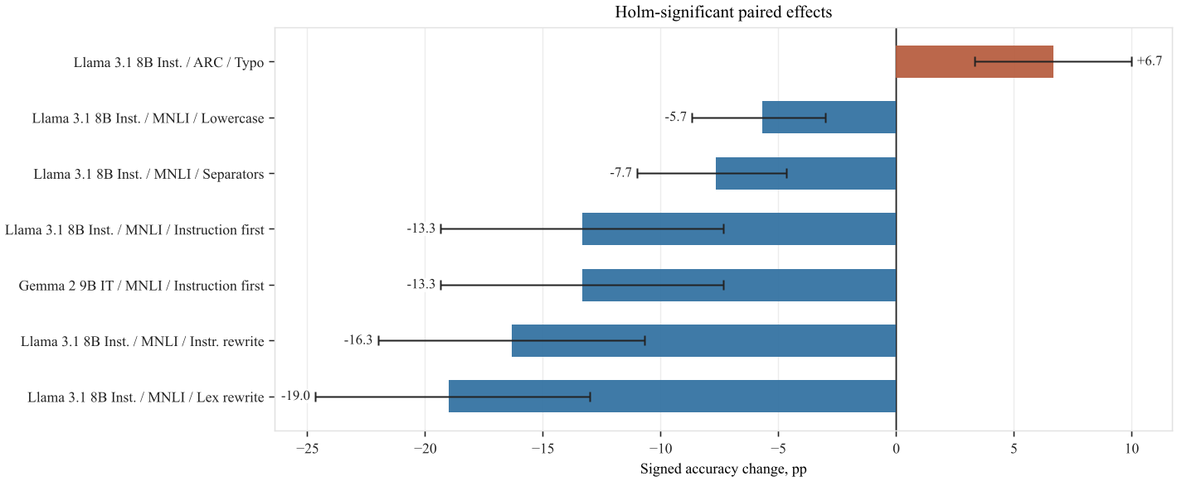
Statistical Significance
95% CI | McNemar’s Test | Holm-Bonferroni correction
Estimates the plausible range of the true accuracy drop under resampling providing a measure of uncertainty | Whether the perturbation changes predictions asymmetrically on the same examples by comparing correct→wrong vs wrong→correct swaps (b vs c) | Adjusts p-values across multiple perturbations to control the family-wise error rate, reducing false positives when many tests are run together.
Only 7 of 81 instruction model perturbation effects survive Holm correction.
6 of 7 are MNLI improvements.
Only one significant harmful instruction tuned effect: Llama ARC under typos.
52 of 81 tests are underpowered due to fewer than 20 discordant pairs, null result here means inconclusive, not zero effect.

Slide 22
Conclusion
analytics
search
psychology
build
1. Prompt sensitivity is real, but it is not automatically fragility.
Sensitivity ≠ fragility — large Δacc can signal recovery from a poorly matched baseline, not brittleness. Sign and baseline level must be read together.
2. A high flip rate only becomes concerning when it also causes a harmful accuracy drop.
3. Some perturbations reveal collapse; others recover from a poor baseline prompt.
4. Robust evaluation should report multiple prompts, signed Δacc, flip rate, and label diagnostics.

Slide 23
Limitation and Future Work
1. Shared baseline vs. model optimized prompts Cross-model sensitivity differences entangled with baseline prompt model fit
2. Single seed and subset Results are reproducible but do not estimate sampling variance
3. Quantization confound 4-bit NF4 may itself alter calibration and sensitivity; full precision comparison not done
4. Limited perturbation suite (9 items, unbalanced categories) Category level averages would be misleading; category comparisons avoided
5. Asymmetric chat templates Qwen auto-injects system message; Llama/Gemma do not confounds cross model comparison
6. Holm correction is conservative Many BBH/ARC tests underpowered; null = inconclusive, not zero effect

Slide 24
References:
Brown, T. et al. 2020. Language Models are Few-Shot Learners. NeurIPS 33, 1877–1901.
Wei, J. et al. 2021. Finetuned Language Models are Zero-Shot Learners. arXiv:2109.01652.
Williams, A., Nangia, N., Bowman, S. 2018. A Broad-Coverage Challenge Corpus for Sentence Understanding Through Inference (MultiNLI). NAACL-HLT.
Clark, P. et al. 2018. ARC: The AI2 Reasoning Challenge. arXiv:1803.05457.
Suzgun, M. et al. 2023. Challenging BIG-Bench Tasks and Whether Chain-of-Thought Can Solve Them. Findings of ACL 2023.
Lu, Y. et al. 2022. Fantastically Ordered Prompts and Where to Find Them. arXiv:2104.08786.
Mizrahi, M. et al. 2024. State of What Art? A Call for Multi-Prompt LLM Evaluation. arXiv:2401.00595.
Sclar, M. et al. 2023. Quantifying LMs’ Sensitivity to Spurious Features in Prompt Design. arXiv:2310.11324.
Voronov, A., Wolf, L., Ryabinin, M. 2024. Mind Your Format: Towards Consistent Evaluation of In-Context Learning. arXiv:2401.06766.
Reimers, N., Gurevych, I. 2019. Sentence-BERT: Sentence Embeddings Using Siamese BERT-Networks. EMNLP-IJCNLP.
AI@Meta. 2024. The Llama 3 Herd of Models. arXiv:2407.21783 [cs.AI]
Qwen Team. 2024. Qwen2.5 Technical Report. arXiv:2412.15115 [cs.CL]
Gemma Team, Morgane Riviere, Shreya Pathak, Pier Giuseppe Sessa, Cassidy Hardin, Surya Bhupatiraju, Léonard Hussenot, Thomas Mesnard, Bobak Shahriari, Alexandre Ramé, et al. 2024. Gemma 2: Improving open language models at a practical size. arXiv preprint arXiv:2408.00118 (2024).
Tim Dettmers, Artidoro Pagnoni, Ari Holtzman, and Luke Zettlemoyer. 2023. QLoRA: Efficient Finetuning of Quantized LLMs arXiv:2305.14314 [cs.LG]

Slide 25


