Slide 1
Operating system and system programming (25CS2104E)
Multi-Process Task Manager for Linux
Team Members:
R.Vishnu Vardhan - 2520090166
K. Amruthavalli - 2520090070
N. Divya Sree - 2520090031
Under the Esteemed Guidance of
Raghupathi M
CSE Department

Slide 2
Contents
Abstract
Introduction
Problem Statement and Objectives
Hardware and Software requirements
System Architecture
Modules and Key Features
Implementation and Working
Sample Output Screenshots
Testing and Results
Future Scope
Conclusion

Slide 3
Abstract
The Multi-Process Task Manager for Linux is a system-level application designed to simplify the monitoring and management of multiple processes running in a Linux environment. Managing several processes through traditional command-line utilities can be challenging, especially when users need to identify related processes, monitor their resource consumption, and control their execution efficiently.
The proposed system provides a centralized interface to view running processes, inspect process details, monitor CPU and memory usage, and perform process-management operations. It aims to improve visibility into parent-child process relationships and make it easier to manage groups of related processes. By utilizing Linux process information and operating-system mechanisms, the application offers a structured approach to process monitoring and control.
The project demonstrates practical concepts of operating systems, including process management, process states, process identification, signals, and interaction with the Linux kernel. It can serve as a useful utility for students, developers, and system administrators who need a clearer and more organized way to manage multiple running processes.

Slide 4
Introduction
A process is a program in execution and is one of the fundamental concepts of an operating system. Linux supports multitasking by allowing multiple processes to execute concurrently, sharing system resources such as CPU time, memory, and input/output devices.
As the number of running processes increases, monitoring their status and controlling their execution becomes more complicated. Users often rely on command-line utilities such as ps, top, pgrep, and kill. Although these tools are useful, switching between commands can make it difficult to maintain an organized view of related processes and their resource usage.
The Multi-Process Task Manager for Linux aims to address this challenge by providing a centralized process-management interface. It is designed to display process information, identify related processes, monitor resource usage, and support appropriate process-control operations.
The project combines operating-system concepts with practical system programming to create a more structured and accessible process-management solution.

Slide 5
Problem Statement and Objectives
Problem Statement:
Linux provides several command-line utilities for monitoring and controlling processes. However, managing multiple related processes can require several commands and repeated manual checks.Users may find it difficult to identify parent-child relationships, compare resource consumption, locate specific processes, and control the correct process without affecting unrelated applications.Therefore, a centralized and organized solution is needed to simplify process inspection, resource monitoring, and process control while maintaining appropriate permission checks and safegraurds.
Objectives
Develop a centralized interface for managing multiple Linux processes.
Display essential process details, including PID, process name, state, and parent PID.
Enable users to search for processes by name or process ID.
Monitor CPU and memory usage where supported by the implementation.
Represent parent-child process relationships in a structured process tree.
Support appropriate process-control operations with permission checks.
Reduce the need to switch between multiple command-line utilities.

Slide 6
Hardware and Software Requirements
Hardware :
Processor: Intel Core i3 or equivalent
RAM: 4 GB
Storage: 2 GB of free disk space
System: Desktop computer or laptop
Processor: Intel Core i5 or equivalent
RAM: 8 GB or higher
Storage: 5 GB of free disk space
System: 64-bit computer capable of running Linux
Software :
Operating System: Ubuntu Linux or another compatible Linux distribution
Programming Language: C, C++, or Python, depending on the implementation
Development Environment: Visual Studio Code or another suitable code editor
Compiler/Runtime: GCC or Clang for C/C++; Python 3 for Python
System Interface: Linux /proc filesystem for retrieving process information
Terminal: Linux command-line terminal for execution and testing
Version Control (Optional): Git and GitHub for source-code management

Slide 7
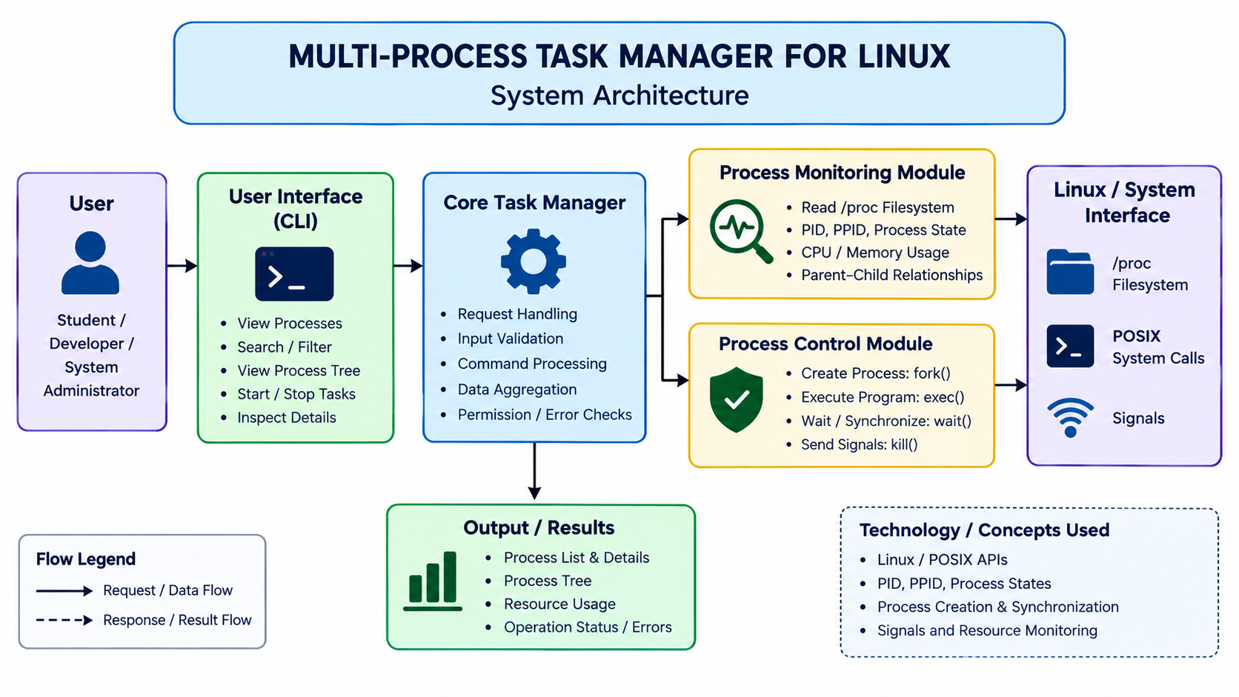
System Architecture

Slide 8
Modules and Key Features
1. Process Discovery Module
Identifies running processes in the Linux system.
Retrieves PID, PPID, process name, and state.
2. Process Search and Filtering Module
Searches processes by PID or process name.
Filters process information for quick identification.
3. Process Monitoring Module
Displays available CPU and memory usage.
Tracks process states and parent-child relationships.
4. Process Tree Module
Organizes processes based on parent-child relationships.
Provides a structured view of related processes.
5. Process Control Module
Supports process creation and execution using fork() and exec(), where implemented.
Manages process termination using signals.
Supports process synchronization using wait() or waitpid(), where implemented.

Slide 9
Implementation and Working
Implementation:
Command-Line Interface: Accepts user commands to perform supported process-related operations.
Command Processing: Reads and validates user input.
Process Information: Retrieves available process details, such as PID, PPID, and process state.
Linux Interface: Uses relevant Linux interfaces, such as /proc and system calls, where implemented.
Output Generation: Displays process information and operation status in a readable format.
Working Process:
1. User Input
2. Input validation
3. Linux process information or operations are accessed
4. Requested operation is performed
5. Results are displayed to the user

Slide 10
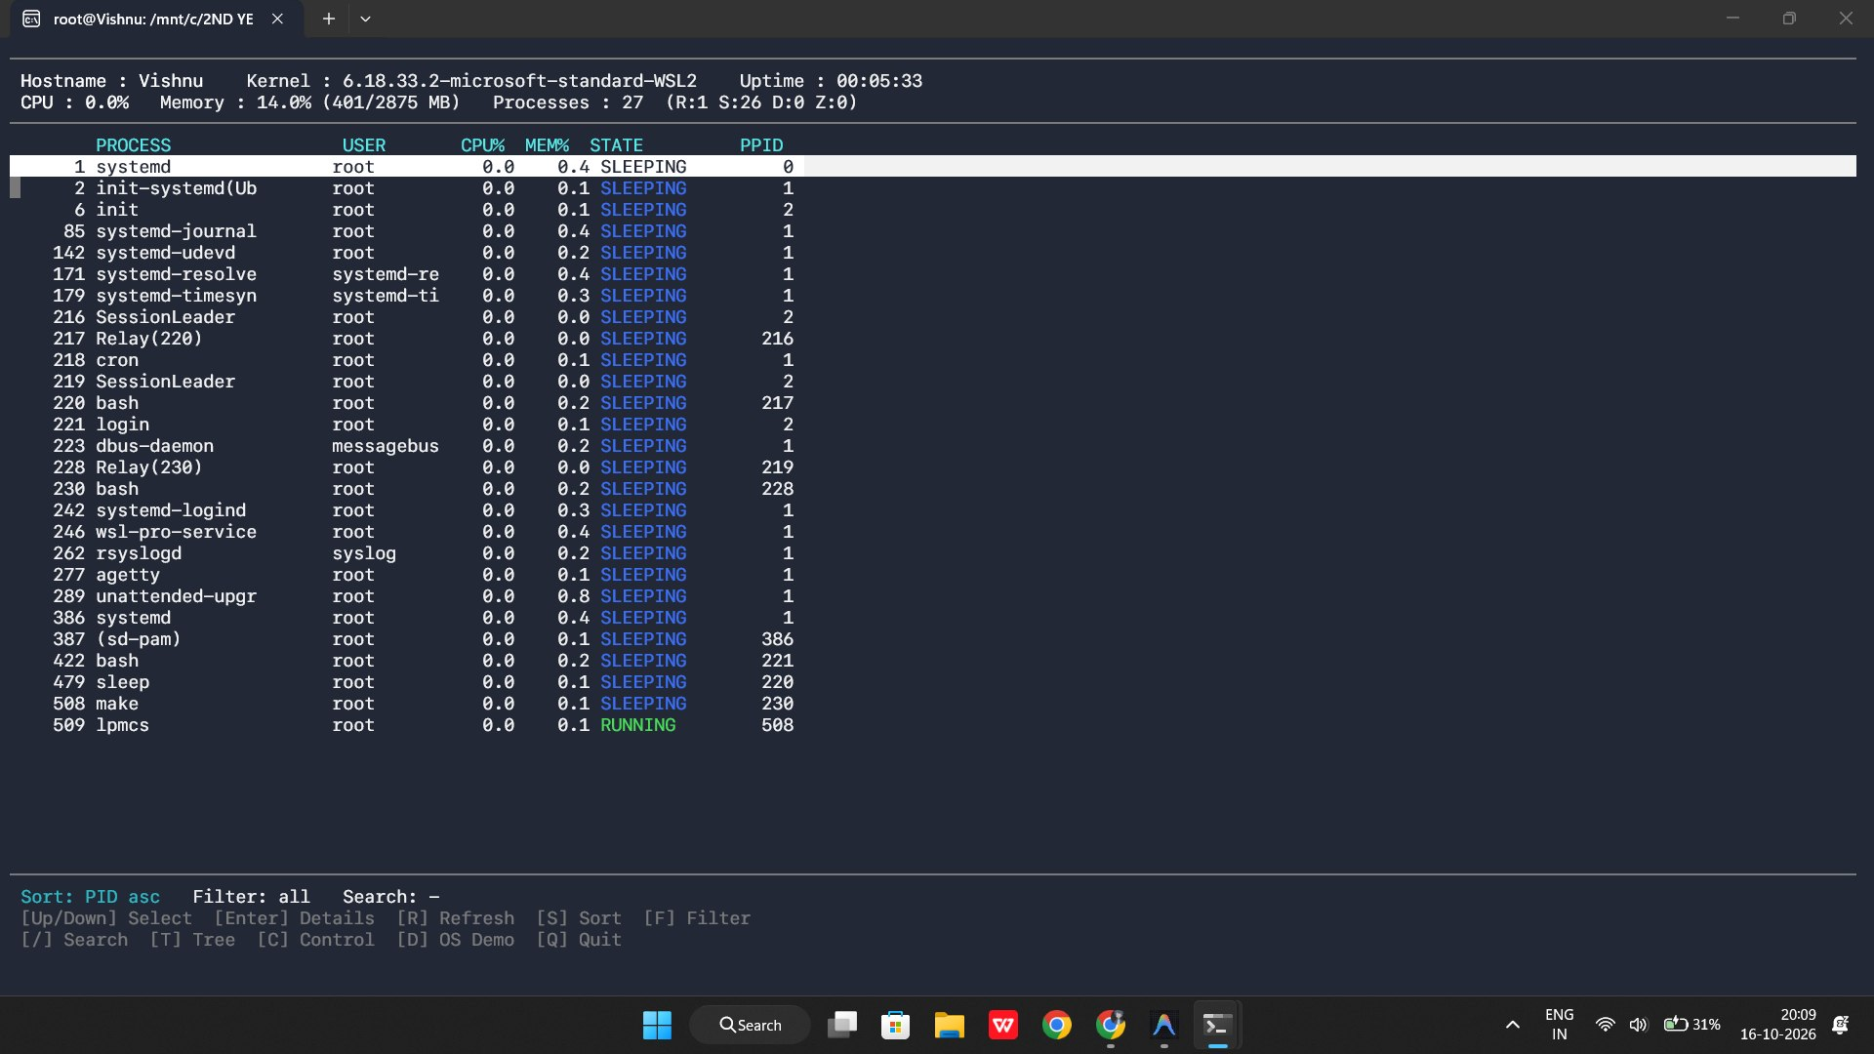
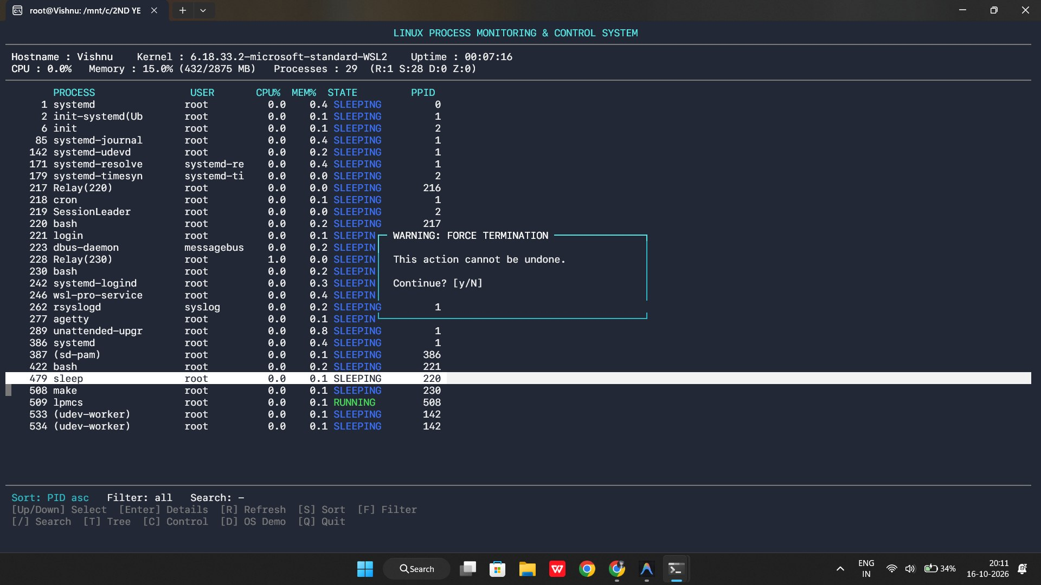
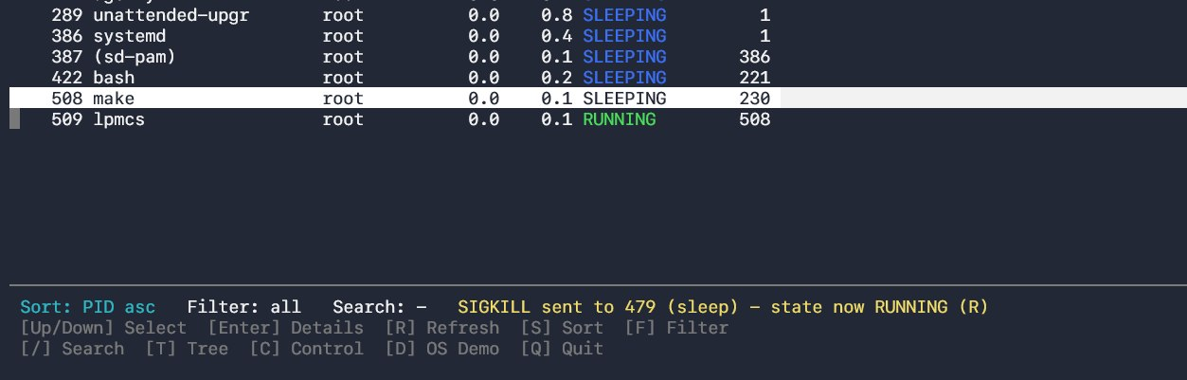
Sample Output Screenshots

Slide 11
Testing and Results
Testing:
Process Identification: Verify that process IDs (PID) and parent process IDs (PPID) are displayed correctly.
Process Monitoring: Check whether process information and states are retrieved correctly.
Process Creation: Verify process creation and parent–child relationships.
Process Control: Test supported process-control operations and signal handling.
Input Validation: Check how the system handles invalid commands and incorrect inputs.
Results:
The system is designed to display relevant process information through a command-line interface.
Process-related operations can be observed through their output and status messages.
Testing helps identify incorrect inputs and potential process-management errors.
The project supports practical learning of Linux process-management concepts.

Slide 12
Future Scope
Real-Time Monitoring: Display continuously updated process information.
Graphical User Interface: Develop a user-friendly dashboard for process management.
Resource Tracking: Monitor CPU and memory usage of individual processes.
Advanced Process Control: Add process-priority management and safer control operations.
Data Visualization: Display process statistics through charts and reports.
Alerts and Logging: Record process events and notify users about unusual activity.
CPU and Memory Analytics: Track resource consumption and identify resource-intensive processes.

Slide 13
Conclusion
The project demonstrates Linux process monitoring and control mechanisms.
It explains key operating-system concepts, including PID, PPID, process states, and parent-child relationships.
It provides practical exposure to Linux system calls and process-management techniques.
It bridges the gap between theoretical operating-system concepts and practical implementation.
It establishes a foundation for exploring advanced process management and synchronization techniques.

Slide 14
Thank you

