Slide 1
Analysis and detection of phishing websites
SAI SIVA ROHIT NERUSU
VISHNUVARDHAN RAO SIDDURI

Slide 2
CONTENTS
Abstract
Modules description
Machine Learning Models
Output
Conclusion

Slide 3
Abstract
Phishing stands for a fraudulent process, where an attacker tries to obtain sensitive information from the victim. Usually, these kinds of attacks are done via emails, text messages, or websites. Phishing websites, which are nowadays on a considerable rise, have the same look as legitimate sites. However, their backend is designed to collect sensitive information that is inputted by the victim. Discovering and detecting phishing websites has recently also gained the machine learning community’s attention, which has built the models and performed classifications of phishing websites.
Our project is the analysis and detection of phishing websites based on the website URL. This project includes two datasets from mendaly data for phishing websites. The URL-based analysis is performed and various factors like the number of redirections, domain lookup response time, etc. are considered for analysis. One can easily detect whether a website is a phishing website or not by just entering the URL of that website with the help of our project. The advantages of this project include:
Obtaining interesting patterns from the available data.
Information regarding which parameters play a key role in making the website a phishing website is obtained.
A model is built which predicts the URL is a phishing website or not.

Slide 4

Modules

Slide 5
Data collection: This project includes two datasets from mendaly data for phishing websites of sizes 89,000 and 59,000 rows respectively. The URL-based analysis is performed and various factors like the number of redirections, domain lookup response time, etc. are considered for analysis.
Literature survey: A literature survey in a project report represents the study done to assist in the completion of a project. A literature survey also describes a survey of the previous existing material on a topic of the report.
Exploratory data analysis: Exploratory data analysis (EDA) is used by data scientists to analyze and investigate data sets and summarize their main characteristics, often employing data visualization methods. ... It can also help determine if the statistical techniques you are considering for data analysis are appropriate.

Slide 6
Machine learning modelling: A machine learning model is a file that has been trained to recognize certain types of patterns. You train a model over a set of data, providing it an algorithm that it can use to reason over and learn from those data. Classification model has been used in this project due to the presence of categorical values. A set of classification models have been tried and tested upon the dataset.
Model metrics and fitness checking: Model metrics include accuracy scores, confusion matrix, recall precision scores and f1 scores.

Slide 7
MACHINE LEARNING MODELS
We trained the dataset to a variety of machine learning algorithms namely:
KNN Classifier
Logistic regression
Decision tree Classifier
Random forest
Multilayer perceptron
Gradient boost
Adaboost

Slide 8
Output Graphs

Slide 9
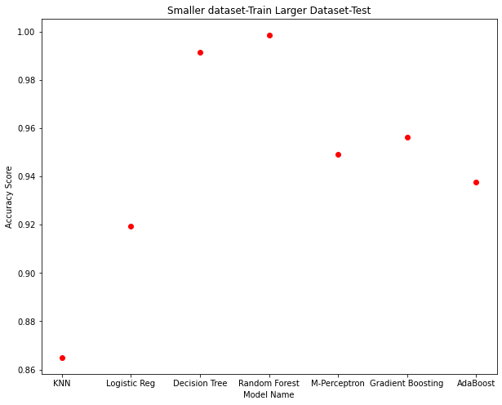

Slide 10
Conclusion
After our research, we have come to a conclusion that among the algorithms that we have used, Random forest algorithm has yielded higher accuracy value compared to all the other algorithms.

Slide 11
Thanks!

