Slide 1

Capstone Project - 01
Auto Insurance -
Quote to New Policy Conversion

Slide 2
Agenda
Auto Ins - Quote to Policy Conversion 03
Quotes Trends Analysis by Month wise 04
New Policy Conversion by Month wise 05
12
17

Slide 3
Auto Insurance - Quote to Policy Conversion
Problem Statement: Client is looking for the Predictive Analytics in Sales & Marketing module of Auto Insurance Line of Business.
Salient Business Features:
Business is serving in 8 regions
Auto insurance Policy Types - Car, Van & Trunk
Auto policies selling through EA / IA (~ 300) channels
Quotes data - Provide data of ~ 1,46,000 which covers the 12 months (01-Oct-2019 to 30-Sep-2020)
Client Expectations:
Quotes Trend Analysis by Month - To understand the quotations trend with 3 months predictions
Quote to Policy Conversion by Month - To understand the New Policy bind trend with 3 months predictions
Predicting the buying behavior pattern of auto insurance customer by using the client provided data
Exploratory Data Analysis of Auto Insurance Quotes and New Policies data (Top 10 KPI’s)

Slide 4
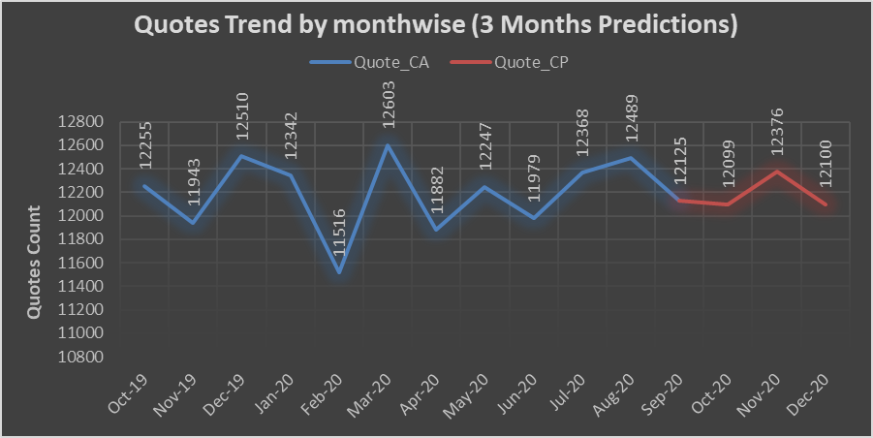
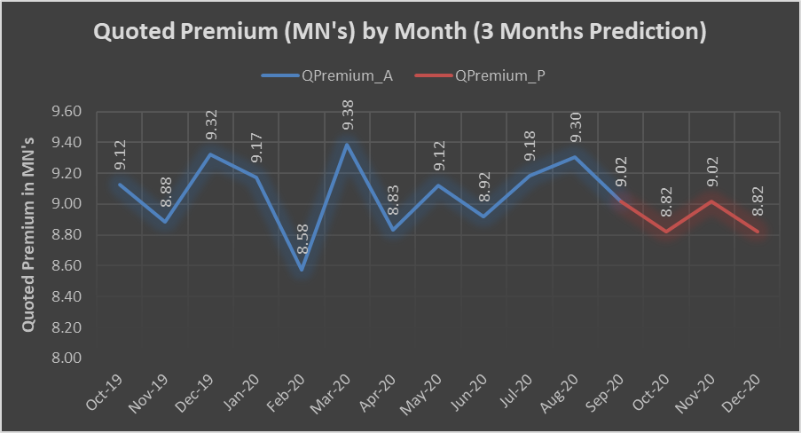
2 points
Quotes Trend Analysis by Month wise
2 points here

Slide 5
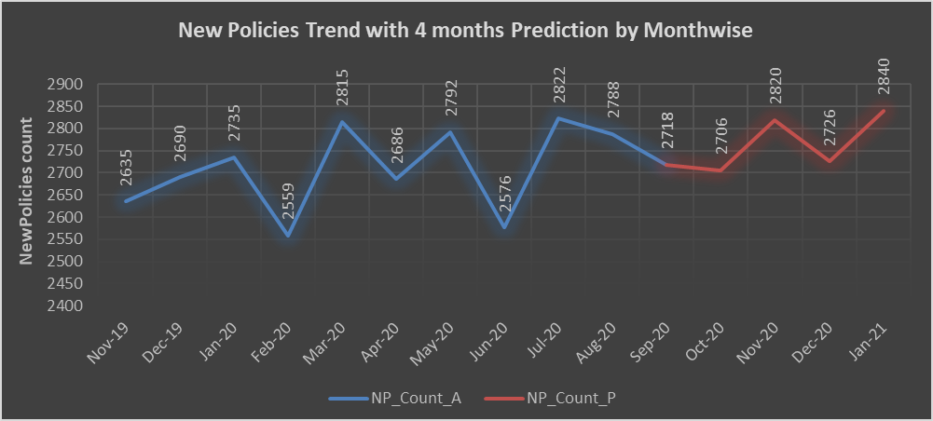
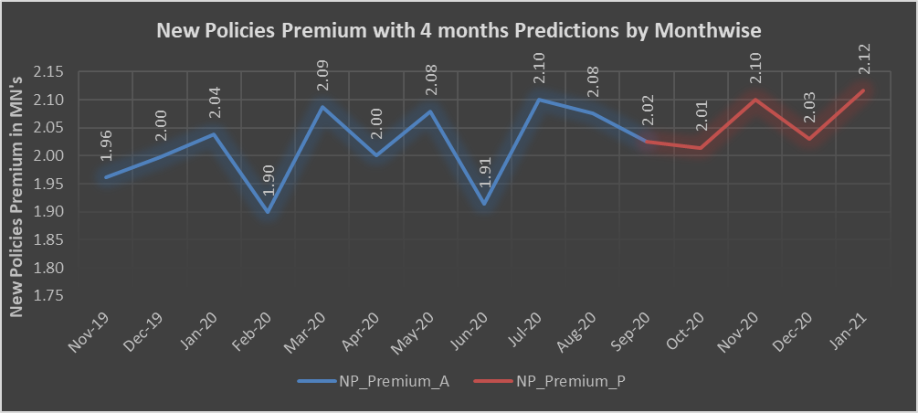
2 points
New Policy Conversion by Month wise
2 points here

Slide 6
Random Forest Algorithm with U/O Sampling (Sampling Strategy=0.45) 01 - Accuracy 83.91% 02 - F1 Score 83.91% 03 - ROC AUC Score 0.744
Recommendation of Classification Model - Trail 1

Slide 7
Random Forest Algorithm with U/O Sampling (Sampling Strategy=0.45) 01 - Accuracy 83.91% 02 - F1 Score 83.91% 03 - ROC AUC Score 0.744
Recommendation of Classification Model - Final

Slide 8
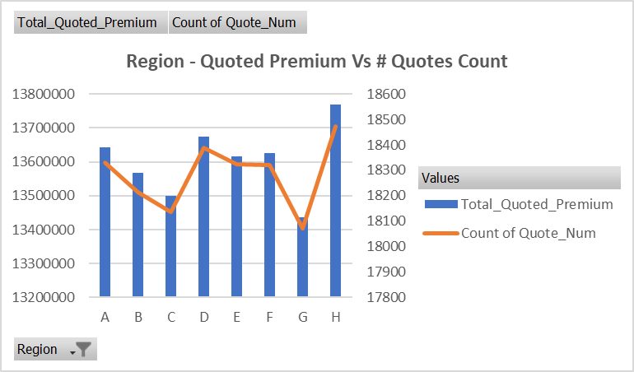
Text
Exploratory Data Analysis - KPI 01

Slide 9
Text
Exploratory Data Analysis - KPI 02

Slide 10
Thank You
Q & A
Student Name
Roll Number
Mobile: +91 99999 99999
Email: name@iiitk.ac.in
IIIT-DM, Kurnool - India

