Slide 1

Capstone Project -01
Auto Insurance-
Quote to New Policy Conversion

Slide 2
Agenda
Auto Ins – Quote to Policy Conversion 03
Quotes Trends Analysis by Month wise 04
New Policy Conversion by Month wise 05
Recommendation of Classification Analysis 06
Exploratory Data Analysis 08

Slide 3
Auto Insurance – Quote to Policy Conversion
Problem Statement: Client is looking for the Predictive Analytics in Sales & Marketing module of Auto
Insurance Line of Business
Salient Business Features:
Business is serving in 8 regions
Auto Insurance Policy Type – Car, Van & Truck
Auto Policies selling through EA / IA ( ~ 300) channels
Quotes data – Provide data of – 1,46,000 which covers the 12 months (01-Oct-2019 to 30-Sep-2020)
Client Expectations:
Quote Trend Analysis by Month – To understand the quotations trend with 3 months predictions
Quote to Policy Conversion by Month – To understand the New Policy bind trend with 3 months predictions
Predicting the buying behaviour pattern of auto insurance customer by using the client provided data
Exploratory Data Analysis of Auto Insurance Quotes and New Policies data (Top 10 KPI’s)

Slide 4
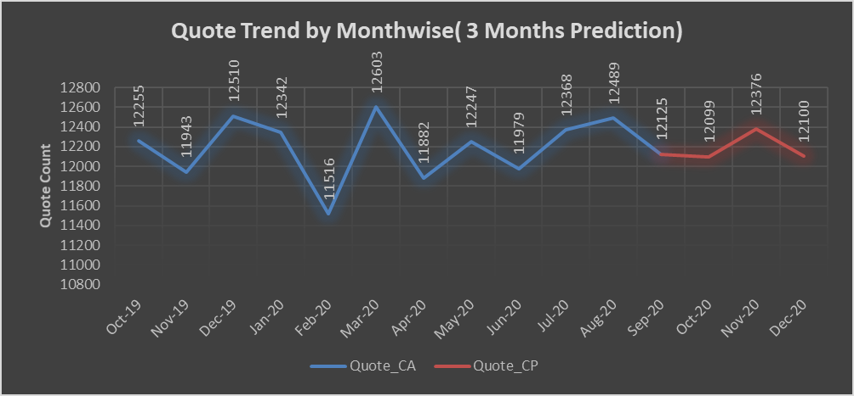
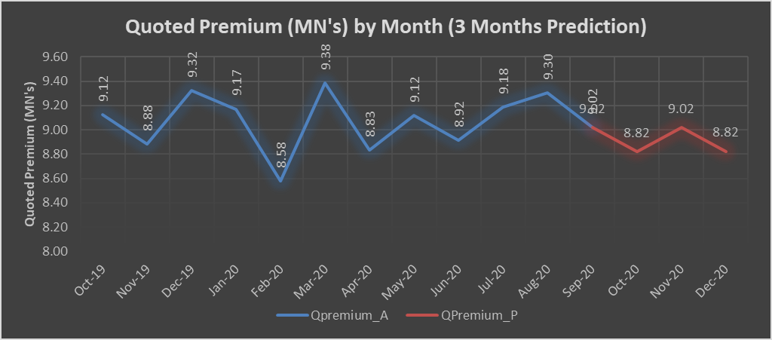

Quotes Trend Analysis by Month wise
2
2

Slide 5
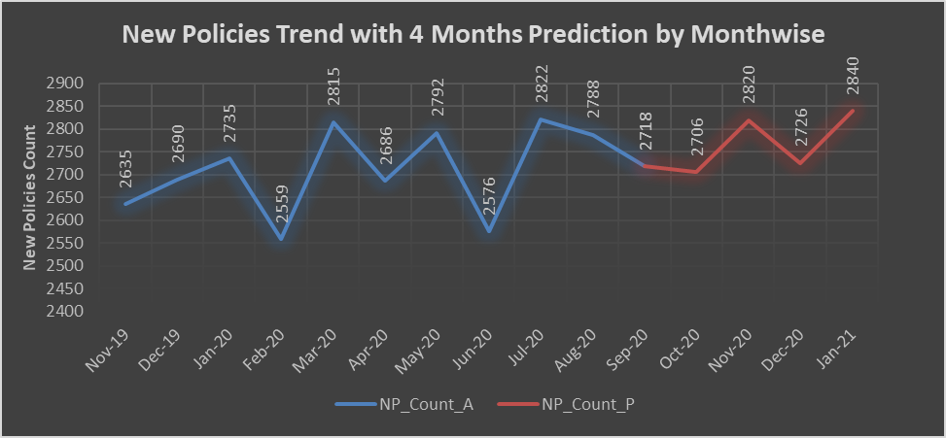
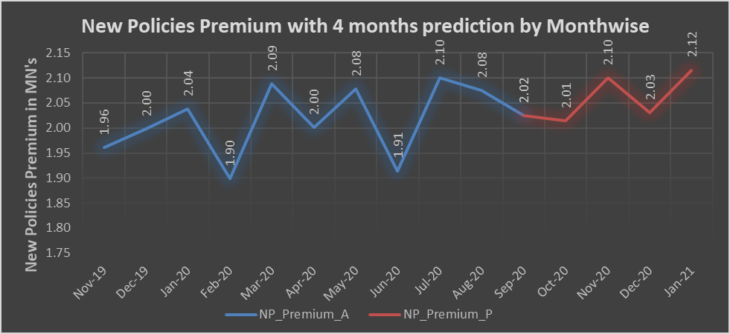
New Policy Conversion by Month wise
2
2

Slide 6
Recommendation of Classification Model – Trail 1
Random Forest Algorithm with U/O Sampling ( Sampling Strategy = 0.70)
01 – Accuracy 91.01 %
02 – F1 Score 91.01 %
03 – ROC AUC Score 0.953

Slide 7
Recommendation of Classification Model – Final
Random Forest Algorithm with U/O Sampling ( Sampling Strategy = 0.45)
01 – Accuracy 84.06 %
02 – F1 Score 84.06 %
03 – ROC AUC Score 0.746

Slide 8
Exploratory Data Analysis
KPI - 01
KPI - 02

Slide 9
Exploratory Data Analysis
KPI - 03
KPI - 04

Slide 10
Exploratory Data Analysis
KPI - 05
KPI - 06

Slide 11
Exploratory Data Analysis
KPI - 07
KPI - 08

Slide 12
Exploratory Data Analysis
KPI - 09
KPI - 10

