Slide 1

DEPARTMENT OF ARTIFICIAL INTELLIGENCE AND DATA SCIENCE ACADEMIC YEAR 2025 - 2026 SEMESTER III ARTIFICIAL INTELLIGENCE LABORATORY MINI PROJECT REVIEW <Probabilistic Disease Diagnosis System using Bayesian Theorem>
REGISTER NUMBER
NAME | VishnuVardhan A
YEAR | II
SECTION | F
FACULTY IN-CHARGE | Ms.S.Divya

Slide 2
PROBLEM STATEMENT
The manual diagnosis of diseases based on symptoms is often slow, error-prone, and inconsistent due to overlapping and ambiguous symptoms. Healthcare professionals face challenges dealing with incomplete and uncertain patient data, leading to delayed or inaccurate diagnoses. This results in ineffective treatment, increased patient risk, and higher healthcare costs. The proposed system uses Bayesian theorem to provide a probabilistic, data-driven diagnosis, helping clinicians make faster, more accurate decisions by effectively handling uncertainties and improving diagnostic precision. This will ultimately enhance patient outcomes and reduce diagnostic errors.

Slide 3
THEORETICAL BACKGROUND
Disease diagnosis involves uncertainty due to overlapping symptoms and incomplete data.
Bayesian theorem helps manage uncertainty by updating disease likelihoods as new symptoms are observed.
Combines prior knowledge (prevalence) with symptom likelihoods for accurate diagnosis.
Provides a transparent and interpretable approach ideal for clinical decision support.
Supports evidence-based, probabilistic reasoning in healthcare diagnostics.
Justification for choosing Bayesian Theorem:
Interpretability
Uncertainty Handling
Data Efficiency
Modularity
S.No | Name of Reference | Information Required for Our Project
1 | Employing Bayesian Networks for the Diagnosis and Prognosis of Diseases: A Comprehensive Review | Demonstrates how Bayesian networks can model uncertain disease diagnosis effectively.
2 | Bayesian Biostatistics and Diagnostic Medicine by Lyle D. Broemeling | Explains Bayesian statistical methods useful for accurate disease diagnosis.
3 | Diagnose a disease using Bayes Theorem, step by step (YouTube Video) | Shows practical application of Bayes’ theorem for incremental disease diagnosis.

Slide 4
IMPLEMENTATION AND CODE
Link to code in Git-hub Repository
List | Git-hub Repository Links
Implementation of Code Link | https://github.com/VishnuVardhanAtech/Aiminiprj
Word Document Report Link | https://github.com/VishnuVardhanAtech/Aiminiprj
PPT Link | https://github.com/VishnuVardhanAtech/Aiminiprj

Slide 5
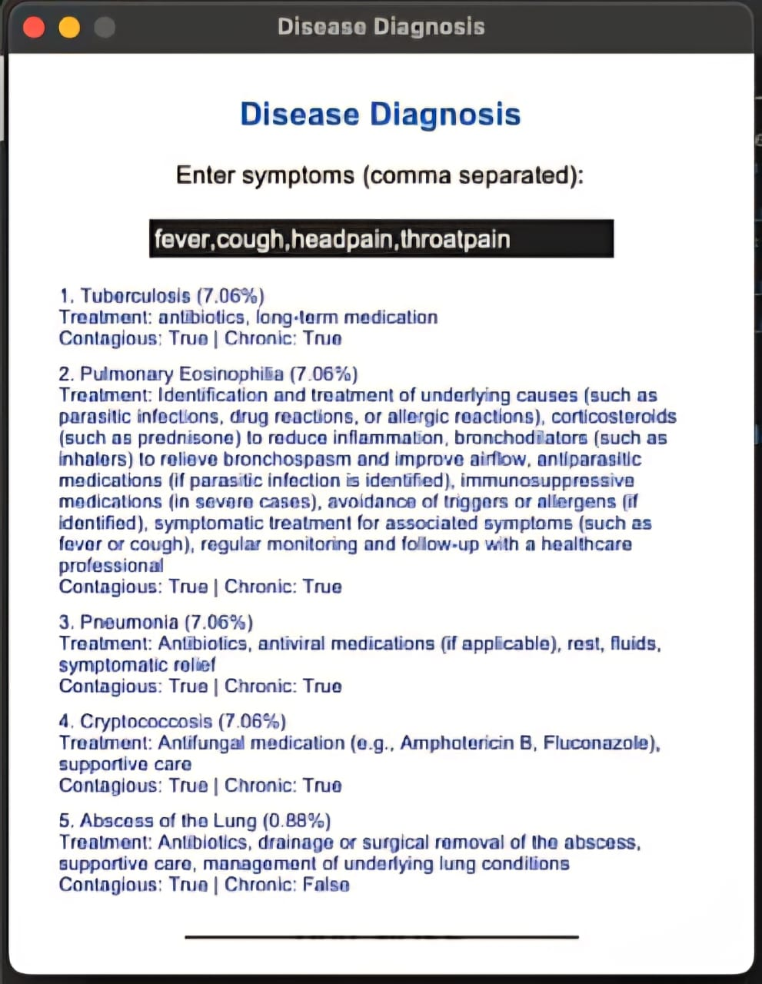
OUTPUT AND RESULTS

Slide 6
OUTPUT AND RESULTS
The system predicts the top 5 probable diseases based on user symptoms by calculating posterior probabilities.
Diseases are ranked from highest to lowest probability with clinical details like treatments and contagious/chronic indicators.
Results capture diagnostic uncertainty and symptom overlap, signaling when further tests are needed.
Transparent, data-driven outputs support confident, informed clinical decisions and improve diagnostic accuracy.

Slide 7
REFERENCES
1•⁠ ⁠Title: "Employing Bayesian Networks for the Diagnosis and Prognosis of Diseases: A Comprehensive Review"
•⁠ ⁠Link: https://arxiv.org/abs/2304.06400
•⁠ ⁠Authors: Carlos Segundo Muñoz-Valencia et al.
2•⁠ ⁠Title: "Bayesian Biostatistics and Diagnostic Medicine"
•⁠ ⁠Author: Lyle D. Broemeling
•⁠ ⁠Link: https://www.barnesandnoble.com/w/bayesian-biostatistics-and-diagnostic-medicine-lyle-d-broemeling/1132542227
3•⁠ ⁠Title: "Diagnose a disease using Bayes Theorem, step by step upon evidence and lab test result arrives."
•⁠ ⁠Channel: Spice Logic
•⁠ ⁠Link: https://www.youtube.com/watch?v=C9D6hcY6-Es

