Slide 1

DEPARTMENT OF ARTIFICIAL INTELLIGENCE AND DATA SCIENCE ACADEMIC YEAR 2025 - 2026 SEMESTER III ARTIFICIAL INTELLIGENCE LABORATORY MINI PROJECT REVIEW <Probabilistic Disease Diagnosis System using Bayesian Theorem>
REGISTER NUMBER
NAME | VishnuVardhan A
YEAR | II
SECTION | F
FACULTY IN-CHARGE | Ms.S.Divya

Slide 2
PROBLEM STATEMENT
Accurately diagnosing diseases based on patient symptoms is a challenging task due to overlapping symptoms, incomplete information, and inherent uncertainty in clinical data. Manual diagnosis processes are often time-consuming, subjective, and prone to errors, especially when dealing with rare or complex diseases. This project aims to develop a Probabilistic Disease Diagnosis System using Bayesian reasoning that takes patient symptoms as input and calculates the likelihoods of multiple possible diseases from a comprehensive and structured dataset.
The system leverages probabilistic inference to quantify the uncertainty in diagnosis and present interpretable results that assist healthcare professionals in their decision-making process. By integrating statistical reasoning with medical datasets, the model aims to reduce diagnostic errors, improve efficiency, and support evidence-based medical practices. Furthermore, the system will offer a transparent diagnostic framework that can adapt and learn as more data becomes available, thus enhancing its reliability and accuracy over time.

Slide 3
THEORETICAL BACKGROUND
Disease diagnosis involves uncertainty due to overlapping symptoms and incomplete data. Probabilistic reasoning, based on Bayes’ theorem, helps manage this by updating disease likelihoods as new symptoms are observed. By combining prior knowledge with symptom likelihoods, Bayesian reasoning offers a transparent and interpretable approach ideal for clinical decision support systems.
Justification for Choosing Bayesian Theorem
• Interpretability: Bayesian methods produce transparent probabilistic outputs that clinicians can understand, fostering trust in AI-driven diagnostics.
• Uncertainty Handling: They combine prior information with observed data to offer robust reasoning even when data is incomplete or noisy.
• Data Efficiency: Bayesian approaches need less labeled data than many deep learning models and adapt well as new data arrives incrementally.
• Modularity: They flexibly incorporate expert knowledge and can handle heterogeneous symptom data sources.
Serial No | Book Name | Survey
1 | Bayesian Biostatistics and Diagnostic Medicine | Introduces Bayesian methods in diagnostic medicine, demonstrating effective management of uncertainty in medical diagnosis through probabilistic models and clinical case studies.
2 | Bayesian Disease Mapping: Hierarchical Modeling | Details Bayesian hierarchical models for disease mapping and spatial epidemiology, providing statistical methods for understanding epidemiological patterns using probabilistic approaches.
3 | Medical Diagnosis System: Based on Bayesian Theory | Focuses on enhancing clinical diagnostic accuracy by applying Bayesian decision theory to medical diagnosis systems.
4 | Bayesian Data Analysis | Presents foundational Bayesian inference and probabilistic modeling techniques essential for developing Bayesian approaches in medical diagnostics.
5 | Bayesian Networks: With Examples in R | Practical guide on Bayesian networks for disease diagnosis, illustrating handling uncertainty and causal relationships with examples in R.

Slide 4
IMPLEMENTATION AND CODE
Link to code in Git-hub Repository
List | Git-hub Repository Links
Implementation of Code Link | https://github.com/VishnuVardhanAtech/Aiminiprj
Word Document Report Link | https://github.com/VishnuVardhanAtech/Aiminiprj
PPT Link | https://github.com/VishnuVardhanAtech/Aiminiprj

Slide 5
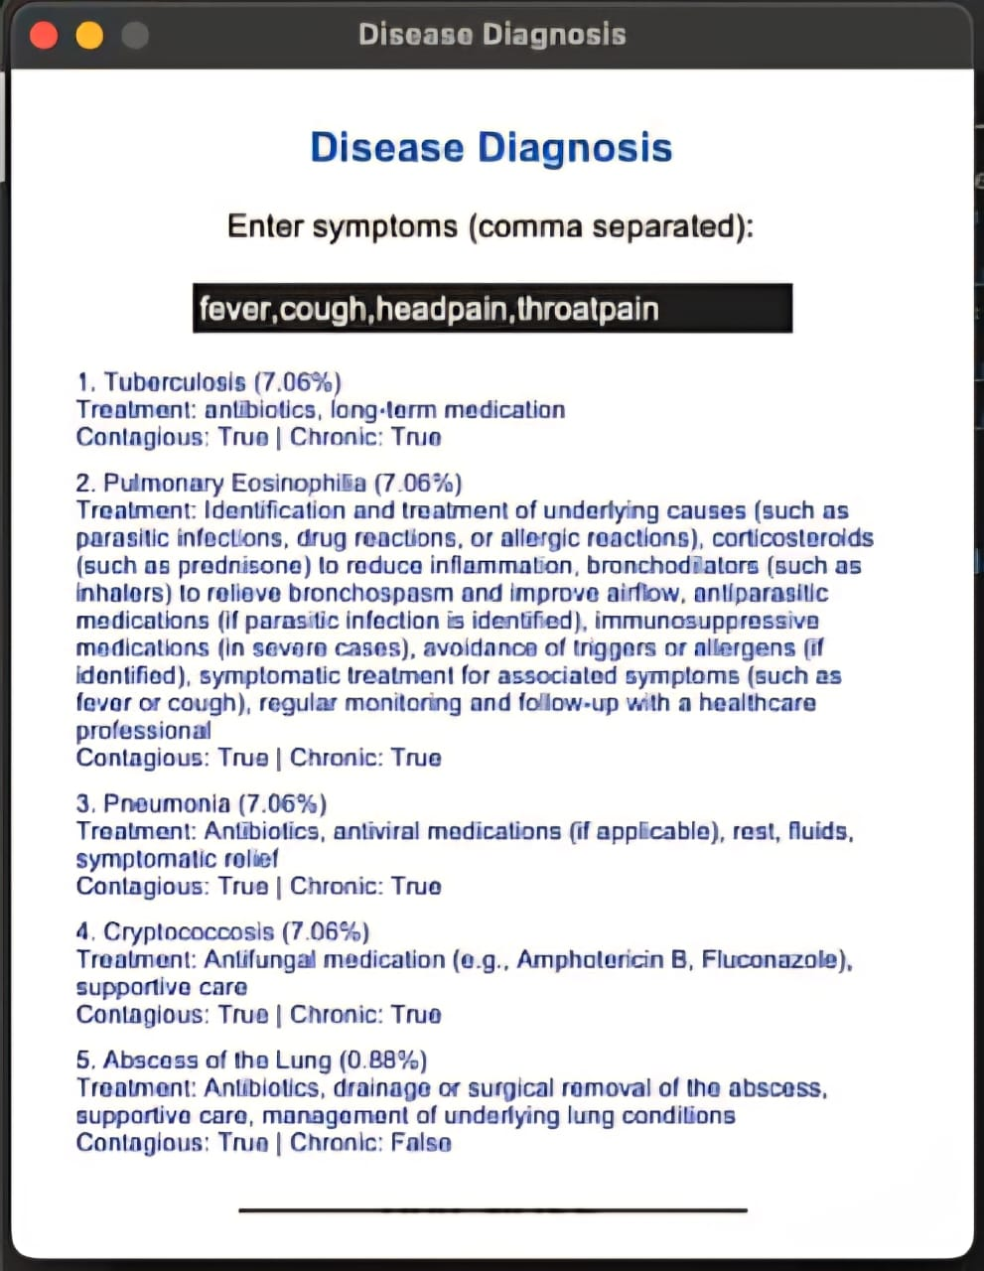
OUTPUT AND RESULTS

Slide 6
OUTPUT AND RESULTS
The output of this Bayesian disease diagnosis system shows the top five most likely diseases based on the symptoms entered by the user. For each disease, the system calculates a posterior probability that quantifies how likely the disease is given the observed symptoms. These diseases are then ranked from the highest to the lowest probability.
Along with the disease names, the system provides helpful clinical details such as recommended treatments, and indicators whether the disease is contagious or chronic. This additional information helps users and healthcare providers understand the potential impact and management of each possible diagnosis.
The probabilistic results capture the uncertainty in medical diagnosis and the overlap of symptoms across diseases. When several diseases have close probabilities, it signals that further clinical tests or evaluations may be necessary. These transparent, data-driven results enable more informed and confident decision-making, ultimately improving diagnostic accuracy and patient care.
Results:
The Bayesian disease diagnosis system effectively predicts the top 5 probable diseases based on user-input symptoms by calculating posterior probabilities. It transparently handles symptom overlap and diagnostic uncertainty, providing clear and interpretable outputs including treatment recommendations, contagiousness, and chronic disease indicators. The system offers competitive, data-driven suggestions that aid clinical decision-making..

Slide 7
REFERENCES
Bayesian Biostatistics and Diagnostic Medicine Author: Lyle D. Broemeling Publisher: CRC Press, 2007 Overview: Introduction to Bayesian methods in diagnostic medicine, including applications, models, and case studies.
Bayesian Disease Mapping: Hierarchical Modeling in Spatial Epidemiology (Third Edition) Author: Andrew B. Lawson Publisher: Chapman & Hall/CRC Interdisciplinary Statistics, 2021 Overview: Comprehensive coverage of Bayesian hierarchical models applied to disease mapping and epidemiology.
Medical Diagnosis System: Based on Bayesian Decision Theory Author: Unknown (Look for similar titled works) Overview: Focus on applying Bayesian decision theory to improve clinical diagnostic accuracy.
Bayesian Data Analysis Authors: Andrew Gelman, John B. Carlin, Hal S. Stern, David B. Dunson, Aki Vehtari, Donald B. Rubin Publisher: Chapman & Hall/CRC, 2013 Overview: Fundamental text on Bayesian inference methods, useful for understanding probabilistic modeling in medical diagnostics.
Bayesian Networks: With Examples in R Authors: Marco Scutari, Jean-Baptiste Denis Publisher: CRC Press, 2021 Overview: Practical guide to Bayesian networks, which are more advanced probabilistic graphical models relevant to disease diagnosis.

