Slide 1
Familiarity routing with label copying for efficient DDoS detection
23AID302 Big Data Analytics · Team project
A familiarity router and label copying, running live on Hadoop, Spark and Kafka
Team No 17
Nirmal A R – CB.AI.U4AID24001
Dheeraj Kumar G – CB.AI.U4AID24017
Meera S Raj – CB.AI.U4AID24031
Vishnu Vardhan N – CB.AI.U4AID24072
Faculty: Dr Sreeja B P
Notes:
Good morning. Our project detects DDoS attacks in network traffic using Hadoop, Spark and Kafka. The interesting part is not the detection itself, which is easy on this dataset, but what happens when the traffic changes from one day to the next. We will show the problem, the two ideas we built to fix it, and a website where a normal user can ask why an attack was flagged.

Slide 2
Problem, objectives and why big data
A DDoS detector is trained once, but the traffic it has to judge keeps changing. When it does, most models start missing attacks, and the usual fixes are too slow for a live attack.
Volume
51.2 GB
70.4 million flow records in 18 files, more than one process can hold on a 15 GB laptop
CSV + JSON
Variety
Objectives
Day 1 is flat CSV, day 2 is nested JSON with missing values; both map to one 86-field schema
Build the full pipeline on HDFS, Spark and Kafka
Test the models on a later day, not only a random split
Score day 2 live and show it on Grafana
Stay accurate on new traffic without retraining, with less work per connection
Explain each decision on a simple website
12,000 / tick
Velocity
Day 2 is streamed through Kafka in time order and scored live, about 2.4 s per tick
Notes:
Our problem: a detector is trained once, but the traffic it judges keeps changing, and when it changes most models start missing attacks. Our objectives were to build the whole pipeline on HDFS, Spark and Kafka, test the models honestly on a later day, score day 2 live, stay accurate on new traffic without retraining, and explain each decision to the user. Why big data: the raw data is 51.2 gigabytes and 70.4 million rows, which is volume; it comes in two formats, CSV and nested JSON with missing values, which is variety; and day 2 is streamed through Kafka and scored live, 12,000 connections per tick, which is velocity.

Slide 3
Dataset: CSE-CIC-DDoS2019
51.2 GB
70.4 M
2 days
55
raw CSV and JSON
flow records
train on day 1, test on day 2
features used by the models
Source and contents
Day 2 after cleaning
Canadian Institute for Cybersecurity, University of New Brunswick (Sharafaldin et al., ICCST 2019); flow records from CICFlowMeter
Day 1, 12 Jan 2019: 11 CSV files, 50.1 M flows, benign + 12 attack types
Day 2, 11 Mar 2019: 7 files stored as nested JSON, 19.9 M flows after cleaning; Portmap appears only on day 2
Benign traffic is under 1% of flows
Key attributes: packet counts and sizes, bytes and packets per second, inter-arrival times, TCP flag counts, header lengths, active and idle times
Left out on purpose: IPs, ports, flow IDs, timestamps, which describe the testbed, not the traffic
Type | Flows | Type | Flows
MSSQL | 5,787,453 | LDAP | 1,915,122
Syn | 4,413,105 | Portmap | 186,960
UDP | 3,867,155 | Benign | 52,561
NetBIOS | 3,657,497 | UDPLag | 1,873
84% of day-1 flows have exactly the same 55 values as another flow, because floods repeat themselves. We merge identical rows before splitting, so the same pattern is never in both train and test.
Notes:
Our dataset is CSE-CIC-DDoS2019 from the Canadian Institute for Cybersecurity. It has flow records produced by CICFlowMeter on two capture days. Day 1, in January, has 50 million flows and twelve attack types; we train on it. Day 2, in March, has about 20 million flows and seven attack types, and Portmap only appears there; we test on it. Benign traffic is under one percent. The models use 55 numeric features about packet sizes, rates, timing and flags. We removed IPs, ports and timestamps because they describe the lab, not the attack. One more property matters: 84 percent of day-1 flows are exact repeats, so we merge them before splitting, otherwise the test set would mostly be copies of training rows.

Slide 4
End to end pipeline
Raw files
51.2 GB CSV, JSON
HDFS
data and models
Spark batch
clean, features, train
Grafana
Kafka
day 2, in time order
Spark streaming
gate, router, 5 models
PostgreSQL
result tables
Website
Kafka label topics
requests and answers
Notes:
Everything runs on one laptop with Docker Compose: HDFS with three datanodes, Spark with one worker of six cores, Kafka, PostgreSQL and Grafana. Raw files go into HDFS. Spark batch jobs clean them, build features and train the models. Then day 2 is replayed into Kafka in time order, and a Spark streaming job scores it live. Results go to PostgreSQL, which feeds the Grafana dashboards and our website. The label topics at the bottom are the loop that label copying uses.

Slide 5
Spark setup
6 cores
5 GB
on 1 Spark worker
memory for that worker
2 executors
2 GB
3 cores and 2,500 MB each
for the driver, in client mode
Notes:
This is the Spark side. Spark runs in standalone mode with one worker that has 6 cores and 5 gigabytes of memory. It runs two executors of 3 cores and 2,500 megabytes each, and the driver gets 2 gigabytes. The laptop has 15 gigabytes and gives 11 to WSL, because HDFS, Kafka, PostgreSQL and Grafana need the rest. We lowered the shuffle partitions from Spark's default of 200 to 24, and to 6 for the live job, so each core gets a few full tasks instead of many tiny ones. The heavy cleaning and feature jobs use 96. Each live tick reads 12,000 connections in 6 partitions, one per core, and runs 16 or 17 jobs and about 115 tasks in roughly 2.4 seconds.

Slide 6
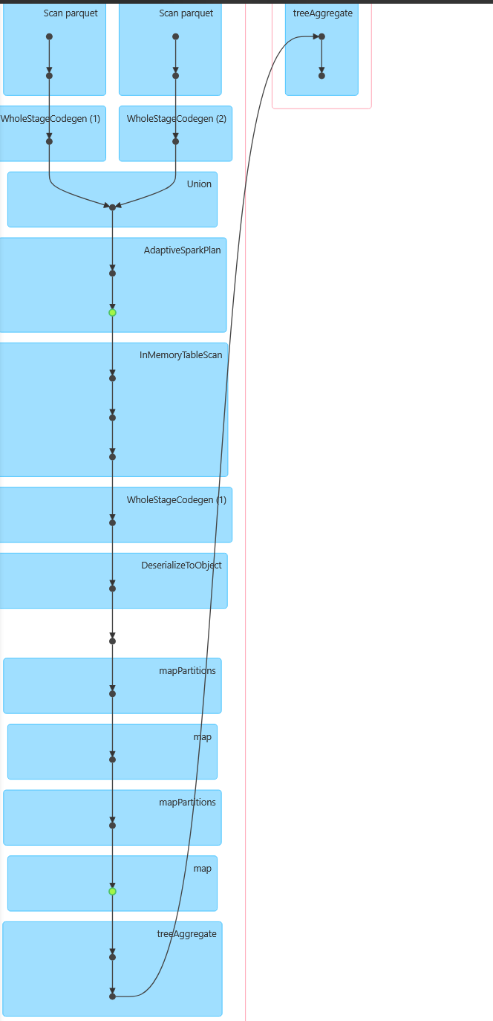
Spark workflow: DataFrame jobs, partitions, DAG and caching
Job | Main DataFrame operations | Input partitions | Shuffle partitions
BuildBronze | read CSV + JSON, unionByName, write by day | 413 | 24
BuildSilver | groupBy connection key, 32 formulas, join medians | 41 | 96 (7.31 GB shuffled)
BuildFeatures | groupBy all 55 features, hash split, persist(DISK_ONLY) | 41 | 96 (9.09 GB shuffled)
Training | cached; one job per iteration or tree level | 11 | 96
BuildGate | sample 1 M rows, StandardScaler, KMeans k = 50 | 7 | 24
LiveScorer | readStream Kafka, localCheckpoint, foreachBatch | 6 per tick | 6
Why these choices
Shuffle partitions lowered from 200 to 24, about 4 tasks per core; 96 for the two jobs that shuffle 7 to 9 GB, so each task stays under 100 MB
Every shuffle (groupBy, join) starts a new stage; skipped stages are shuffle output reused by a later job
Cache only what is read more than once: DISK_ONLY when read twice and large, MEMORY_AND_DISK when read hundreds of times
Parquet partitioned by day and split, so a job reads only the folders it needs
Spark UI: one training job, read from cache, summed with treeAggregate over 2 stages
Notes:
This is how the Spark jobs work. Bronze has no shuffle: reading, renaming and union are narrow, so its 413 tasks each read one 128 megabyte split and write one file. Silver has the big shuffle, 7.31 gigabytes, because merging duplicate copies of a connection needs a groupBy on the connection key. Features shuffles 9 gigabytes to merge identical rows. We lowered the shuffle partitions from 200 to 24, and used 96 for those two heavy jobs so each task fits in memory. Training reads the same data hundreds of times, so it is cached in memory and disk. On the right is a real DAG from the Spark UI: the cached sample is read, each partition computes a partial result, and treeAggregate combines only those small sums in a second stage.

Slide 7
Scala implementation: project structure and key code
Project structure
Gate: is this connection familiar?
spark/src/main/scala/
ddos/common/ Session, Schema, Rules,
Metrics, Postgres
ddos/ingest/ BuildBronze, BuildSilver,
BuildFeatures
ddos/train/ TrainModels, TrainModelsWhole,
Evaluation
ddos/learn/ Gate, Memory
ddos/stream/ ReplayProducer, LiveScorer,
LoadReports
org/apache/spark/ml/tree/ DecisionPath
val limit = ...approxQuantile("distance", Array(0.99), 0.0005)
.withColumn("unfamiliar", col("distance") > limit) // 5.60
Router + label copying for unfamiliar traffic
val close = col("nn_distance") <= gate.limit
when(close, col("nn_label")).otherwise(col("random_forest"))
Scala 2.12, Spark 3.5.5, built with sbt-assembly into one jar
Each job runs with spark-submit --class <name>
One shared Schema maps CSV headers and JSON paths to the same 86 columns
Live stream from Kafka
spark.readStream.format("kafka").option("subscribe", "flows")
.option("maxOffsetsPerTrigger", "12000")
.option("minPartitions", "6")
val batch = arrived.localCheckpoint() // per tick
Notes:
The code is organised by stage: common helpers, ingest jobs, training, the two ideas in the learn folder, and streaming. Everything builds into one jar with sbt, and each job is started with spark-submit and its class name. On the right are the three lines that matter most. The gate's limit is the 99th percentile of day-1 test distances, 5.60, computed by Spark and saved, not typed in. For unfamiliar traffic, if a labelled example is within that same distance we copy its label, otherwise the random forest answers. The live job reads Kafka 12,000 connections at a time, splits each tick into six partitions, one per core, and checkpoints each tick once so its sixteen actions do not recompute it.

Slide 8
Spark ML pipeline: features, algorithms and tuning
55 features
Encoder
Class weights
Tuning
5 models
identifiers removed
StringIndexer + VectorAssembler
N / (2 x class count)
TrainValidationSplit 75/25, benign F1
saved to HDFS
Model | Settings | Tuned over | Chosen
Logistic regression | 100 iterations, class weights | - | -
Decision tree | depth 12, class weights | - | -
Random forest | subsampling 0.8, class weights | depth 8, 12, 16 x trees 50, 100 | depth 16, 100 trees
Gradient-boosted trees | class weights | depth 4, 6 x rounds 20, 40 | depth 6, 40 rounds
Neural network (MLP) | 55-64-32-2, StandardScaler, 100 iterations | - | -
Notes:
The ML pipeline: 55 features go through a StringIndexer and VectorAssembler, which are fitted on training data only and reused by the live job. Benign traffic is rare, so we weight each class to count equally, and we choose settings by benign F1. The random forest and boosted trees are tuned with a train-validation split; the forest chose depth 16 with 100 trees, and the boosted trees depth 6 with 40 rounds. We tune on a balanced sample because tuning trains the forest six times, then retrain each model once on all rows. Every model is tested twice: on a random split of the same days, and on a different day.

Slide 9
Models
Five Spark MLlib models, trained on day 1 of CIC-DDoS2019
Tested on the same day, every model scores 0.89 to 0.98
Tested on day 2, four of them collapse. Gradient-boosted trees fall to 0.49 and miss 2.5 million attacks
Only the random forest holds up, and it is the slowest model we have
Notes:
We trained five standard models on day 1 of CIC-DDoS2019. The usual way people test is a random split of the same data, and there every model looks good: 0.89 to 0.98 macro-F1. But a real detector is trained once and then used on new traffic. So we trained on day 1 and tested on day 2. Four of the five models fell apart. Gradient-boosted trees dropped to 0.485 and missed 2.5 million attacks. Only the random forest held on, and it is the slowest model. That gap is what the whole project is about.

Slide 10
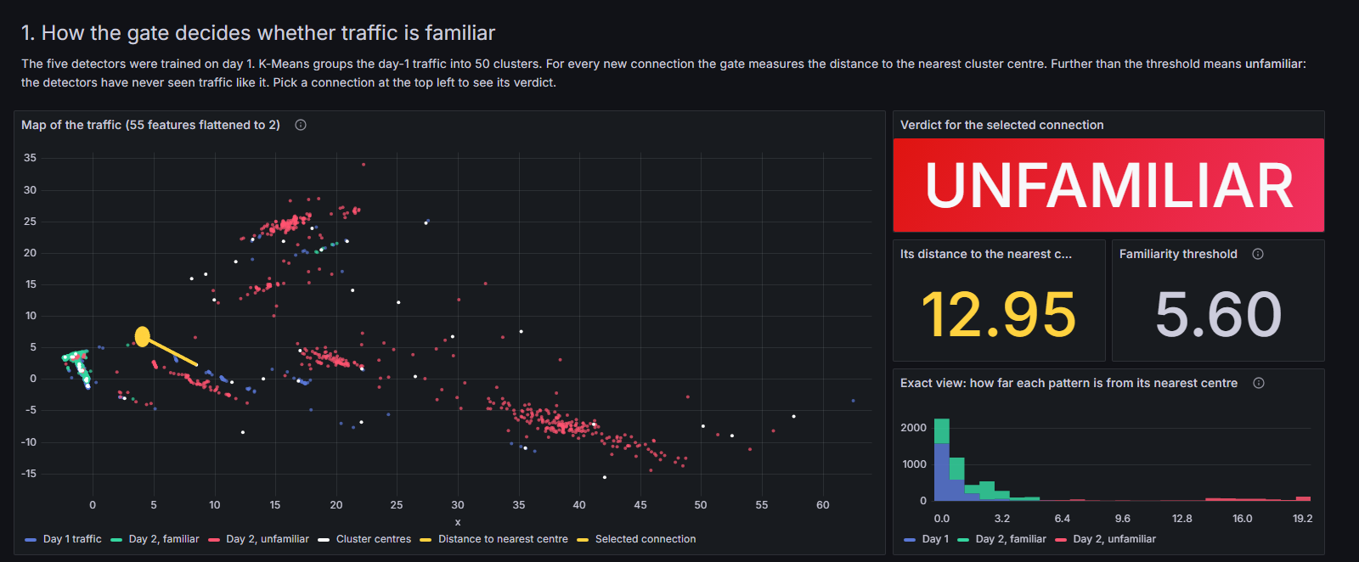
Inference from the dataset
22.6%
of day-2 traffic looks unfamiliar to the K-Means gate
96–99.9%
of every model's mistakes are in that part
A connection is unfamiliar when it is further from all 50 day-1 cluster centres than 99% of day-1 traffic (distance 5.60).
The gate on our dashboard: day-1 traffic, its cluster centres, and one Syn flood connection measured at 12.95, far beyond the 5.60 limit.
Notes:
This is the observation everything else is built on. We grouped day-1 traffic into 50 clusters with K-Means. For any connection we measure how far it is from the nearest cluster centre. If it is further than 99 percent of day-1 traffic, which is a distance of 5.60, we call it unfamiliar. On day 2, 22.6 percent of the traffic is unfamiliar, and that small part holds between 96 and 99.9 percent of every model's mistakes. On familiar traffic, all five models are almost never wrong. We also checked the usual alternative, the model's own confidence, and it only finds 4 percent of the decision tree's mistakes. The models are confidently wrong.

Slide 11
Idea 1: let the cheap model answer only what it knows
Day-1 model
familiar · 77.5%
Connection
from Kafka
Gate
how familiar?
Random forest
unfamiliar · 22.5%
Notes:
The first idea follows directly from that finding. If the cheap models are only wrong on unfamiliar traffic, let them answer the familiar traffic, and send only the unfamiliar part to the strongest model, the random forest. Nothing is retrained. The router only decides who answers each connection. The chart shows what that does: the weak models jump close to the forest's level. Gradient-boosted trees go from 0.485 to 0.959. And the forest now only scores 22.5 percent of the traffic, so the whole stream is scored 1.41 times faster.

Slide 12
Idea 2: copy the answer from a connection we already know
Copy its label
22.5% → 2.1%
yes
Unfamiliar
connection
Close to a label?
same cluster, ≤ 5.60
of the traffic still needs the random forest
Random forest
no
0.967 → 0.981
Add to memory
Ask for the label
through Kafka
the system now beats the random forest itself
1,000 labels
for all of day 2, which is 0.005% of the connections
Notes:
The second idea is about the traffic that still goes to the forest. A flood is extremely repetitive: millions of connections that look almost the same. So when an unfamiliar connection arrives, we first look for a labelled example that is very close to it, in the same cluster and within the same 5.60 distance. If there is one, we simply copy its label. If not, the forest answers straight away, and in parallel we ask for the true label through Kafka, so the next similar connection can be copied. In our replay the dataset's own label plays the analyst. With just 1,000 labels, which is 0.005 percent of day 2, the forest's share falls from 22.5 to 2.1 percent, and the score passes the forest itself.

Slide 13
Results: higher scores for every model, and faster
Time to score the stream
36.5 s
Forest on everything
1.41 times faster
Router
2.5 times faster
Router + label copying
Notes:
Here are both ideas measured on the same 5,964,207 connections, replayed in time order, with labels only usable after they were asked for. Grey is each model alone, amber adds the router, green adds label copying. The router gives the big jump for the weak models. Label copying adds the last step for every model, including the forest, and halves the false alarms. On the right is the time: the forest on everything took 36.5 seconds, the router 25.8, and both ideas together 22.8, so 1.6 times faster. Over the whole day 2 run live through Kafka, the full system reached 0.97 to 0.98 for four of the five models.

Slide 14
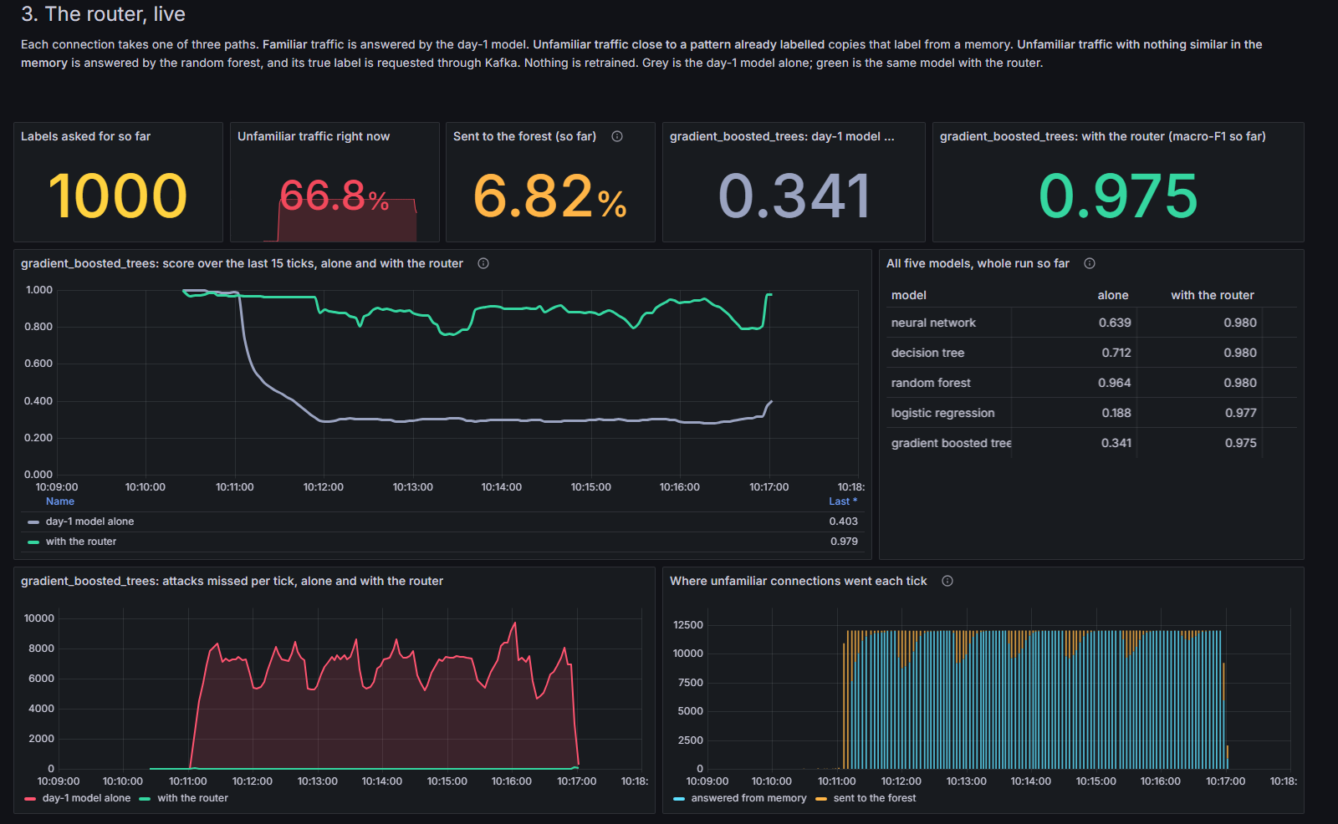
Results: live Grafana dashboard
12,000
connections per tick from Kafka
Notes:
This is the live part of our dashboard during a run. We picked gradient-boosted trees as the front model because it fails worst on its own. When the Syn flood starts, the grey line, the model alone, falls to about 0.3. The green line, the same model with the router, stays near 1 from the very first tick, because the flood is unfamiliar and goes straight to the forest and then to copied labels. Each tick is 12,000 connections from Kafka, split into 6 partitions for our 6 cores, and takes about 2.4 seconds, which is 16 or 17 Spark jobs and about 115 tasks.

Slide 15
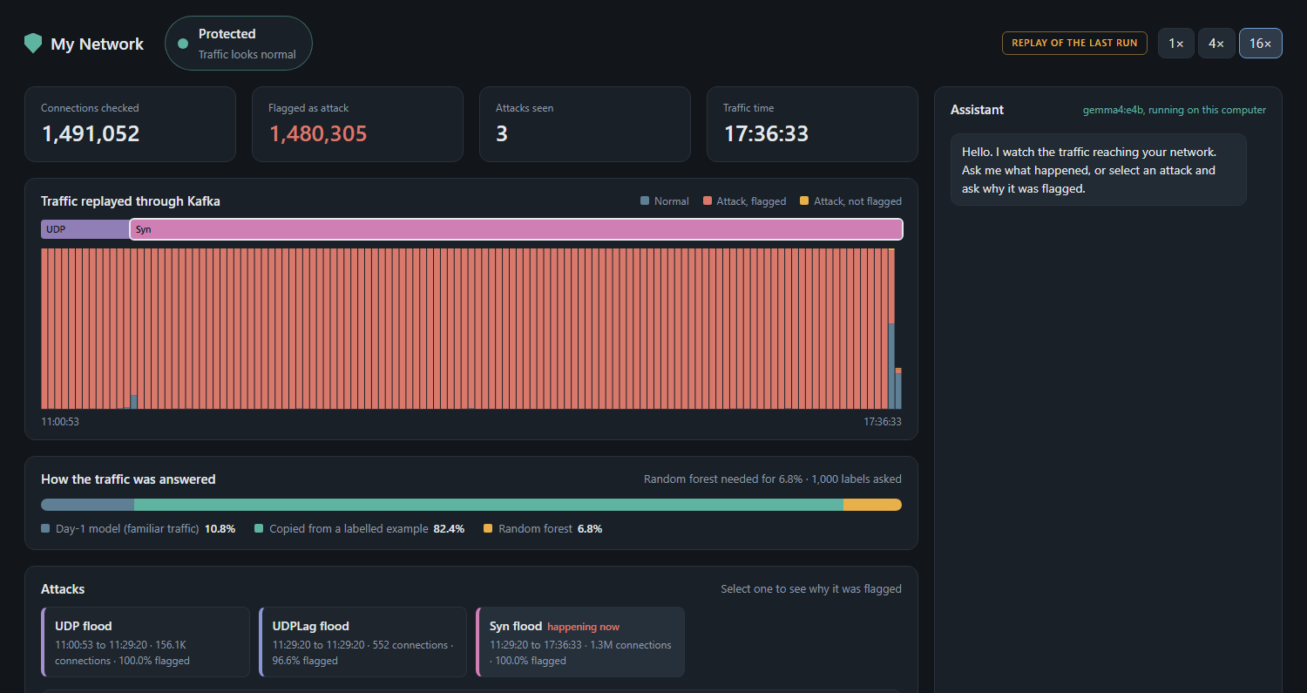
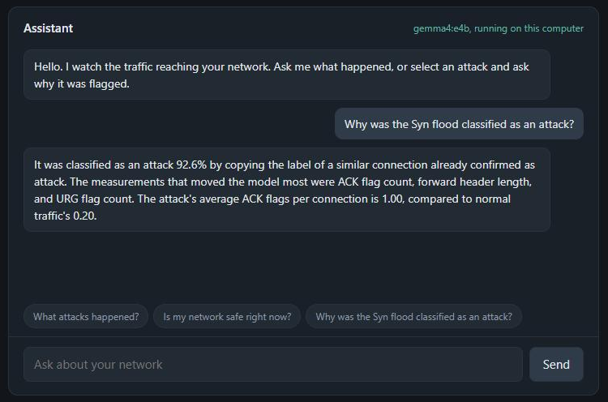
Results: user-side website and assistant
Gemma runs on the laptop through Ollama
It answers from the page's facts: when, how much, current status
My Network: the replay, how traffic was answered, and the attacks seen.
Notes:
Our teacher asked us to think about consumer use, so we built a small website called My Network. It shows the traffic replayed through Kafka, how each connection was answered, and a card for each attack. On the right is the assistant. It is a Gemma model running locally through Ollama, so no network data leaves the machine. With every question it gets the facts behind the page, including the features that moved the model's decision, read from the model's own decision path. So when you ask why the Syn flood was flagged, the answer comes from what the detector actually measured.

Slide 16
Challenges, limitations, conclusion and future work
Challenges
Limitations
BuildSilver: 7.31 GB shuffle, 6.96 GB spill, 45 min
11 GB shared by Spark, HDFS, Kafka, PostgreSQL, Grafana
One dataset, two days, captured in a testbed
Labels come from the dataset, standing in for an analyst
One machine: HDFS replication 1
Detects attacks; does not block them
Conclusion
Future work
Four of five models collapse on a new day; 96-99.9% of their mistakes are in unfamiliar traffic
Router + label copying: every model improves, forest 0.967 to 0.982, NN 0.685 to 0.983, with 1,000 labels and no retraining
A real analyst in the label loop
Multi-node cluster
Update the familiarity limit online
Test on other datasets and add blocking
Notes:
The hardest part was memory: everything shares 11 gigabytes, and the cleaning job had to shuffle and spill several gigabytes. The limitations are clear: one dataset captured in a lab, labels taken from the dataset instead of a real analyst, and one machine. Our conclusion: models trained on one day fail on the next, and nearly all their mistakes are in traffic that looks unfamiliar. Routing that traffic to the forest, and copying true labels to near-identical connections, improves every model without retraining and makes scoring 1.6 times faster over the day and 2.76 times during the flood. Next we would put a real analyst in the loop, run on several machines, adapt the limit online, and test on other datasets.

Slide 17
References and GitHub
Paper | Published | Its limitation | How our project answers it
Real-Time DDoS Attack Detection System Using Big Data Approach Awan et al. | Sustainability (MDPI), 2021 | Spark ML with random forest reports 99.5% accuracy, but on one dataset with no test on later traffic and no handling of traffic that changes | We tested the same kind of models on a later day: four of five fell to 0.46-0.76. The router lifts three of them back to 0.95-0.97
TESSERACT: Eliminating Experimental Bias in Malware Classification across Space and Time Pendlebury, Pierazzi, Jordaney, Kinder, Cavallaro | USENIX Security, 2019 | Shows that models decay over time; its remedies are retraining or active learning, and the authors call full retraining likely unrealistic because everything must be labelled | Label copying learns from the new day with 1,000 labels and no retraining at all
Transcend: Detecting Concept Drift in Malware Classification Models Jordaney et al. | USENIX Security, 2017 | Rejects predictions it cannot trust, so those samples get no answer; its conformal evaluation was costly enough that a 2022 follow-up was needed to reduce the overhead | Nothing is rejected: unfamiliar traffic goes to the random forest. The K-Means check is cheap, and the whole stream is scored 1.6 times faster (2.76 times during the Syn flood)
CADE: Detecting and Explaining Concept Drift Samples for Security Applications Yang, Guo, Hao, Ciptadi, Ahmadzadeh, Xing, Wang | USENIX Security, 2021 | Needs an extra neural network trained to measure distance, and only flags drifting samples for an analyst; the model stays wrong until it is retrained | Plain K-Means needs nothing extra to train, and flagged traffic is answered in the same tick by the forest or a copied label
Notes:
Each of these papers has a limitation that one part of our project answers. Awan and colleagues built DDoS detection on Spark with random forest and report 99.5 percent accuracy, but they test on one dataset with nothing from a later period. When we tested the same kind of models on a later day, four of five collapsed. That is why we built the router. TESSERACT showed that models decay over time, and its fixes are retraining or active learning; the authors themselves say full retraining is likely unrealistic because everything must be labelled. Our label copying needs 1,000 labels and no retraining. Transcend rejects predictions it does not trust, so those samples simply get no answer, and its method was expensive enough that the same group published a follow-up to cut the overhead. Our router never rejects; it sends that traffic to the forest, and the check is a cheap K-Means distance. CADE trains an extra neural network to measure distance and only flags drifting samples for an analyst. We use plain K-Means and answer that traffic in the same tick. We did not rerun their code, so these are the limitations of their design, not a head-to-head benchmark.

