Slide 1
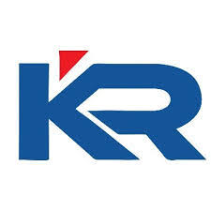

Department of Electronics and Communication Engineering
Minor Project Review - 01
Team Members
Subiksha K (927622BEC210)
Swathi D (927622BEC225)
Vennila V (927622BEC247)
Vishnu Bharathi J (927622BEC250)
Guided By : Mrs T Balamani

Slide 2
IYAL : Real-Time Voice to Text Communication for the Deaf

Slide 3
Problem Statement
Develop a mobile application that enables real-time voice-to-text and text-to-voice translation for Indian regional languages, aimed at assisting individuals with hearing and speech impairments to communicate effectively.
The app should support multiple Indian languages and dialects, be user-friendly, and have a simple interface for easy navigation
Key Features to Include: Real-time voice-to-text translation for Indian regional languages. Text-to-voice feature to convert typed text into spoken words in the selected Indian language
An intuitive user interface that is accessible for individuals with hearing and speech impairments.

Slide 4
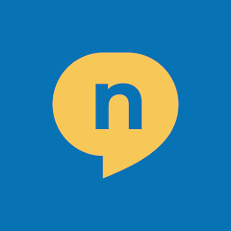
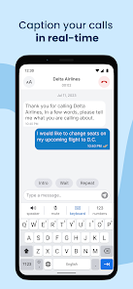
Existing System
Nagish App
Nagish is a free app that uses AI to provide real-time captioning for phone calls, allowing people who are deaf or hard of hearing to communicate
Convert audio into highly accurate real-time text and vice versa in six languages.
English, Spanish, French, Japanese, Hebrew, and Italian
This allows for use even in noisy environments, and ensures privacy

Slide 5
Abstract
Our project proposes the development of an Indian version of the Nagish app, designed to enhance communication accessibility for individuals with hearing or speech impairments.
Leveraging India’s linguistic diversity and inclusive technological advancements, this app aims to bridge communication gaps through real-time transcription and voice-to-text conversion in major Indian languages.

Slide 6
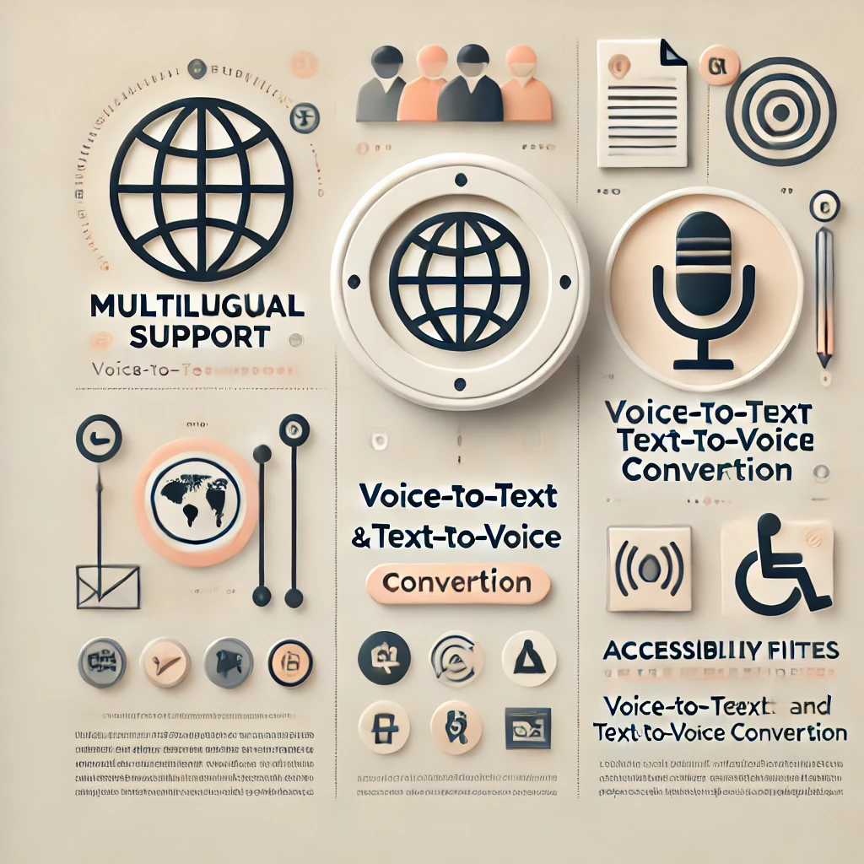
Proposed System
The proposed system of the Indian version of the Nagish app is designed to cater to the unique communication needs of the hearing-impaired population in India
It aims to provide an accessible platform that offers real-time conversion of speech to text (STT) and text to speech (TTS) in multiple Indian languages, ensuring easy communication for people with hearing disabilities
Uniqueness
Multilingual Support
Voice-to-Text and Text-to-Voice Conversion
Accessibility Features
User-Friendly Interface

Slide 7
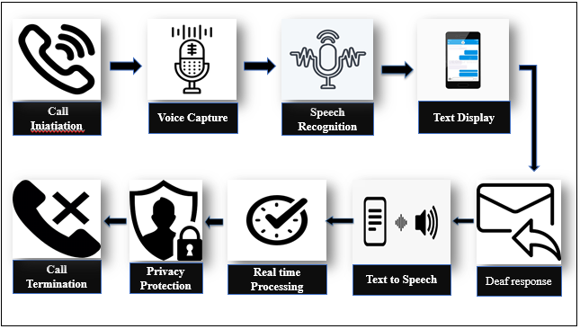
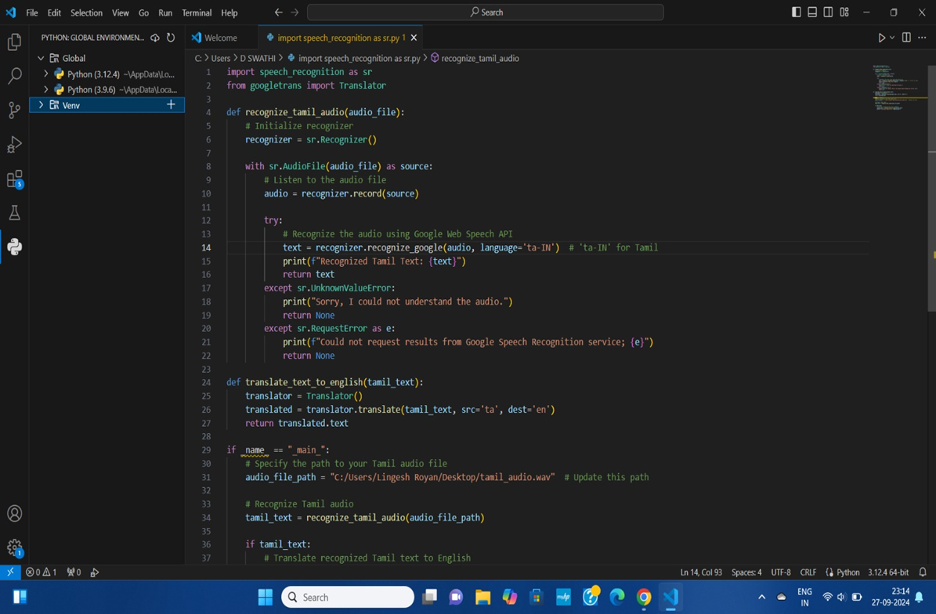
Block Diagram and Technical Approach
Notes:
Technical Approach

Slide 8
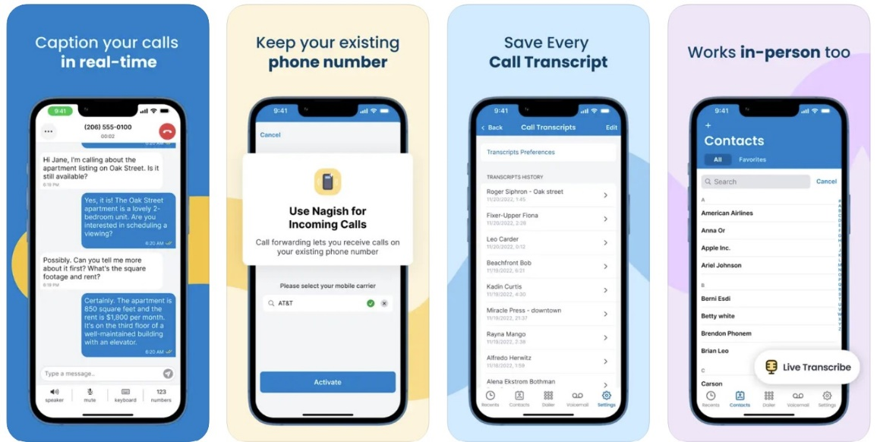
Objectives
To provide a real-time voice-to-text and text-to-voice conversion service for people who are unable to communicate due to hearing and speech disability.
This will enhance their communication capabilities and make various areas more inclusive and accessible

Slide 9
Impacts and Benefits
Quality of Life
Greater independence and opportunities
Increased Inclusion
Promote greater inclusion of individuals such as education, employment, and social interactions
Empowerment
By providing a tool for effective communication, the app can empower individuals with disabilities, boosting their confidence and self-esteem
Accessibility
More accessible for individuals with disabilities, breaking down barriers and promoting equality
Communication enhancement
Interact more effectively with others

Slide 10
Research & References
Siri, Cortana, AlexaAmrita S.Tulshan(&)and Sudhir Namdeorao Dhage Department of Computer Engineering, Sardar Patel Institute of Technology, Mumbai 400058, Indiaamrita.tulshan@spit.ac.in, https://nagish.com/post/nagish-benefits-and-features
Manjusha Jadhav, Krushna kalyankar, Ganesh Narkhede, Swapnil Kharose, Survey On Smart Virtual Voice Assistant, Volume:09 Issue:01|Jan2022
https://zeroproject.org/view/project/fbb37452-8e20-48ae-9068-04452c512781
https://www.prnewswire.com/news-releases/nagish-raises-16-million-to-revolutionize-communication-for-individuals-with-hearing-loss-through-ai-302192713.html

Slide 11
THANK YOU

