Slide 1

SCHOOL OF ARTS AND SCIENCE DEPARTMENT OF COMPUTATIONAL STUDIES
PROJECT
A MOBILE-BASED SYSTEM FOR DETECTING PLANT LEAF DISEASES
USING DEEP LEARNING
Internal Guide
Dr. N. MOGANARANGAN, M.E., Ph.D.,
Head Of The Department
Department Of Computational Studies
School Of Arts And Science
PROJECT BY
VISHNU J
21UBCA048

Slide 2
ABSTRACT:
Plant diseases are a major challenge in agriculture globally, causing significant crop losses, especially in the United States, where they result in one-third of crop production losses annually. Traditional disease diagnosis through visual inspection of plant leaves is challenging for resource-constrained farmers.A mobile-based system using Computer Vision and Machine Learning is introduced to automate plant leaf disease diagnosis. The system employs Convolutional Neural Networks (CNN) to classify 38 disease categories .A dataset of 96,206 plant leaf images, both healthy and infected, is used for training and testing the CNN model. An Android mobile app interface allows farmers to capture images of infected plant leaves, providing disease category and confidence percentage.The system aims to help farmers maintain crop health and avoid incorrect fertilizer use. Performance evaluation metrics, including classification accuracy and processing time, indicate an overall accuracy of 94% for 38 disease classes across 14 crop species.

Slide 3
INTRODUCTION
Plant diseases , pest infection , weed pressure and nutrient deficiencies are some of the grand challenges for any agricultural producer. For instance, in the United States, plant disease causes losses of between 20 and 40 percent of the agricultural crop production annually. Any misdiagnosis of crop decreases will lead to the use of the wrong fertilizers that could stress the plants and lead to nutrient deficiencies in the agricultural field. Machine Learning coupled with computer vision have already enabled game-changing precision agriculture capabilities .Imagine a smart mobile-based system that farmers can use to identify the different types of plant diseases with high accuracy. This paper presents a mobile-based system for detecting plant leaf diseases using Deep Learning in real time. We created a dataset that consists of more than 96 k images for the most common 38 plant disease categories in 14 crop species.

Slide 4
OBJECTIVES
Develop a mobile-based system for the automated detection and diagnosis of plant leaf diseases using deep learning techniques.
2.Utilize Convolutional Neural Networks (CNN) to classify a wide range of plant diseases, encompassing 38 disease categories.
3.Create a user-friendly Android mobile app interface that enables farmers to capture images of diseased plant leaves for immediate diagnosis.
4.Eliminate the risk of incorrect fertilizer application that can further stress plants, ultimately increasing crop yield and quality.

Slide 5
DEEP LEARNING
Deep learning is a method in artificial intelligence (AI) that teaches computers to process data in a way that is inspired by the human brain. Deep learning models can recognize complex patterns in pictures, text, sounds, and other data to produce accurate insights and predictions.

Slide 6
Requirements Specification
→Compatibility Requirements
→Windows
→MAC OS
→Software Requirements
→Android Studio
→Minimum Hardware Requirements
Processor : Pentium 4 processor or higher
SSD : 512
RAM : 8GB

Slide 7
Technologies/Platforms Used
JAVA
Java is a widely used, high-level, general-purpose programming language known for its platform independence, versatility, and extensive ecosystem.
CNN CONVOLUTIONAL NEURAL NETWORK
It is a subset of machine learning.
It is one of the various types of artificial neural networks. It is used for image processing and object detection. CNN used in Deep Learning and Artificial Intelligence. The convolutional refers to the Filtering Process
TYPES
Convolution Layer Pooling Layer Fully Control Layer

Slide 8
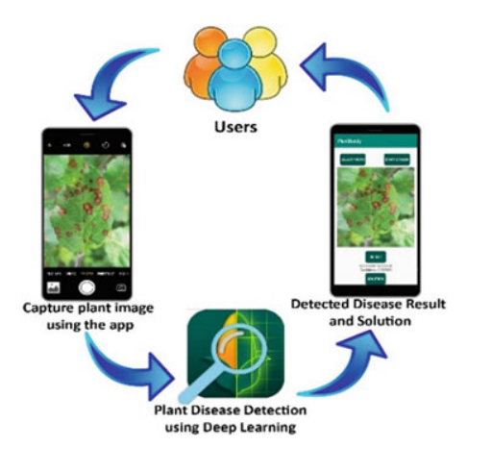
System overview

Slide 9
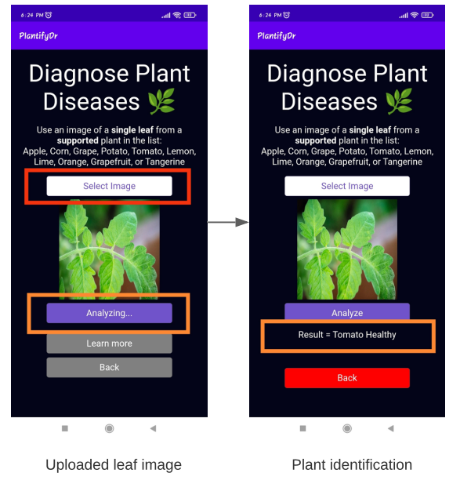
MODULE

Slide 10
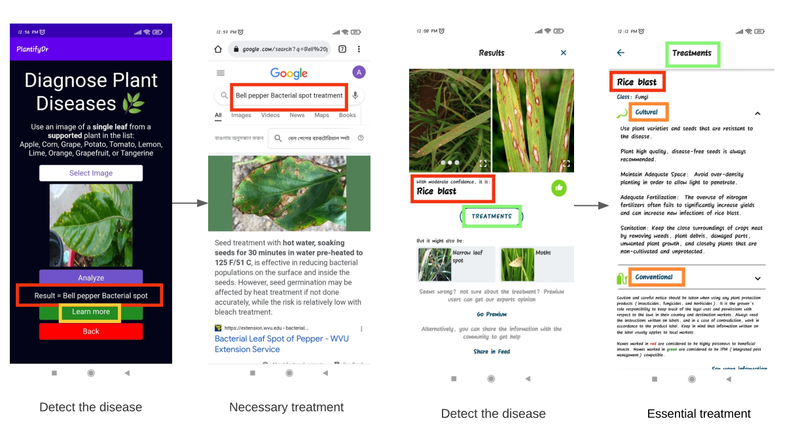
Apps screenshots of treatment functionality.

Slide 11
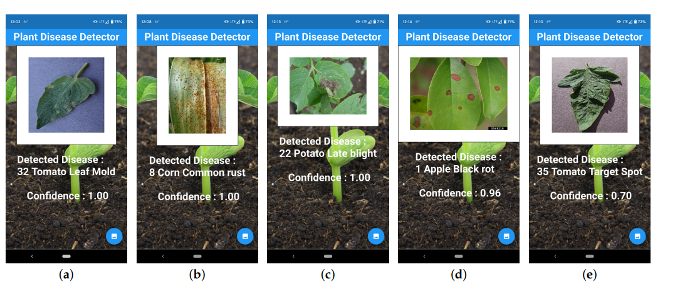
Output Screens

Slide 12
BENEFITS
The project offers the benefits of improved crop health management, reduced crop losses, enhanced productivity, a user-friendly interface, elimination of incorrect fertilizer use, resource efficiency, accessible technology, data-driven decision-making, and wide applicability, collectively empowering farmers with the tools and knowledge to protect their crops and increase agricultural yields."

Slide 13
SCOPE
The future scope of your project could involve expanding disease detection capabilities to additional crop species, enhancing the mobile app's user interface, and implementing real-time disease monitoring for more proactive agricultural management.

Slide 14
CONCLUSION
"A Mobile-Based System for Detecting Plant Leaf Diseases Using Deep Learning," represents a significant stride towards revolutionizing agriculture by providing an accessible and effective solution for disease diagnosis. With the successful deployment of a deep learning model, a user-friendly mobile app interface, and impressive disease classification accuracy, we are poised to empower farmers, reduce crop losses, and promote sustainable agricultural practices. As we move forward, there is tremendous potential for further advancements and broader implementation, ultimately contributing to a healthier and more productive agricultural sector.

