Slide 1

SCHOOL OF ARTS AND SCIENCE DEPARTMENT OF COMPUTATIONAL STUDIES BACHELOR OF COMPUTER APPLICATIONS
MINI PROJECT
REAL-TIME OBJECT RECOGNITION USING
TENSORFLOW
Internal Guide
Dr. N. MOGANARANGAN, M.E., Ph.D.,
Head Of The Department
Department Of Computational Studies
School Of Arts And Science
PROJECT BY
VISHNU J
21UBCA048

Slide 2
ABSTRACT:
In recent years, deep learning has been used in image classification, object tracking, action recognition and scene labeling. Traditionally, Image Processing techniques were used to solve any Computer Vision problems occurred in an artificial intelligence system. However, in real-time identification, image processing cannot be used. This is where Deep Learning concepts are applied. We built a simple Convolutional Neural Network for object detection. The model is trained and multiple test cases are implemented in the TensorFlow environment so as to obtain accurate result

Slide 3
INTRODUCTION
"Real-Time Object Detection using TensorFlow is a project that leverages the capabilities of TensorFlow, an open-source machine learning framework, to develop a system for swiftly and accurately identifying objects within images and video frames, facilitating automation and informed decision-making across diverse domains, including autonomous vehicles, surveillance, healthcare, robotics, and more."

Slide 4
Existing System
TRADITIONAL COMPUTER VISION TECHNIQUES
In the absence of deep learning frameworks like TensorFlow, traditional computer vision methods have been used for object detection in real-time systems. These methods typically involve hand-crafted features and classical machine learning algorithms.
SOME COMMON COMPONENTS OF SUCH SYSTEMS
Limited Scalability
Object Classification
Real-Time Implementation
Real-Time Implementation
Feature Extraction

Slide 5
PROPOSED SYSTEM
Deep Learning-Based Object Detection
The proposed system for your project, "Real-Time Object Detection using TensorFlow," involves the use of state-of-the-art deep learning techniques and TensorFlow to create an advanced and highly efficient real-time object detection system
Data Collection
Data Preprocessing
Model Selection
OUTLINE
Evaluation and Testing
Visualization
Monitoring and Maintenance

Slide 6
OBJECT DETECTION
Object detection is a computer vision and image processing technique that involves identifying and locating specific objects within an image or video frame. It goes beyond simple image classification (where the task is to determine the primary object in an image) by not only categorizing objects but also providing information about their precise positions and boundaries. In other words, object detection answers the question.
CLASSIFICATION
Identification: Object detection algorithms classify objects into predefined categories or classes, such as "car," "person," "dog," etc.
2.Localization: Object detection provides the coordinates (usually in the form of bounding boxes) that specify the exact location of each detected object within the image.
3.Multiple Object Detection: It can detect and label multiple objects of various classes within a single image or video frame.

Slide 7

TENSORFLOW
TensorFlow is a free and open-source software library for machine learning and artificial intelligence. It can be used across a range of tasks but has a particular focus on training and inference of deep neural networks.

Slide 8
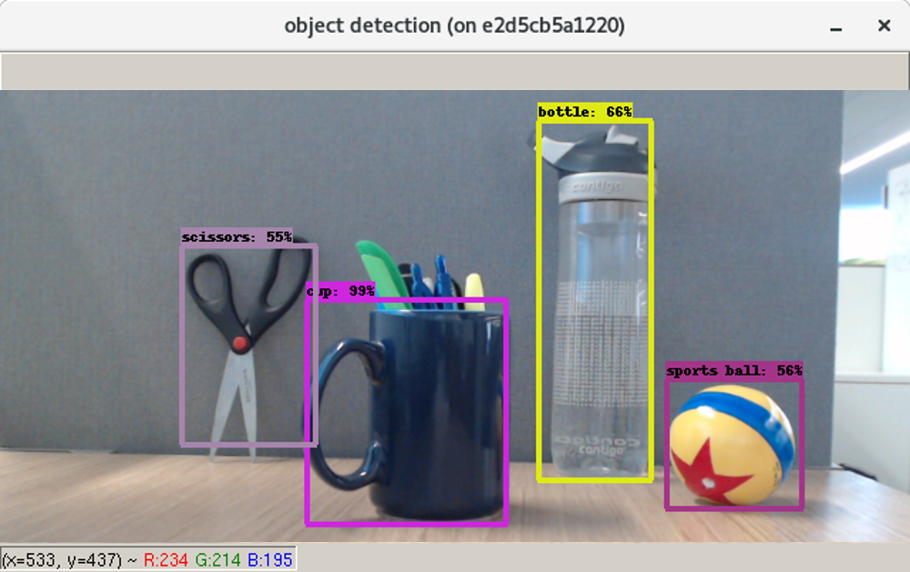
REAL-TIME OBJECT DETECTION
Real-time object detection refers to the ability to identify and locate objects within images or video frames as they are captured, with minimal delay. It is a critical capability in many applications where timely and continuous analysis of visual data is essential.

Slide 9
REQUIREMENTS SPECIFICATION
→Compatibility Requirements
→Windows
→MAC OS
→Linux
→Software Requirements
→Android Studio
→Minimum Hardware Requirements
Processor : Pentium 4 processor or higher
SSD : 512
RAM : 8GB

Slide 10
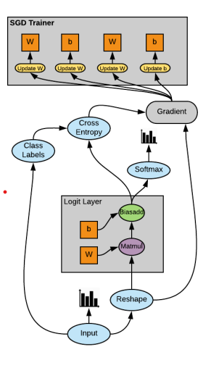
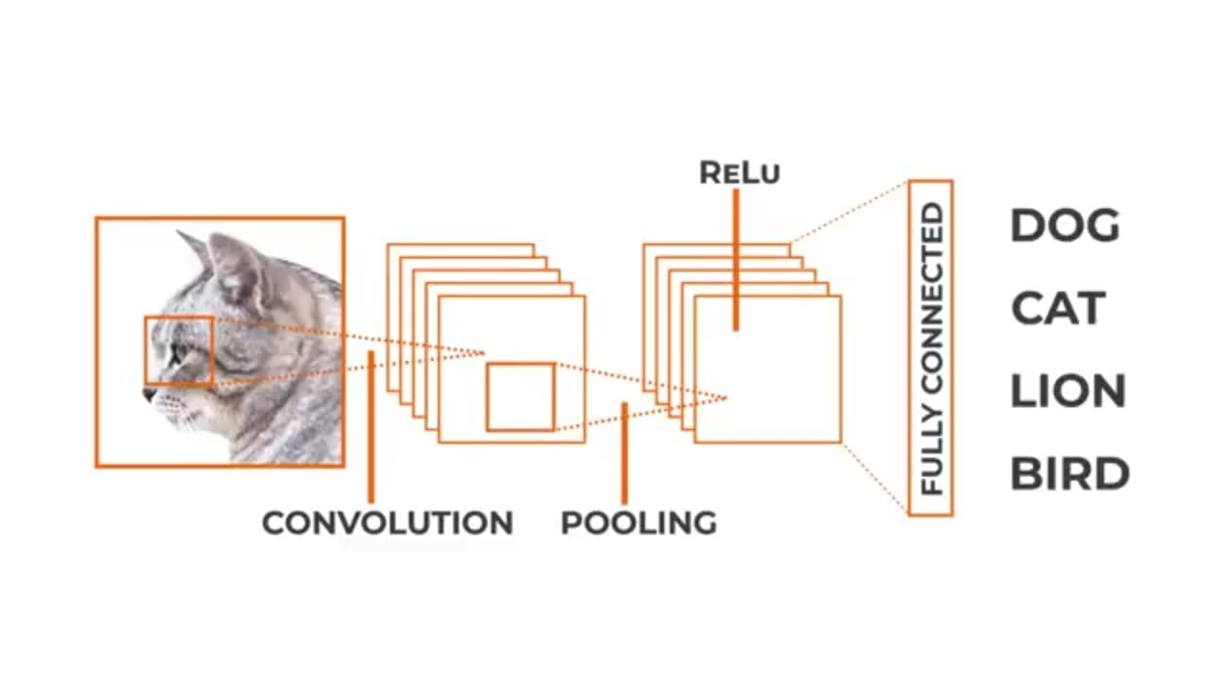
TENSORFLOW WORKFLOW

Slide 11
Technologies/Platforms Used
JAVA
Java is a widely used, high-level, general-purpose programming language known for its platform independence, versatility, and extensive ecosystem.
TENSORFLOW LIBRARY
TensorFlow is a free and open-source software library for machine learning and artificial intelligence. It can be used across a range of tasks but has a particular focus on training and inference of deep neural networks.
CNN CONVOLUTIONAL NEURAL NETWORK
It is a subset of machine learning. It is one of the various types of artificial neural networks which are used for different applications and data types.

Slide 12
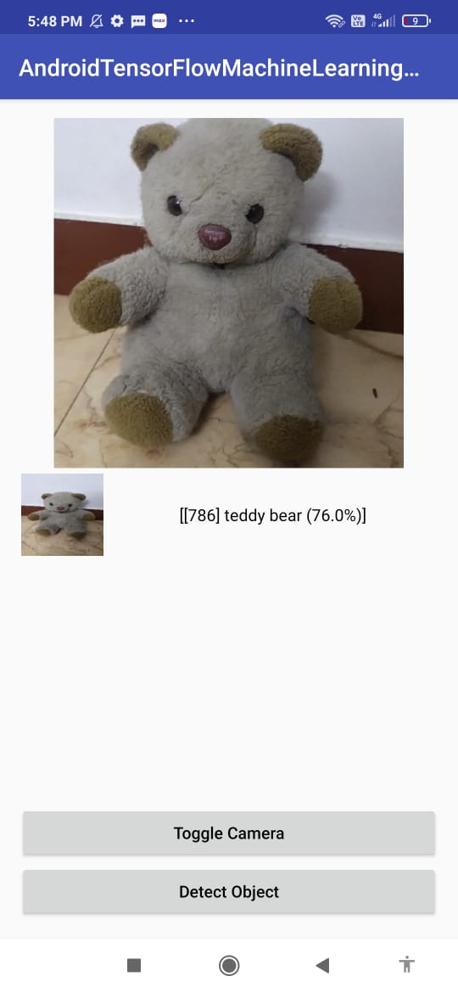
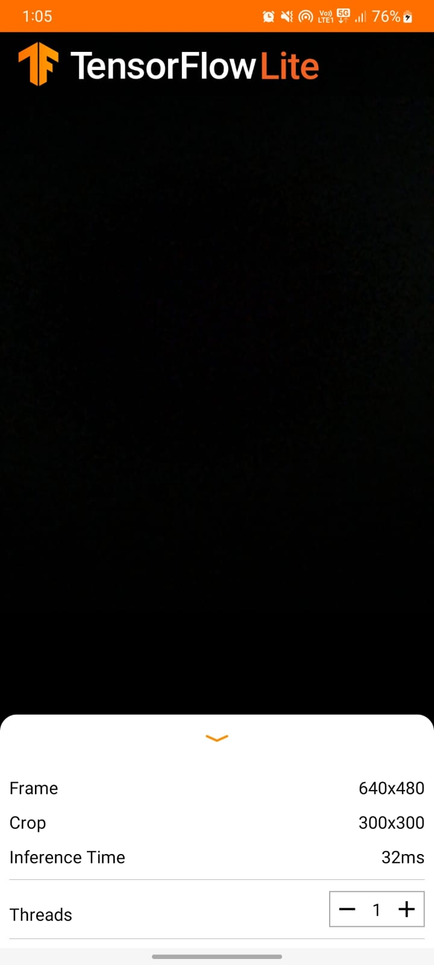
OLD VERSION
CURRENT VERSION

Slide 13
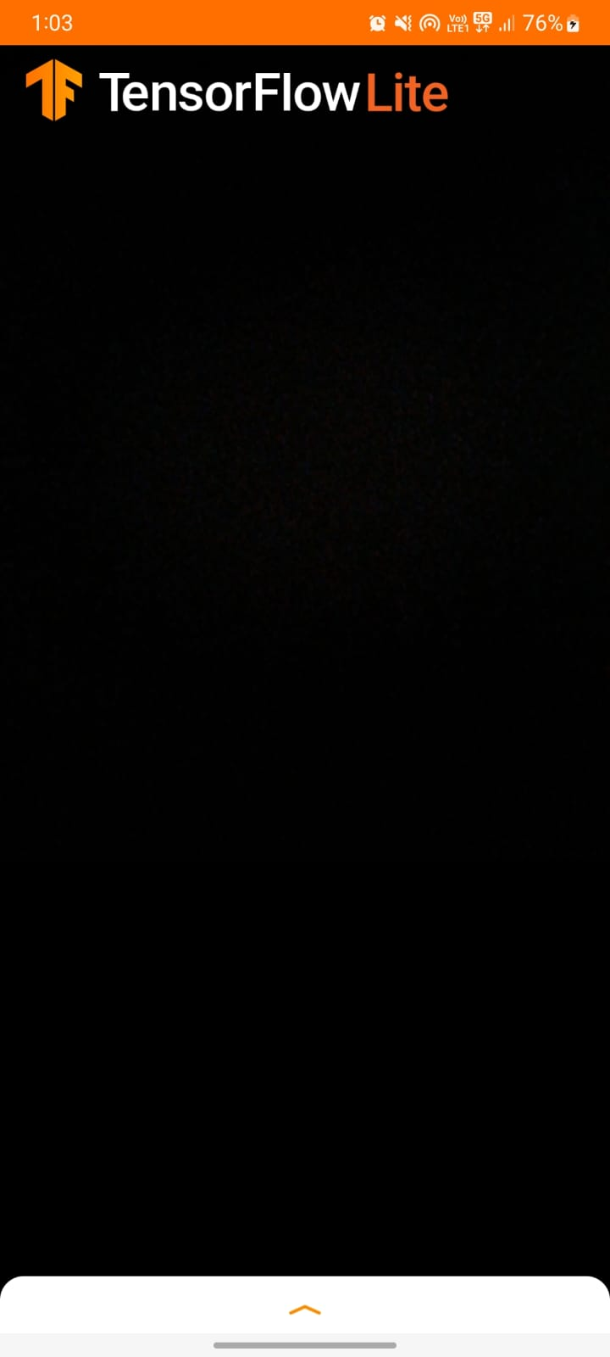
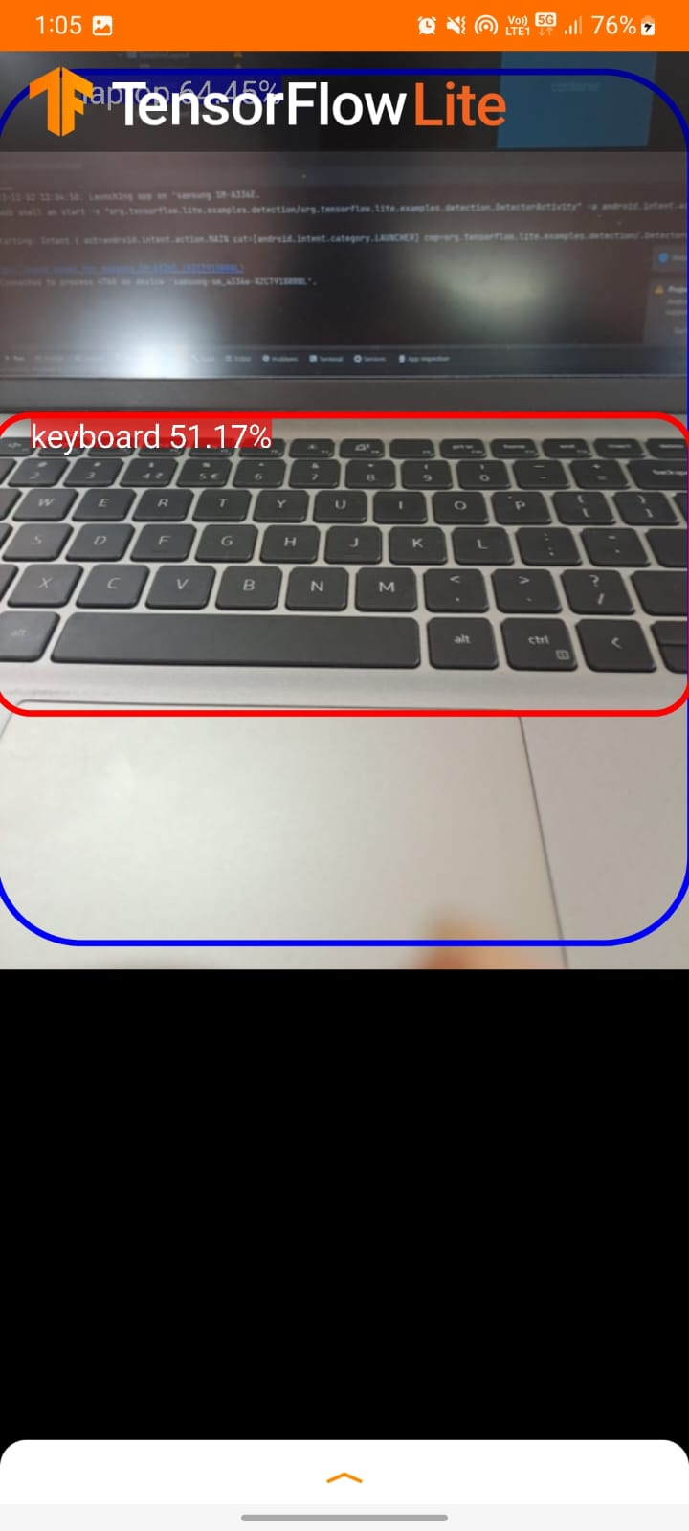
OUTPUT SCREENS

Slide 14
BENEFITS
The benefits of your project, "Real-Time Object Detection using TensorFlow," include the ability to enhance safety, automation, and decision-making in various domains such as autonomous vehicles, surveillance, healthcare, robotics, and more by providing real-time, accurate object recognition and localization.
SCOPE
The scope of your project, "Real-Time Object Detection using TensorFlow," encompasses a wide range of applications, including autonomous vehicles, security and surveillance systems, healthcare, robotics, retail, and many other fields, where real-time object detection is pivotal for efficient and intelligent decision-making.

Slide 15
CONCLUSION
This paper presents a comprehensive review of deep learning and convolutional neural network architecture. For the applications in the computer vision domain, the paper mainly explains how the advancements of CNN based schemes have made it most suitable for images. Despite the assuring results recorded so far, there is significant room for further advances. For example, the theoretical foundation does not yet explain under what conditions they will perform in the desired manner or outperform other approaches. TensorFlow is used to achieve object detection with maximum accuracy for a live scene. A bounding box is created around each object detected which displays the class label and the percentage of accuracy

Slide 16
THANKYOU

